Slide 2
Physical activity and movement can play a crucial role in promoting teen recovery from substance abuse. Parents and educators can support teen recovery through the approaches in this presentation to build healthy habits, manage stress, and promote physical and emotional well-being, which can be critical components of recovery from substance abuse.
These school and community-based approaches can
support teen recovery through physical activity and movement.
Notes:
Physical activity and movement can play a crucial role in promoting teen recovery from substance
abuse. Parents and educators can support teen recovery through the below approaches to build healthy
habits, manage stress, and promote physical and emotional well-being, which can be critical
components of recovery from substance abuse. These school and community-based approaches can
support teen recovery through physical activity and movement.

Slide 3
Joining a school or community sports team can provide a positive outlet for
physical activity and social interaction.
It can also help build self-esteem and confidence.
Notes:
Sports Teams: Joining a school or community sports team can provide a positive outlet for
physical activity and social interaction. It can also help build self-esteem and confidence.

Slide 4
Outdoor adventure programs, such as hiking, camping, and rock
climbing, can provide a physical and mental challenge, as well as an opportunity to connect with nature and build resilience.
Outdoor adventure camps can also provide kids with a supportive and positive social environment, which can help reduce feelings of loneliness and isolation.
Notes:
Outdoor adventure programs, such as hiking, camping, and rock
climbing, can provide a physical and mental challenge, as well as an opportunity to connect with
nature and build resilience. These camps can also provide kids with opportunities to learn new
skills, such as outdoor survival skills, teamwork, and leadership, which in turn can help build
confidence, self-esteem, and a sense of self-worth. Outdoor adventure camps can also provide
kids with a supportive and positive social environment, which can help reduce feelings of
loneliness and isolation. In addition, outdoor adventure camps can provide kids with
opportunities to make new friends and build meaningful relationships, which can be important
for overall well-being. Lastly, these camps can provide opportunities for kids to engage in
mindfulness and other stress-management techniques, such as yoga and meditation.

Slide 5
By improving physical fitness, promoting mental focus and discipline,
providing social support, teaching anger management skills, and promoting healthy habits, martial arts can help support kids in avoiding substance use and leading healthy, fulfilling lives.
Martial arts require mental focus and discipline, which can help build skills that can be applied in other areas of life, including avoiding substance use.
Notes:
Martial Arts: Martial arts can provide kids with many benefits that can help reduce the risk of
substance abuse. By improving physical fitness, promoting mental focus and discipline,
providing social support, teaching anger management skills, and promoting healthy habits,
martial arts can help support kids in avoiding substance use and leading healthy, fulfilling lives.
The high level of physical activity and exercise in martial arts improves physical fitness, reduce
stress, and boost overall health and well-being. Martial arts require mental focus and discipline,
which can help build skills that can be applied in other areas of life, including avoiding substance
use. The focus and discipline required in martial arts can help kids build self-confidence, self-
esteem, and a sense of self-worth. Additionally, martial arts can provide kids with a supportive
and positive social environment as well as a sense of belonging and community. This can help
reduce feelings of loneliness and isolation, which can be risk factors for substance abuse.

Slide 6
Dance or movement therapy can provide an opportunity for teens to express themselves creatively and physically, and can also help them manage emotions and develop stress-management skills.
Notes:
Dance or Movement Therapy: Dance or movement therapy can provide an opportunity for
teens to express themselves creatively and physically, and can also help them manage emotions
and develop stress-management skills.

Slide 7
Joining a group fitness class, such as a fitness boot camp or an exercise
class, can provide a structured and supportive environment for physical activity and can also help build a sense of community and accountability.
Notes:
Joining a group fitness class, such as a fitness boot camp or an exercise
class, can provide a structured and supportive environment for physical activity and can also
help build a sense of community and accountability.

Slide 8
Volunteer opportunities, such as working on a community garden or participating in a neighborhood clean-up, can provide a sense of purpose and engagement, as
well as an opportunity for physical activity.
Notes:
Volunteer Opportunities: Volunteer opportunities, such as working on a community garden or
participating in a neighborhood clean-up, can provide a sense of purpose and engagement, as
well as an opportunity for physical activity.

Slide 9
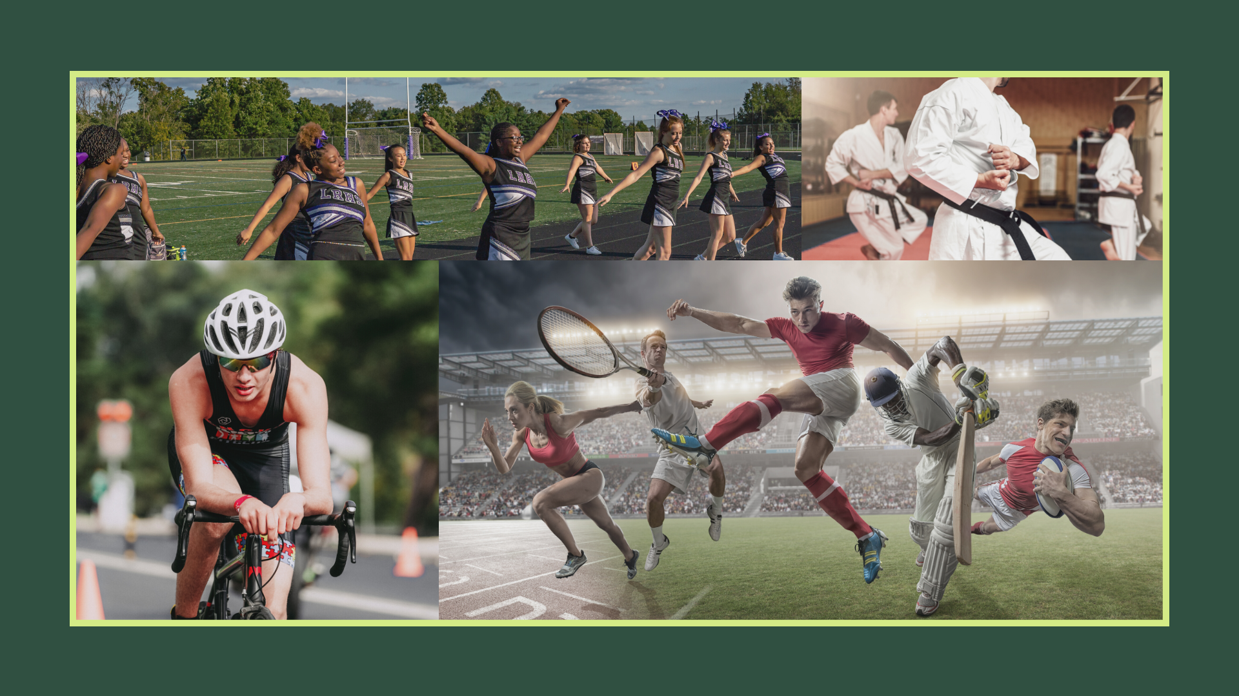
Notes:
Parents and educators play an important role in supporting kids to avoid substance use through
movement and physical activity. Strategies that parents and educators can incorporate specifically are
as follows:

Slide 10
Parents and Educators
Parents and educators play an important role in supporting kids to avoid substance use through movement and physical activity. Following are strategies that parents and educators can incorporate.

Slide 11
This can help increase kids’ overall activity levels and provide them with opportunities to engage in healthy physical activity.
This can include encouraging recess and
outdoor physical education classes, or organizing field trips that involve outdoor activities such as hiking or camping.
Notes:
Incorporate physical activity into the curriculum: Educators can incorporate physical activity
into the school day by offering physical education classes, or by incorporating movement and
physical activity into other subjects. This can help increase kids&#39; overall activity levels and
provide them with opportunities to engage in healthy physical activity.
Encourage outdoor activity: Parents and educators can also encourage kids to spend time
outside and engage in outdoor physical activity. This can include encouraging recess and
outdoor physical education classes, or organizing field trips that involve outdoor activities such
as hiking or camping.

Slide 12
Educators and parents can also promote healthy lifestyle habits, such as eating nutritious foods, getting enough sleep, and avoiding substance use.
Parents and educators can also teach kids stress-management techniques, such as mindfulness, yoga, and deep breathing, which can help reduce stress and anxiety levels.
Notes:
Promote healthy lifestyle habits: Educators and parents can also promote healthy lifestyle
habits, such as eating nutritious foods, getting enough sleep, and avoiding substance use. These
habits can have a positive impact on overall health/well-being, and can help reduce the risk of
substance abuse.
Teach stress-management techniques: Parents and educators can also teach kids stress-
management techniques, such as mindfulness, yoga, and deep breathing, which can help reduce
stress and anxiety levels. These techniques can also be incorporated into physical education
classes, making them more accessible and appealing to kids.

Slide 13
Educators can also partner with community organizations to provide kids with opportunities for physical activity and healthy lifestyle habits.
This can include partnering with local sports teams, parks and recreation departments, or
community health organizations to provide kids with access to physical activity programs and
resources.
Notes:
Partner with community organizations: Educators can also partner with community
organizations to provide kids with opportunities for physical activity and healthy lifestyle habits.
This can include partnering with local sports teams, parks and recreation departments, or
community health organizations to provide kids with access to physical activity programs and
resources.

Slide 14
Finally, educators and parents should focus on modeling healthy behaviors themselves, such as engaging in regular physical activity, eating nutritious foods, and avoiding substance use.
Notes:
Model healthy behaviors: Finally, educators and parents should focus on modeling healthy
behaviors themselves, such as engaging in regular physical activity, eating nutritious foods, and
avoiding substance use.

Slide 15
Spending time in nature and engaging in physical activity can be beneficial for promoting teen recovery from substance abuse. The natural environment and physical activity can provide a number of positive benefits that support the recovery process, including:
Reduced stress and anxiety: Spending time in nature and participating in physical activity can reduce stress and anxiety levels, which are common challenges for individuals in recovery.
Notes:
Spending time in nature and engaging in physical activity can be beneficial for promoting teen recovery from substance abuse. The natural environment and physical activity can provide a number of positive benefits that support the recovery process, including:
Reduced stress and anxiety: Spending time in nature and participating in physical activity can reduce stress and anxiety levels, which are common challenges for individuals in recovery. This can help to improve overall mental health and well-being.

Slide 16
Improved physical health: Physical activity can help improve overall physical health, which can be negatively impacted by substance abuse. Regular physical activity can help build strength, increase energy levels, and improve overall fitness, which can be crucial in the recovery process.
Notes:
Improved physical health: Physical activity can help improve overall physical health, which can be negatively impacted by substance abuse. Regular physical activity can help build strength, increase energy levels, and improve overall fitness, which can be crucial in the recovery process.

Slide 17
Increased self-esteem and confidence: This can be especially important for teens in recovery, as they may feel a sense of low self-worth due to their substance abuse.
Enhanced mood and emotional well-being: This can help individuals in recovery manage negative emotions and reduce the risk of relapse.
Notes:
Increased self-esteem and confidence: Engaging in physical activity and spending time in nature can also boost self-esteem and confidence levels. This can be especially important for teens in recovery, as they may feel a sense of low self-worth due to their substance abuse.
Enhanced mood and emotional well-being: Physical activity and spending time in nature can also improve mood and emotional well-being. This can help individuals in recovery manage negative emotions and reduce the risk of relapse.

Slide 18
Improved sleep quality: Physical activity and spending time in nature can also improve sleep quality, which is an important factor in recovery. Quality sleep can help reduce stress levels, improve mood and emotional well-being, and promote overall physical health.
Increased sense of purpose: Participating in physical activities and spending time in nature can also provide individuals in recovery with a sense of purpose and a feeling of accomplishment. This can help boost self-esteem and provide a sense of direction in recovery.
Notes:
Improved sleep quality: Physical activity and spending time in nature can also improve sleep quality, which is an important factor in recovery. Quality sleep can help reduce stress levels, improve mood and emotional well-being, and promote overall physical health.
Increased sense of purpose: Participating in physical activities and spending time in nature can also provide individuals in recovery with a sense of purpose and a feeling of accomplishment. This can help boost self-esteem and provide a sense of direction in recovery.
In summary, spending time in nature and engaging in physical activity can be important components of a comprehensive approach to teen recovery from substance abuse. These activities can provide numerous positive benefits that support the recovery process and promote overall health and well-being.

Slide 20
The Health Smart Virginia Project is providing this training resource with funding from the Office of Behavioral Health Wellness at the Virginia Department of Behavioral Health and Developmental Services (2023).

