Slide 1
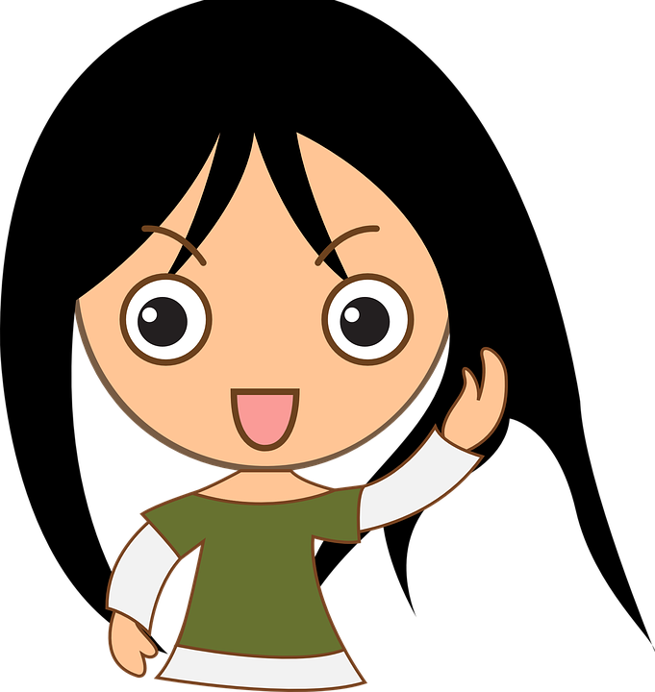
All About Me
Appropriate behaviors in school & social skills
Let’s learn about Health!

Slide 2

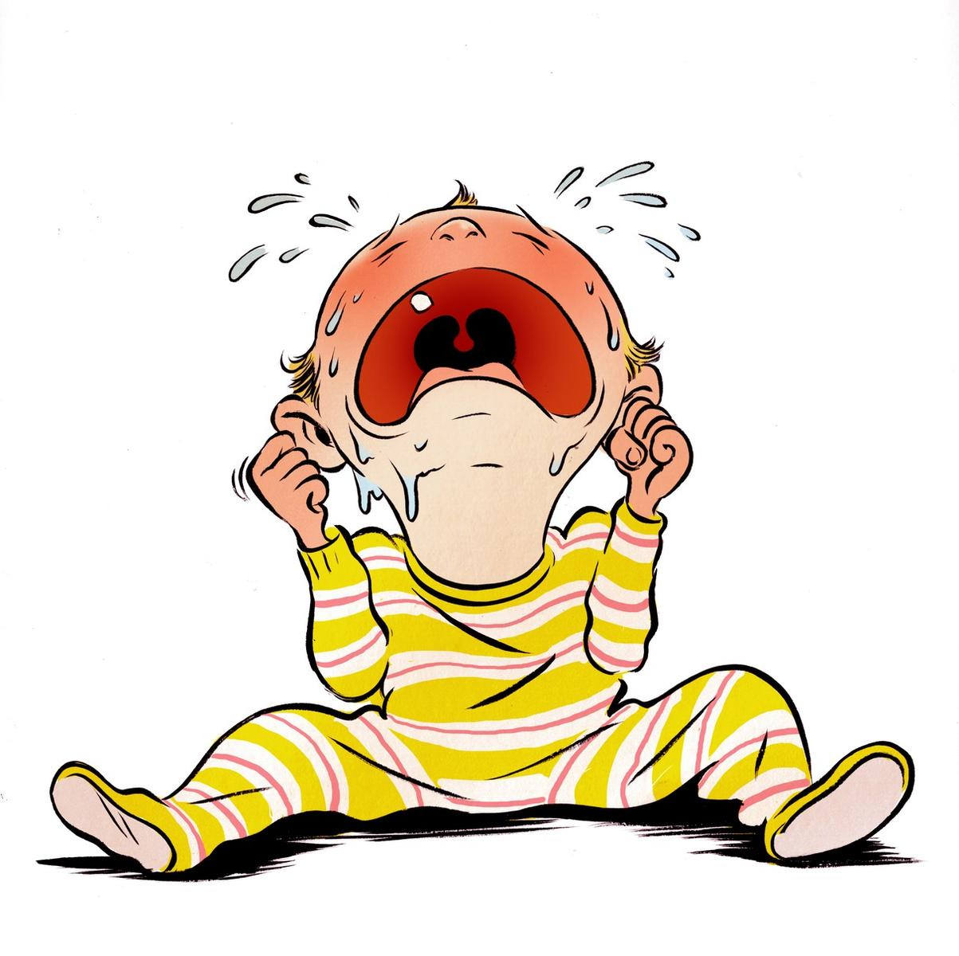
Appropriate
&
Inappropriate Behaviors

Slide 3

Appropriate School Behaviors
Sharing
Raising hand
Following teacher directions
Being nice to other students
Good sportsmanship
Having a positive attitude
Personal space
What are other examples?

Slide 4
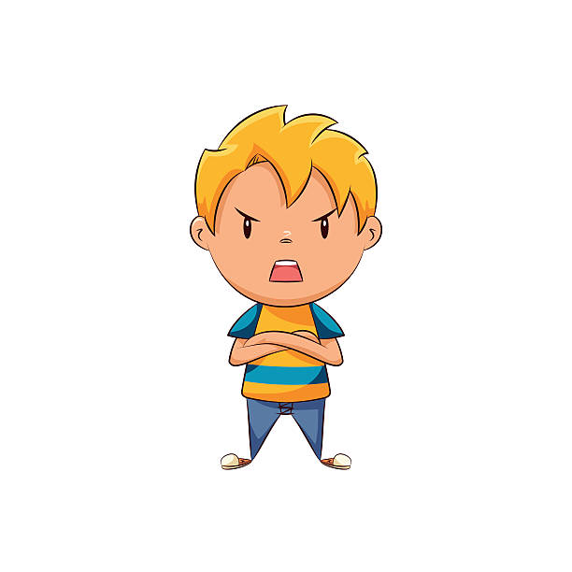
What Should I Do?
It is only the second day of school, and the boy behind me just took my marker off my desk. I want it back! If it was my little brother, I would just take it out of his hands, push him, or even scream at him. What should I do?

Slide 5
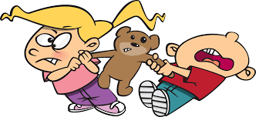
Inappropriate Behaviors at School
Whining
Grabbing
Pushing
Play fighting
Yelling out answers
Talking back to the teachers
Being a bad sport
Name calling
What are other examples?

Slide 6

If you feel… Do This Instead….
like whining

Slide 7
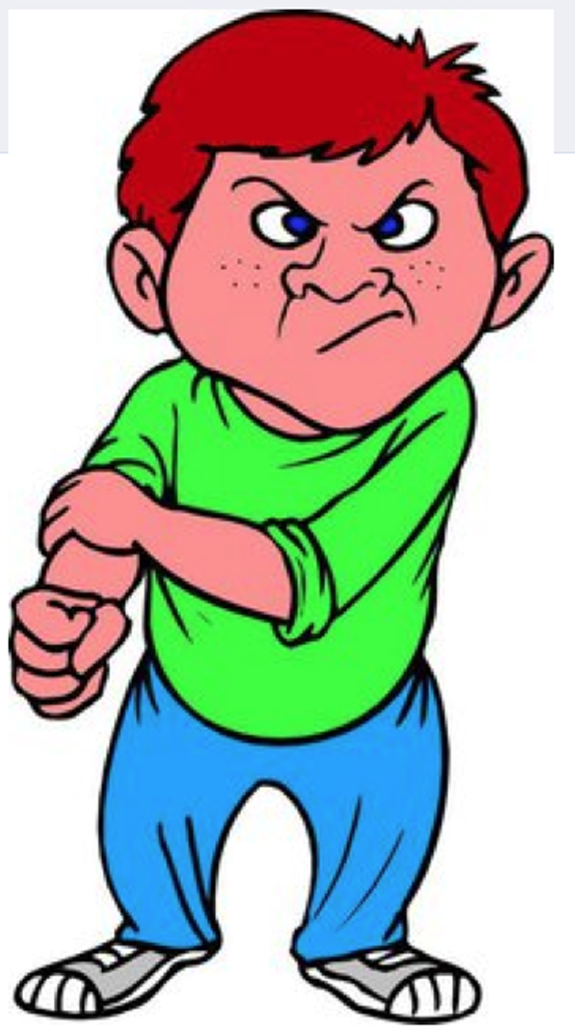
If you feel… Do This Instead….
angry at another student and want to push him

Slide 8

If you feel… Do This Instead….
mad at your teacher and want to yell

Slide 9

Let’s Review

Slide 10
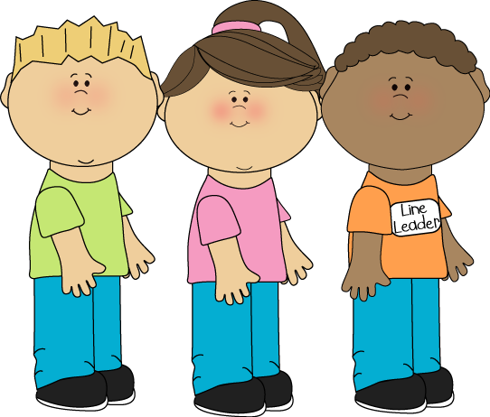
Appropriate or Not?
Is this appropriate personal space when standing in line?

Slide 11
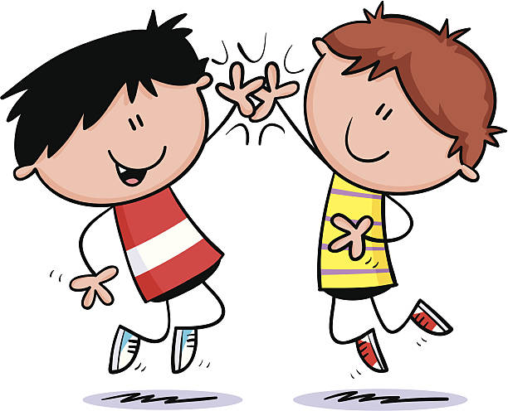
Appropriate or Not?
Is this behavior appropriate after playing a game?

Slide 12
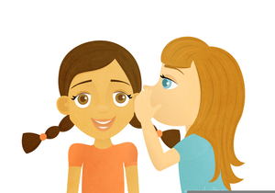
Appropriate or Not?
Is it appropriate to whisper mean words about other kids in class?

Slide 13

Interacting with Others

Slide 14
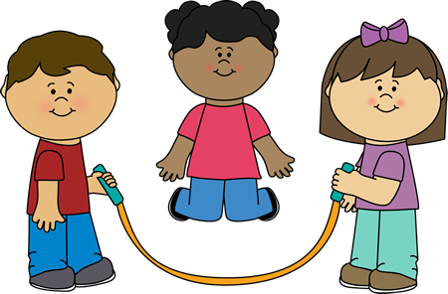
What Should I Do?
It’s recess, and I’m so excited to jump rope with my friends. Kara asked me to sit with her and watch the boys play football. I don’t want to, but I don’t want her to think I don’t like her. How can I nicely say “no” without hurting her feelings?
What should I do?

Slide 15

How to politely say “no”
“That was so nice of you to ask me to watch the football game with you, but I’m going to jump rope instead.”
Can you think of other ways to nicely say “no?”

Slide 16
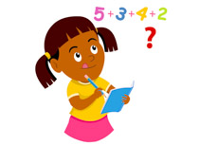
What Should I Do?
It’s time for math. I love math, and I’m really good at it. Today, we are working in pairs, and my teacher paired me with Jonie. I can’t believe it. I don’t like her, and I don’t think she is good at math. How am I supposed to work with her if I don’t even like her?
What should I do?

Slide 17
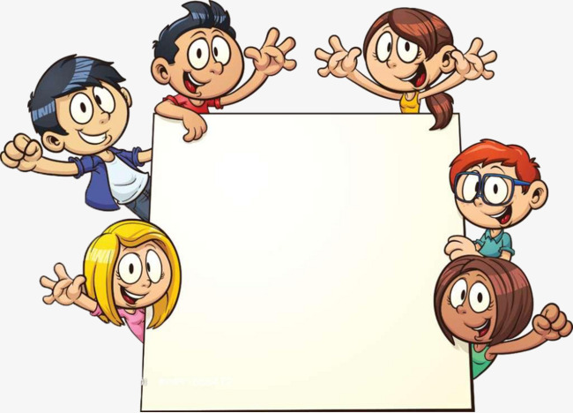
Cooperating with Others
Think of a time that you had to work with another person on project, during an activity, or in a game and were successful. Describe how you worked together to be successful.

Slide 18

Can You Help Me?
Kindergarten is nothing like preschool. I know I’m too old for preschool, but I would love to go back. There are so many changes between preschool and kindergarten. I do not like change. I miss my old friends, and I would rather be playing all day than working.
Do you have any advice to help me adjust to the changes?

Slide 19

Adjusting to Change
Think of a time when you had to adjust to something new in your life. Describe your experience and how you coped with the change.

Slide 20
Role Play
Let’s Practice

Slide 21
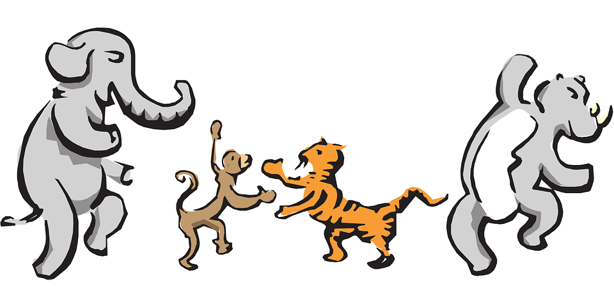
Let’s Move!
https://www.youtube.com/watch?v=u4qpSSwAAXI

Slide 22
The End
Take care of yourself & Others

