Slide 1
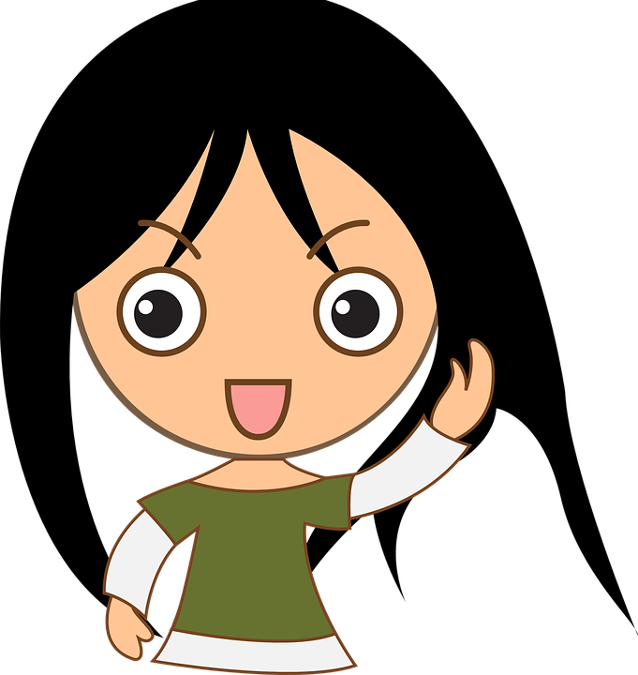
All About Me
How To Be a Friend
Let’s learn about Health!

Slide 2
Friendship

Slide 3
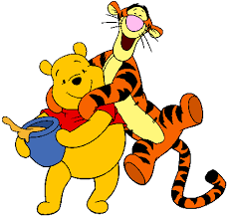
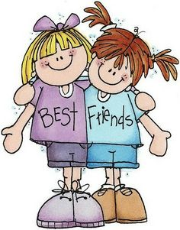
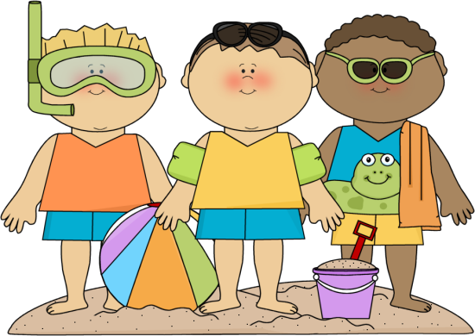
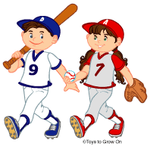
How To Be a Friend
Think about your relationship with a close friend. How do you treat this person? Describe how to be a friend.

Slide 4
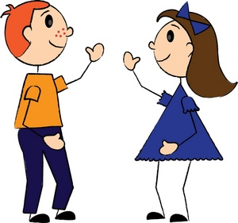
How to Be a Friend
Watch the following video and think about how you can be a good friend to others.
https://www.youtube.com/watch?v=ReMq3KX8F94 (Little Voices: What makes a good friend?)
What are your strengths as a friend?
What could you work on to be a better friend to others?

Slide 5
What Should I do?
At recess, I love to play tag with a group of friends. Carl asks to join the game, and Sam quickly answers, “You are too slow to play.” Carl puts his head down and walks away. I’m eager to get back to the game, but I feel bad that Carl is sad. He is a really good friend to me.
What should I do?
How can I be a good friend in this situation?

Slide 6
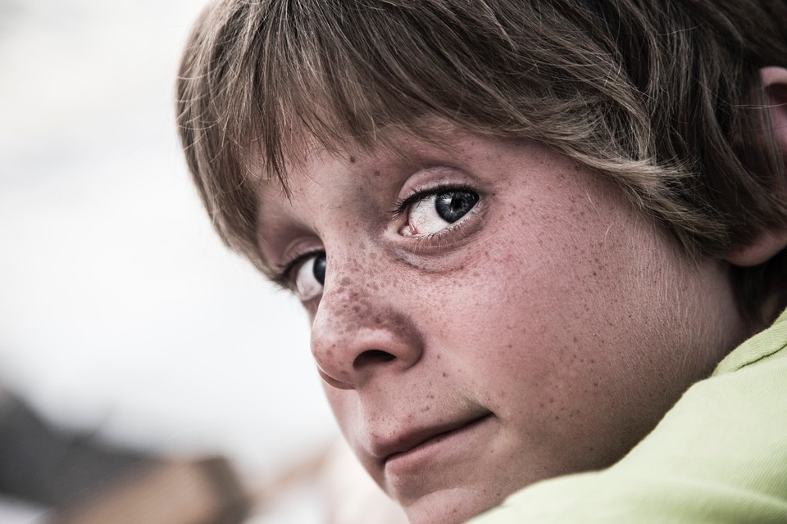
What Should I do?
Life is good! I love kindergarten, and I’m really involved in fun after school activities like soccer and karate. Mom, dad, and my older brother Jaquan all seem happy too.
At school today, I noticed Alex sitting by himself again. I’ve heard other kids say that he wears dirty clothes. He does, but I think he is really nice. He doesn’t have many friends either. During reading, he begins to get really frustrated. Reading is easy to me, so I thought I’d help him. While helping him, he told me he was frustrated because he had not seen his dad in two weeks and really missed him. Life doesn’t seem so good for Alex.
What should I do? How can I be a friend to him?

Slide 7
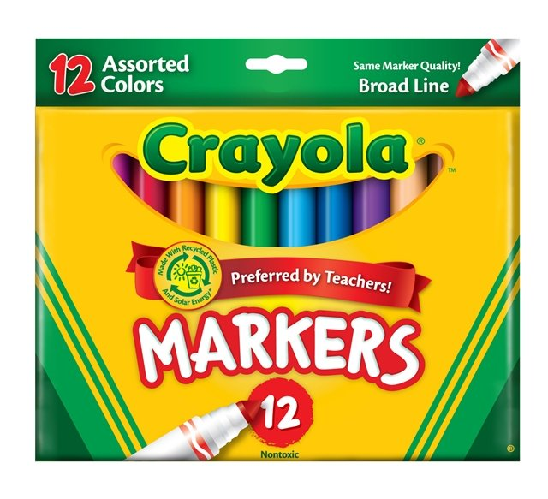
What Should I do?
Today is a rainy day. Rather than playing outside for recess, we are having free time in the classroom. I’m at the drawing station. I love art, and I’m making my dad a card. I quickly grab the good markers and start my card. Jayden sits down at the table and is excited to draw with me. I really don’t want to share my markers with him because he just scribbles and wastes the color in the markers. There are good colored pencils he could use. Should I tell him to use the colored pencils or share the markers?
What should I do?

Slide 8
Why is it important to Share?
https://www.youtube.com/watch?v=fmR-BBj3U1M (Sharing: A Lesson for Everyone)

Slide 9
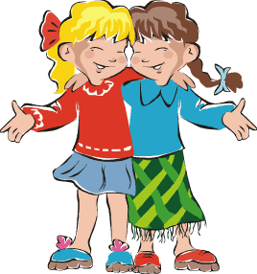
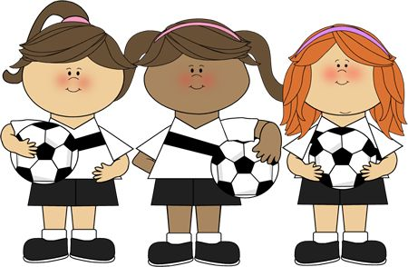
Strategies for Making New Friends
Watch the following video and think about strategies you use to make new friends.
https://www.youtube.com/watch?v=gS61XYP0lOI
What other strategies could you use to make friends?

Slide 10
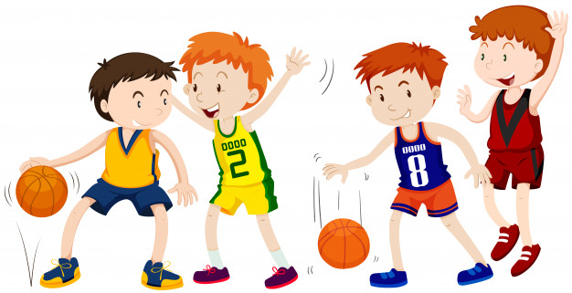
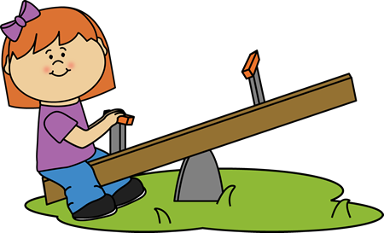
Why Have Friends?
Think about your friendships. Why is it important to have friends?

Slide 11
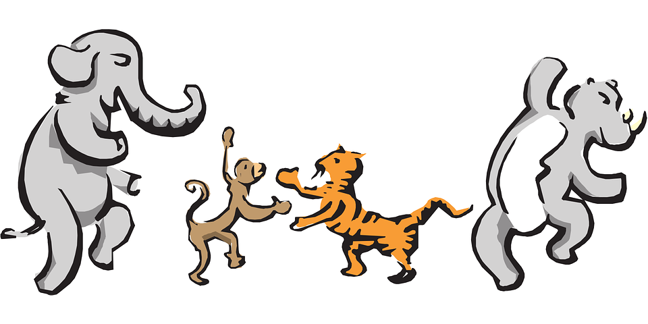
Let’s Move!
https://www.youtube.com/watch?v=u4qpSSwAAXI

Slide 12
The End
Take care of yourself & Others

