Slide 1
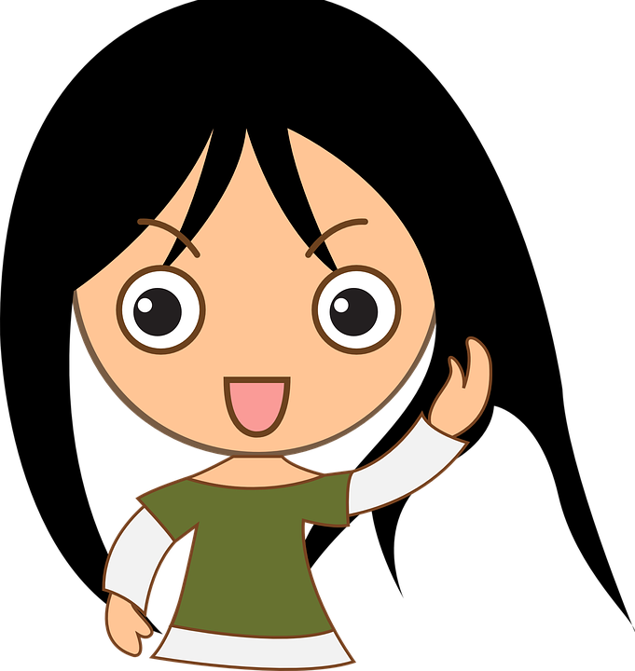
All About Me
Sun Safety
Let’s learn about Health!

Slide 2
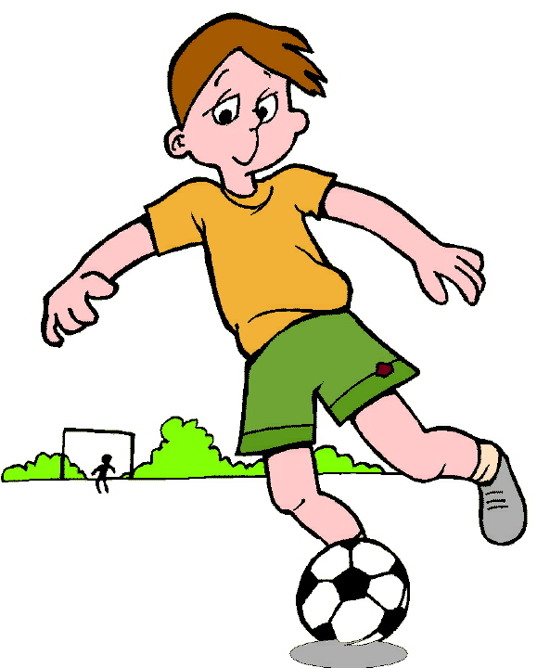
What Should I do?
It is going to be another hot summer day. I have a soccer game at 9am, and older brother has a game at 11am. While soccer is fun, I’m looking forward to going to our neighborhood pool to cool off after the game. Mom is busy making breakfast and packing for the day. I’m getting dress for my game. As I’m getting dressed, I remember the sunburn I got last weekend at my soccer game.
What should I do to protect myself from the sun?

Slide 3
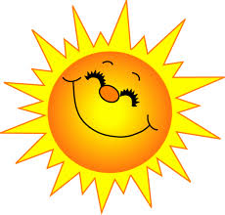
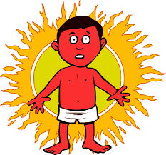
Sun Safety
Have you ever had a sunburn? Describe how a sunburn feels.
What could you have done to prevent getting this sunburn?
Watch the following video on sun safety:
https://www.youtube.com/watch?v=T7ghJsZug60
(George the Sun Safe Superstar)

Slide 4
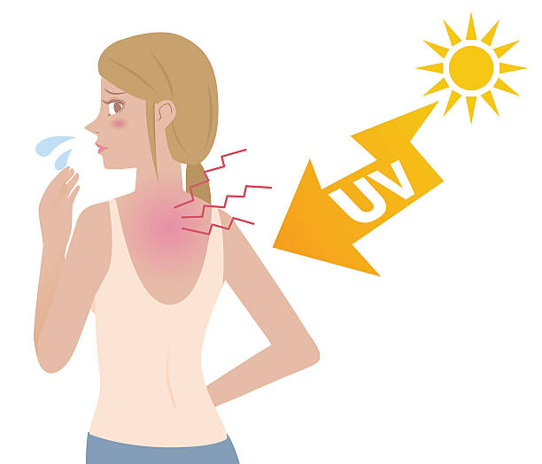
Can You Help Me?
It’s another hot summer day. Mom is busy working, so I sunscreen myself making sure to get my arms, legs, and face. She loves when I go outside and play in the backyard with my older brother. It’s hot, so I wear a tank top. At 3pm, I come inside for a snack. My skin, especially my back, is red and feels hot.
What should I have done differently to prevent getting a sunburn?

Slide 5
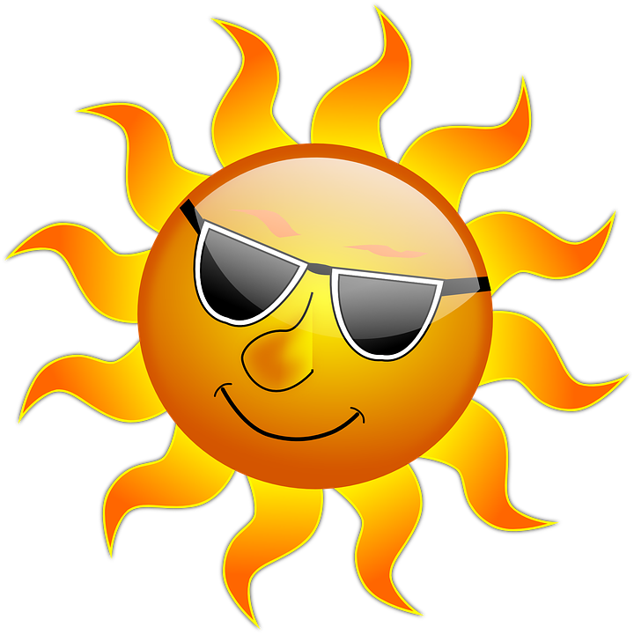
Sun Safety Tips
Wear water resistant sunscreen with SPF of 30 or higher
Reapply sunscreen every 2-3 hours
Ask an adult to help you put sunscreen on
Decrease direct sunlight between the hours of 11am and 3pm
Wear a shirt and a hat to protect your skin
Wear sunglasses to protect your eyes

Slide 6
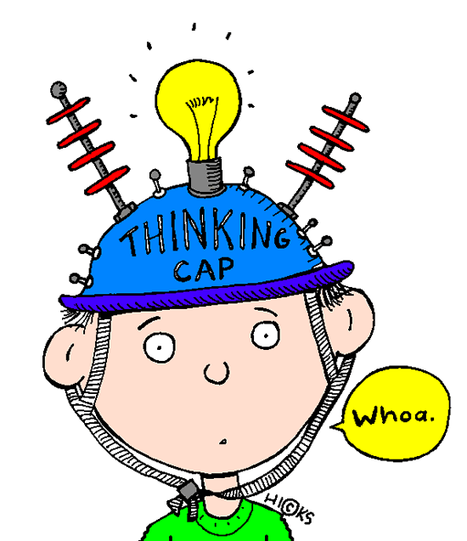
Let’s Review...

Slide 7
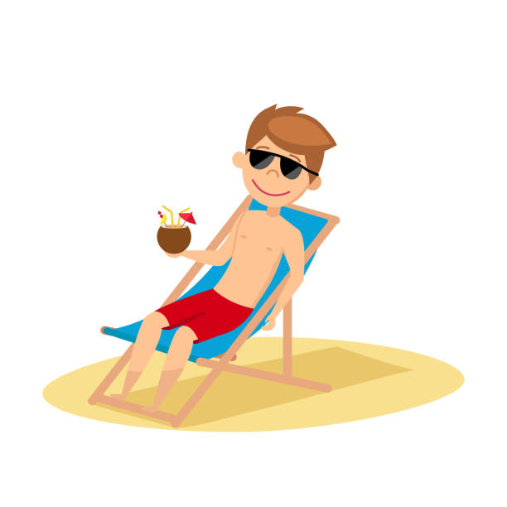
Protect Me from the Sun!
Look at the picture and think about what could be added to the picture to protect him from the sun.

Slide 8
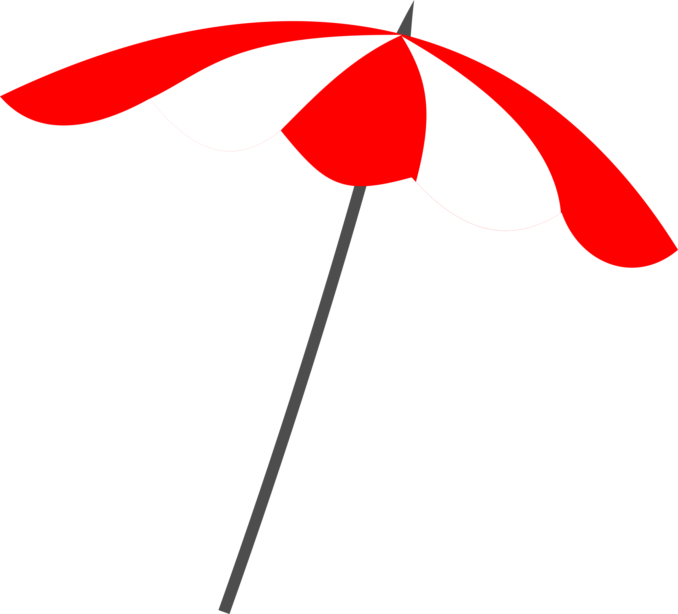
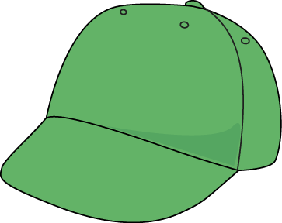
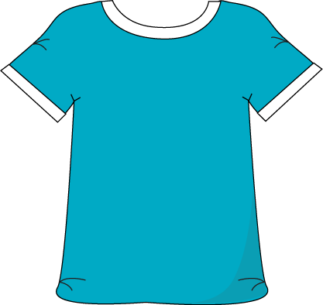
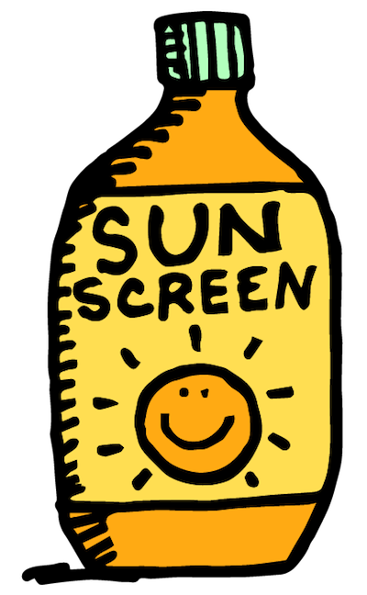
Thanks for Protecting Me from the Sun!
Add sunscreen to re-apply
Add an umbrella
Add a shirt
Add a hat

Slide 9
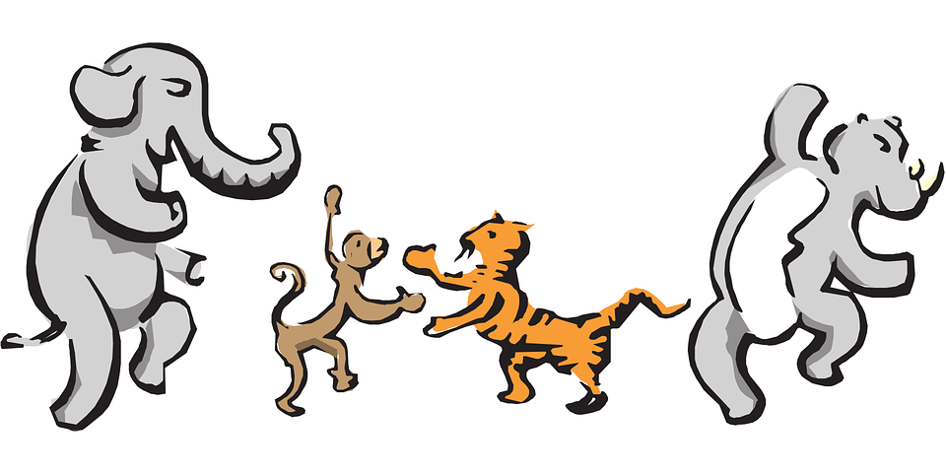
Let’s Move!
https://www.youtube.com/watch?v=u4qpSSwAAXI

Slide 10
The End
Take care of yourself & Others

