Slide 1
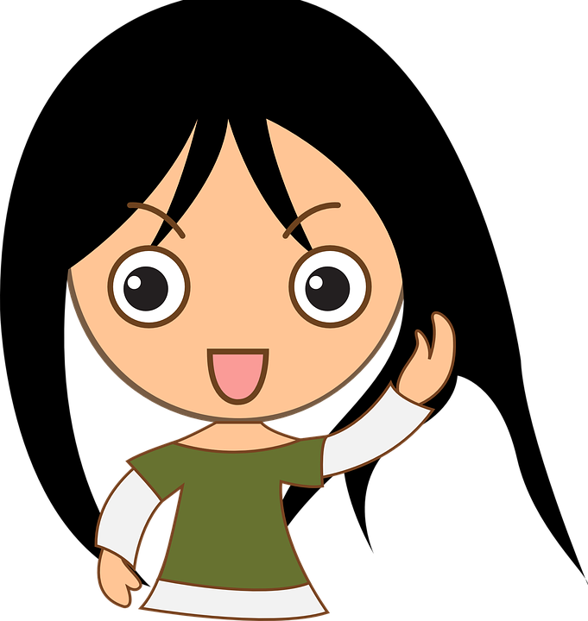
All About Me
Emergency and Non-Emergency Situations
Let’s learn about Health!

Slide 2

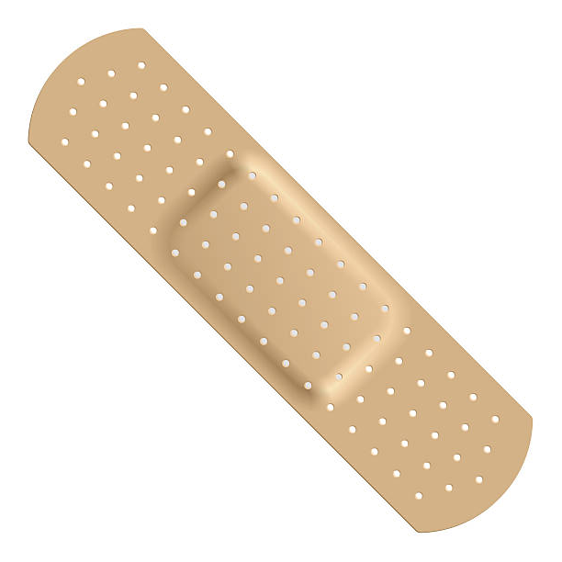
Emergency & Non-Emergency Situations

Slide 3
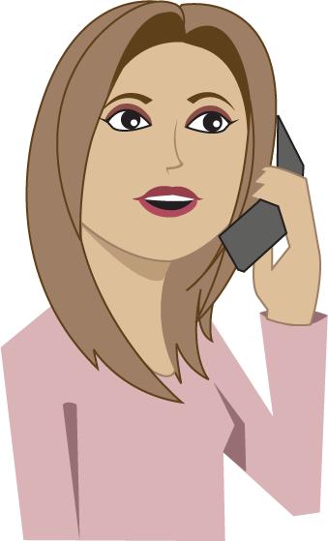
What Should I Do?
My mom is on an important phone call, so I’m in charge of my little sister Katie. While playing, she bumps her knee. Luckily, Katie did not cry, but her knee is a little red. I really need to tell my mom, but she does not want us to bother her unless it is an emergency. Is this an emergency?
What should I do?

Slide 4
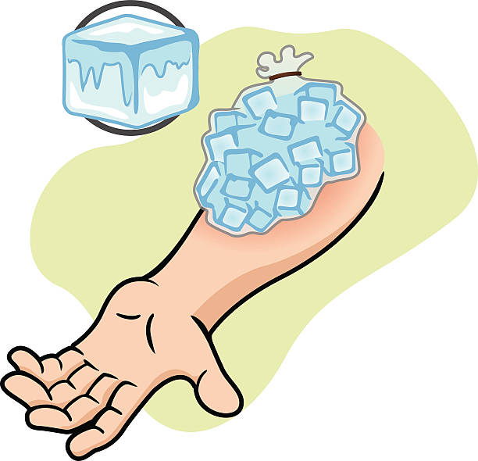


Non-Emergency Situations
Non-emergency situations are ones that do not require immediate attention but you still may need to do something. Think of a time when you had a non-emergency situation. Describe what happened and how you were cared for.

Slide 5
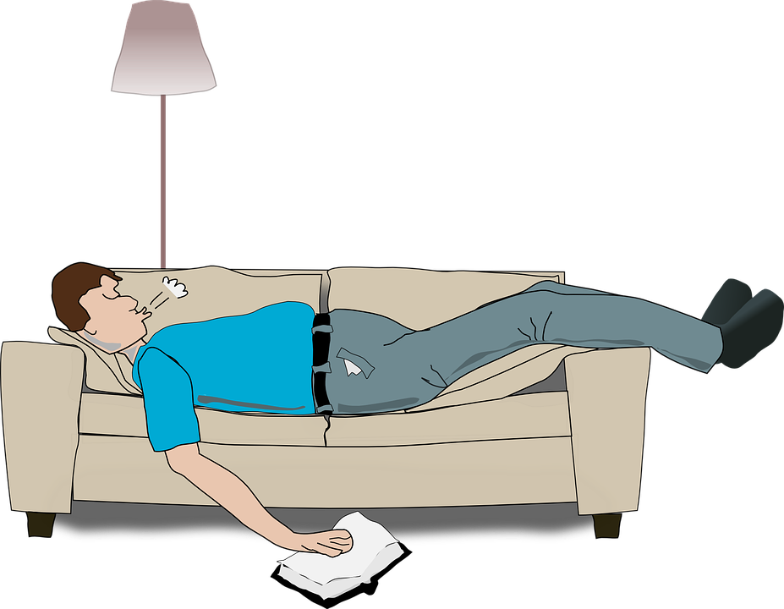
What Should I Do?
My dad is taking a short nap, and I’m in charge of my little brother Sam. Dad has asked us not to wake him unless it is an emergency. We decide to eat a snack. While eating, Sam begins choking. His lips are turning blue, so I start to hit him on his back. The food is not coming out. Is this an emergency?
What should I do?

Slide 6

Emergency Situations
Emergency situations are ones that require immediate attention and may put a person’s health or life at risk. Give an example of an emergency situation.

Slide 7

Imagine that...
Imagine that you are in an emergency situation or a dangerous situation. Who could help you?

Slide 8

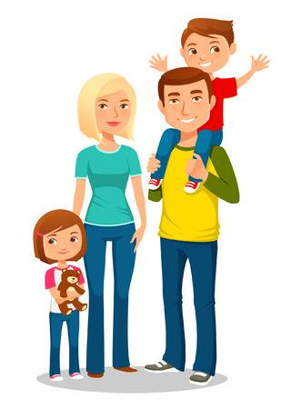

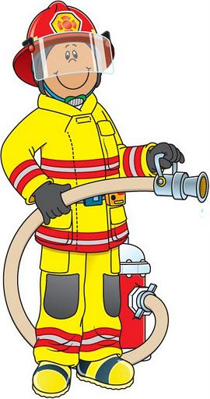
Who Can Help You in an Emergency
Who else could help you in an emergency situation?

Slide 9

Ask for Help!
Why is it important to ask for help right away?
How would you ask for help?

Slide 10

Call 9-1-1
Watch the video clip to learn more about calling 9-1-1.
https://www.youtube.com/watch?v=ulf4oKqTUc8
(Learning about 9-1-1 with Emergency Ernie)
Call 911 if no adult is available
State your name, what the emergency is, and other information that you know so police can find your location
Let’s Practice calling 9-1-1 using a pretend phone

Slide 11

Let’s Review

Slide 12
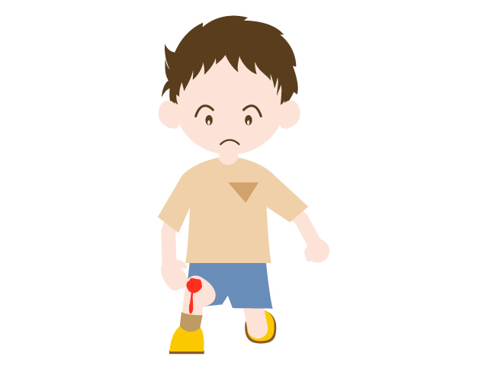
Emergency or Not?
What would you do?

Slide 13
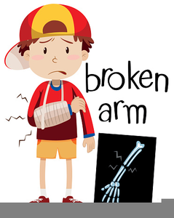
Emergency or Not?
What would you do if you broke your arm on the playground?

Slide 14
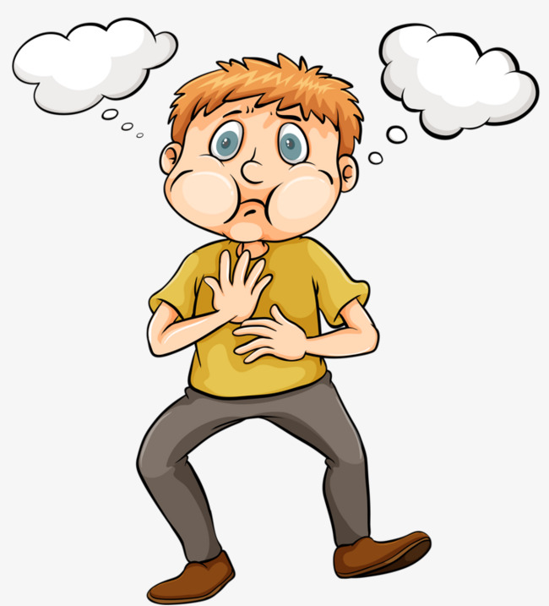
Emergency or Not?
Can’t breathe
Choking
What would you do?

Slide 15
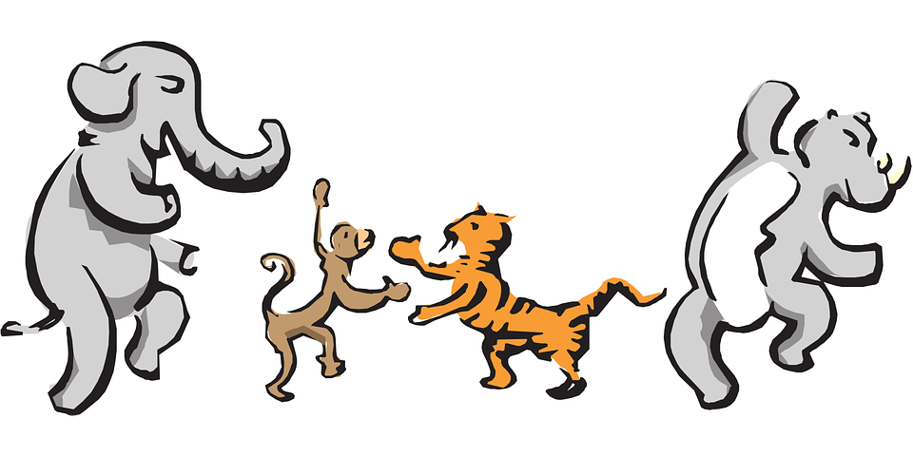
Let’s Move!
https://www.youtube.com/watch?v=u4qpSSwAAXI

Slide 16
The End
Take care of yourself & Others

