Slide 1
All About Me
Nutrition
Let’s learn about Health!

Slide 2
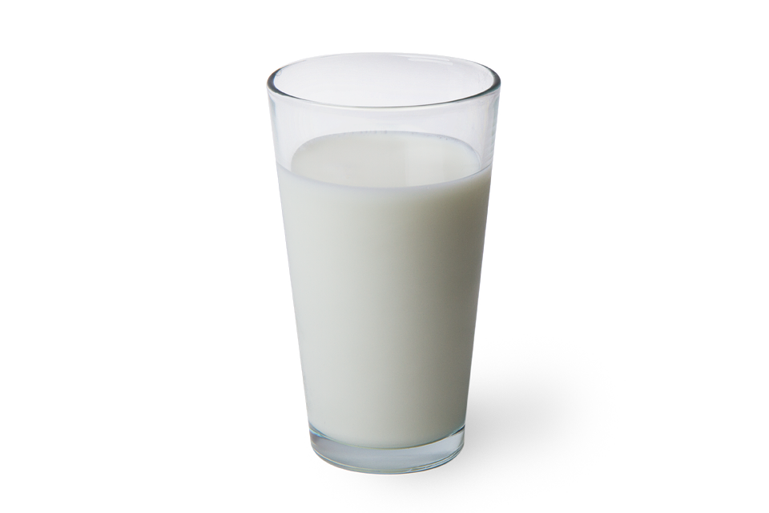
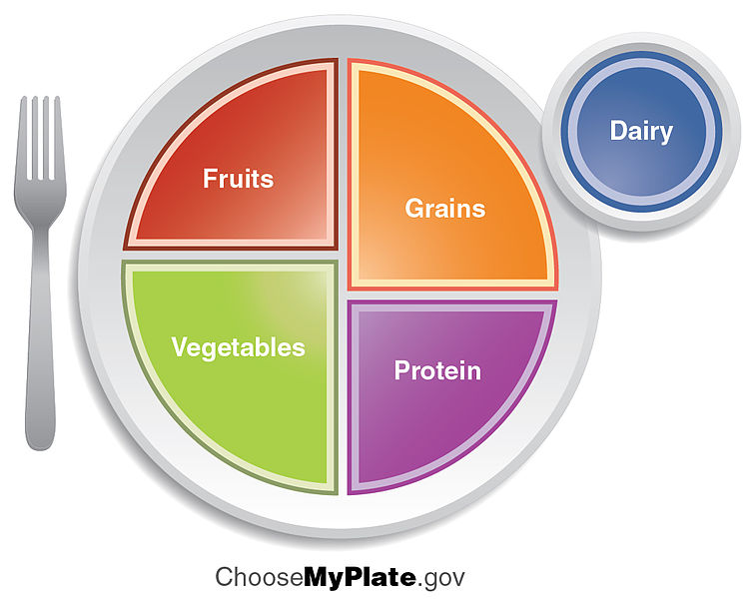
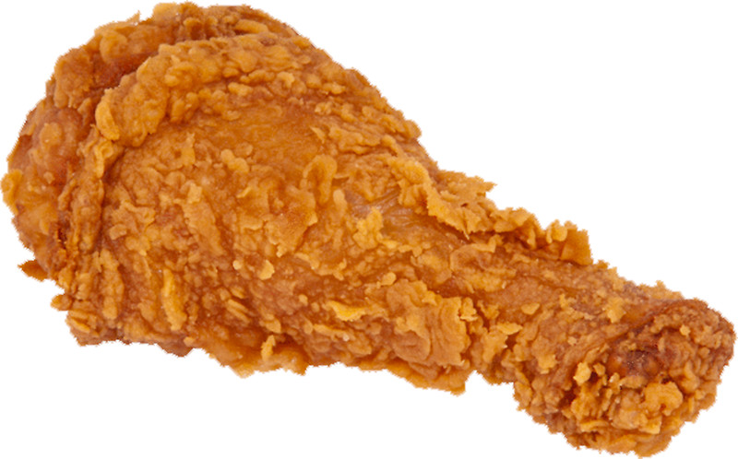
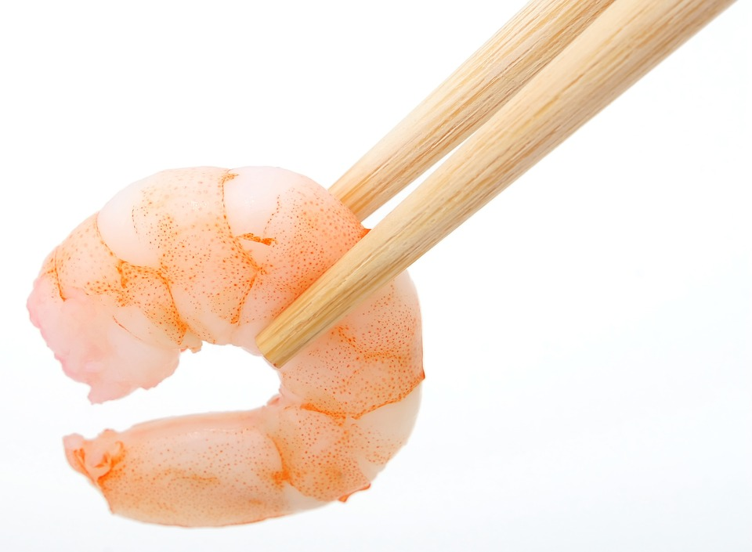
Can You Help Me?
I have lots of food to choose from, but I’m trying to pick one food from each food group. Can you help me?

Slide 3
The Food Groups
https://www.youtube.com/watch?v=L9ymkJK2QCU

Slide 4
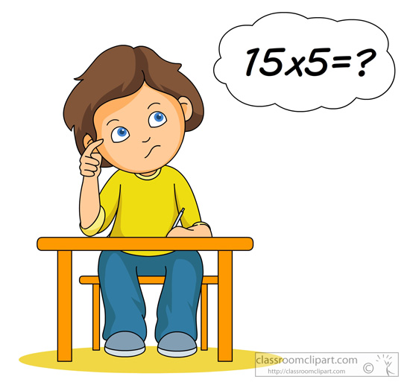
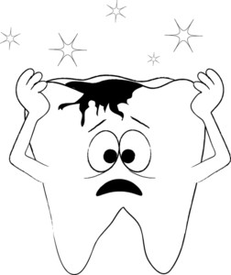
Benefit to Healthy Eating
Helps with Growth Helps with Brain Development Avoid Health Problems Energy
https://www.youtube.com/watch?v=YimuIdEZSNY

Slide 5
It’s Your Turn...
Create a healthy lunch using MyPlate. Include all 5 food groups. Draw and label your foods.

Slide 6
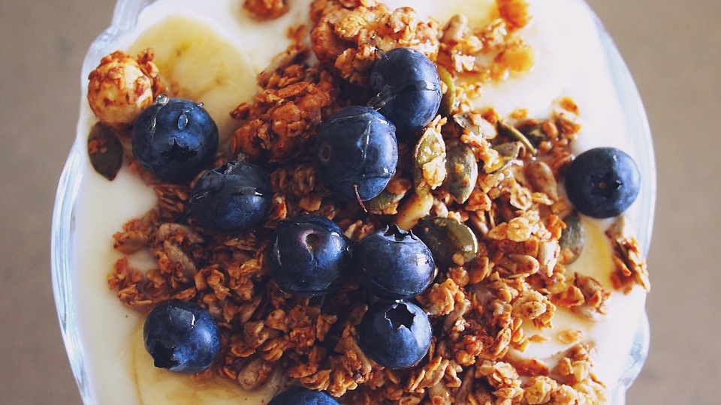
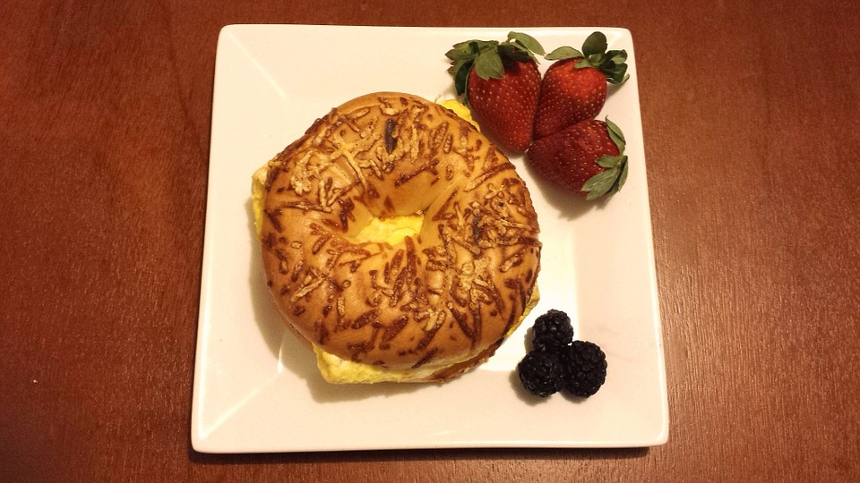
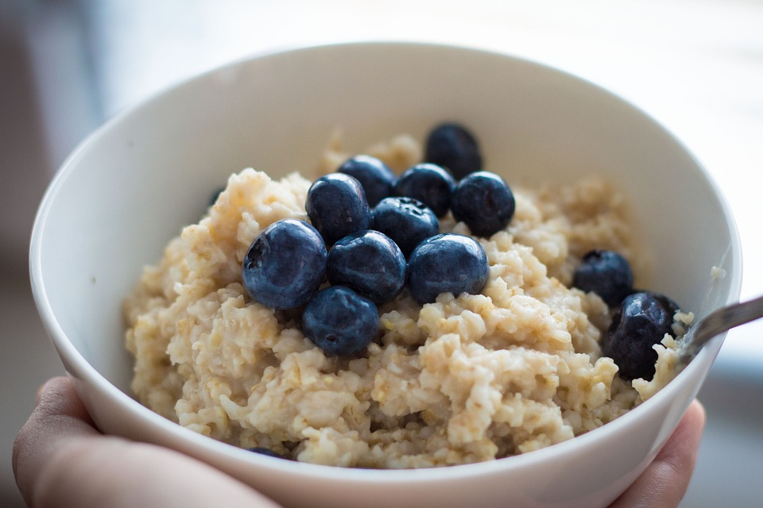
What Should I do?
Eating healthy food throughout the day will allow me to feel good and have lots of energy. I really want to eat a doughnut and pop tart for breakfast but I know I need meals that are more healthy. I have these other meals to choose from. What should I do?

Slide 7
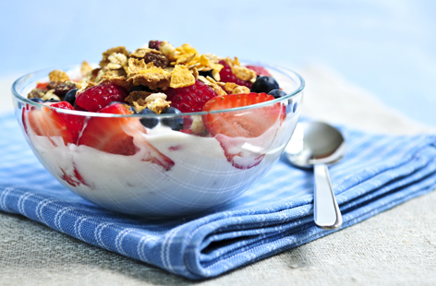
Eat a Healthy Breakfast
=
More Awake, More Alert, More Energy

Slide 8
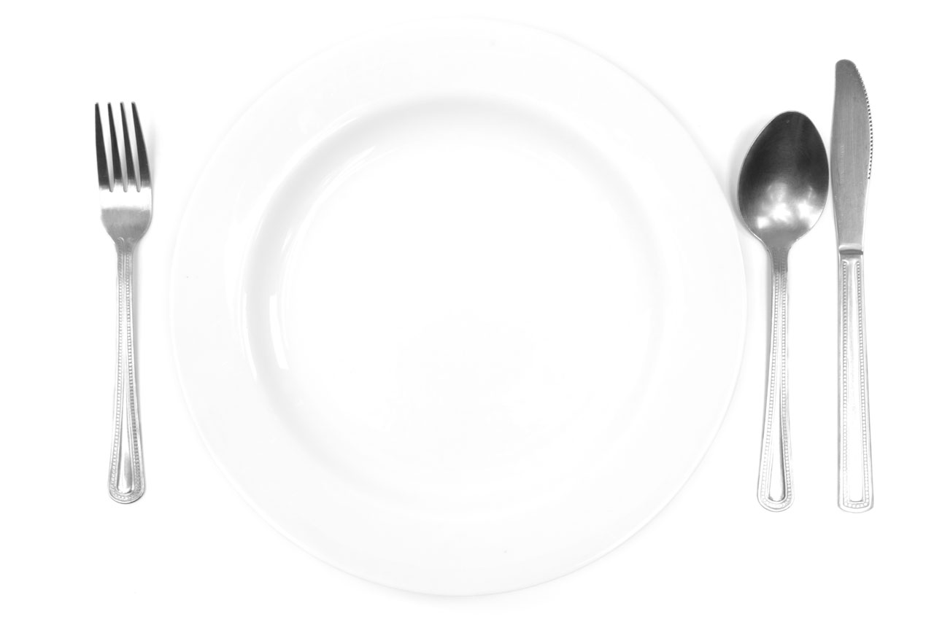
It’s Your Turn...
Create a healthy breakfast. Draw and label your foods.

Slide 9
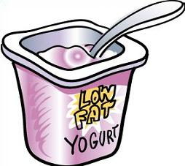
Can You Help Me?
My grandma always tells me to eat healthy snacks. I want to make good food and drink choices to help me stay healthy. I need help deciding what to choose. Can you help me?

Slide 10
Healthy or Not?

Slide 11
It’s Your Turn...
Draw and label 3 healthy snacks you eat or could eat.

Slide 12
Fruits and Vegetables
What are your favorite fruits and vegetables?
Goal: Eat at least 5 Fruits and Vegetables a Day

Slide 13
It’s Your Turn...
Draw and label your favorite fruit and your favorite vegetable.

Slide 14
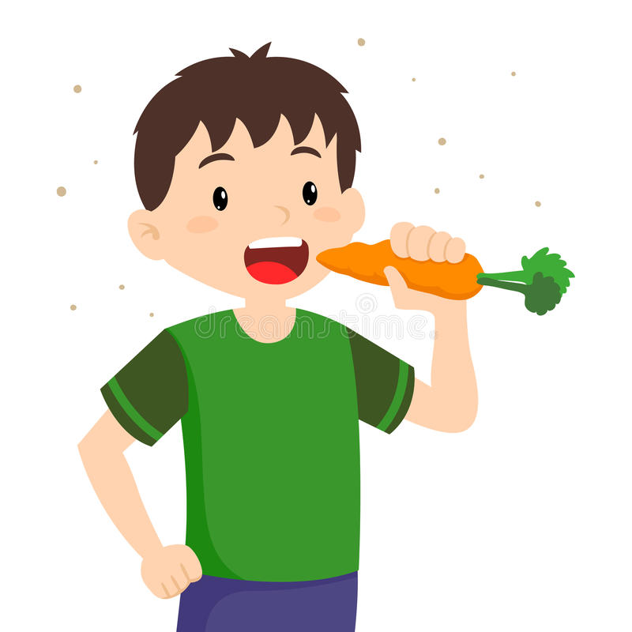
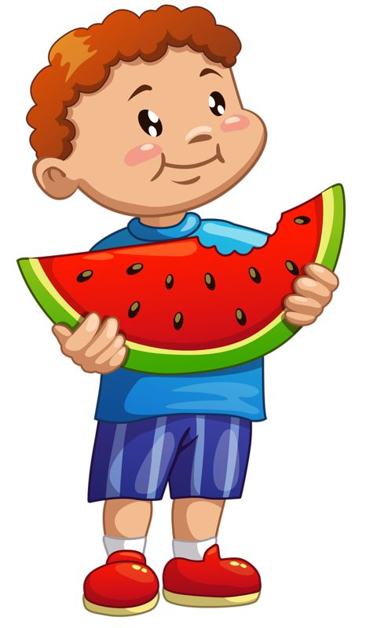
A Healthy Me

Slide 15
Let’s Move!
https://www.youtube.com/watch?v=u4qpSSwAAXI

Slide 16
The End
Take care of yourself & Others

