Slide 1
All About Me
Your 5 Senses & Body Parts
Let’s learn about Health!

Slide 2
My 5 Senses

Slide 3
My 5 Senses
Watch the following video to learn about your 5 senses.
https://www.youtube.com/watch?v=LQNqXnjJxH4 (5 Senses)

Slide 4
Sight
Think of a time when you saw something interesting or amazing. Describe it.

Slide 5
Hearing
Think of a sound that makes you happy. Describe it.

Slide 6
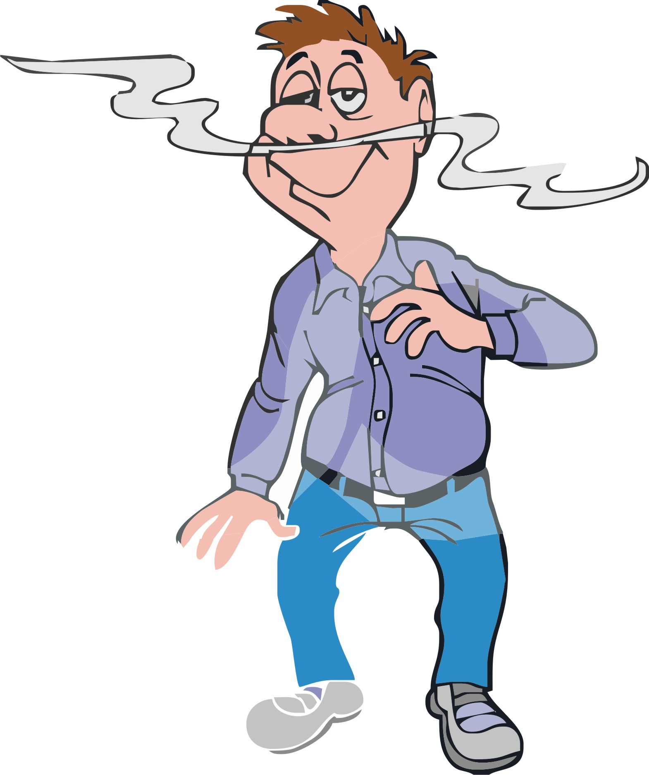
Smell
Think of a smell that makes you feel hungry. Describe it.

Slide 7
Taste
Think of your favorite food to eat and your least favorite food to eat. Describe it.

Slide 8
Touch
Think of the last three things you touched. Did they feel soft, hard, cold, or wet? Describe what you touched.

Slide 9
Can You Help Me?
Grandma just finished cooking an apple pie. What senses will I use to enjoy the apple pie?

Slide 10
Can You Help Me?
While sitting on the back porch, several bird fly to a tree near you. What senses will you use to enjoy the birds?

Slide 11
Imagine that….
Imagine that you had to give away one of your senses and could never use that sense again. Which would you give away? Why did you choose that one?

Slide 12
Let’s Protect Our Senses
What can you do to protect your senses today and as you age?
Sight Smell Touch
Hearing Taste

Slide 13
Body Parts

Slide 14
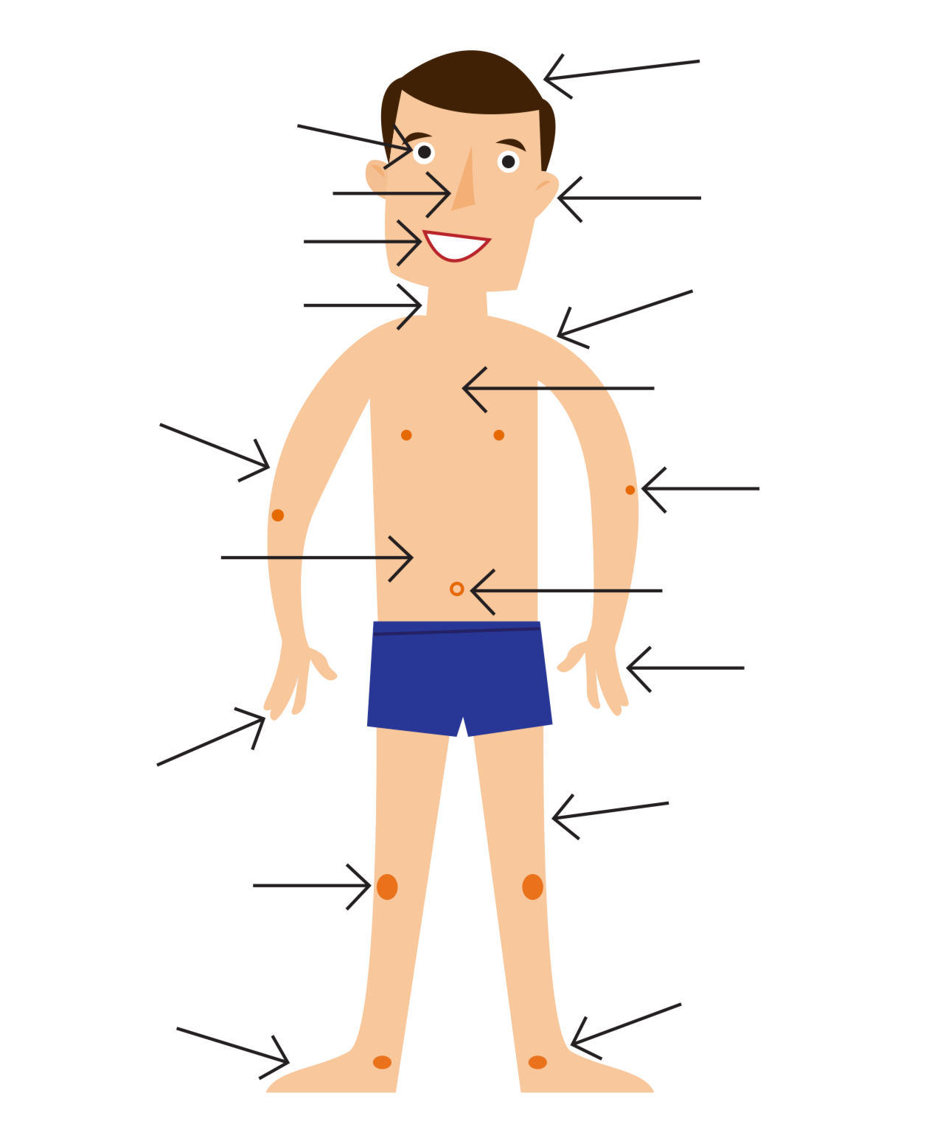
Can You Help Me?
Look at the picture and see how many body parts you know.

Slide 15
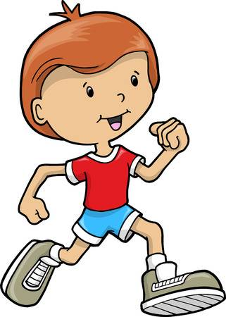
What’s Missing?
Look at the picture below to figure out what body parts are missing.

Slide 16
Let’s Work Together...
Body parts must work together to produce many movements. Think about your favorite sports or physical activity. What body parts work together to allow you to participate?

Slide 17
Let’s Practice...
Let’s stand up at our desks and slowly practice a baseball swing together. As we are going through the movements, think about how many body parts are working together to help you hit the ball.

Slide 18
Let’s Review

Slide 19
Simon Says...
To review the 5 senses and body parts, let’s play a game of Simon Says at your desks. If you make a mistake, keep playing and learning...

Slide 20
Let’s Move!
https://www.youtube.com/watch?v=u4qpSSwAAXI

Slide 21
The End
Take care of yourself & Others

