Slide 1
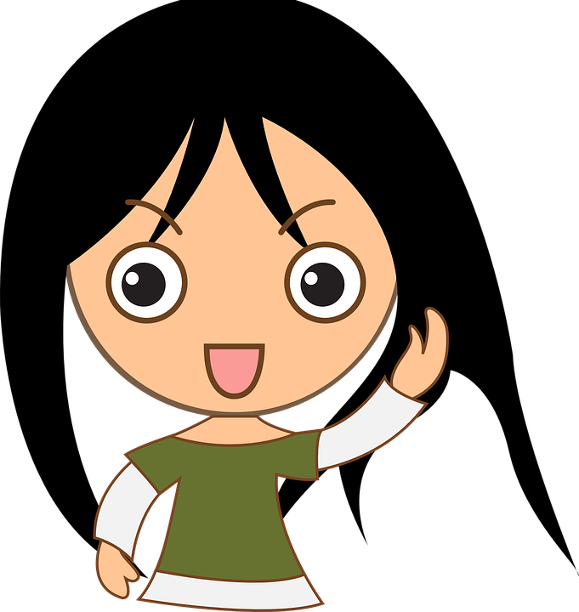
All About Me
Staying Safe
Let’s learn about Health!

Slide 2
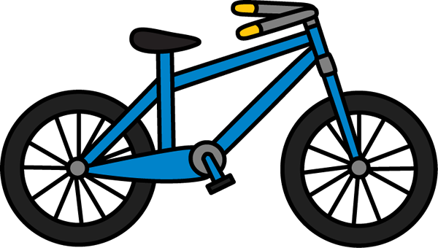
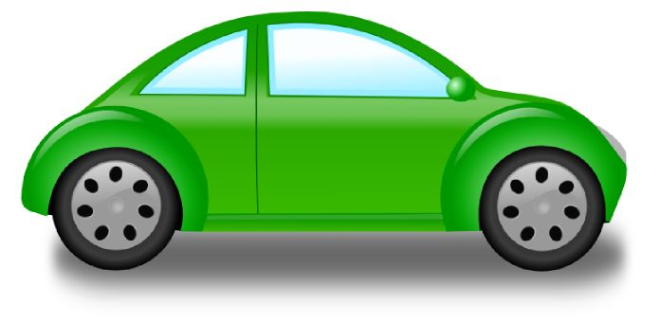
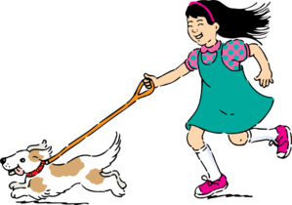
Staying Safe

Slide 3
Car Safety

Slide 4
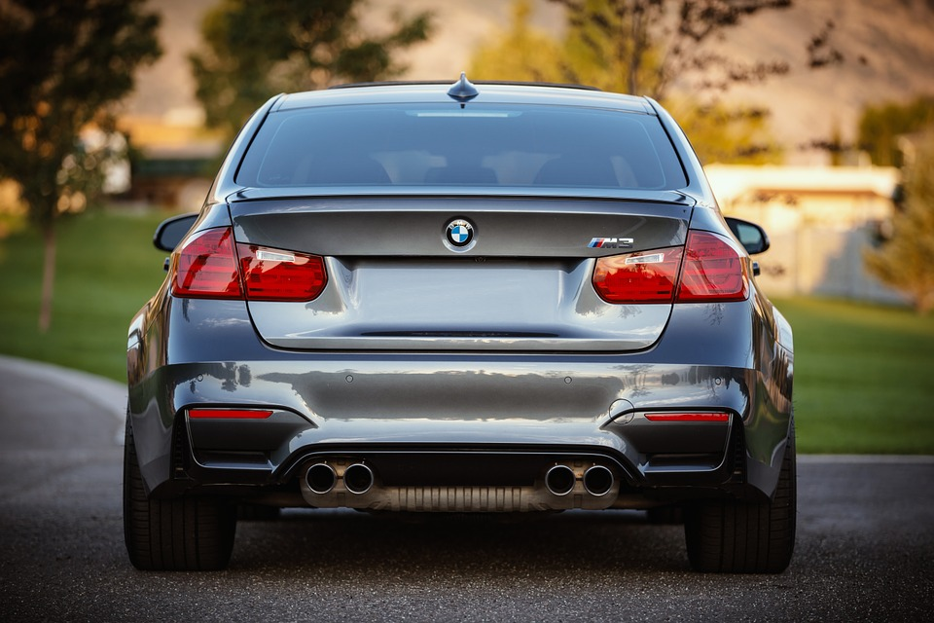
What Should I do?
Off we go again to gymnastics then swim practice and finally out to eat. My family is constantly on the go. We do everything in our car: eat, nap, sing, and sometimes dance. I’m stuck in the back seat between my little brother and little sister. I mostly sit on crumbs, cheerios, and dried milk. Today, I’m not sure if I want to buckle my seatbelt. There is gooey red stuff on it. Mom says to always buckle my seatbelt but maybe she won’t notice.
What should I do?

Slide 5
Buckle Up!
Protect you from serious injury
It’s the law
What else can you do to stay safe in a car?

Slide 6
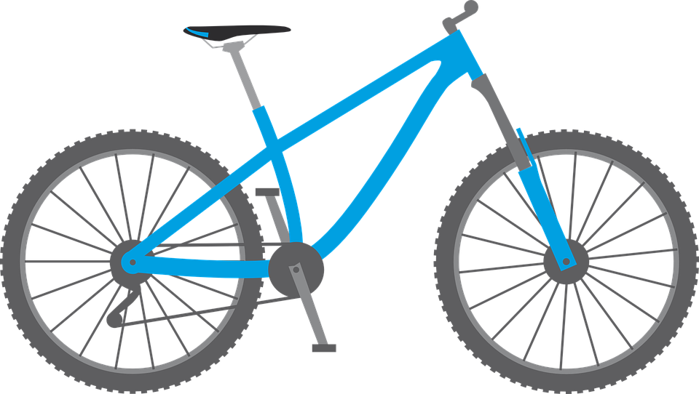
Bike Safety

Slide 7
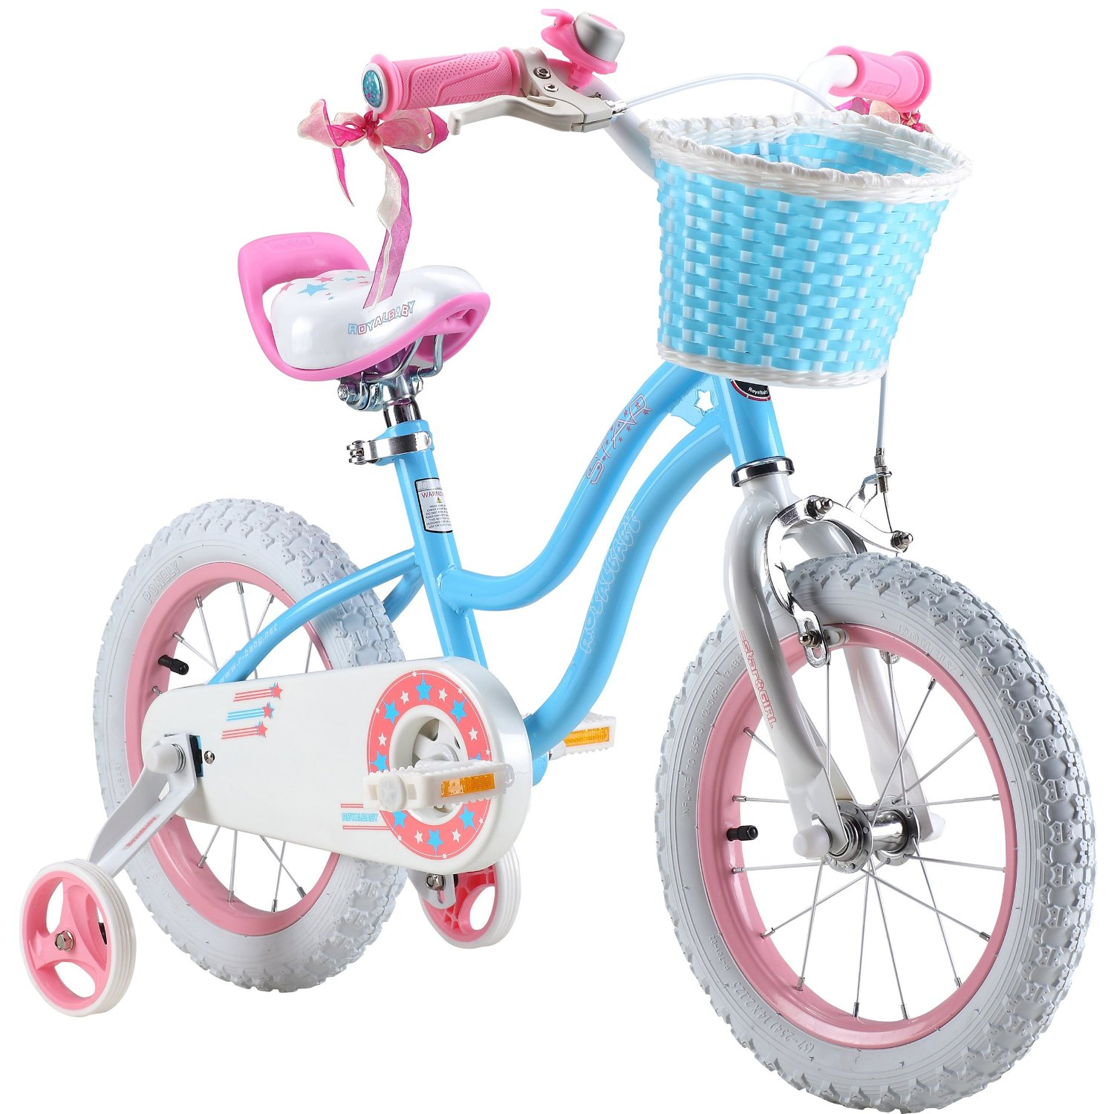
What Should I do?
It’s another beautiful spring day and my friends are all biking in the cul-de-sac. Grandma loves when I go out and play with my friends. While I have my bike, I forgot my helmet at my house. I want to bike with my friends, but I know I should wear a helmet.
What should I do?

Slide 8
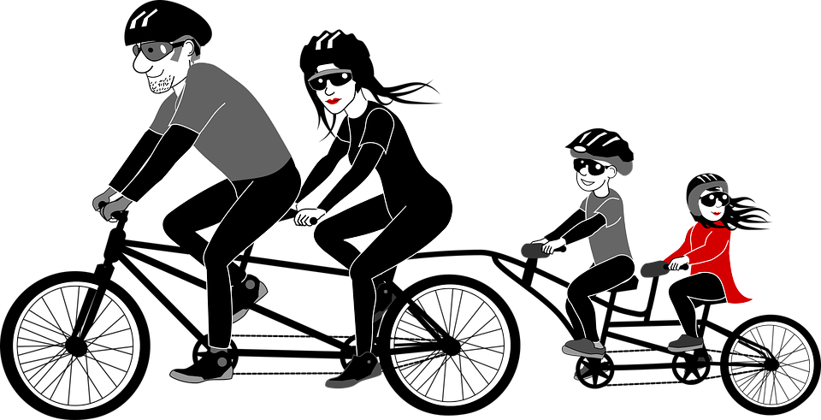
Wear a Bike Helmet
Protects your head from injury
https://www.youtube.com/watch?v=NF8CiNXEmcU

Slide 9
Pedestrian Safety

Slide 10
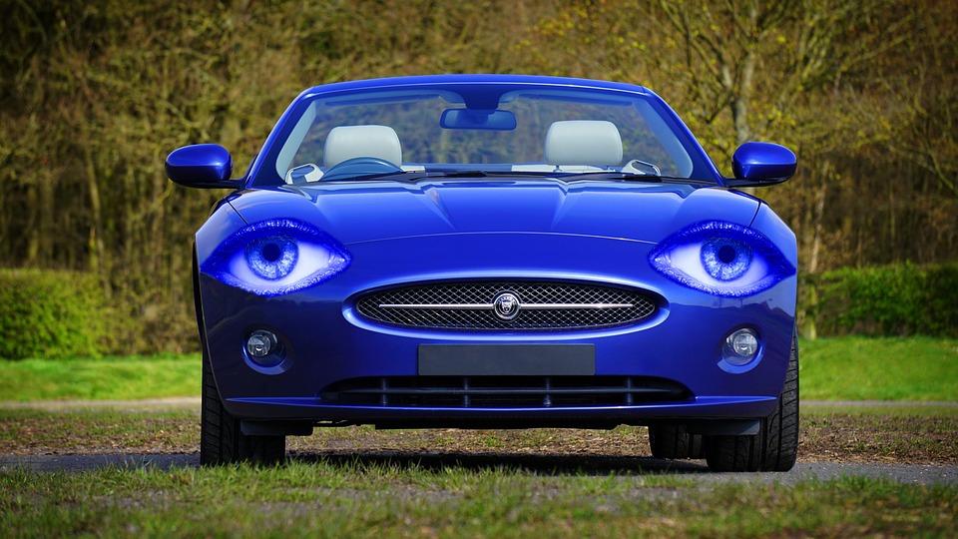
What Should I do?
It is important to know how to read warning signs, labels, and respond correctly to warning sounds. Can you help me respond to the following:
What should I do?
I’m about to cross the road and see this sign:
While dribbling my basketball, it rolls into the road. I look both ways and begin to go get it but hear a BEEP..

Slide 11
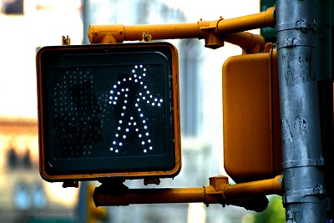
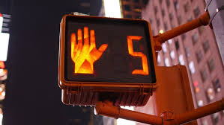
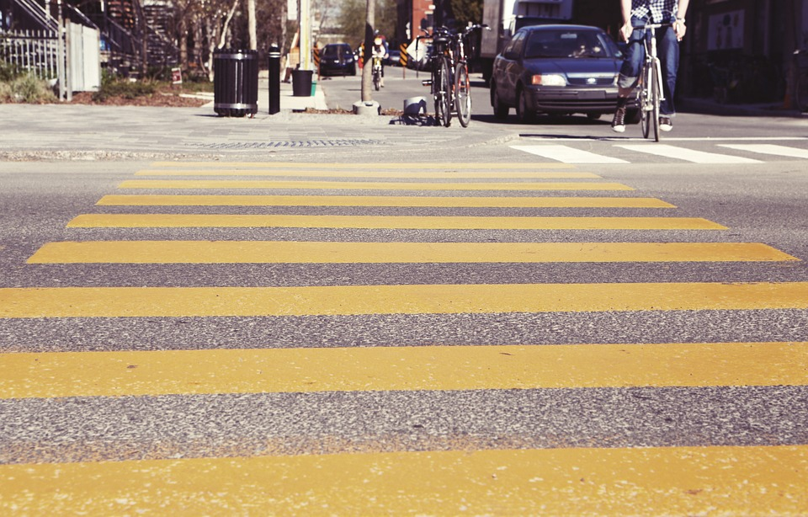
Traffic Signs and Signals
Helps protect you from cars
What are the meaning of the following pictures:
https://www.youtube.com/watch?v=x_Yreu3WKsQ&list=PLYXC5W6Ad0oqMeVSLk-X04Te5OW5o0m-B&index=5
How can you be safe when walking along a road?

Slide 12
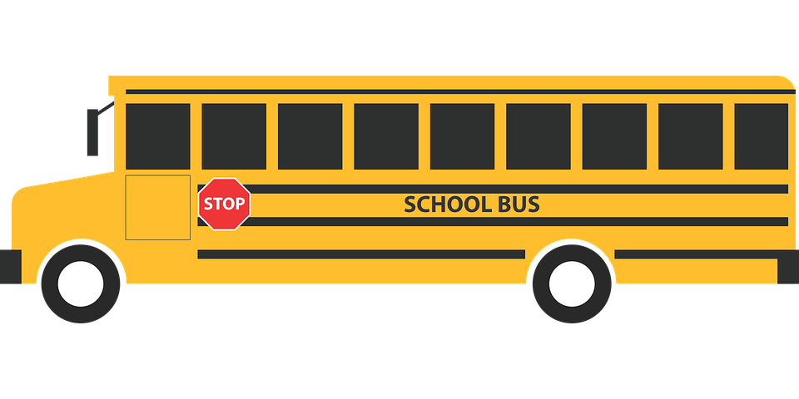
Bus Safety

Slide 13
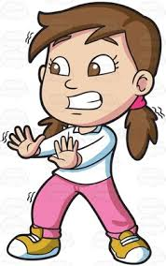
Can You Help Me?
Today is my first day of school, and I’m a little nervous to ride the school bus. My mom helped me on the bus in the morning, but I’m not sure how to get off the bus and safety make it to the sidewalk. When I get off the bus, do I walk in front of the bus or behind the bus to make it to the sidewalk? Can you help me?

Slide 14
Bus Safety
Protect you from injury
How can you stay safe while riding a school bus?

Slide 15
Let’s Review

Slide 16
Question 1
When you get in the car, what is the first thing you should do?

Slide 17
Question 2
Before getting on your bike, what should you do?

Slide 18
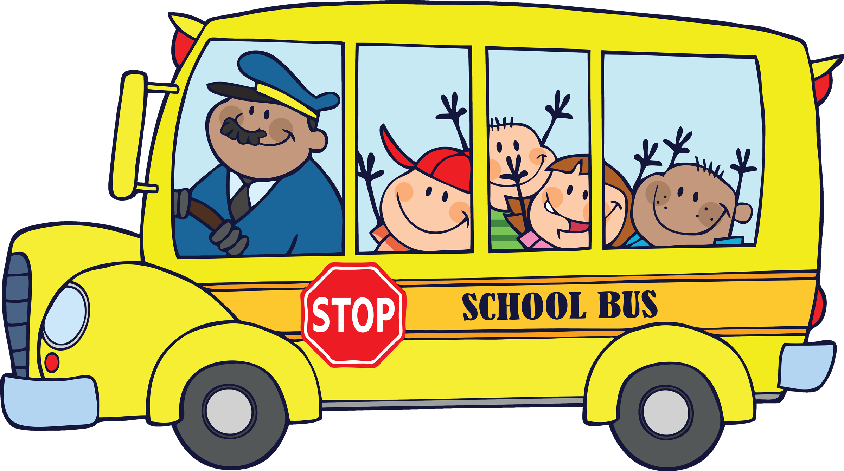
Question 3
When riding the bus, how can you stay safe in your seat?

Slide 19
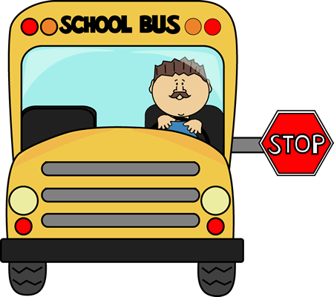
Question 4
When getting off the bus, how can you safety cross the street?

Slide 20
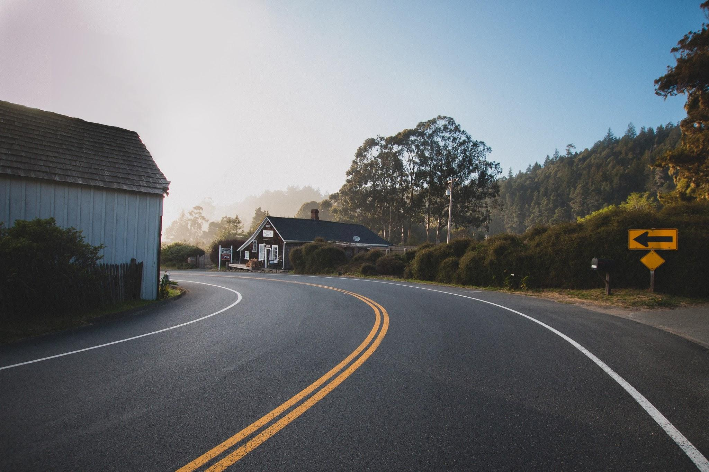
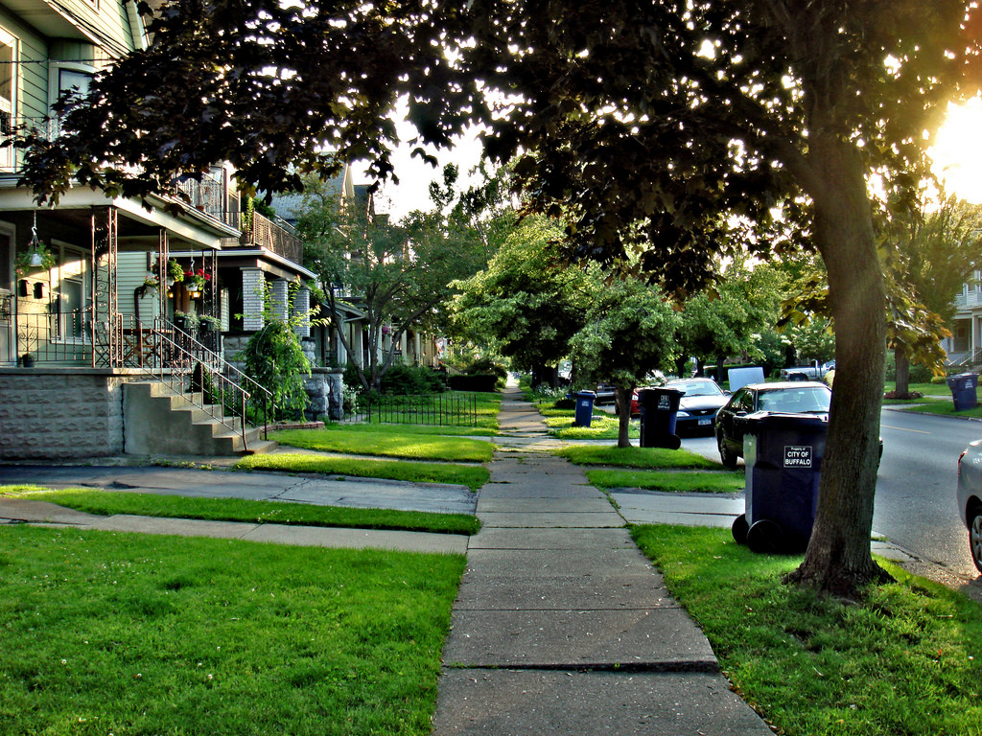
Question 5
Imagine that you were allowed to walk to your friend’s house with your older brother. Where should you walk to safely get there?
OR
In the road
On the sidewalk

Slide 21
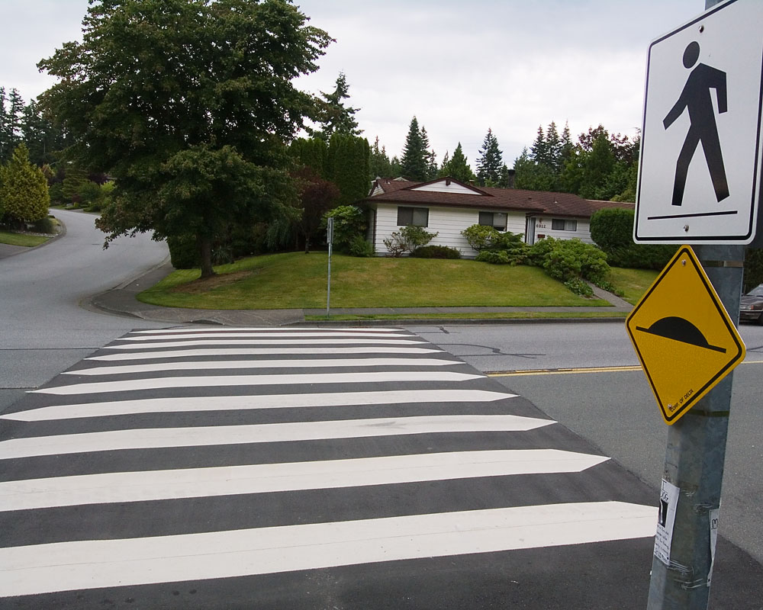
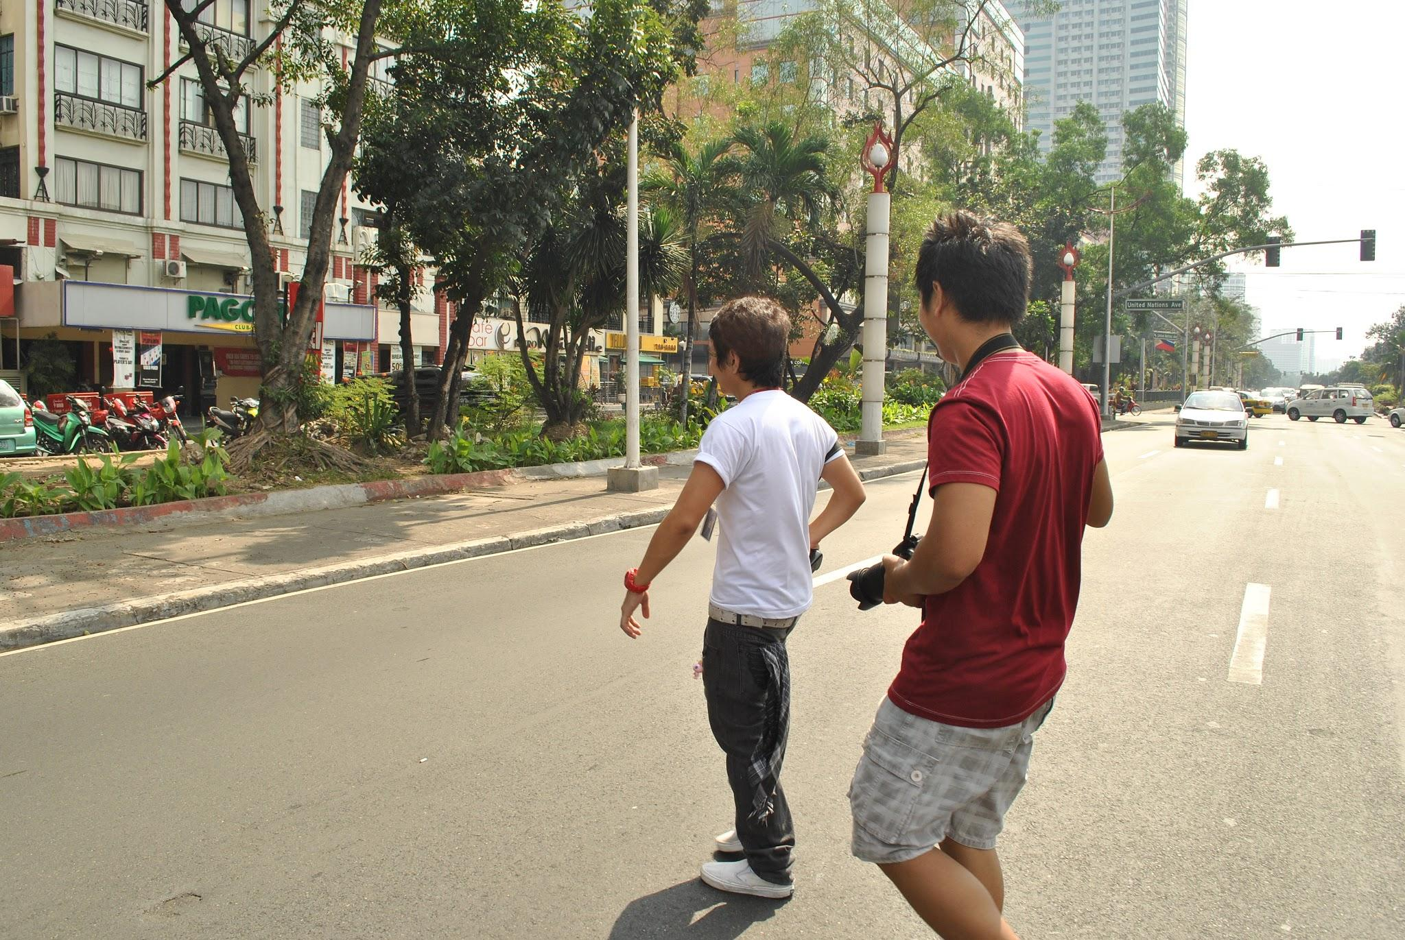
Question 6
How can you safely cross a busy road?
OR
At a crosswalk
In the middle of the street

Slide 22
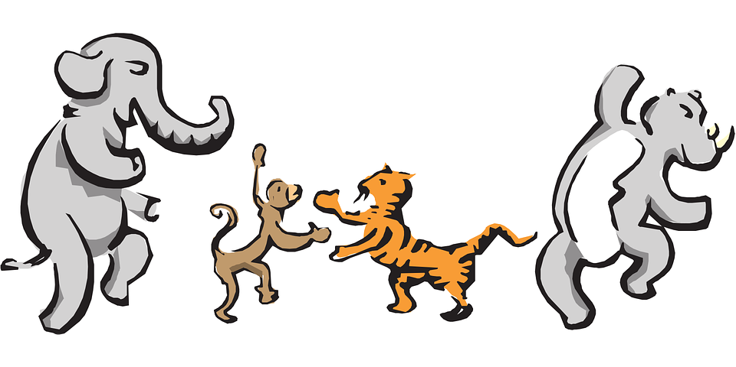
Let’s Move!
https://www.youtube.com/watch?v=UU0AtBzAlYY

Slide 23
The End
Take care of yourself & Others

