Slide 1
All About Me
Physical Activity, Sleep, Hand Washing, Oral Care
Let’s learn about Health!

Slide 2
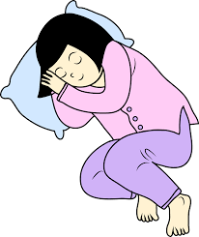
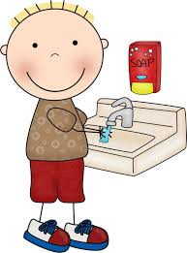
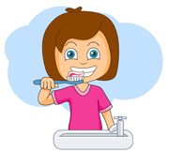
A Healthy Me
Eat Healthy Exercise Sleep Wash Hands Oral Care

Slide 3
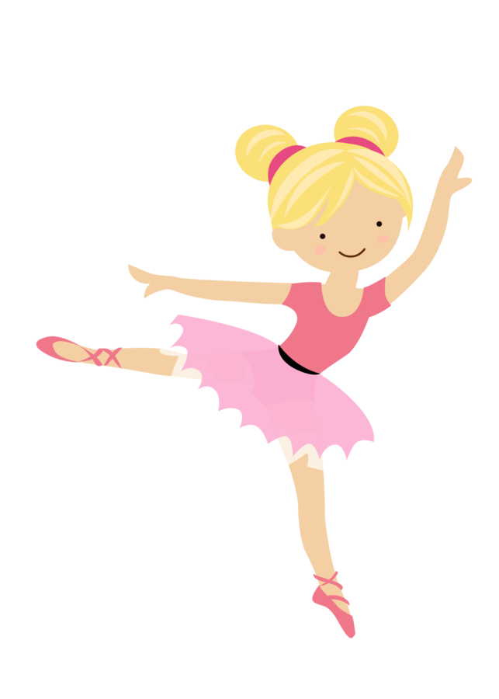
Exercise

Slide 4
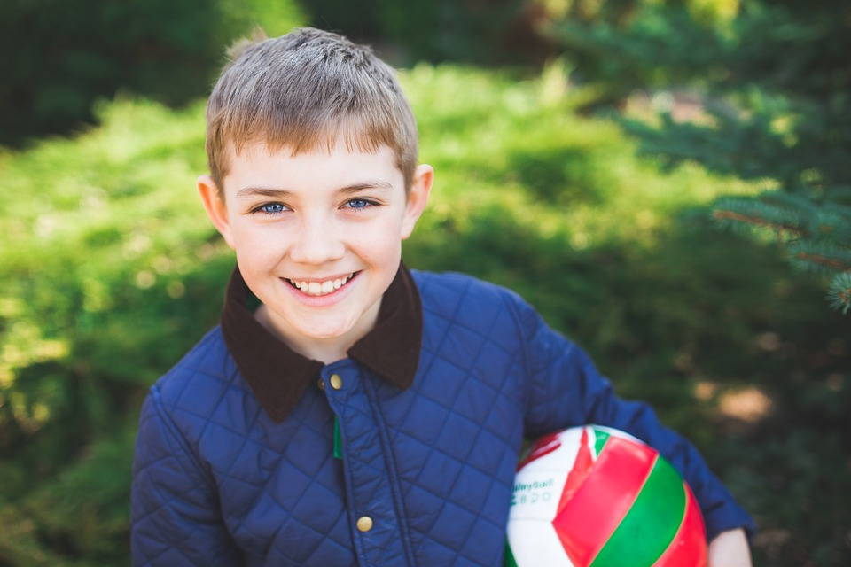
Can You Help Me?
After school, I love to go outside and play. Sometimes mom takes us to a playground. Other times, I play soccer with my neighborhood friends. Playing outside makes me feel good and gives me more energy. Today, I’m not sure what to do. Can you help think of fun activities for fitness and outdoor play that I can do?
https://www.youtube.com/watch?v=B_TwrjeJ6WA

Slide 5
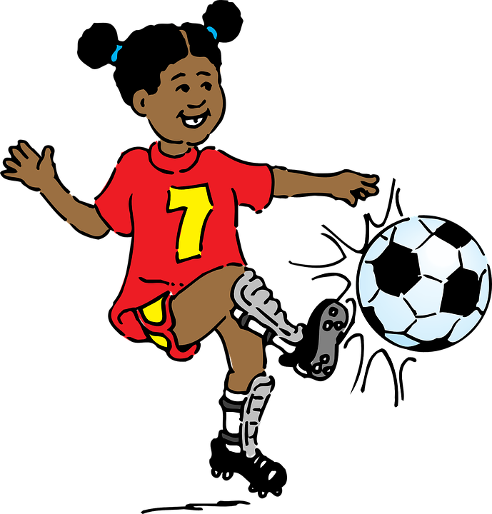
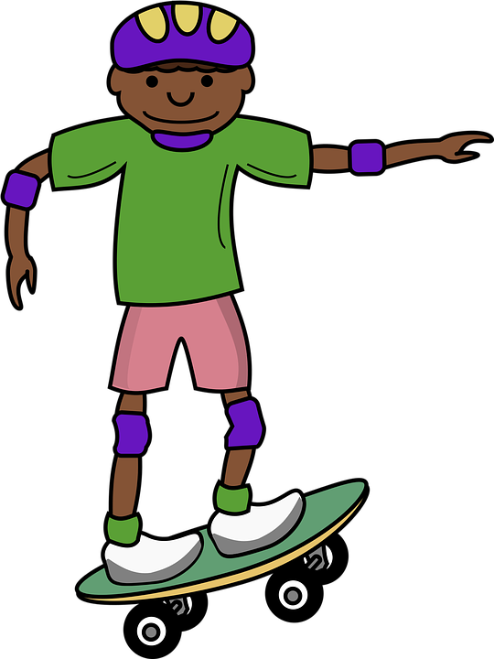
Physical Activity
What types of physical activity do you enjoy?
Why is exercise important?

Slide 6
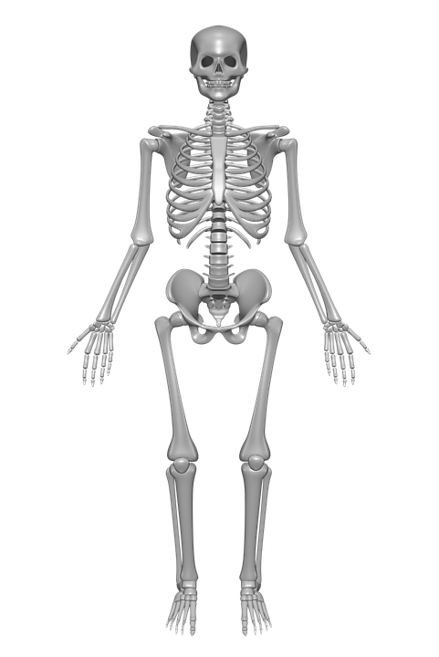
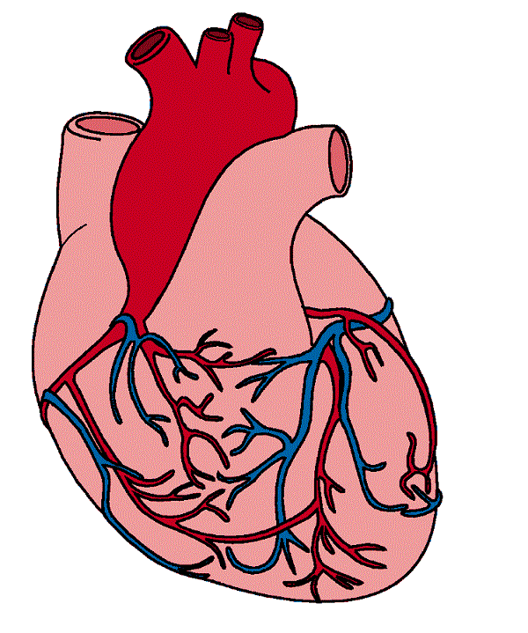
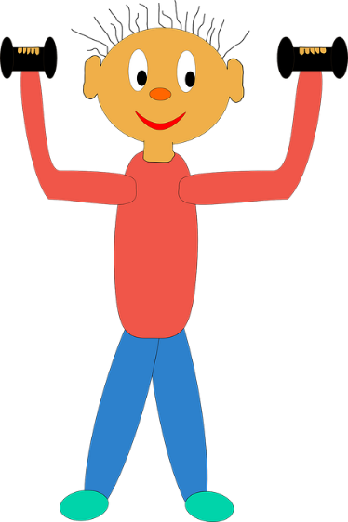
Benefits of Exercise
Watch the following video clip and think about what you like to do to stay physically fit.
https://www.youtube.com/watch?v=NbEeaBULvys
Gives you more energy
Strong bones
Healthy heart
Prevents future health problems
Creates happiness
Strong muscles

Slide 7
Hand Washing

Slide 8
What Should I do?
Hi. I’m Jones, and I love soccer, art, reading, and playing in my treehouse. Sometimes, I’m so busy playing that I think it is a pain to have to stop and go to the bathroom, but I do. As for hand washing, I think it is a waste of time. I would rather get back to playing.
I just finished using the bathroom. I made sure to blow my nose after sneezing twice into my hands. My friends are waiting for me outside. Should I skip hand washing or wash my hands?
What should I do?

Slide 9
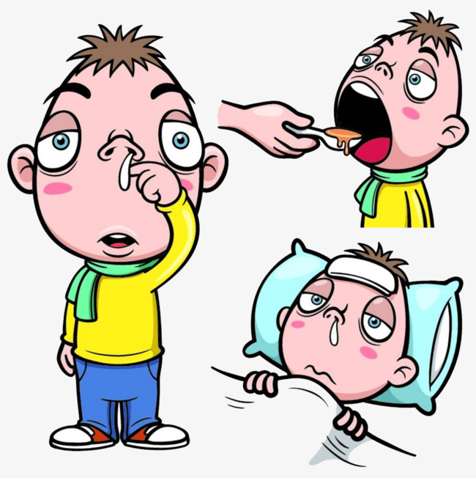
Wash Your Hands
Wash your hands before eating
Wash your hands before helping to cook food
Germs can cause sickness
Wash your hands after going to the bathroom
Wash your hands after sneezing or coughing
Wash your hands after playing outside

Slide 10
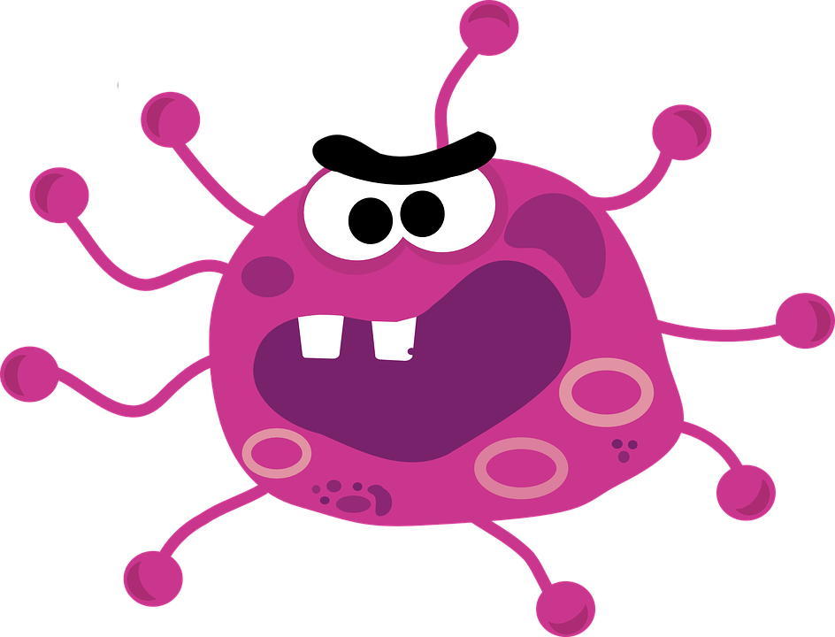
Steps to Hand Washing
https://www.youtube.com/watch?v=LQ24EfM7sEw

Slide 11
Let’s Practice
Turn on the water
Get your hands wet.
Put soap on your hands and make suds.
Rub. Rub your soapy hands together long enough to hum “Happy Birthday” twice. Clean your palms, the back of your hands, and between your fingers. Don’t forget to clean under your nails. Nails can trap dirt and germs.
Rinse. Hold your hands under clean, running water. Rub them to rinse them fully.
Shake and dry. Shake your hands a few time. Then dry them with a clean towel or hand dryer.

Slide 12
Brushing Teeth

Slide 13
What Should I do?
“Brush your teeth. Your teeth are going to turn black and fall out!” yells mom from inside the house. I’m already outside playing with my friends on this beautiful Saturday morning. My mom wants me to brush for two minutes. In my world that is forever. Today, I am eager to play outside so maybe I’ll just brush for a little bit, or maybe I should take my time and do it right.
What Should I do?

Slide 14
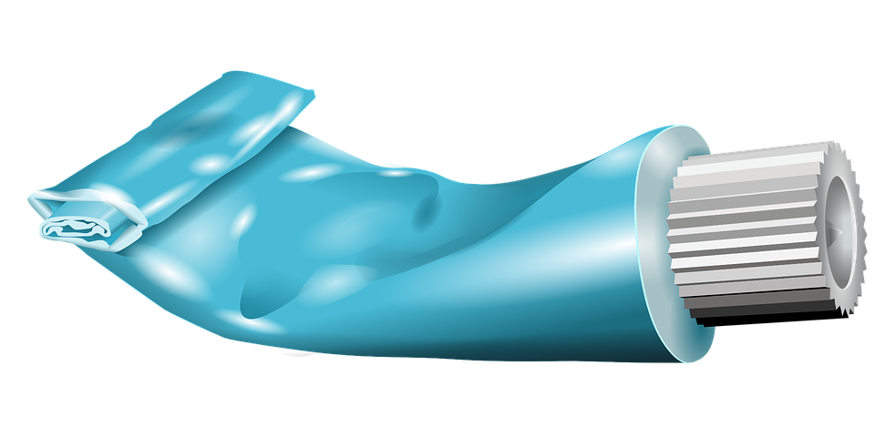
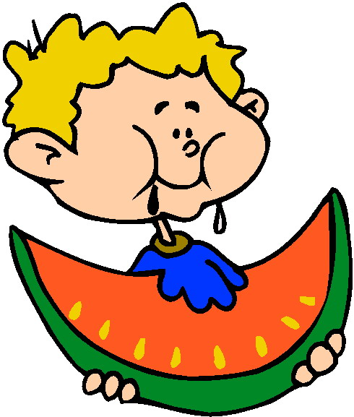
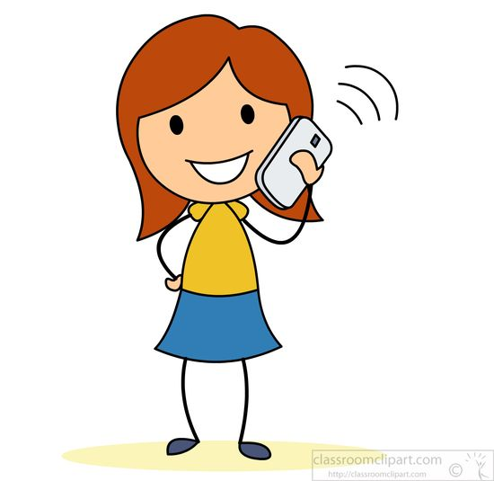
Brush Your Teeth
Teeth help us eat and talk.
https://www.youtube.com/watch?v=Jy8JurvYlH4

Slide 15
Good Sleep

Slide 16
What Should I do?
My older sister is having a friend over to spend the night. I’m going to try to stay up all night with them. However, I am getting a little tired…
What should I do?

Slide 17
Sleep
Allows the body to rest
Helps you grow
Gives you energy
Helps your brain work
https://www.youtube.com/watch?v=toNMe7gs7c0

Slide 18
Good Sleep
Ways to get good sleep:
Follow a bedtime routine
Do not watch TV, play video games, or use electronics prior to bed
Sleep in a dark, cool room
How do you calm down before bedtime?

Slide 19
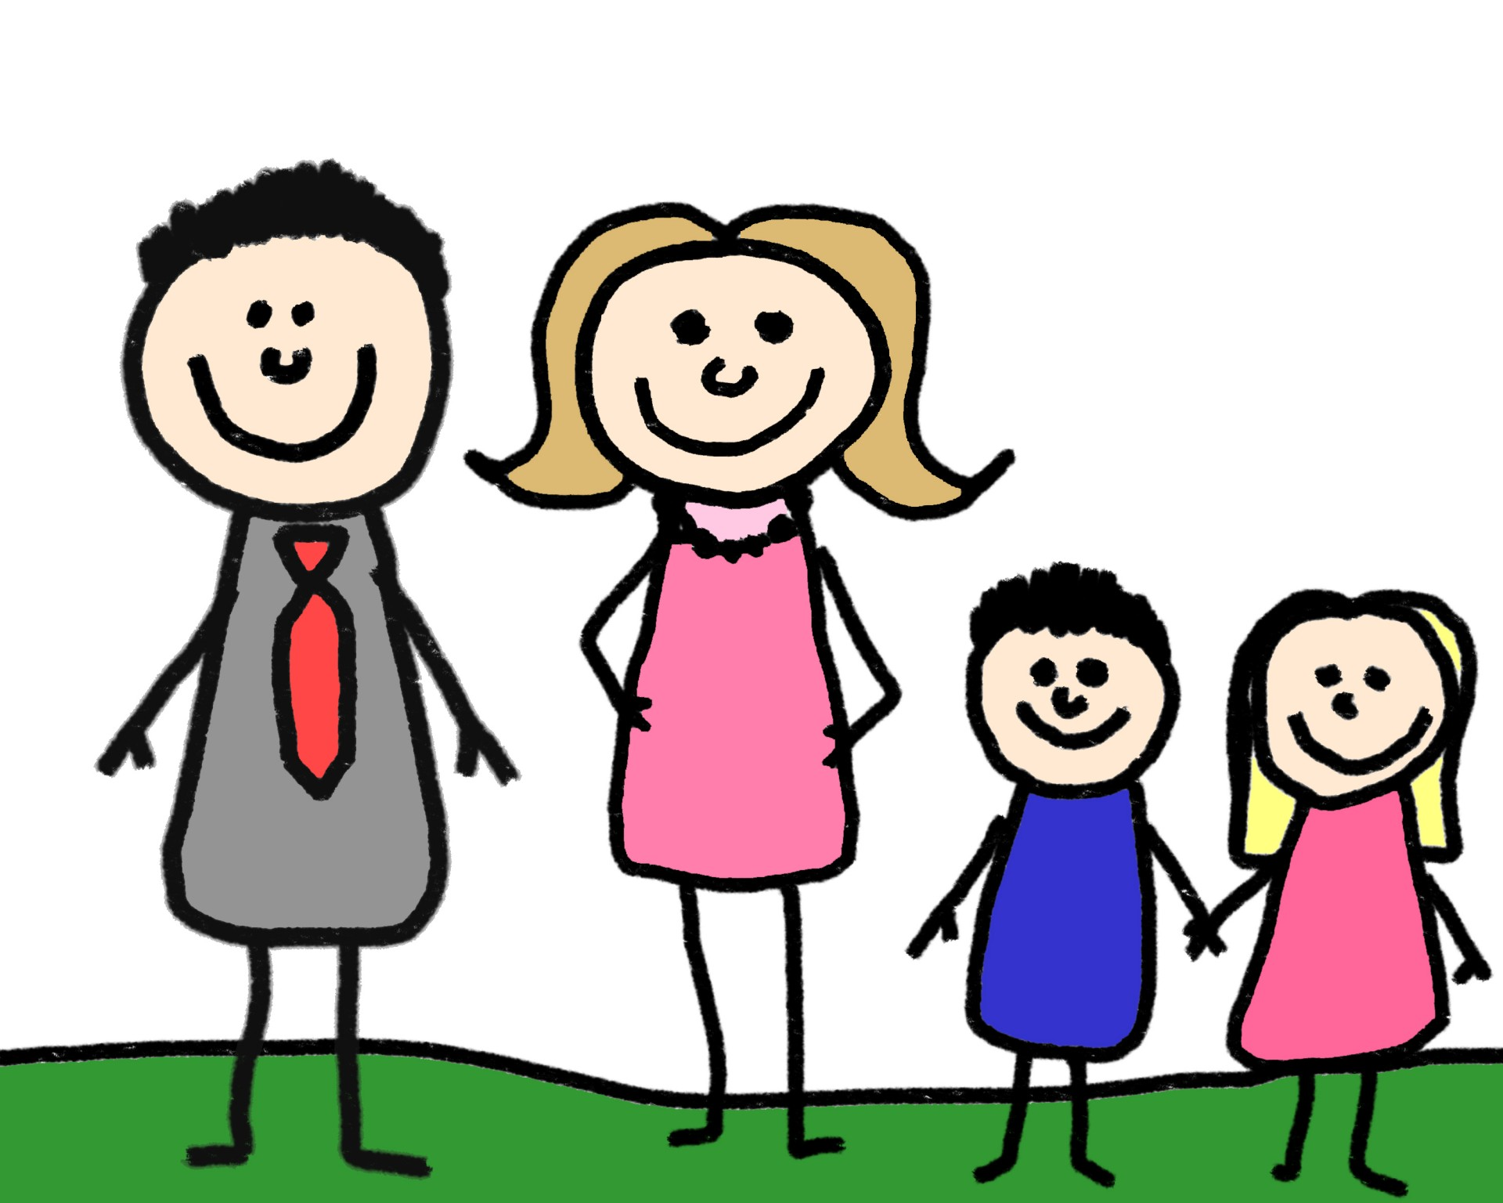
Let’s Review...
Eat Healthy Exercise Sleep Wash Hands Oral Care
Who can help you stay healthy?

Slide 20
Let’s Move!
https://www.youtube.com/watch?v=KpdRc9L97TY

Slide 21
The End
Take care of yourself & Others

