Slide 1
Understanding Gangs

Slide 2
Essential Questions:
Why do some young people join gangs?
What is the appeal?
What are the consequences of gang affiliation?

Slide 3
Class Reading:
10 Things you Didn’t know about gangs
Notes:
https://pullias.usc.edu/blog/10-things-didnt-know-gangs/

Slide 4
What is a Gang?
Virginia law defines a “criminal street gang” as any group, organization or association of three or more persons, whether formal or informal,
which has as one of its primary objectives or activities the commission of one or more criminal acts,
which has an identifiable name or identifying sign or symbol, and
whose members individually or collectively have engaged in the commission of, attempt to commit, conspiracy to commit, or solicitation of two or more predicate criminal acts, at least one of which is an act of violence. (Code of Virginia § 18.2-46.1)
(Code of Virginia § 18.2-46.1)
Notes:
https://virginiarules.org/virginia-rules/gangs
https://law.lis.virginia.gov/search_cov.aspx?query=gang

Slide 5
Why do some young people join gangs?

Slide 6
Notes:
http://www.lapdonline.org/top_ten_most_wanted_gang_members/content_basic_view/23473

Slide 7
Why Young People Join Gangs?
Identity or Recognition
Achieve a level of status the person feels impossible outside of gang culture.
Protection
Many members join because of the gang area they live. They join for protection from other rival gangs.
Fellowship and Brotherhood
Gangs function as extension of the family. Provides companionship lacking in the gang member’s home life. Many older brothers, relatives belong or have belonged to the gang.
Notes:
http://www.lapdonline.org/top_ten_most_wanted_gang_members/content_basic_view/23473

Slide 8
Why Young People Join Gangs?
Intimidation
Some members are forced to join to contribute to the gang’s criminal activity. Some join to intimidate others in the community that are not involved in gang activity.
Criminal Activity
Some join a gang to engage in narcotics activity and benefit from the group’s profits and protection.
Notes:
http://www.lapdonline.org/top_ten_most_wanted_gang_members/content_basic_view/23473

Slide 9
Consequences
Many youth who join gangs don’t understand the full dangers of gang involvement. Many parents/guardians are not aware of their child’s gang activity until it’s too late.

Slide 10
Consequences of Gang membership
For The Individual:
Less likely to get an education
Dropout
Less likely to find employment
Increase likeliness of becoming a teen parent
Drug Addiction
Death
Greater risk:
Arrest, Juvenile Court ,
Detention and/or Prison

Slide 11
Consequences of Gang membership
For the Family:
Lives in fear of their safety and lives
Lives in fear for their family member(s) safety that is involved in the gang
Financial consequences from the gang members behavior and actions

Slide 12
Gang Impact on
communities & Schools
Community residents live in fear of being victims of violence
Increase in criminal activity
Increase in sex trafficking
In schools there is a strong correlation between gang presence, guns and drug availability
Notes:
https://www.dcjs.virginia.gov/victims-services/human-trafficking

Slide 13
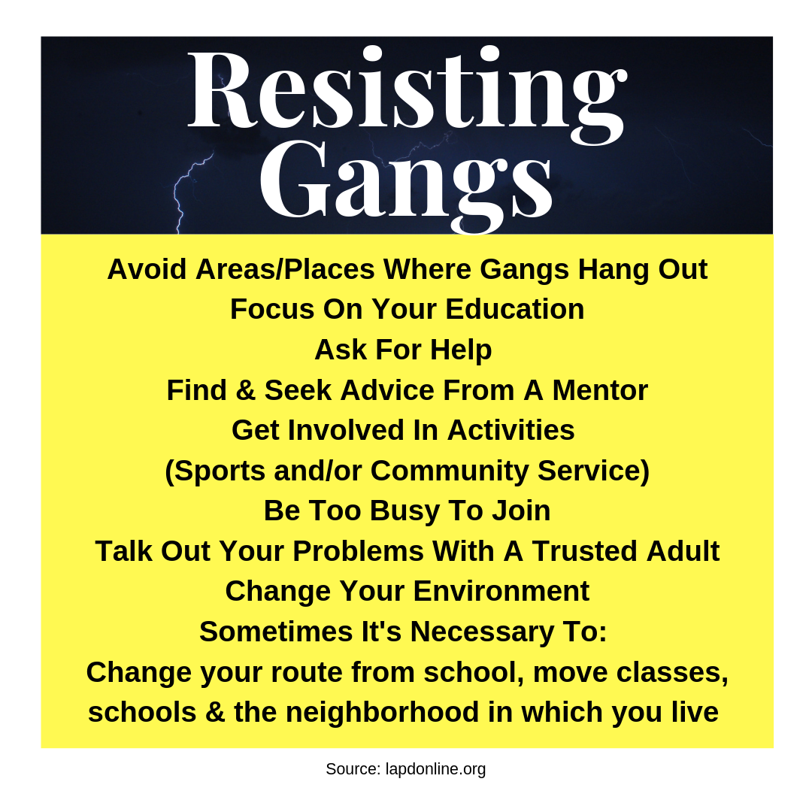

Slide 14
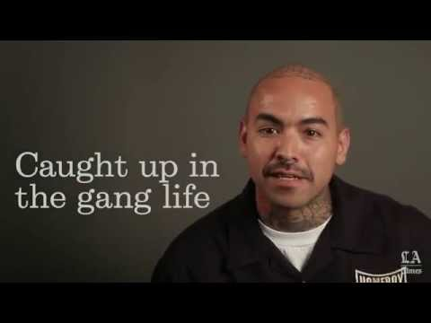
A HomeBoy’s Guide to healing former L.a. gang members
Notes:
2:08 mins

Slide 15
Test Your Knowledge
Notes:
https://create.kahoot.it/share/understanding-gangs/6ce2acb7-be28-4b21-917b-ea2fb7131710

