Slide 1
The Health Triangle
Health is the measure of our body’s efficiency and overall well-being.
The health triangle is a measure of the different aspects of health.
The health triangle consists of: Physical, Social, and Mental Health.

Slide 2

The Health Triangle Review
There are 3 major areas of the health triangle: physical, mental and social.
Good decision making and healthy choices reduce the risk of disease and increase health overall.

Slide 3

Physical Health
Physical health deals with the body’s ability to function.
Physical health has many components including: exercise, nutrition, sleep, alcohol & drugs, and weight management.

Slide 4
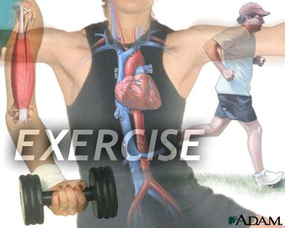
Physical Health
Exercise
Exercise is the act of using your muscles to stay physically fit.
Exercise helps to give you more energy, maintain weight, increase confidence & self esteem, and helps to battle chronic diseases.

Slide 5
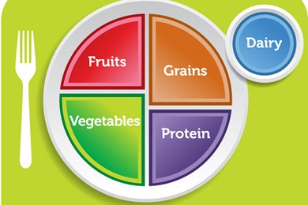
Physical Health
Nutrition
Proper balanced meals are essential in leading a healthy life.
Nutritious meals create a balance between what we eat and the way our body uses the food for energy and growth.

Slide 6

Physical Health
Sleep
It is recommended that the average person get at least 8 hours of sleep.
The human body likes regularity, so try to go to bed and wake up at the same time daily.

Slide 7
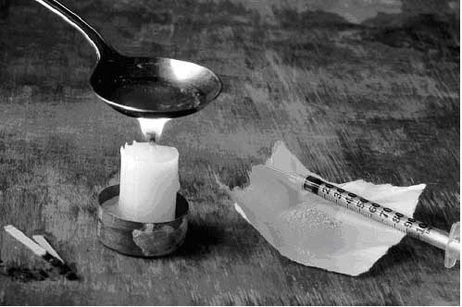
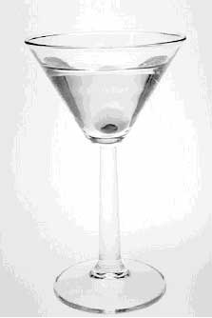
Physical Health
Alcohol & Drugs
Alcohol and other drugs interfere with messages to the brain and alters perception.
Use of such substances puts you at risk for accidental injuries, car crashes, trouble with the law, unwanted pregnancies, and fights.

Slide 8
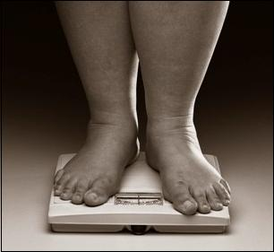
Physical Health
Weight Management
Maintaining a healthy weight decreases your risk of certain diseases such as heart disease and diabetes.
Exercise and proper nutrition helps to maintain healthy weight levels.

Slide 9
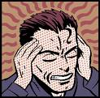
Mental Health
Mental health deals with how we think, feel and cope with daily life.
Mental health encompasses learning, stress management, and mental illnesses or disorders.

Slide 10

Mental Health
Learning
Learning is the development of skills, behaviors, and knowledge.
Learning increases self-confidence, awareness, and self perception. It also teaches one coping skills.

Slide 11
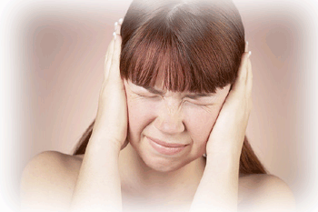
Mental Health
Stress Management
Stress deals with the way our bodies and minds deal with life changes.
It is important to learn healthy ways to deal with stress or you could be at risk for anxiety or depression.

Slide 12

Mental Health
Mental Disorders
Stress and problems with school, friends, and family can cause mental illnesses.
Mental illnesses include: depression, bipolar disorder, schizophrenia, and phobias.

Slide 13

Social Health
Social Health deals with the way react with people within our environment.
This includes: public health, family relationships, and peer relationships.

Slide 14

Social Health
Family Relationships
A healthy family relationship is one that is supportive, loving, responsible, and balanced.
Families should work together to eliminate stress and negativity in the home. Promoting a safe and enjoyable environment.

Slide 15

Social Health
Peer Relationships
Strong and supportive friendships increase happiness, self-esteem, and reduces stress.
Friends are there to help celebrate your accomplishments and there to offer support in times of need.

Slide 16
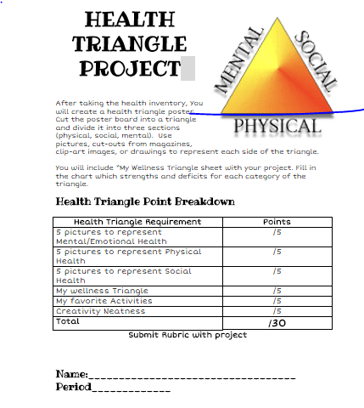
Put your name on this immediately.

Slide 17
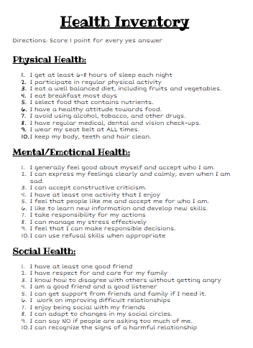
Add up the yes scores and circle your score to the left

Slide 18
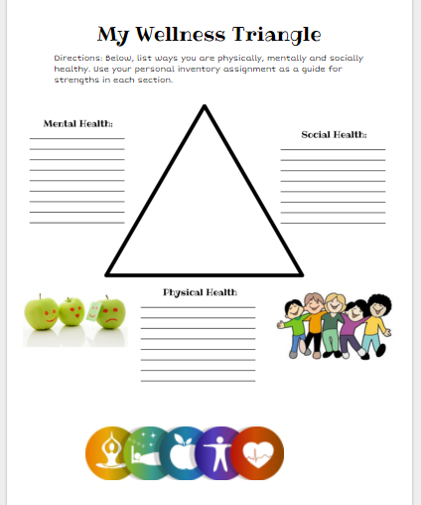
Summarize all of the yes answers from the previous page.

Slide 19
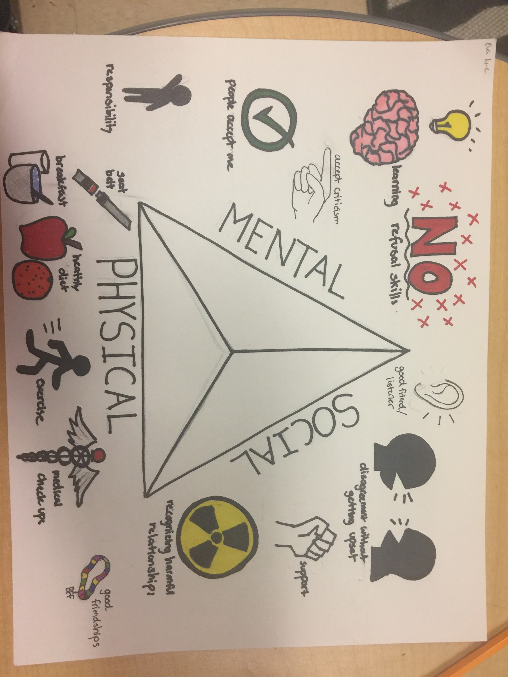
Now create your triangle. Place 4-5 items on each side.

Slide 20
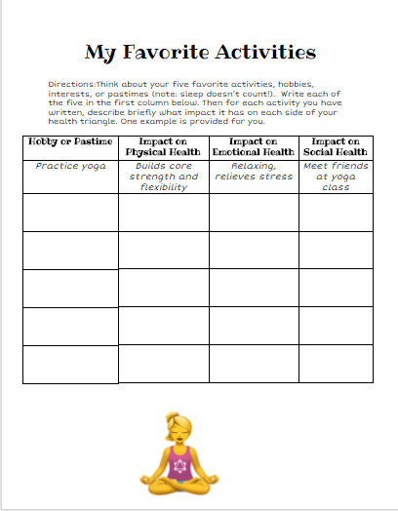
Do this after you finish your triangle.

Slide 21

Reflection

