Slide 1
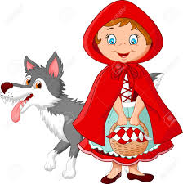
Misunderstood
In the
Hood

Slide 2
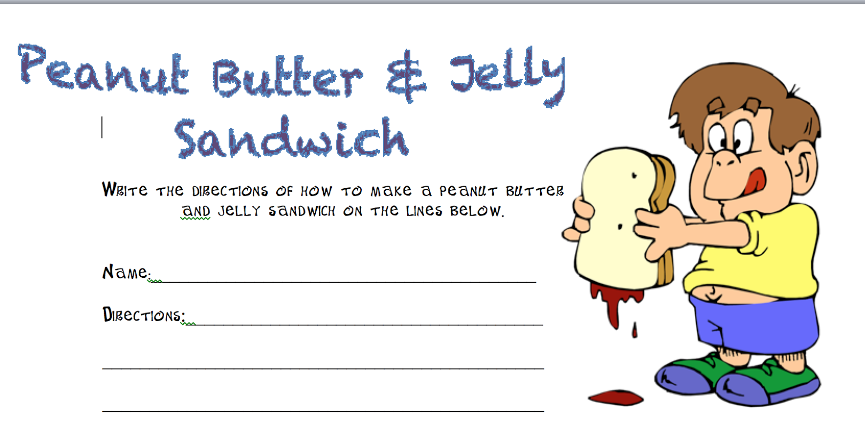
Alien Recipe
Notes:
Explain to the students that an Alien has landed on our planet and now they also need calories to survive on Earth. They have never cooked before nor seen someone cook. They were told that making a Peanut Butter and Jelly sandwich would be the easiest thing to learn how to make. Have each student write down the directions. Teacher will now have a volunteer to read the directions as the teacher makes the sandwich. NOTE: follow the directions exactly. If the directions say to put peanut butter on your knife, but does not say to open the jar and place the knife in the peanut butter, balance the jar of peanut butter on your knife. You may hear comments such is “You know what I meant”. Teacher replies, “Yes, but that is not what you wrote”. Discuss the importance of proper communication and checking for understanding when someone speaks.

Slide 3
Communication
Notes:
Essential Questions:
Why is communication so important?
Why do people have such a hard time communicating sometimes?

Slide 4
Step 1
Clarify what the disagreement is

Slide 5
Step 2
Establish a common goal for both parties

Slide 6
Step 3
Discuss ways to meet the common goal

Slide 7
Step 4
Determine the barriers to the common goal

Slide 8
Step 5
Agree on the best way to resolve the conflict

Slide 9
Step 6
Acknowledge the agreed upon solution and determine the responsibilities each party has in the resolution.

Slide 10
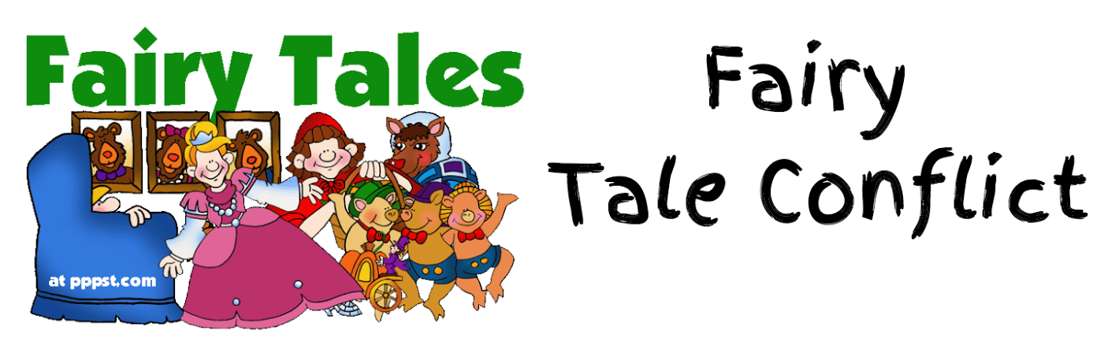
Conflicts

Slide 11
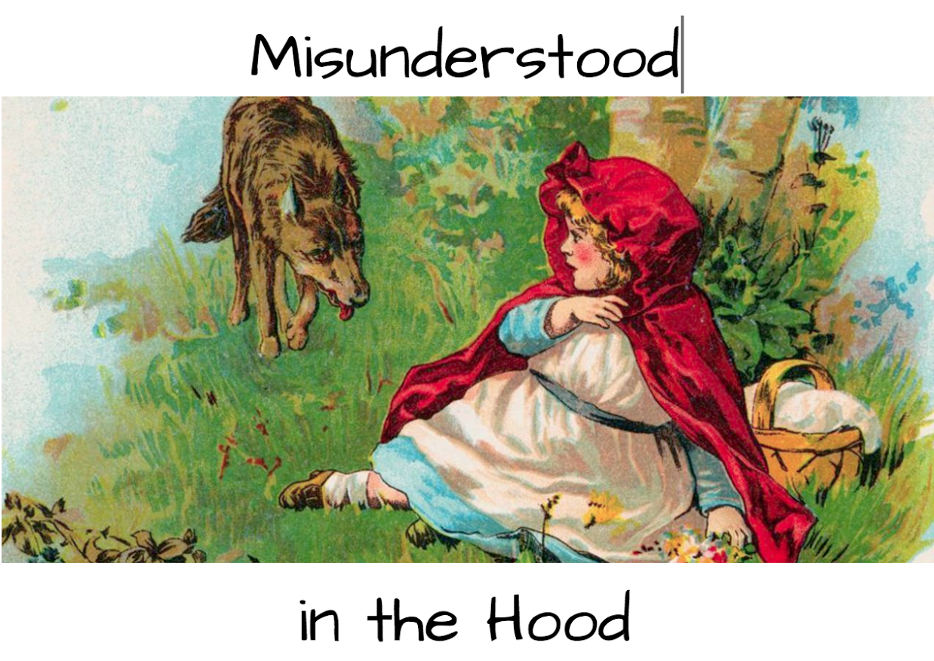
Conflicts

Slide 12
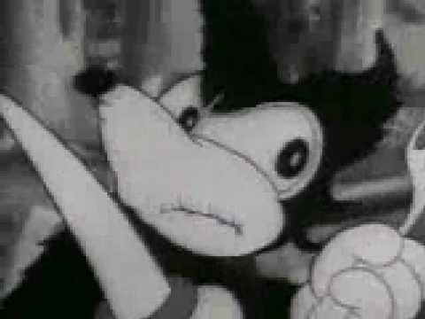
Little Red riding Hood

