Slide 1
Analyze & DECIDE
Against Violence

Slide 2
Instant Activity - Journal Prompt
Think about any instances of violence (school or home) that have occured in your community? How safe and comfortable do you feel at your school? In your neighborhood? How did these instances affect your feelings of safety and comfort?

Slide 3
Instant Activity - Journal Prompt
After you reflect on the questions, make a chart such as the one below and come up with some ideas.
Factors that Make Me Feel Safe | Factors that Make Me Feel Unsafe

Slide 4
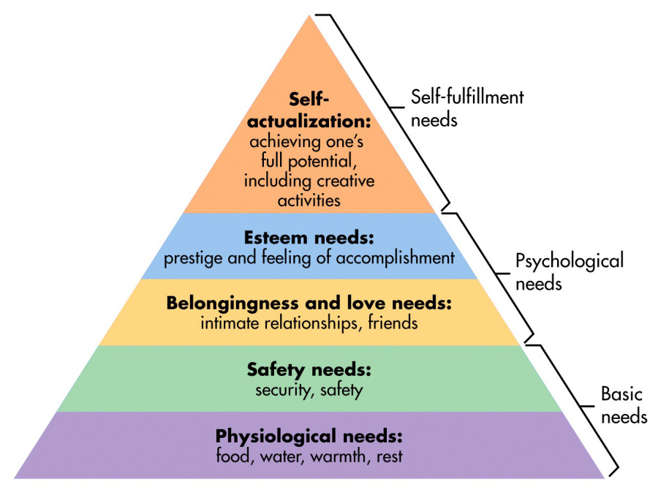
Maslow’s Hierarchy of Needs
Notes:
Talk about how safety is a basic need that we need to have as human beings. Safety needs - protection from elements, security, order, law, stability, freedom from fear.

Slide 5
Violence Risk Factors
It is hard to predict what might lead one person to engage in an act of violence. Factors about the person and factors about the person’s environment or situation can have an impact and lead to violence.

Slide 6
Mental or Emotional State
Feeling frustrated is one factor that can lead a person to behave violently.
Sometimes aggression may seem like the easiest way to release pent-up anger.
Hurting someone else is never acceptable.

Slide 7
Personal Gain
Some people use violence to get what they want or retaliate against someone else.
People who use violence behavior may receive punishment from parents, their school, or even police.
Injury might also be a result of this type of behavior

Slide 8
Exposure to Violence
Children witnessing parents’ behavior are more likely to behave violently
People who have been bullied are more likely to bully others.
Exposure to violence in their neighborhood or media can also lead to aggression and violent behavior

Slide 9
Alcohol and Drug Use
Impairs people’s ability to use good judgement and consider consequences of their actions.
Many victims of violence report their attacker was under the influence of alcohol.

Slide 10
Availability of a Weapon
Research shows that that having access to a weapon increases a person’s risk of behaving violently.
Owner’s of a weapon should keep them unloaded and locked in a cabinet.
If you know of anyone who carries a gun or brings a weapon to school, tell a trusted adult.

