Slide 1
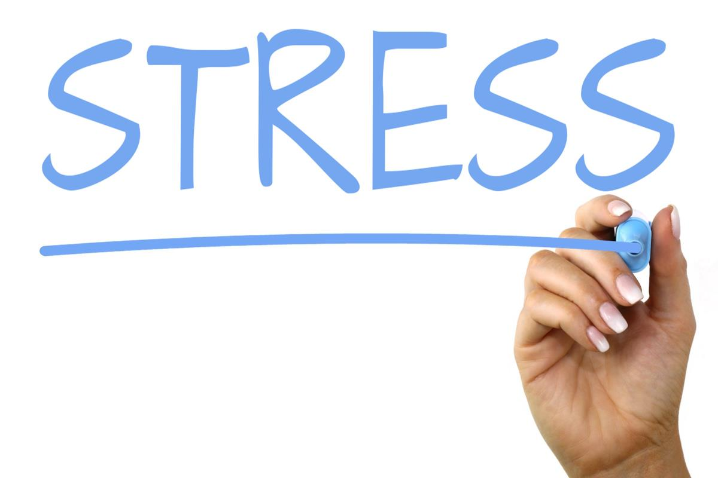
So Stressed!
Now Stress Less!

Slide 2
Instant Activity - Please think about these two questions when you walk into class.
What are 5 things that stress you out the most?
2. What are some things you try to do to cope with your stress?

Slide 3
On a scale of 1-10
(1 = low stress & 10 = high stress)
Stand and hold up the number on your hand(s) that corresponds to your stress level as a student

Slide 4
Stand and mime one of your go to “more healthy” coping strategies
to deal with stress
Try to guess what a couple people are miming near you

Slide 5
Types of Stress
Can you think of any “good” types of stress?
This is called a “Eustress”
Can you think of any “bad” types of stress?
This is called a “Distress”

Slide 6


Slide 7
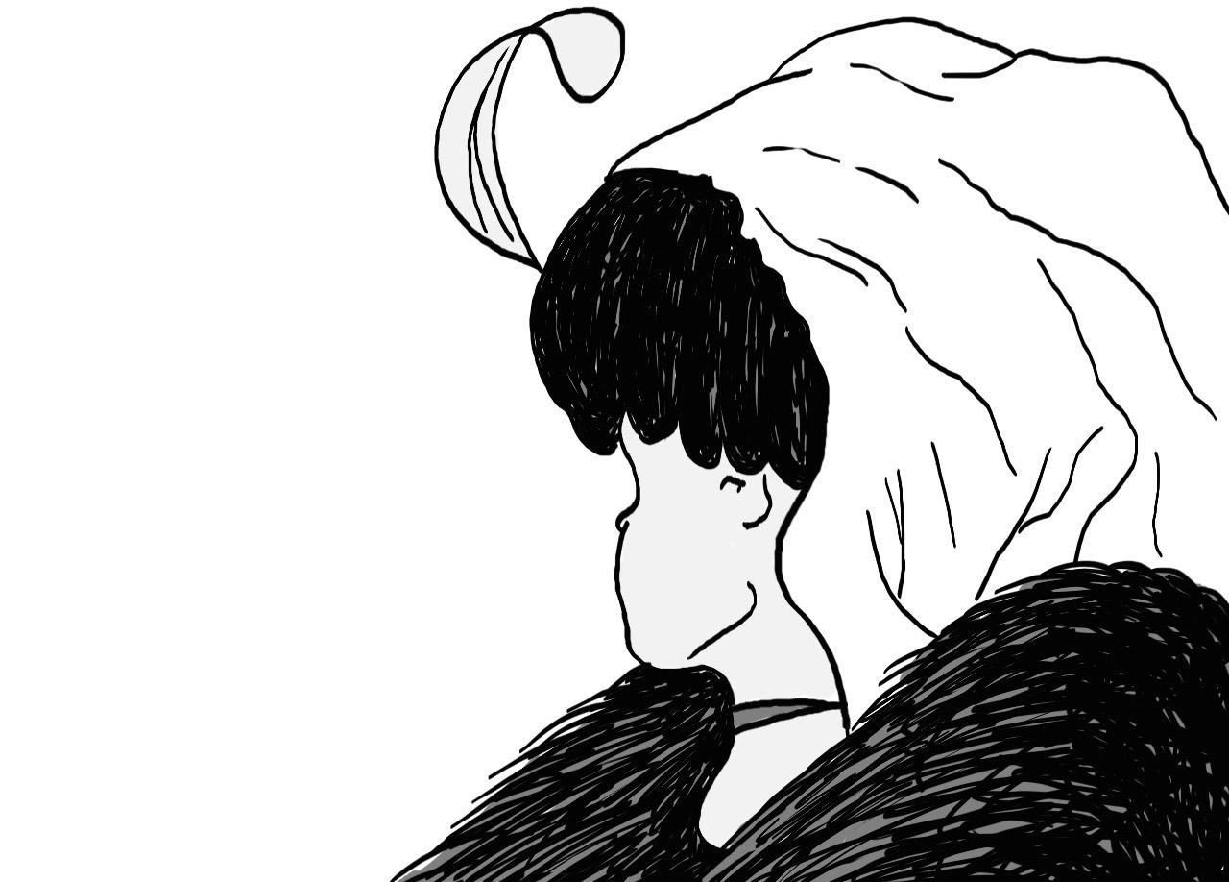

Slide 8

The stress system is a complex, sophisticated, and carefully regulated adaptation that has been shaped by natural selection because it gives a selective advantage.
Notes:
Emphasize that stress is functional, and that the same stress response in businessmen was in hunters and gatherers. Stress response is the same but stressors are different.

Slide 9
The Stress Response - Flight or Fight
Autonomic Nervous System: Action within the central nervous system that is “reflexive.”
Sympathetic Nervous System (stimulates our body)
Parasympathetic Nervous System (calms our body)

Slide 10
The Stress Response - Flight or Fight
Alarm Stage - The sympathetic nervous system takes on an active role in this stage
Resistance Stage - Needs to be a healthy balance between sympathetic and parasympathetic. These 2 systems are constantly active, thus constantly trying to maintain balance.
Exhaustion Stage - Energy is depleted, body returns to normal if stress is removed. Body returns to alarm stage if stress is not removed

Slide 11
Stress & the Body - Flight or Fight Response
What do you physically feel when your body is stressed? What physical sensations happen in your body?
Increased Heart Rate Increased Breathing Rate
Sweaty Palms Butterflies in Stomach
Sweating Pupils Dilate
Increased Blood Pressure Increased Stress Hormones
Notes:
The sympathetic nervous system takes over in the Alarm Stage

Slide 12
Stress & the Body - Flight or Fight Response
What do you emotionally feel when your body is stressed? What feelings might one have when stressed?
Anger Frustration Scared
Sad Worried Lonely
Guilty Anxious Agitated

Slide 13
Stress & Behavior - Flight or Fight Response
How might one act or behave when stressed? What might you see from someone who is stressed?
Arguing Fighting Crying
Hurting self Yelling Pushing
Violence Acting out

Slide 14
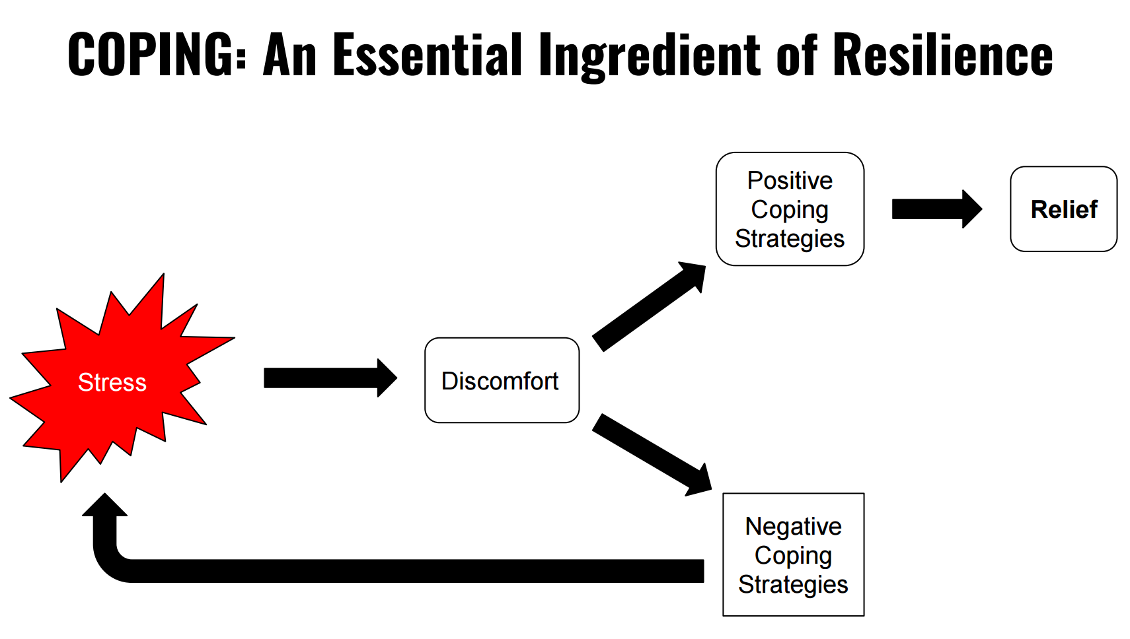
Source: Guiding Adolescents, Ginsburg & Kinsman

Slide 15
Stress & Coping - Relieving the Tension
What are some healthy coping strategies someone can use to effectively deal with stress?
Exercise/Sports Manage time Talk to others
Cry Music Deep breathing
Writing/journaling Drawing Walking

Slide 16
Stress & Coping at Our School
Can you think of any stress-coping services at our school? In other words, where could you get help if you felt stressed. List some of them.

Slide 17
Stress Reduction Plan for Teens
Tackling the Problem
  Identify & then address the problem
  Avoid stress when possible
  Let some things go
Taking Care of My Body
  The power of exercise
  Active relaxation (Mindfulness)
  Eat well
  Sleep well
3. Dealing With Emotions
  Take instant vacations
  (hobbies, read, music)
  Release emotional tension
  (talking to someone, creativity, journaling, meditation, crying, laughing)
4. Making the World Better
Contribution makes us feel better
Teens who serve feel more gratitude
Source: Guiding Adolescents, Ginsburg & Kinsman

Slide 18
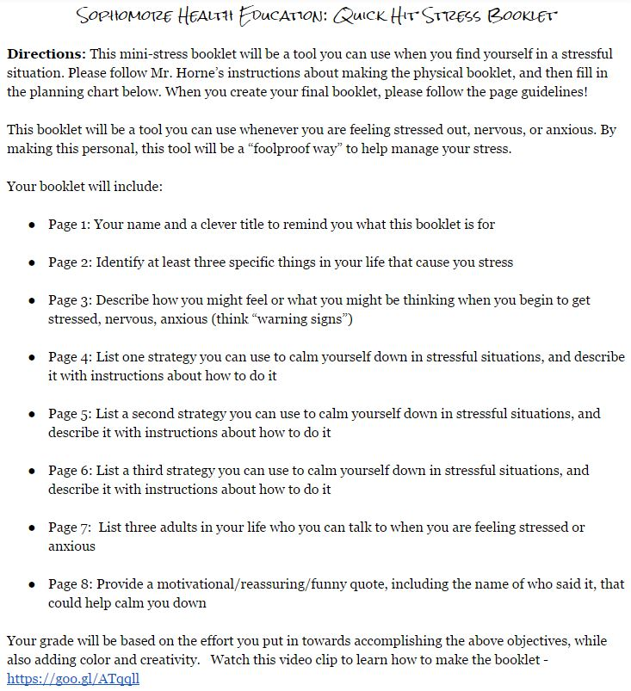
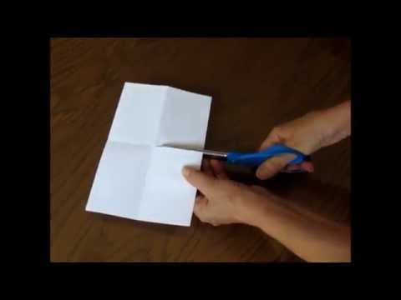
Quick Hit
Stress Booklet
Watch the video to learn how to make the booklet

Slide 19


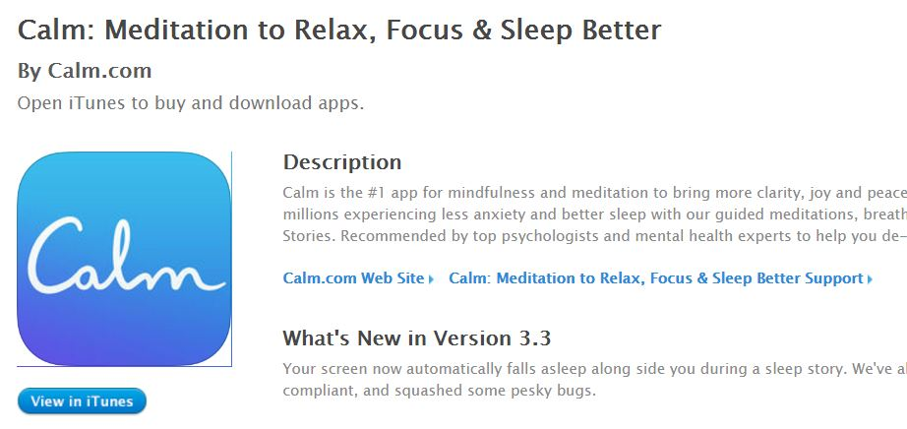
Resources

Slide 20
BONUS Materials & Activities

Slide 21


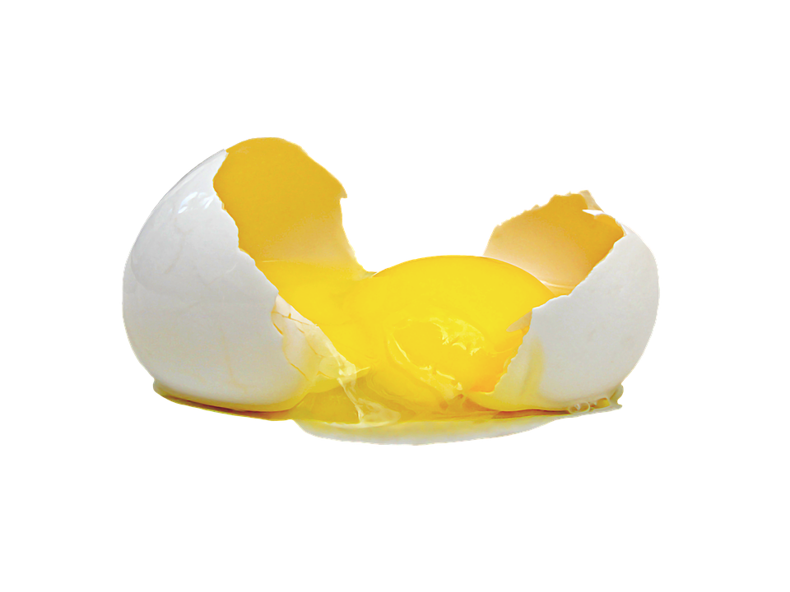
Carrot, Egg, or Tea?
Notes:
Read this story about the Carrot, Egg, or Tea and see which one students identify the most. There is a great message to this story as it pertains to stress. See Story HERE - http://www.wyos.biz/docs/Carrots,_Eggs_or_Tea.pdf

Slide 22


Slide 23
Agree
Disagree
Teens are more stressed now than when my parents were teens
Social media is a source of stress for me
I am very good at dealing with or coping with stress in my life
School causes me stress
The future (life beyond high school) causes me stress
My social life causes me stress
My current state of stress has a negative impact on my health and well being
Our school should do more to help us cope and/or lower our stress levels
Notes:
You could have students do an agree/disagree activity by having them walk to one side of the room depending on how they feel.

