Slide 1
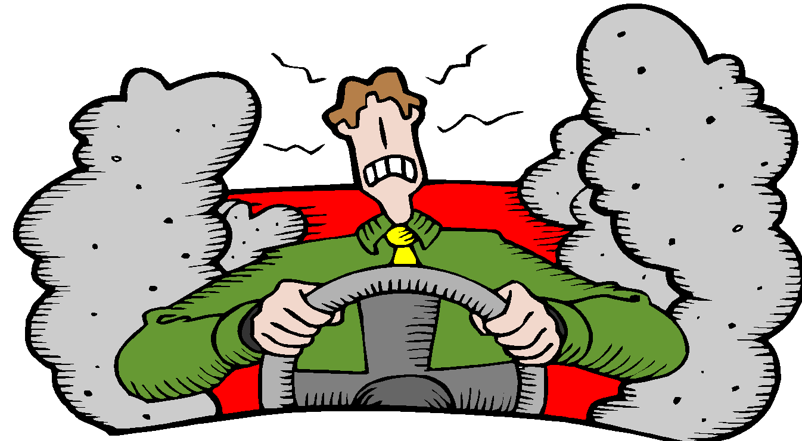
Stress Management

Slide 2
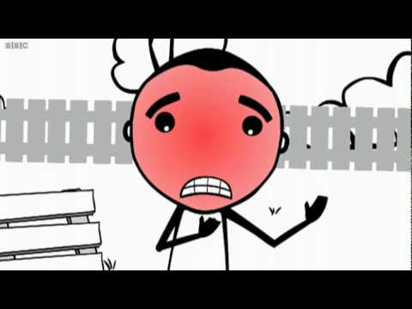
Stress Video from BBC
https://www.youtube.com/watch?v=hnpQrMqDoqE

Slide 3
Trouble Tree
Bell Ringer:
Read the poem, Trouble Tree and Answer the Questions about the Poem.
Be ready to Share out

Slide 4
What is Stress?
The term “stress” actually refers to the body’s reactions to any demand placed upon it.
Stress can be good and bad.

Slide 5
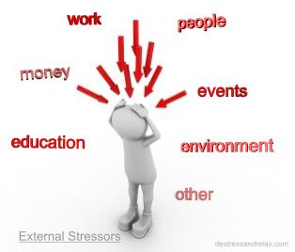
What is a stressor?
Any factor that causes stress
Examples: body image, money, friends, family, school

Slide 6
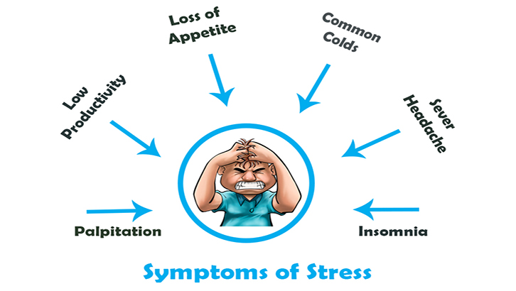
Stress Check

Slide 7
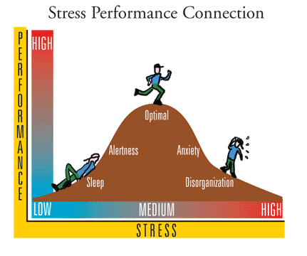

Slide 8
Eustress
Good stress
Is stress that provides a welcome challenge

Slide 9
Distress
Bad stress
Is stress that is perceived as negative

Slide 10
Perception
A meaning given to an event or occurrence based on a person’s previous experience or understanding. Threatening or non-threatening.

Slide 11
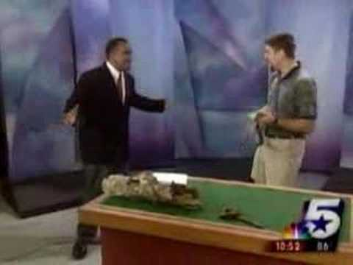
Prception

Slide 12
Parachute

Slide 13
When we are overwhelmed, we all need to remember that we are never alone.

Slide 14
Step 1. List 5 people who always have your back and you feel comfortable telling your problems

Slide 15
Step 2. List 4 resources that you could use if your problems are more serious

Slide 16
Step 3. List 10 chronic stressors that continue to cause you ongoing, prolonged levels of stress

Slide 17
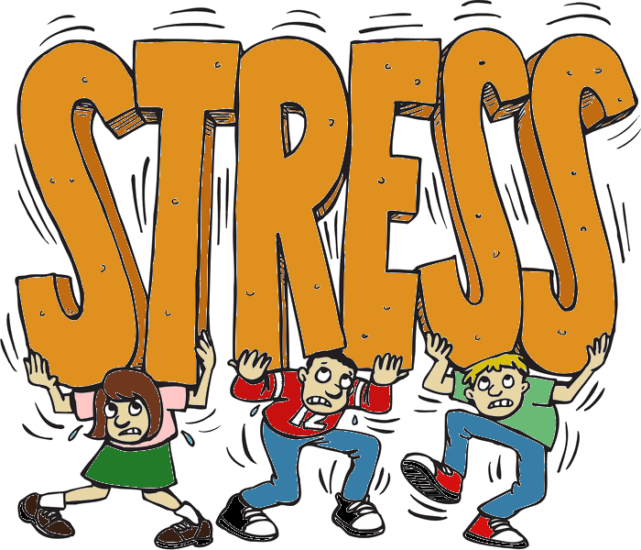
Now that you have brainstormed what is causing you stress and your resources, create a visual representation of both.

Slide 18
Remember, we are never alone.

Slide 19
Student Samples

Slide 20
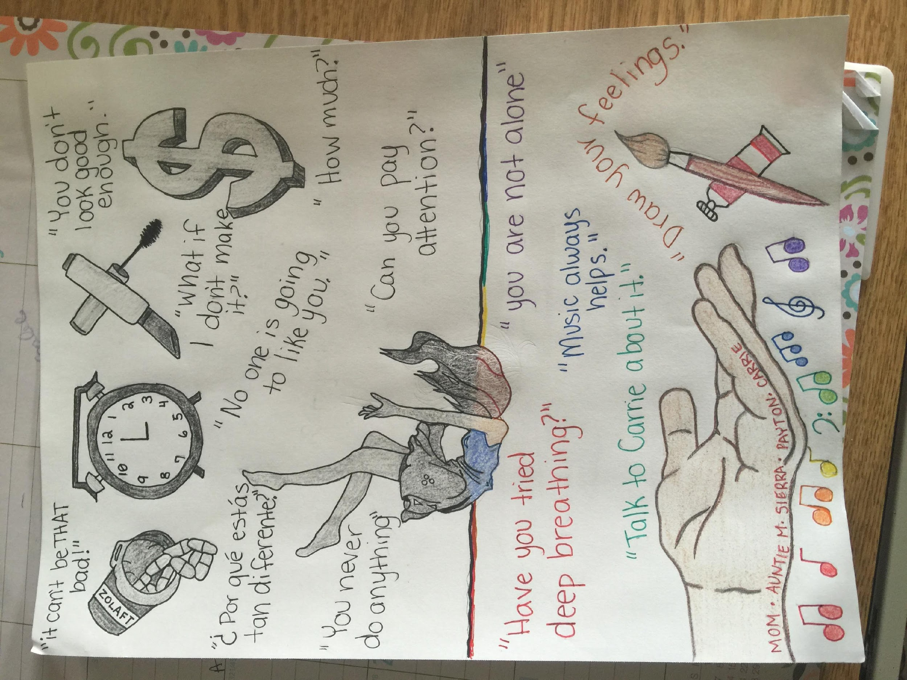

Slide 21
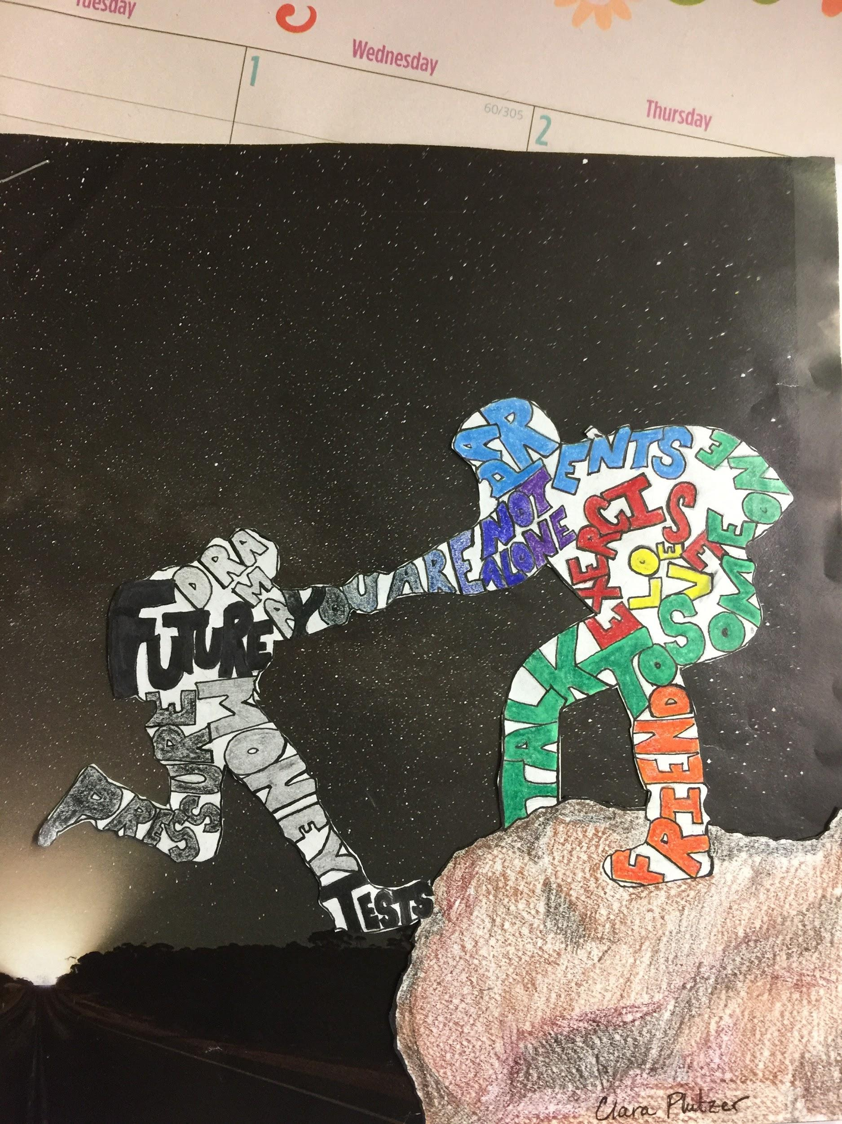

Slide 22
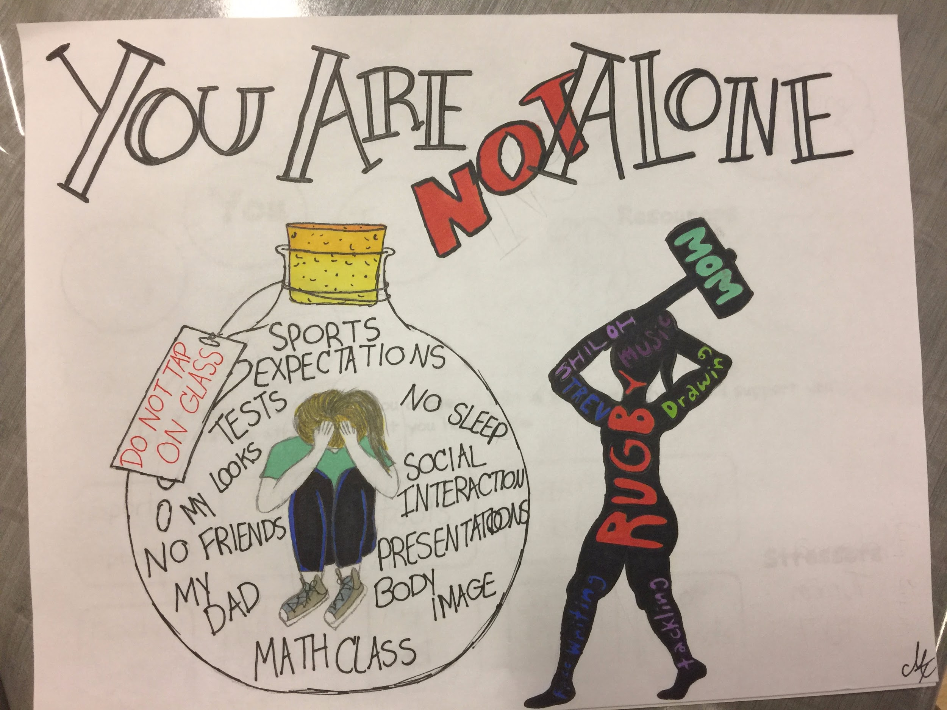

Slide 23
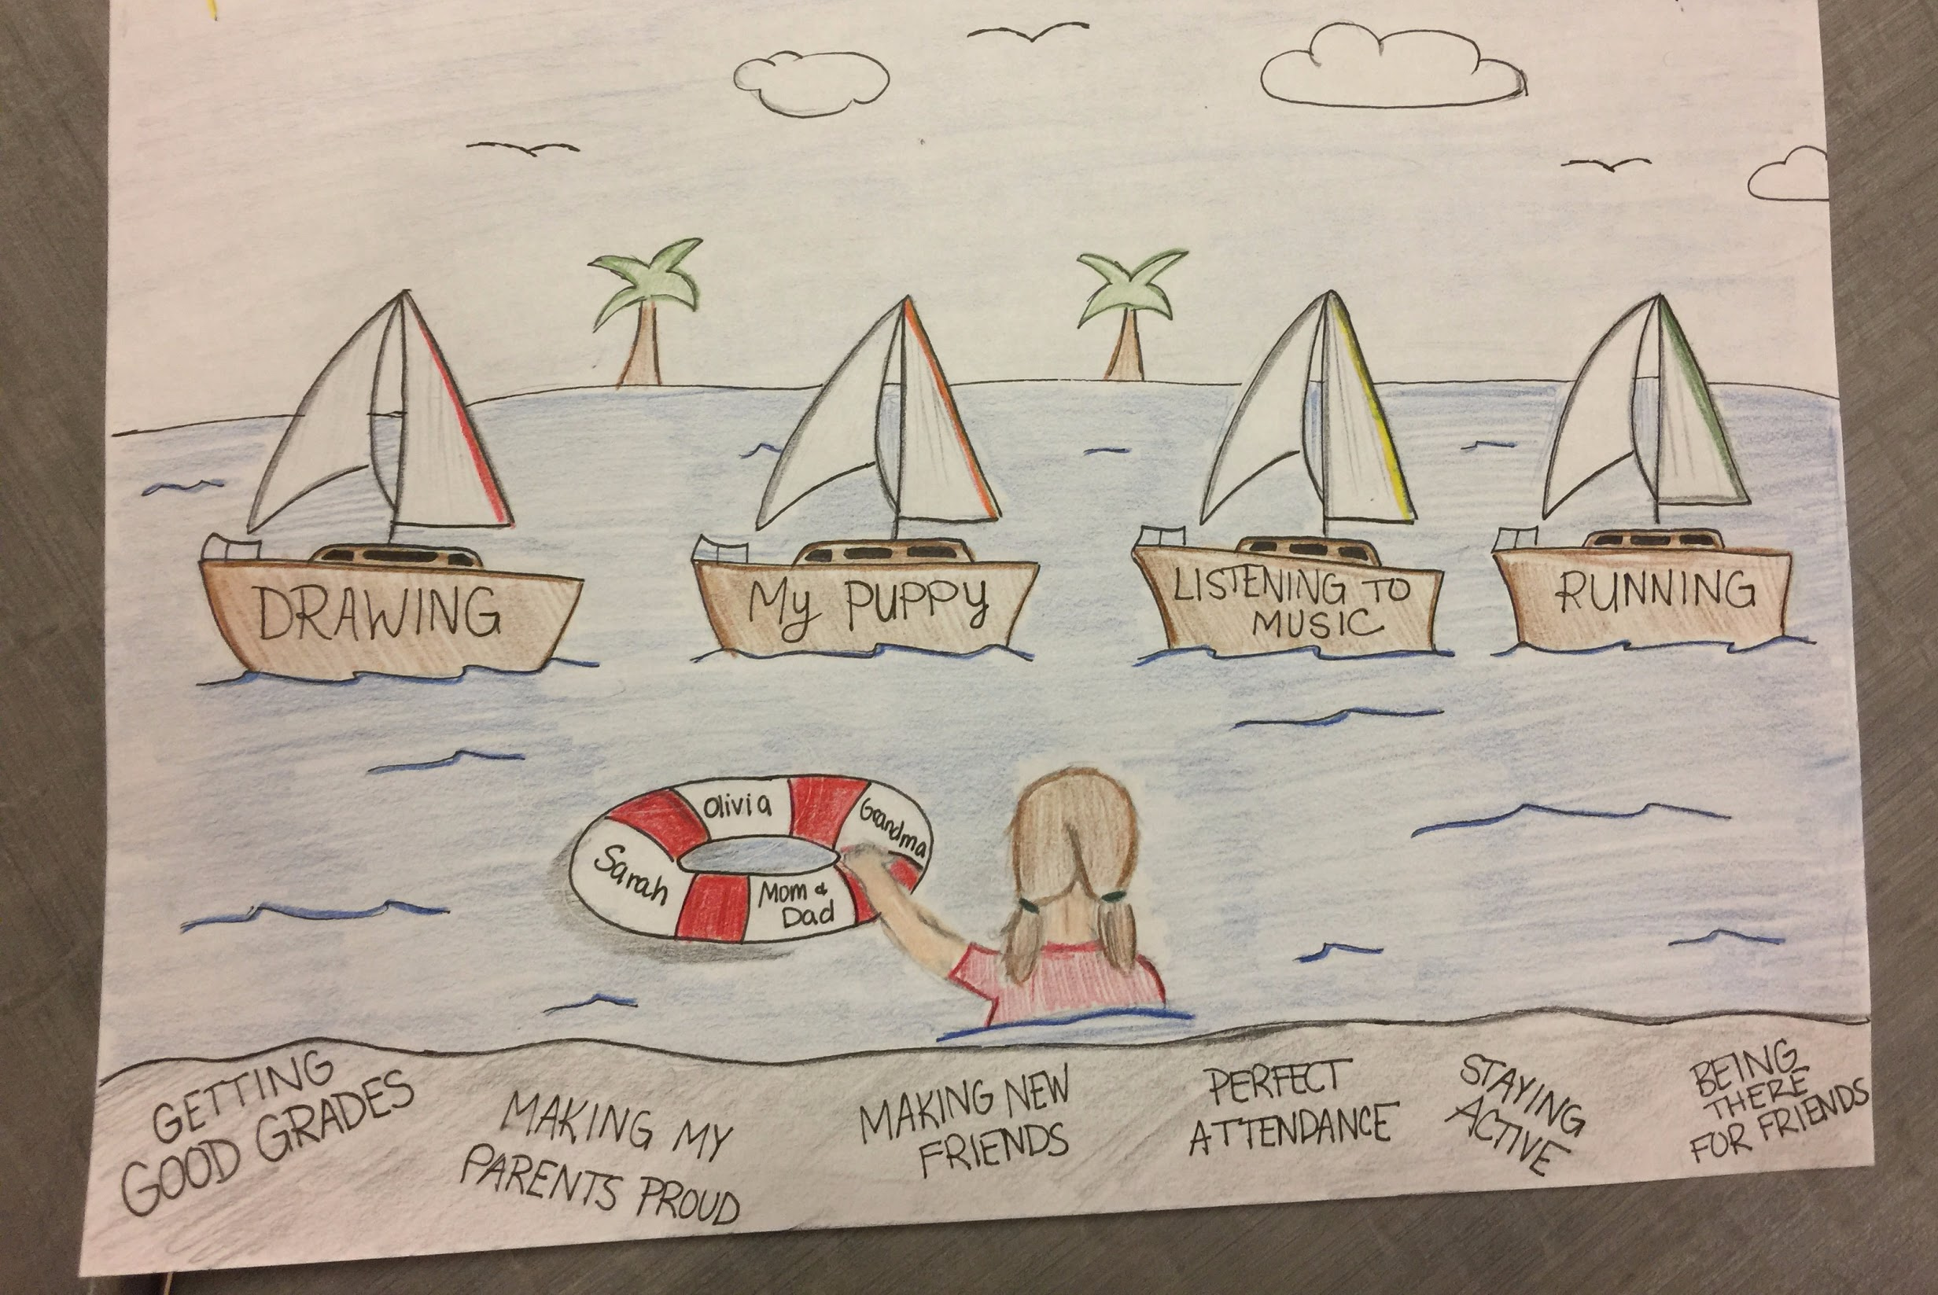

Slide 24
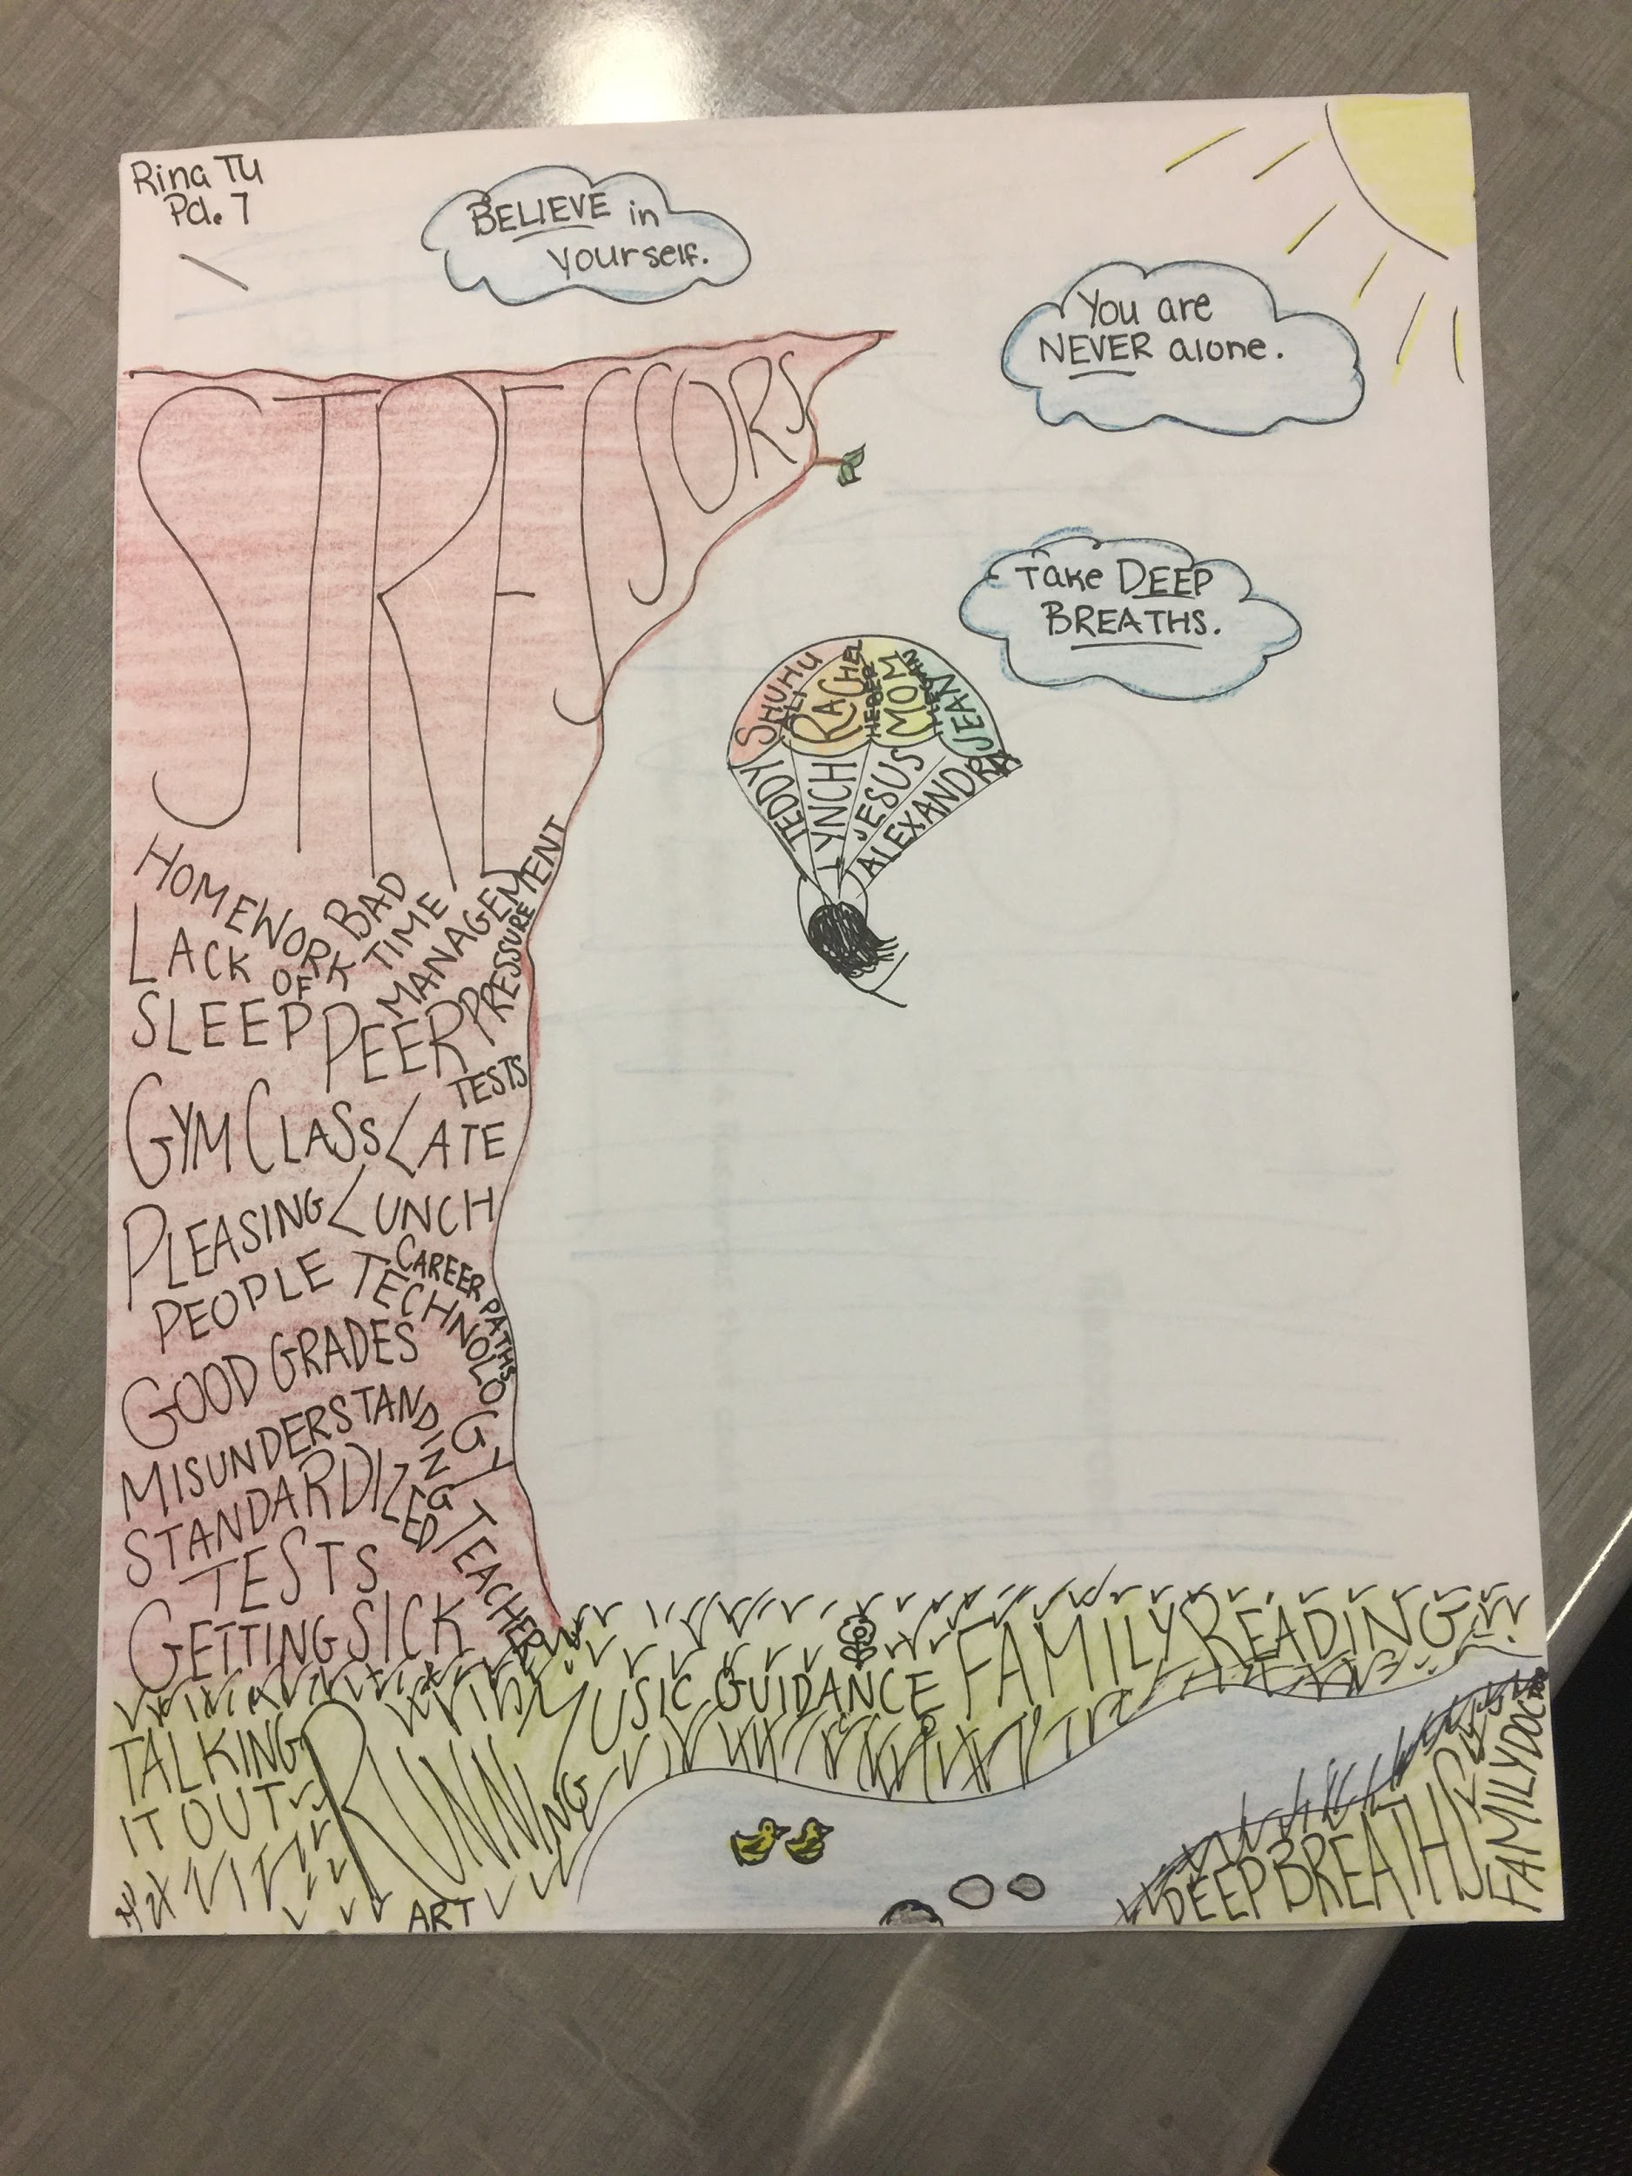

Slide 25
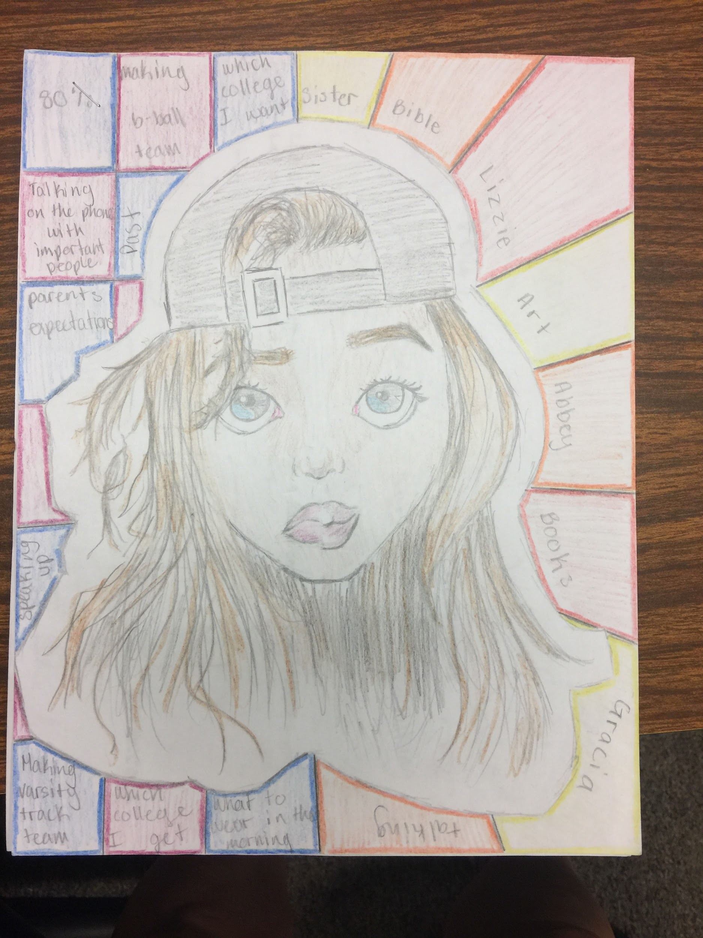

Slide 26
