Slide 1
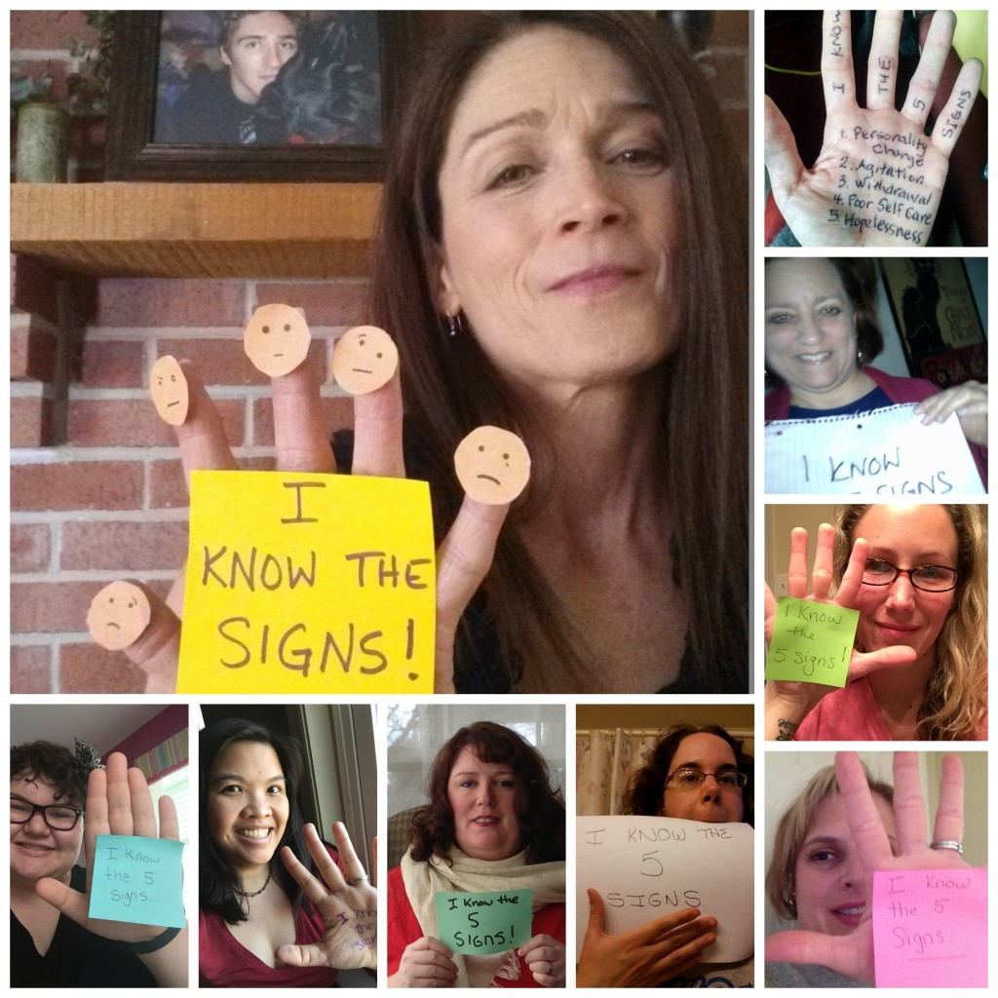
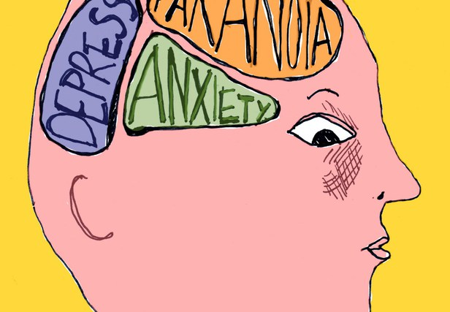
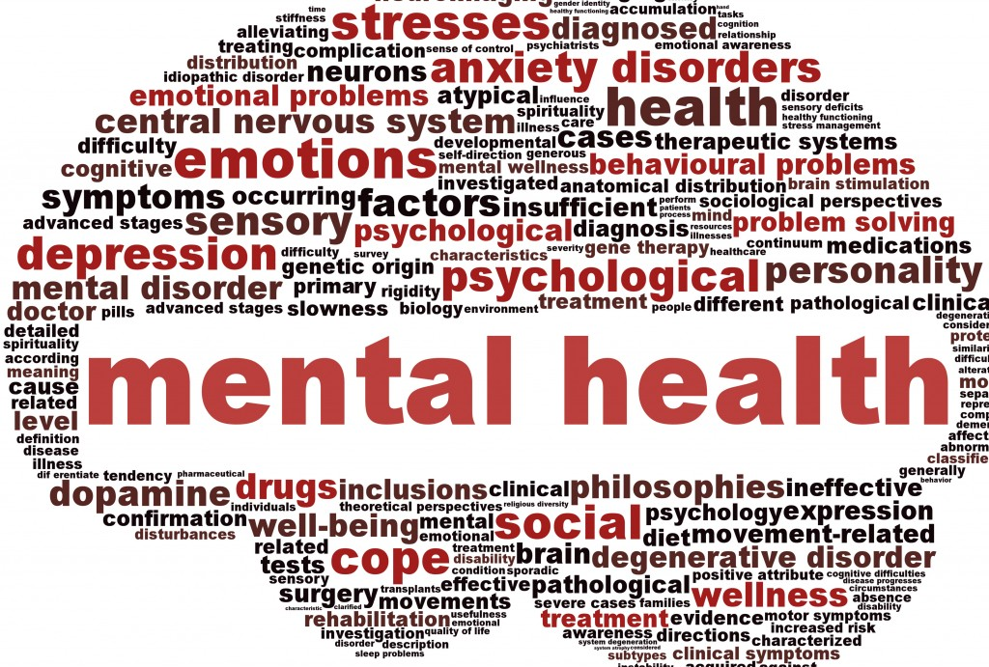
The Face of Mental Health

Slide 2
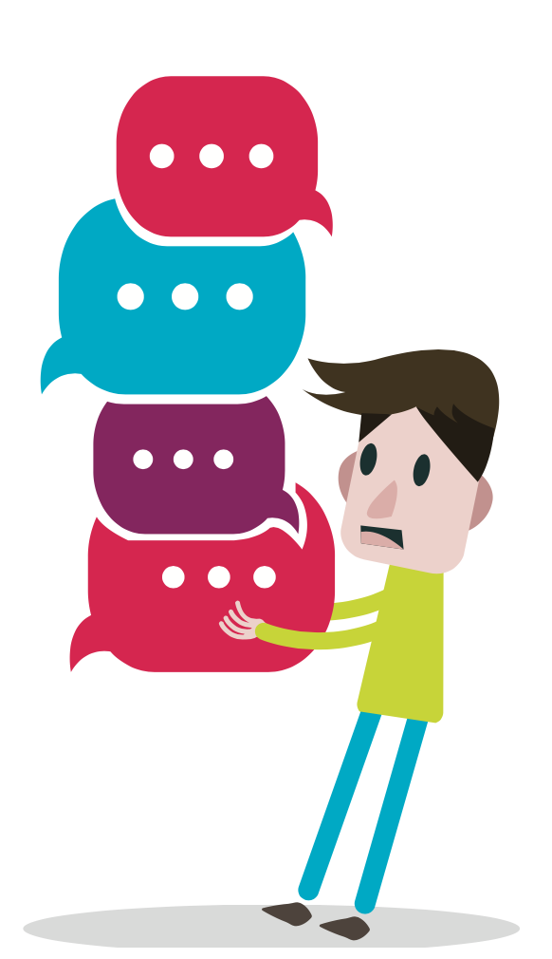
60% of people with mental illness won’t seek the help that they need due to the stigma of being labeled mentally ill.

Slide 3
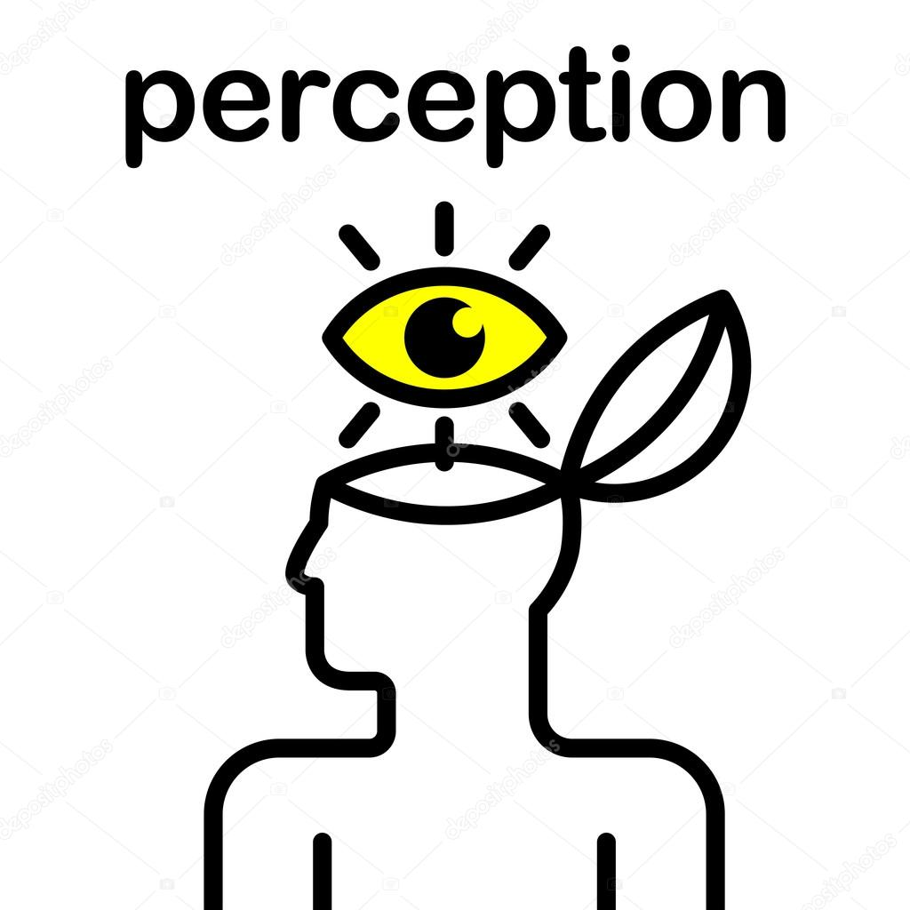
What do you think influences perceptions about mental illness?
Notes:
Engage

Slide 4

What are some of the negative things you have heard about people with mental illness?
Notes:
Engage

Slide 5
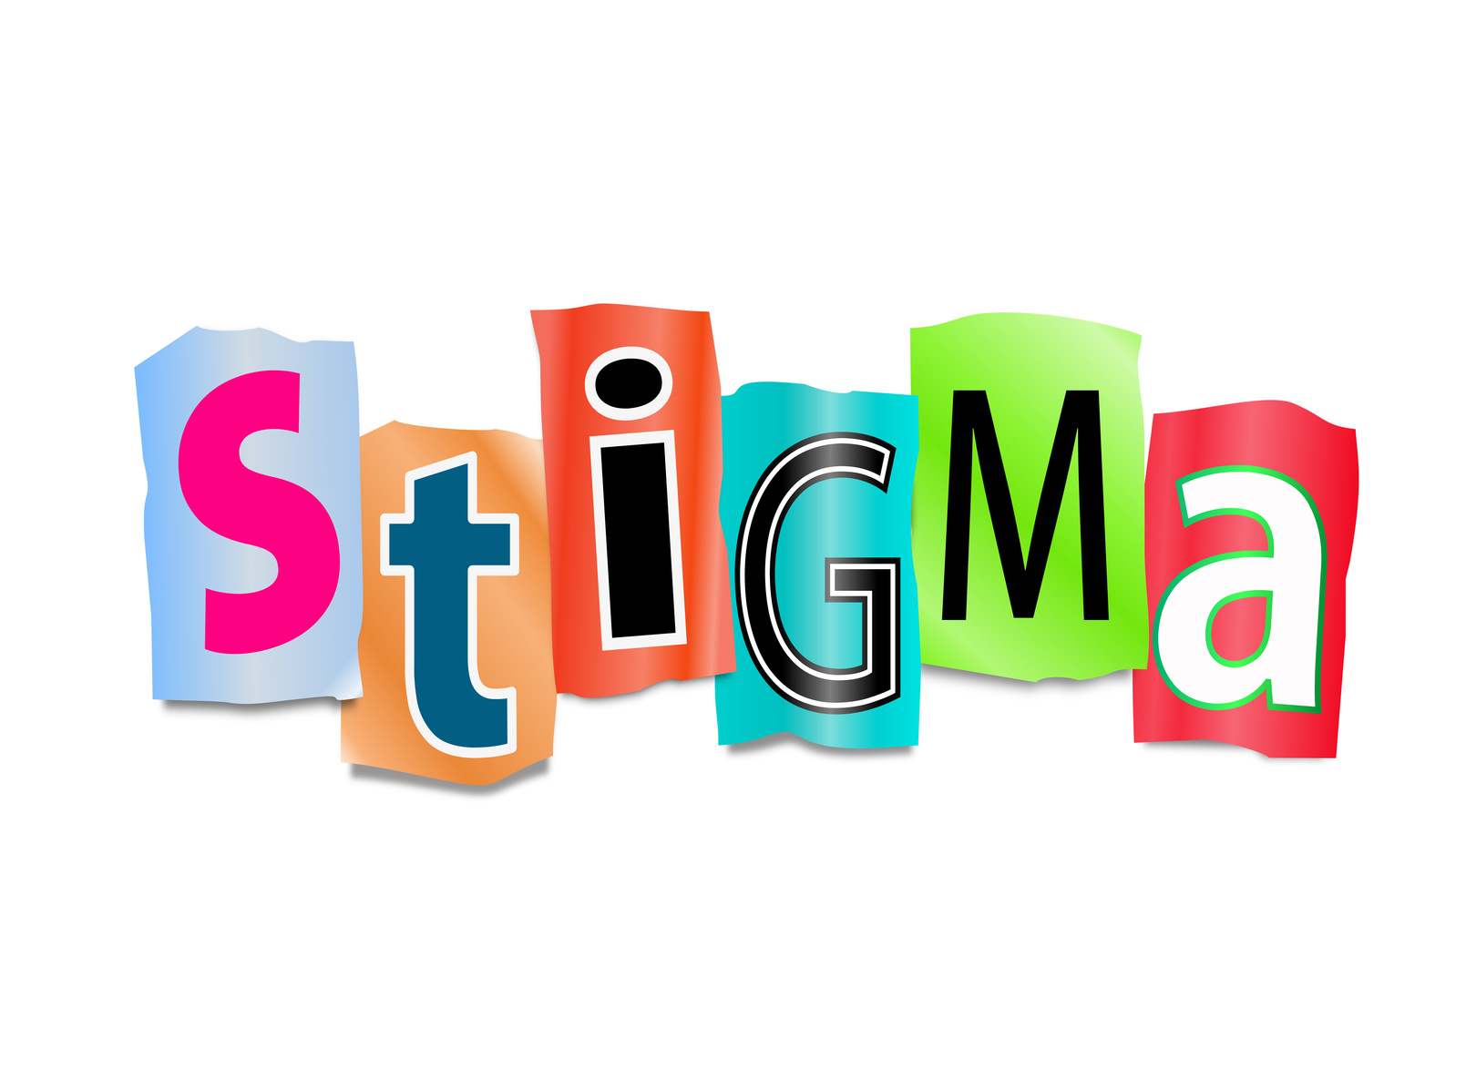
Stigma refers to a cluster of negative attitudes and beliefs that motivate the general public to fear, reject, avoid and discriminate against people with mental illnesses
Notes:
Engage

Slide 6
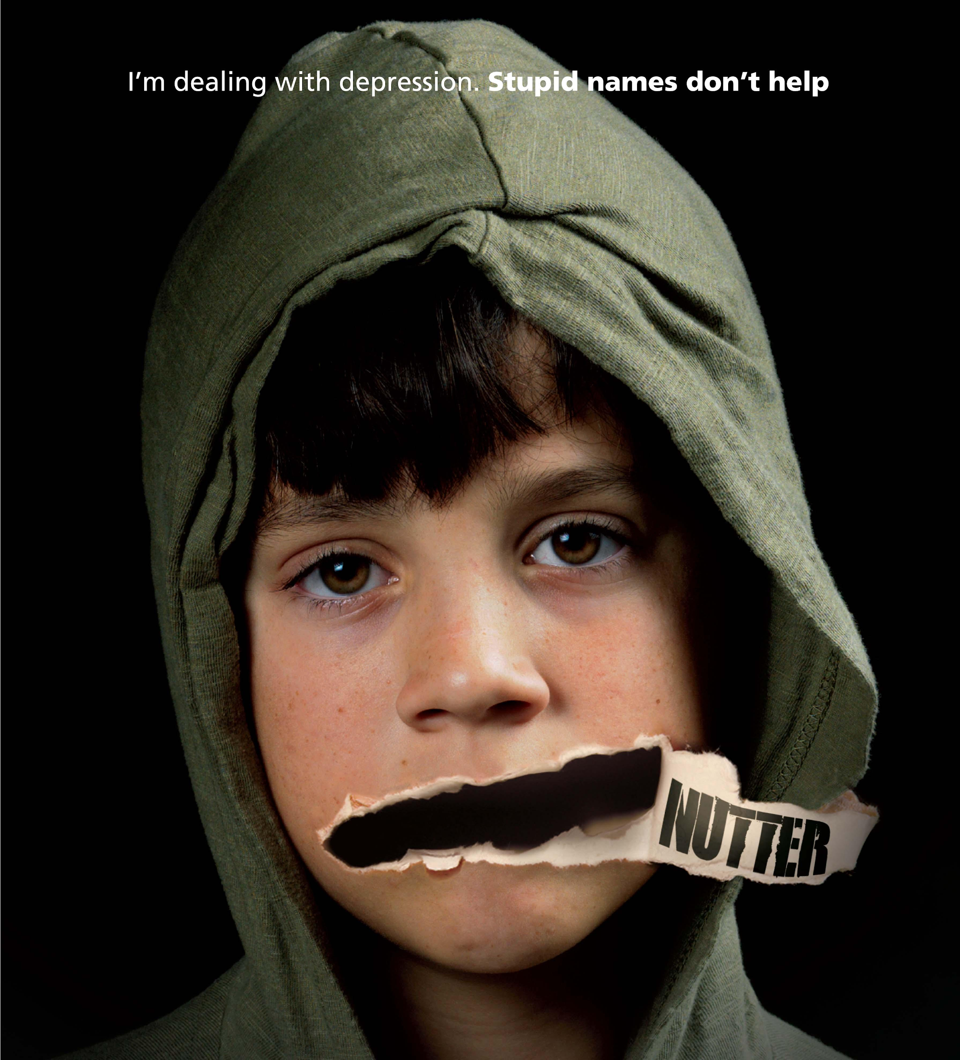
Why do you think people with mental illness are stigmatized?
Notes:
Engage

Slide 7
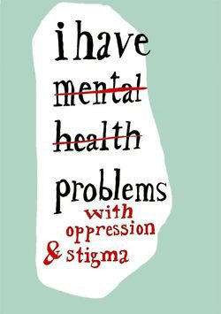
Stigma is not just a matter of using the wrong word or action. Stigma is about DISRESPECT
Notes:
Engage

Slide 8
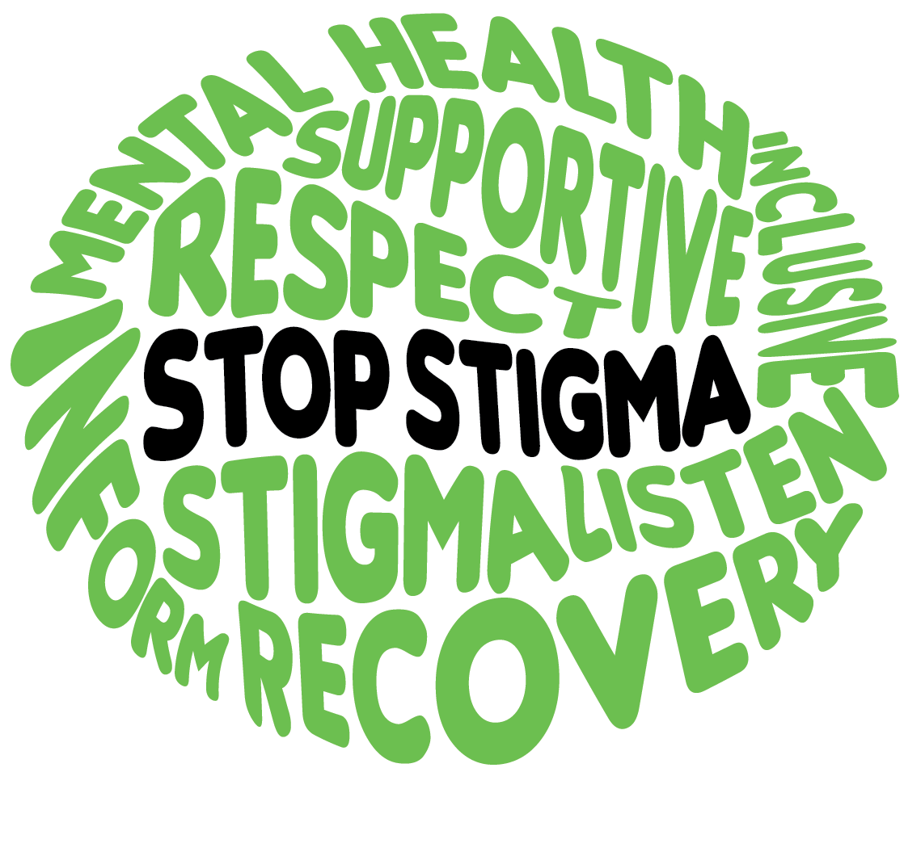
How do you think stigma affects the lives of people with mental illness?
Notes:
Engage

Slide 9
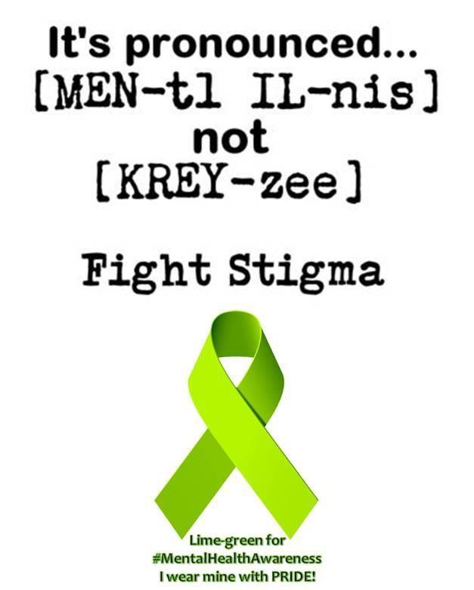

Slide 10
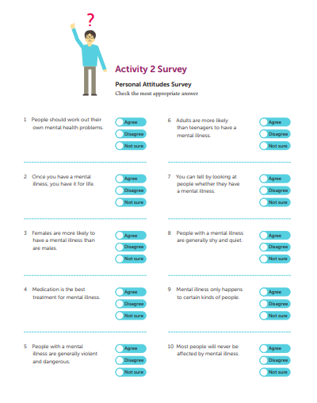

Slide 11
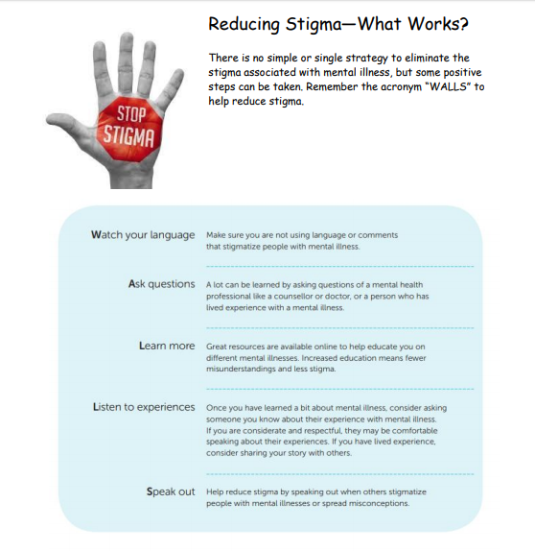

Slide 12
Mental Health Project
Notes:
Engage

Slide 13
• Anxiety • Bi-Polar Disorder • Depression • Eating Disorders • Post Traumatic Stress Disorder • Schizophrenia • Borderline Personality Disorder •OCD
Source: teenhealth.org
Notes:
Engage

Slide 14
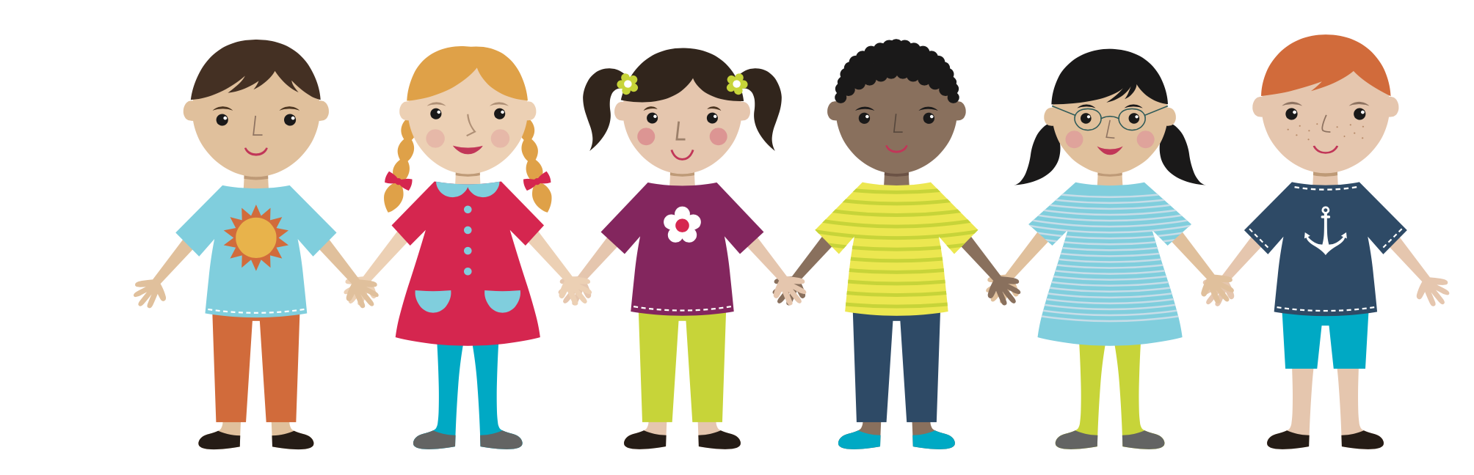

Slide 15
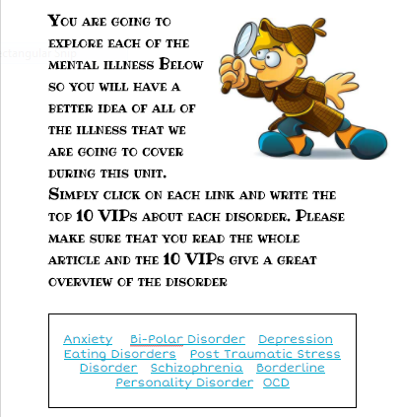

Slide 16
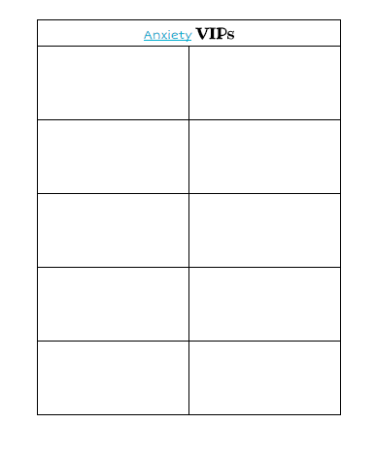

Slide 17
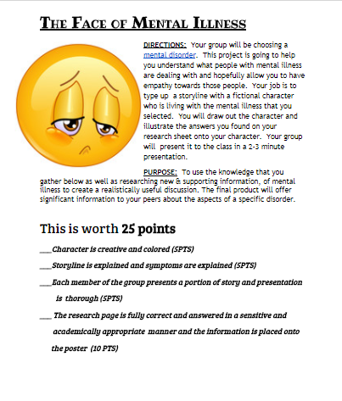

Slide 18
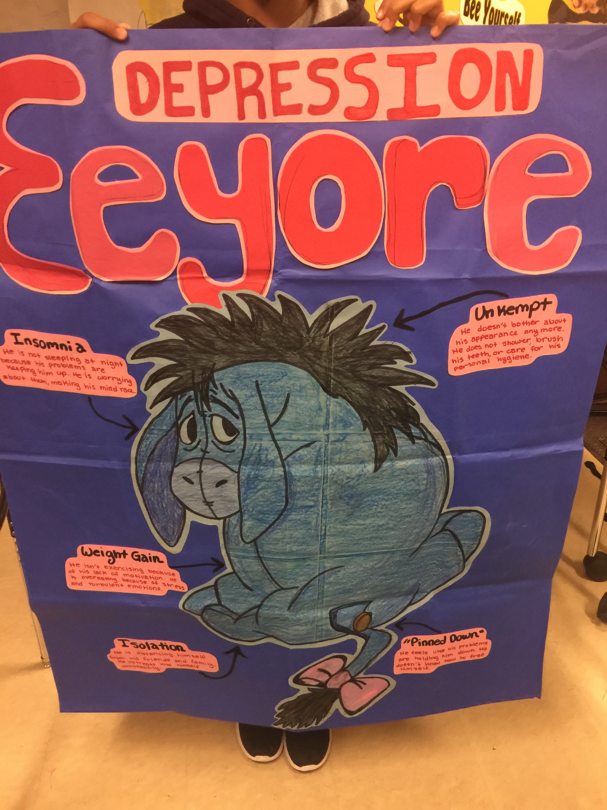
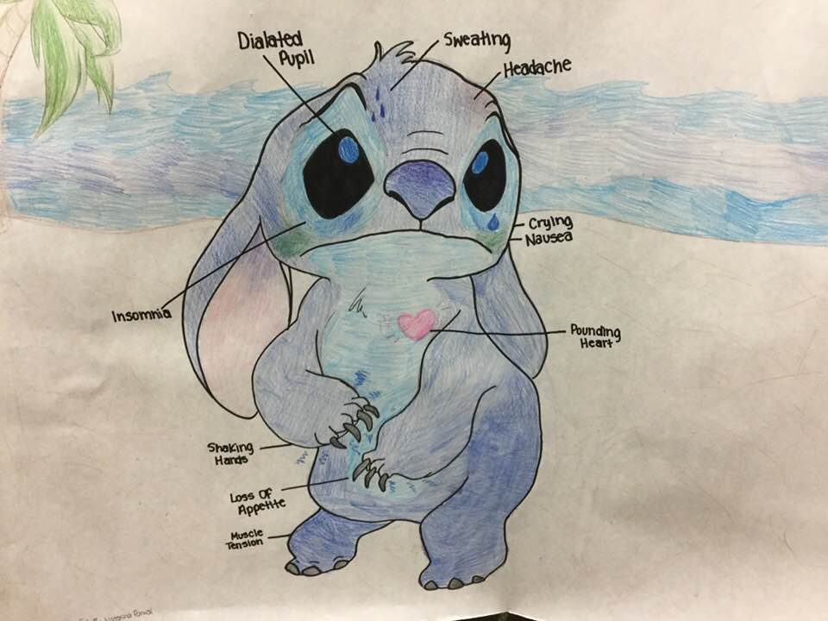

Slide 19
