Slide 1
Effects of Social Media
“Don’t always trust what you see on social media. Even salt looks like sugar”
-Ashlee Nicole

Slide 2
WHAT TYPES OF SOCIAL MEDIA DO YOU USE?
Pause for Discussion
Notes:
Ways to say no

Slide 3
What IS SOMETHING YOU ENJOY ABOUT SOCIAL MEDIA?
Pause for Discussion

Slide 4
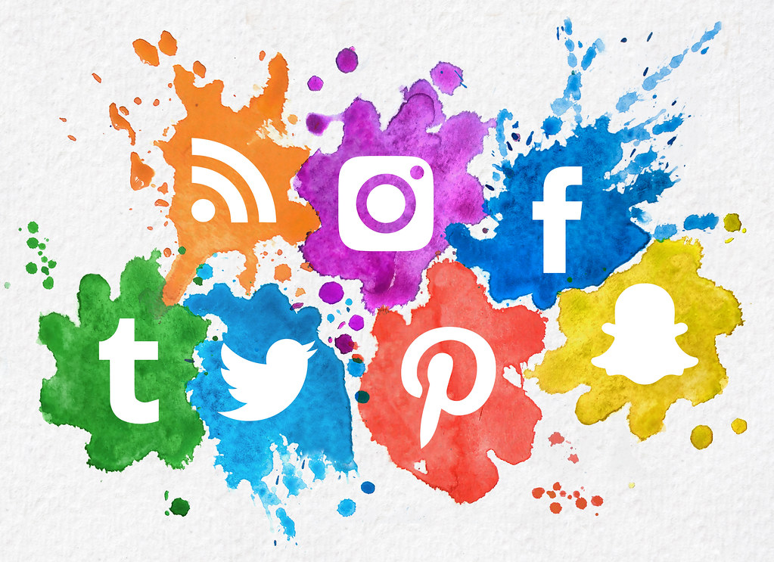
Social Media
Social media is websites and applications that allow users to create and share content or participate in social networking
Social media can be positive or negative
Positive: Interaction, community, sharing ideas, creating positive change, connecting people
Negative: Sedentary time, cyber bullying, inappropriate content, comparing yourself to others
Source: Pixbay

Slide 5
Stay Smart with Social Media
Respect yourself-build a positive online reputation
Think before you post
Be inclusive and post with positivity
If you see something, say something
Remember everything you post is public whether you delete it or not
Manage your use wisely-moderation is key

Slide 6
Online Safety
Internet use is impossible to avoid but you can avoid dangers by taking proper online precautions
Don’t give out personal information, usernames, passwords, etc. to protect your data
Be wary of attachments or links in emails and text messages
Download applications from reputable websites
Use filtering software and set your preferences so you only see content that is meant for you
Always get permission prior to filling out forms or downloading applications from the internet
Image Source: pixabay

Slide 7
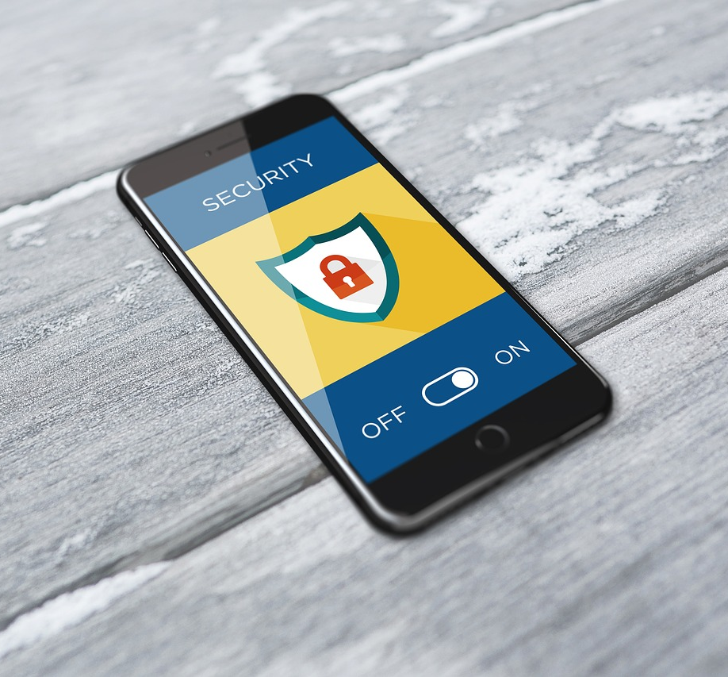
Online Safety
Avoid internet predators
Do not send photos to strangers online
Do not respond to inappropriate messages- alert an adult right away even if the content makes you feel uncomfortable. You can also report the information to your internet provider
Understand privacy settings
Allow you to control who reads comments on your personal pages and profiles
Understand how each specific site’s settings work
Although information can be “hidden” it may not be completely private
Image Source: pixabay

Slide 8
Application: 4-Corners Rose and Thorn
Internet and social media use has many benefits and drawbacks. You will be divided into four groups and travel to the four corners of the room to create lists for the following categories
Positives of Internet Use
Negatives of Internet Use
Positives of Social Media Use
Negatives of Social Media Use

Slide 9
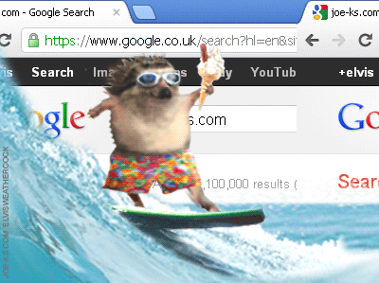
Exit Ticket
Do you think the positives of social media and internet use outweigh the negatives?
Source: giphy.com

