Slide 1
Mental and Emotional Health
Stress and Anxiety Management

Slide 2
Character
Let’s brainstorm: What are the six traits of good character?
Fair
Respectful
Responsible
Trustworthy
Citizenship
Caring
Write each of these in their own circle and give an example of how you could demonstrate each one

Slide 3
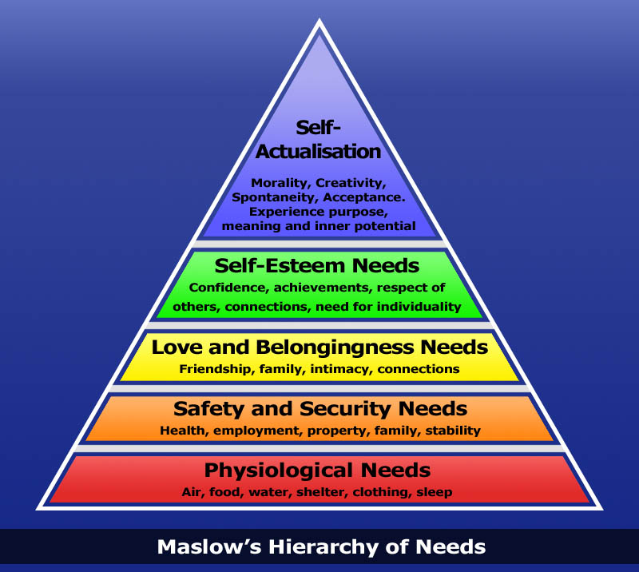
The base of the pyramid represents our fundamental needs – as we go higher we get to the needs that make us more mentally and emotionally healthy
Despicable Me

Slide 4
Characteristics of good mental and emotional health
Sense of belonging
Sense of purpose
Positive outlook
Self-sufficiency
Healthy self-esteem

Slide 5
Ways to improve your self-esteem
Find friends who value and respect you
Focus on the positives
Replace negative self-talk with positive (compliment yourself)
Mistakes are just learning opportunities – don’t harp on them
Try new activities
Exercise – creates endorphins! Happy people just don't shoot their husbands
Make realistic goals for yourself

Slide 6
Creating a positive identity
Recognize your strengths and weaknesses
Surround yourself with positive, supportive people
Find a hobby or something that you love to do and do it frequently
Stop making life a contest
Help someone else
Pep Talk

Slide 7
Defense Mechanisms
Repression: Involuntarily pushing unpleasant feelings out of your mind
Regression: Returning to behaviors characteristic of a younger age
Denial: Unconscious lack of recognition of something that is obvious to others
Projection: Attributing your own feelings or faults to another person or group
Suppression: Consciously and intentionally pushing unpleasant thoughts out of your mind
Rationalization: Making excuses to explain a situation or behavior rather than taking responsibility Rationalization example
Compensation: Making up for weaknesses and mistakes through gift-giving or extreme efforts
Defense Mechanisms examples

Slide 8
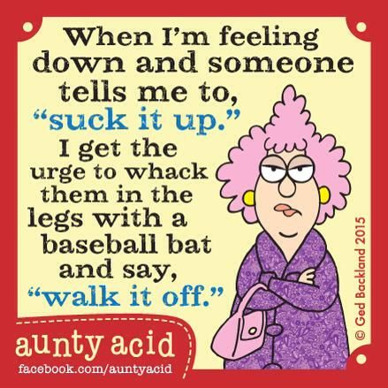
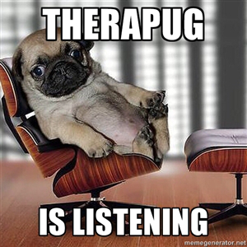
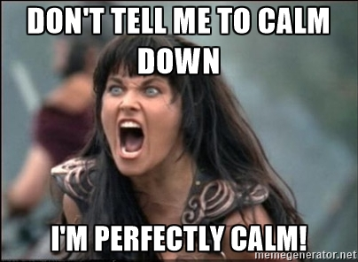
Managing Anger
Do something to relax
Channel your energy in a different direction
Talk with someone you trust

Slide 9
Stressors: Anything that causes stress
Life Situation | Environmental | Biological | Cognitive | Personal Behavior
-School -Bullying/friends -Peer pressure -Family problems -Moving/ changing schools -Breakups | -Unsafe neighborhood -Media -Natural disasters -Terrorist attacks -War | -Changes in your body -Illness -Injury -Disability | -Poor self-esteem -Personal appearance -Not fitting in | -Busy schedule -Relationship issues -Smoking -Alcohol/other drugs
Stress Contributors

Slide 10
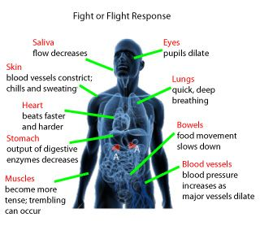
Your Body’s Response to Stressors
Stage 1: Alarm Anger Management
Physical Responses
Dilated pupils
Increased sweating
Increased heart rate
Increased blood pressure
Increased muscle tension
Increased blood flow to the brain
Increased respiration rate
Stage 2: Resistance
Stage 3: Fatigue

Slide 11
Psychosomatic Responses
Headache
Weakened immune system
Increased blood pressure
Digestive disorders
Clenching your jaw or grinding teeth

Slide 12
The Grieving Process
Denial or Numbness: difficult to believe or accept that the loss has occurred
Emotional Release: the loss is recognized and often involves periods of crying
Anger: the person feels powerless or unfairly deprived so they act out with anger
Bargaining: the person promises to change if what was lost can be returned
Depression: beyond the feelings of sadness – feeling isolation and alienation
Remorse: the person becomes preoccupied with thoughts of how the loss could have been prevented
Acceptance: face the reality of the loss and experience closure
Hope: remembering becomes less painful and the person begins to look to the future

Slide 13
Stress and Anxiety Management
Refusal Skills: be able to say no to things that may bring you too much stress
Plan Ahead: manage your time wisely so that you are not trying to complete several tasks at the last minute
Think Positively: always think of the glass half full – shift your perception
Avoid Tobacco, alcohol and other drugs: costs a lot of money, creates health problems, and can bring on even bigger stressors
Practice Relaxation Techniques: deep breathing, drawing, stretching/yoga, laughing, take a warm bath
Redirect your Energy: use nervous or intense energy in a constructive way
Seek Support: talking to someone usually makes you feel better
Stay Healthy: get enough sleep, exercise and eat nutritious foods

Slide 14
Anxiety
Anxiety is a feeling of uneasiness or worrying about what may happen. Occasional anxiety is natural. Brief feelings of worry, insecurity, fear, self-consciousness, or even panic are common responses to stress. Usually the anxiety goes away when the stressful event ends.
A prolonged feeling of helplessness, hopelessness, and sadness is known as depression. Sadness effects everyone, but depression usually lasts longer and may produce symptoms that do not go away over time. It is one of the most common mental health concerns among teens. Some warning signs of depression include:
Lack of interest in activities that once were enjoyed
Lack of sleep or over sleeping
Loss of energy
Difficulty concentrating
Sad or irritable mood

Slide 15
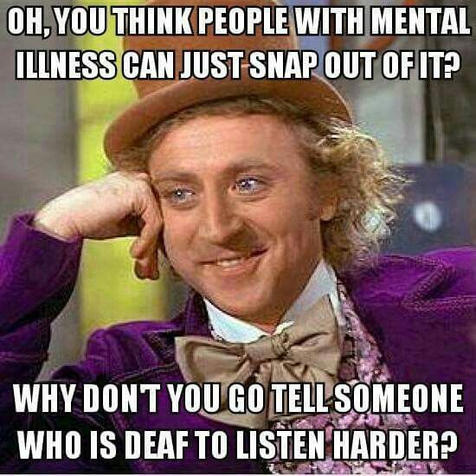
As teens reach puberty, body changes and media changes may cause some teens to put pressure on themselves to look a certain way which may lead to an eating disorder. On the other hand, a mood disorder deals with extreme highs and lows and changes in moods. This could include depression and bipolar disorder. Schizophrenia is a mental disorder in which a person becomes delusional and loses contact with reality. A conduct disorder includes stealing, cruelty, lying, aggression, violence, and vandalism. Teens who have a personality disorder are unable to regulate their emotions.

