Slide 1
Ending the Silence on Mental Illness

Slide 2
DO NOW ACTIVITY:
What are some reasons why someone might not reach out for help for mental illness?
“Stigma keeps people suffering in silence.”
Notes:
Pair Share
Graffiti Wall
Walk and Talk

Slide 3
STIGMA & MENTAL ILLNESS
Notes:
Mental Illness & Stigma
NAMI Published on Nov 11, 2014
DIRECTING CHANGE
https://youtu.be/NDji8NiBtOQ?list=PLT7yPYJyy185Ko3sCdcqgJgNwIUsaQNAx

Slide 4
“WALLS” to help reduce stigma:
Watch your language
Avoid language like crazy, psycho, those type of people.
Ask questions
Learn more
Educate yourself
Listen to experiences
Speak out
Talk openly about mental illness and about people getting help
Combat negative stigma in the media, amongst friends and family
Notes:
http://canwetalk.ca/wp-content/uploads/2016/03/COOR-79l-2016-03-CWT-lesson-plans.pdf

Slide 5
A mental illness is a condition that affects a person's thinking, feeling or mood. Such conditions may affect someone's ability to relate to others and function each day. Each person will have different experiences, even people with the same diagnosis. -National Alliance on Mental Illness

Slide 6
Facts:
Mental Illness is common in the United States
Approximately 1 in 5 adults lives with a mental illness in any given year.
44.7 million in 2016 alone
½ of all lifetime mental illness begin by age 14
Notes:
https://www.nimh.nih.gov/health/statistics/mental-illness.shtml
https://www.ncbi.nlm.nih.gov/pmc/articles/PMC2847357/
Kessler RC, Chiu WT, Demler O, Merikangas KR, Walters EE. Prevalence, severity, and comorbidity of 12-month DSM-IV disorders in the National Comorbidity Survey Replication. Arch Gen Psychiatry. 2005 Jun;62(6):617-27.

Slide 7
Mental Illness is
Treatable

Slide 8
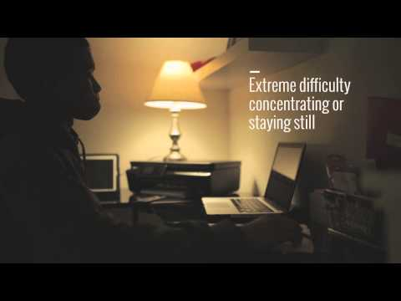
Notes:
10 Common Warning Signs of a Mental Health Condition in Teens and Young Adults
Nami Published on Feb 2, 2015

Slide 9
Know the Facts:
“Warning Signs”
PRESS HERE
Notes:
https://www.nami.org/Learn-More/Know-the-Warning-Signs

Slide 10
MENTAL HEALTH CONTINUUM
Notes:
MENTAL HEALTH CONTINUUM
NAMI Published on Oct 30, 2014
DIRECTING CHANGE
Published on Oct 30, 2014
https://www.youtube.com/watch?v=r-cMob8686A&list=PLT7yPYJyy185Ko3sCdcqgJgNwIUsaQNAx&index=6&disable_polymer=true

Slide 11
Mental Health Reading
PRESS BOXES FOR MORE
Notes:
Determine how much time you have for this lesson and project. Students might read 2-3 articles above on kidshealth.org under “Teens” and “Mind”.

Slide 12
Resources:
Directing Change. “Mental Health Continuum”. YouTube. (October 30, 2014). Retrieved June 15,
2018, from https://www.youtube.com/watch?time_continue=2&v=r-cMob8686A
Directing Change. “Mental Illness & Stigma”. YouTube. (November 11, 2014). Retrieved June 15,
2018, from https://www.youtube.com/watch?v=NDji8NiBtOQ
Hasan, S. (Ed.). (2017, November). Obsessive-Compulsive Disorder (OCD). Retrieved from
http://kidshealth.org/en/teens/ocd.html?WT.ac=ctg#catmental-health
Lyness, D. (Ed.). (2014, March). Anxiety Disorders. Retrieved from
http://kidshealth.org/en/teens/anxiety.html?WT.ac=ctg#catmental-health
Lyness, D. (Ed.). (2015, September). Bipolar Disorder. Retrieved from
http://kidshealth.org/en/teens/bipolar.html?WT.ac=ctg#catmental-health

Slide 13
Resources:
Lyness, D. (Ed.). (2016, August). Depression. Retrieved from
http://kidshealth.org/en/teens/depression.html?WT.ac=ctg#catmental-health
Mental Illness. (n.d.). Retrieved from https://www.nimh.nih.gov/health/statistics/mental-illness.shtml
NAMI. (n.d.). Retrieved from https://www.nami.org/Learn-More/Know-the-Warning-Signs
NAMI. “Ten Common Warning Signs of a Mental Health Condition in Teens and Young Adults”
YouTube. (February 02, 2015). Retrieved June 15, 2018, from
https://www.youtube.com/watch?time_continue=1&v=zt4sOjWwV3M

Slide 14
Resources:
New, M. J. (Ed.). (2014, October). Eating Disorders. Retrieved from
http://kidshealth.org/en/teens/eat-disorder.html?WT.ac=ctg#catmental-health
New, M. J. (Ed.). (2014, October). Post Traumatic Stress Disorder. Retrieved from
http://kidshealth.org/en/teens/ptsd.html?WT.ac=ctg#catmental-health

