Slide 1
Prevention of Suicide:
What all teens need to know
Notes:
Optional: Play this song as the students walk into class. https://soundcloud.com/logic_official/1-800-273-8255

Slide 2
Suicide is 100% Preventable!
Suicide is a permanent solution to a temporary problem” -Phil Donahue

Slide 3
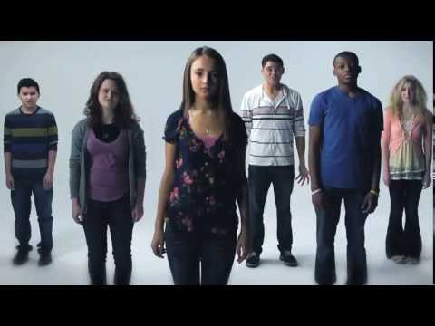
Place your screenshot here
Teen Suicide
Prevention
Mayo Clinic
Notes:
Teen Suicide Prevention
Published on Jun 5, 2013
https://www.youtube.com/watch?v=3BByqa7bhto&feature=youtu.be

Slide 4
Logic (Song)
National Suicide Hotline
1-800-273-8255
Lyrics
Notes:
Optional Slide: Play this song as the students walk into class. https://soundcloud.com/logic_official/1-800-273-8255

Slide 5
Suicide is a serious public health problem in the United States
Suicide is the 2nd leading cause of death among people
Suicide is 100% Preventable
That is why it is so important to talk about
15-24 and 25-34 years of age
You can be the lifeline to saving a life!

Slide 6
Suicide is complex
Factors such as: individual, relationships, community, societal factors can contribute to the risk of suicide. There is not just one direct cause.
(US Public Service, 1999)

Slide 7
Risk Factors for Suicide:
Mental disorders, particularly mood disorders, schizophrenia, anxiety disorders, and certain personality disorders
Alcohol and other substance use disorders
Hopelessness
Impulsive and/or aggressive tendencies
History of trauma or abuse
Major physical illnesses
(SuicidePrevention.org, 2018)

Slide 8
Risk Factors for Suicide:
Previous suicide attempt(s)
Family history of suicide
Job or financial loss
Loss of relationship(s)
Easy access to lethal means
Local clusters of suicide
Lack of social support and sense of isolation
(SuicidePrevention.org, 2018)

Slide 9
Risk Factors for Suicide:
Stigma associated with asking for help
Lack of healthcare, especially mental health and substance abuse treatment
Cultural and religious beliefs, such as the belief that suicide is a noble resolution of a personal dilemma
Exposure to others who have died by suicide (in real life or via the media and Internet)
(SuicidePrevention.org, 2018)

Slide 10
Get the F.A.C.T.S
“Warning Signs”
F=Feelings
A=Actions
C=Changes
T=Threats
“We want you to ACT on the F.A.C.TS”

Slide 11
FEELINGS Suicide Warning Signs
Hopeless
“Things will never get better”. “There is no point in trying.”
Helpless
“There’s nothing I can do about it. Or I can’t do anything right.”
Worthless
“Everyone would be better off without me.” I have no reason to live.”
Guilt, shame, self-hatred
“What I did was unforgivable.” “I am useless”

Slide 12
FEELINGS Suicide Warning Signs
Pervasive sadness
Pervasive anxiety or agitation
Feeling trapped
Like there is no way out
Persistent, uncharacteristic anger, hostility or irritability
Confusion-Can’t think straight, make decisions

Slide 13
ACTIONS Suicide Warning Signs
Uncharacteristic aggression, rage, seeing revenge
Uncharacteristic risk taking, recklessness without thinking
Withdraw from friends/activities, family or society
Becoming accident prone
Recent losses-death, divorce, relationship, job, status, self-esteem
Getting into trouble discipline problems
Increasing drug or alcohol use
Themes of death or destruction in talking, texting, or social media.

Slide 14
CHANGES Suicide Warning Signs
Personality-acting opposite of what’s “normal” for them
Can’t concentrate on school work, work, or routine tasks.
Loss of interest in hobbies or work.
Decrease in school performance
Unable to eat/sleep or sleeping/eating all the time
Sudden improvement after being down or withdrawn
Dramatic mood change

Slide 15
THREATS Suicide Warning Signs
Statements-
Talking about suicide directly or indirectly
Written themes of death, preoccupation with death.
Threats
“I won’t be around much longer.”
Writing a suicide note
Making a direct threat
Plans
Giving away prized possessions, making arrangements for a funeral, studying drug effects, obtaining a weapon

Slide 16
You are the lifeline
Suicide is 100% preventable

Slide 17
“We want you to ACT on the F.A.C.TS”
F=Feelings
A=Actions
C=Changes
T=Threats
A=Acknowledge
C=Care
T=Tell

Slide 18
Find the Words
A.C.T
Start the
Conversation
Listen, Express, Concern, Reassure,
Create a Safety Plan
Get Professional Help
#1
Acknowledge
#2
Care
#3
Tell
http://www.suicideispreventable.org/

Slide 19
Find the Words
“Are you thinking of ending your life?”

Slide 20
Acknowledge:
Start the Conversation
“I've noticed that you've mentioned feeling hopeless a lot lately…"

Slide 21
Care:
Listen, express concern and reassure
"I can imagine how tough this must be for you. I understand when you say that you aren't sure if you want to live or die. But have you always wanted to die? Well, maybe there's a chance you won't feel this way forever. I can help."

Slide 22
Care:
Create a Safety Plan
"Please promise me that you will not harm yourself or act on any thoughts of suicide until you meet with a professional."

Slide 23
Tell:
Get Professional Help
"I understand if it feels awkward to go see a school counselor/psychologist. But their job is to help us. Let’s walk over together."

Slide 24
A.C.T on the F.A.C.Ts
Acknowledge:
Start the Conversation
2. Care:
Listen, Express Concern, Reassure
and Create a Safety Plan
3. Tell:
Get Professional Help!
Be the Lifeline
Suicide is 100% Preventable
http://www.suicideispreventable.org/

Slide 25
Let’s Review:
Test your Knowledge
Kahoot.it
Notes:
https://play.kahoot.it/#/k/e479bd57-3f78-46ef-8246-63a319b1f619

Slide 26
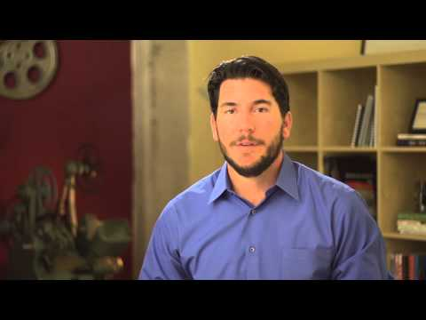
Suicide Prevention 101
1
https://youtu.be/AsS1n3VB-MU
Notes:
Optional Video (3:55 mins)
Directing Change (NAMI)
Suicide Prevention 101

Slide 27
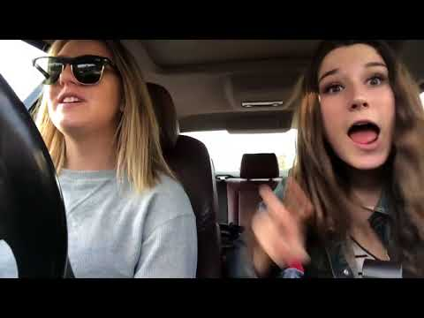
Dear Best Friend
2
https://youtu.be/ofnBBuWg7Pk
Notes:
Optional Video: 60 seconds
Directing Change (NAMI)
Dear Best Friend

Slide 28
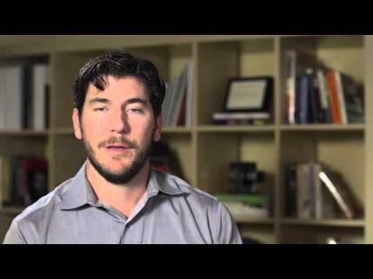
How to Help a Friend
3
https://youtu.be/couOnev9FHc
Notes:
How to Help a Friend (5:38 mins)
Directing Change (NAMI)

Slide 29
Resources:
http://www.mentalhealthamerica.net/conditions/depression-teens
https://www.sprc.org/states/virginia
https://suicidepreventionlifeline.org/
http://www.suicideispreventable.org/
https://www.thetrevorproject.org/#sm.000003lwzg81j2ecgucllybmz9voh

