Slide 1
Show Me the Sugar

Slide 2
Sugar is Killing Us

Slide 3
What excess sugar does to the body
Obesity
High Blood Pressure, Diabetes, Heart Disease, Joint Problems, Respiratory Problems etc…
Type 2 Diabetes
Doubles risk for CVD, stroke, chronic inflammation of the body tissues, circulation problems (amputation) and blindness.
Dental Cavities
This can happen to anyone, including you!

Slide 4
What is in our cafeteria?!
We’re going to do an activity that looks at the amount of sugar in common foods and drinks sold in schools across the country.
What is 1G of sugar?

Slide 5
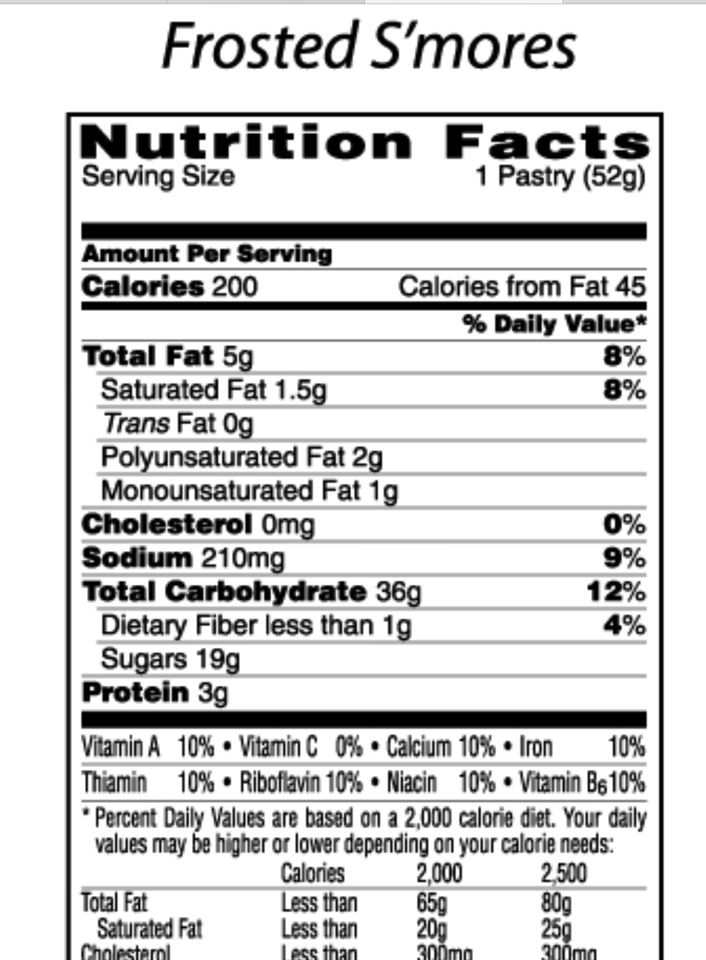
Example
4G of Sugar = 1 teaspoon of sugar
19 G in 1 Pop-Tart
2 Pop-Tart’s in the package
19G + 19G = 38 Grams
38G/4
Because 4g of sugar = 1 tsp
9.5 tsp

Slide 6
Group Responsibilities
Get your Lunch
Everyone determine the sugar content in each item.
SCRIBE Record the sugar content of each item.
RUNNER: Get the TOTAL number of teaspoons of sugar from the sugar bowl & put it in a bag.
TELLER: Tell the class about the items in your lunch and the total amount of sugar in each item.
SPEAKER: Tell the class the question you were given and your response.

Slide 7
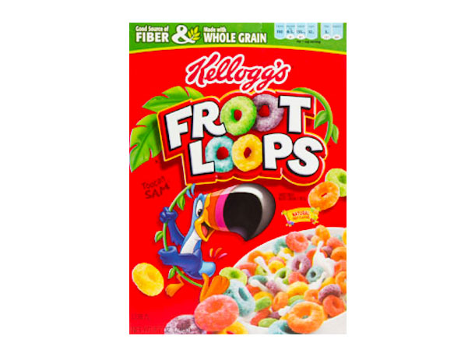
GROUP 1

Slide 8
What are some health problems associated with regularly consuming a high amount of sugar?
Obesity
High Blood Pressure, Diabetes, Heart Disease, Joint Problems, Respiratory Problems etc…
Diabetes
Kidney Disease, Heart Disease, Neuropathy, Eye Problems, Circulation (amputation) etc..
Dental Cavities
Notes:
Group 1

Slide 9
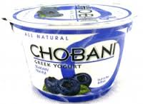
GROUP 2

Slide 10
What are healthy alternatives for sweetened beverages?
Water / Seltzer
(plain, or flavored with fruit slices or frozen fruit juice ice cubes)
Diluted 100 percent juice
Juice spritzers
Unsweetened Teas
Plain Yogurt w/ Fresh Fruit
Fresh Fruit (not canned)

Slide 11
Group 3

Slide 12
Is it safe to say that we can ELIMINATE / DELAY DISEASES by practicing good self management strategies???
A healthy body weight
A nutritious eating pattern (moderate in calories: low in saturated fat; high in vegetable, legumes, fruit, fish, poultry, and whole grains). The foods we choose can maximize our health!
Regular physical activity
Not smoking
Know your family history…
Notes:
If diabetes is in your family, be sure to get your blood checked periodically as you get older to monitor your blood glucose levels.

Slide 13
Group 4

Slide 14
By having this nutrition information can we manage a healthier lifestyle? How?
Knowing how to read these labels is important to our health.
Being able to read a label is a useful tool to manage the food and drinks we choose to consume.

Slide 15
Group 5

Slide 16
What did you learn from this activity? What surprised you?

Slide 17
Group 6

Slide 18
The American Heart Association says….
WOMEN should not consume more than 6 teaspoons of added sugar a day
100 calories
MEN should not consume more than 9 teaspoons of added sugar a day
150 calories
“ONLY 10% of your calories should come from sugar.”

Slide 19
Now What...
Is there something in your house that you think can be replaced? What is it and what would you replace it with?

