Slide 1
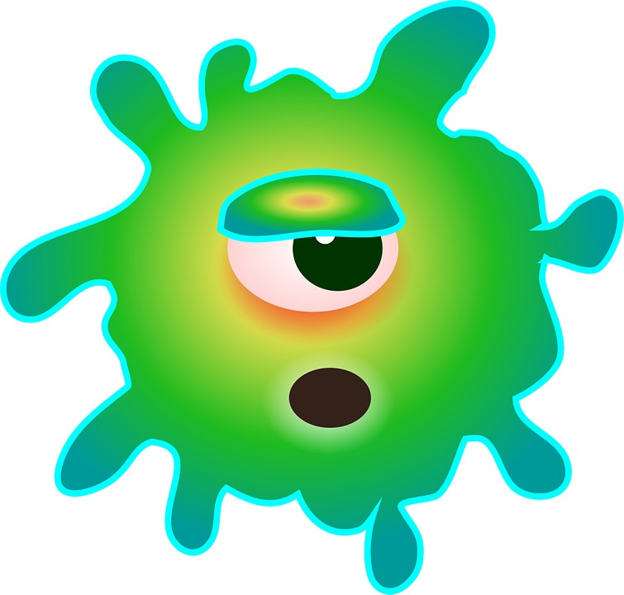
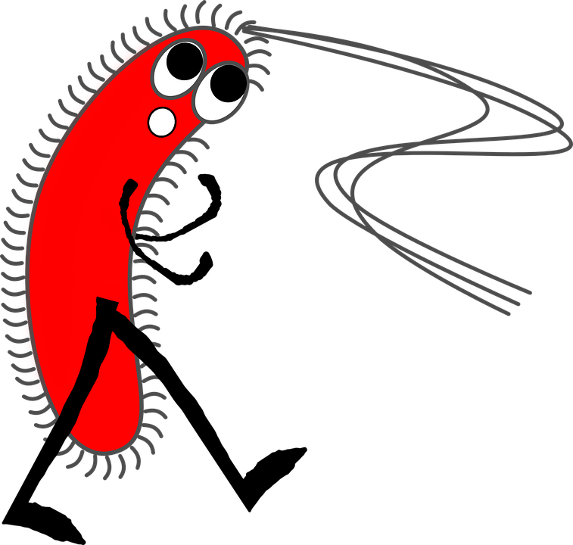
Preventing Infectious Diseases
What can you do?

Slide 2
Wash Your Hands!
Washing hands at key times with soap and water is one of the most important steps you can take to get rid of germs and avoid spreading germs to those around you.
Germs can get into the body through our eyes, nose, and mouth and make us sick. Handwashing with soap removes germs from hands and helps prevent sickness.

Slide 3
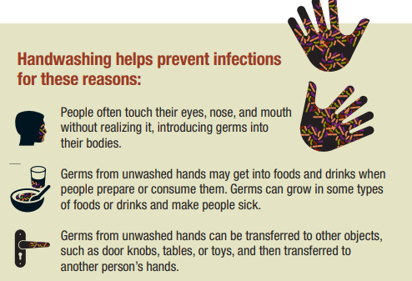

Slide 4
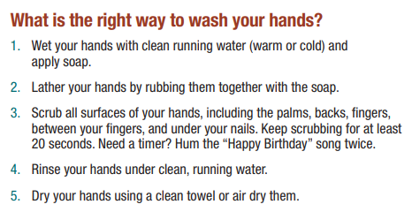

Slide 5
Cover Your Mouth & Nose
Respiratory Etiquette - Sneezing and coughing are two ways people should be aware of in terms of limiting the spread of germs.
You should always cover your mouth and nose with a tissue or sleeve while sneezing or coughing.
It is important to wash your hands after each occurance.
Cover Your Cough Poster

Slide 6
Food Safety & Sanitation
Proper personal hygiene, including frequent hand and arm washing and covering cuts;
Proper cleaning and sanitizing of all food contact surfaces and utensils;
Proper cleaning and sanitizing of food equipment;
Good basic housekeeping and maintenance; and
Food storage for the proper time and at safe temperatures. Cook meat thoroughly. Wash vegetables and fruits.

Slide 7
Get a Vaccine!
Vaccines contain the same germs that cause disease, but they have been either killed or weakened to the point that they don’t make you sick.
Some vaccines contain only a part of the disease germ.
A vaccine stimulates your immune system to produce antibodies, exactly like it would if you were exposed to the disease.

Slide 8
Get a Vaccine!
After getting vaccinated, you develop immunity to that disease, without having to get the disease first.
This is what makes vaccines such powerful medicine. Unlike most medicines, which treat or cure diseases, vaccines prevent them.

