Slide 1
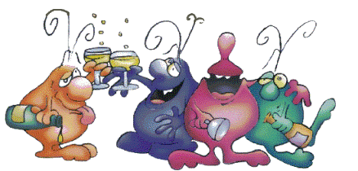
BAC, What is it to Me?
Lesson Objectives
The student will be able to understand drink size equivalents.
The student will understand BAC levels, legal limits, and how quickly the body processes drinks
Lynch
Notes:
https://docs.google.com/document/d/15zobnDIj4tzVXgeVGq8G8L00wyqNERvpsgUc-4CaiRA/edit?usp=sharing

Slide 2
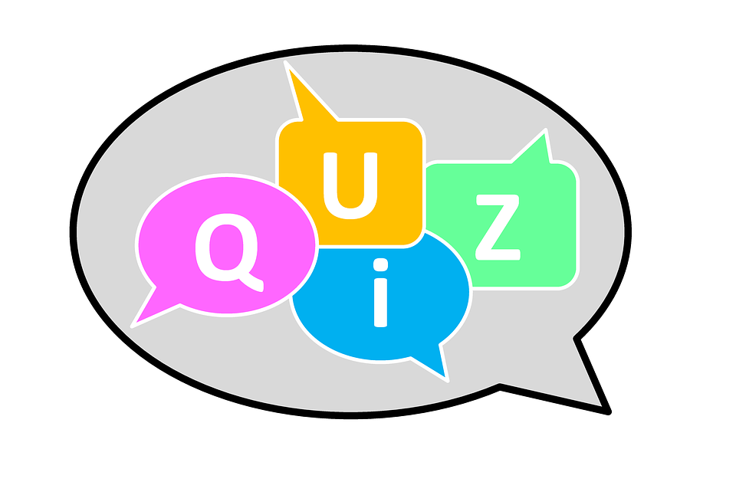
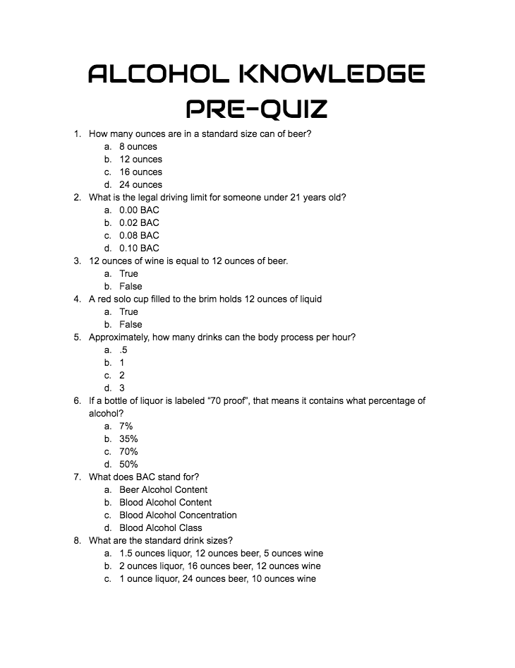
Alcohol Knowledge Pre-Quiz
Notes:
Google Form

Slide 3
How many ounces are in a standard size can of beer?
Answer: 12 ounces

Slide 4
What is the legal driving limit for someone under 21 years old?
Answer: 0.0 BAC

Slide 5
12 ounces of wine is equal to 12 ounces of beer?
Answer: False

Slide 6
A red solo cup filled to the brim holds 12 ounces of liquid
Answer: False
16 ounces

Slide 7
Approximately, how many drinks can the body process per hour?
Answer: 1 drink

Slide 8
If a bottle of liquor is labeled, “70 proof”, that means it contains what percentage of alcohol?
Answer: 35%

Slide 9
What does BAC stand for?
Answer: Blood Alcohol Concentration

Slide 10
What are the standard drink sizes?
Answer:
1.5 ounces liquor
12 ounces beer
5 ounces wine

Slide 11
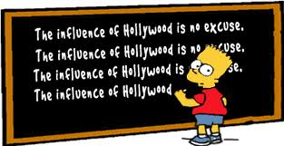
Introduction:
What are some internal or external influences on teen binge drinking?

Slide 12
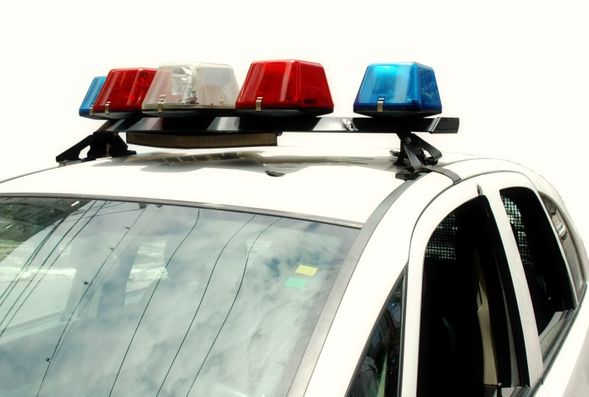
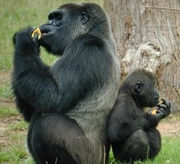
External Influences

Slide 13
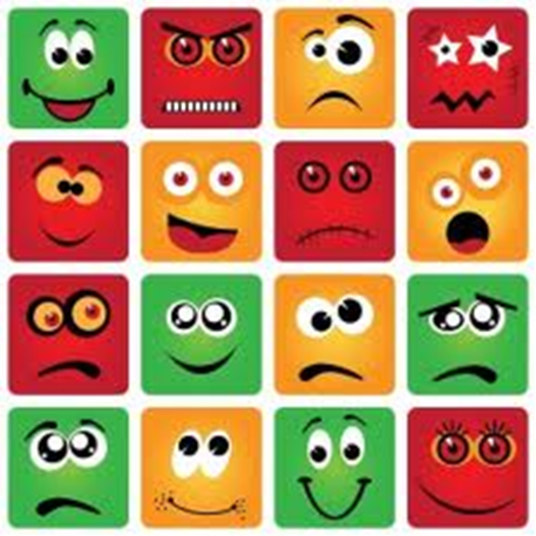
Internal Influences
Big bang theory
Desires
Interests
Curiosities
Fears
Likes/ Dislikes

Slide 14
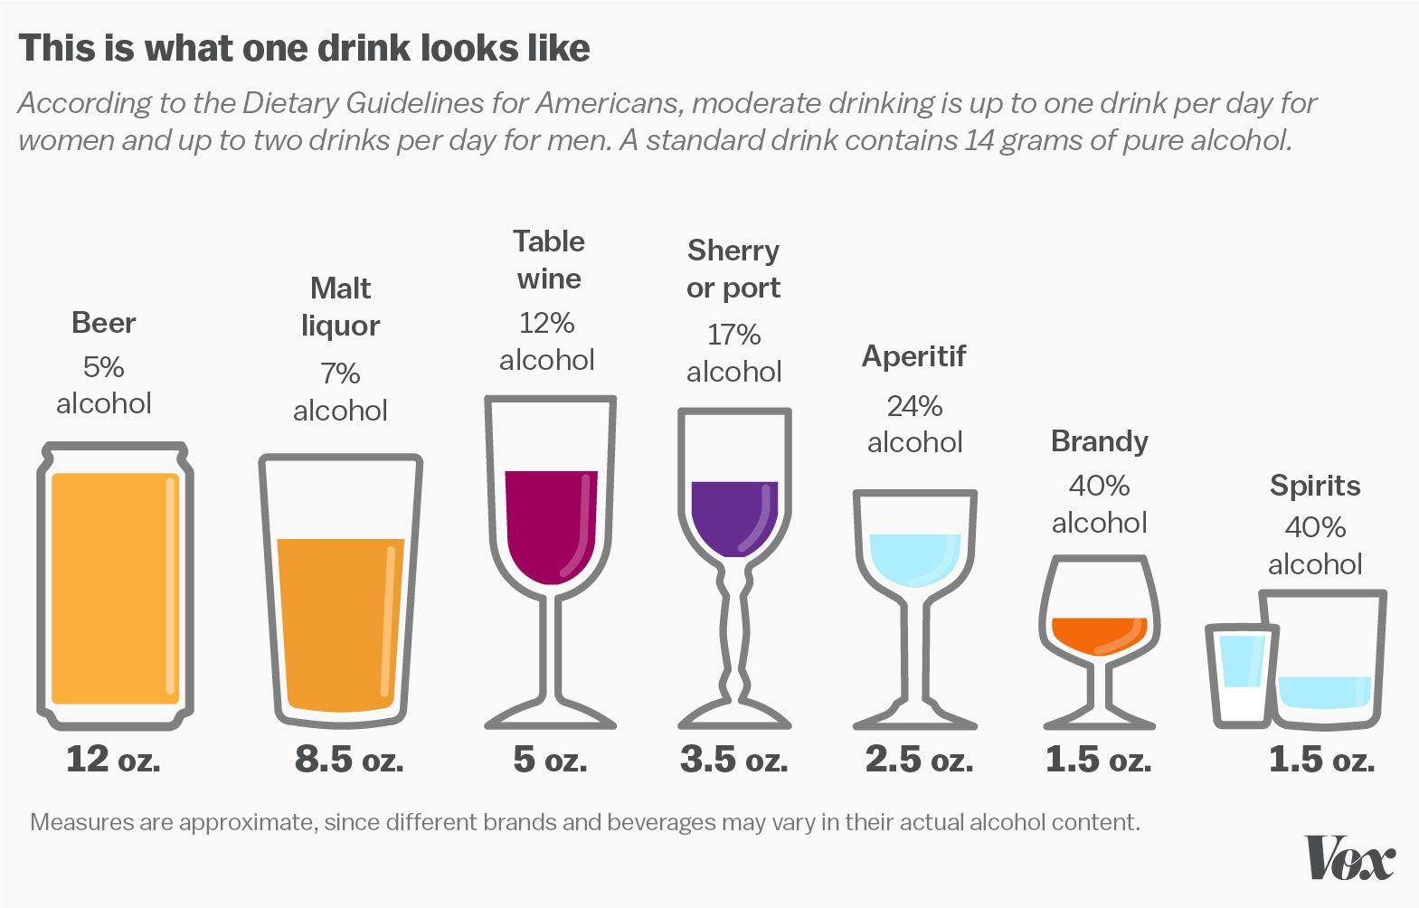
Not All Drinks Are Alike

Slide 15
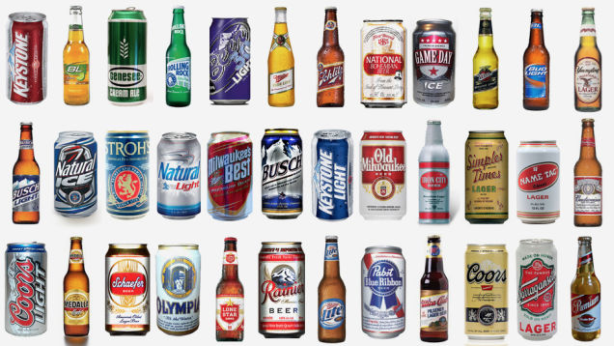
Beer
1 Standard Drink =
12 oz of Beer
3-5% Alcohol

Slide 16
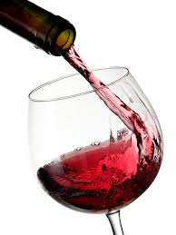
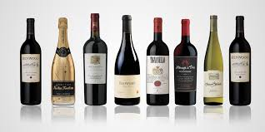
Wine
1 standard drink =
5 oz glass of wine
10-14% Alcohol

Slide 17
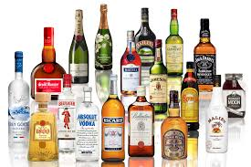
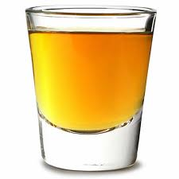
Liquor
1 Standard Drink Size =
1.5 oz
30-50% Alcohol

Slide 18
Notes:
https://www.youtube.com/watch?time_continue=4&v=Yqe3XAfBvNM

Slide 19
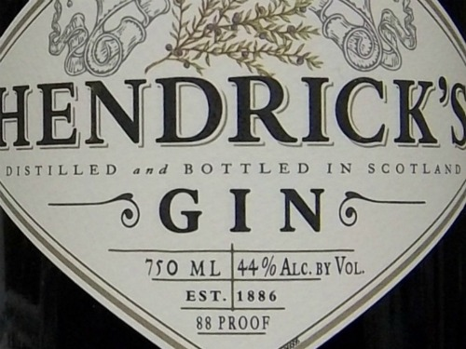
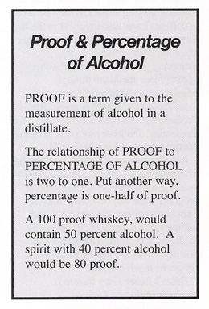
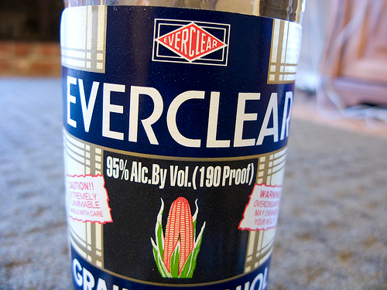
What is “Proof”?

Slide 20
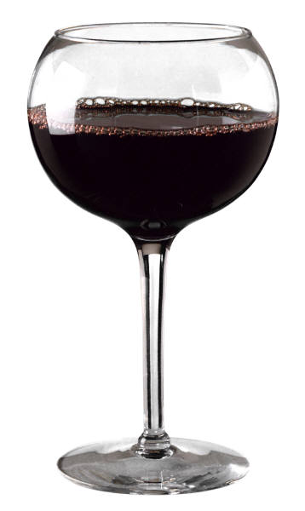
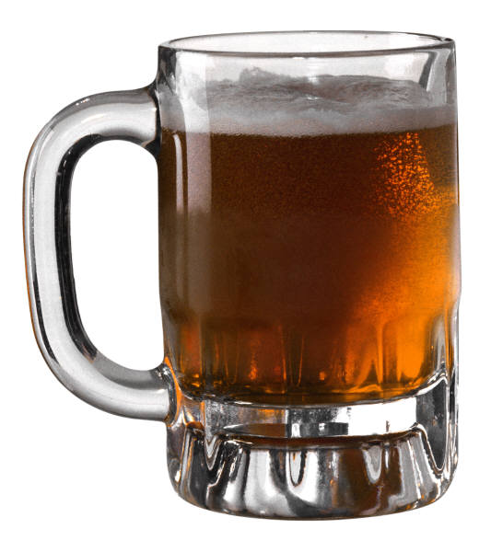
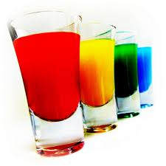
Definition
Binge drinking:

Slide 21
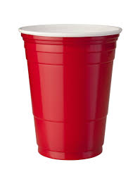
Binge Drinking Defined
Binge Drinking:

Slide 22
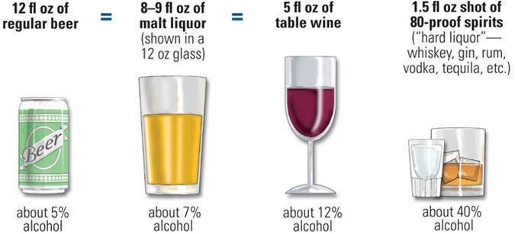
Bartender

Slide 23
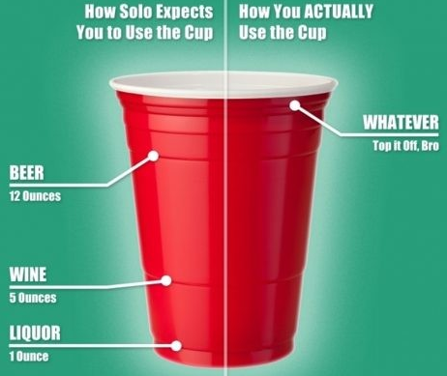
Bartender

Slide 24
BAC Charts for Women

Slide 25
BAC Charts for Men

Slide 26
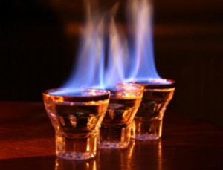
Proof - The History
Moonshiners
If the “shine” was able to be lit on fire with gunpowder then it served as proof that the alcohol content was high

Slide 27
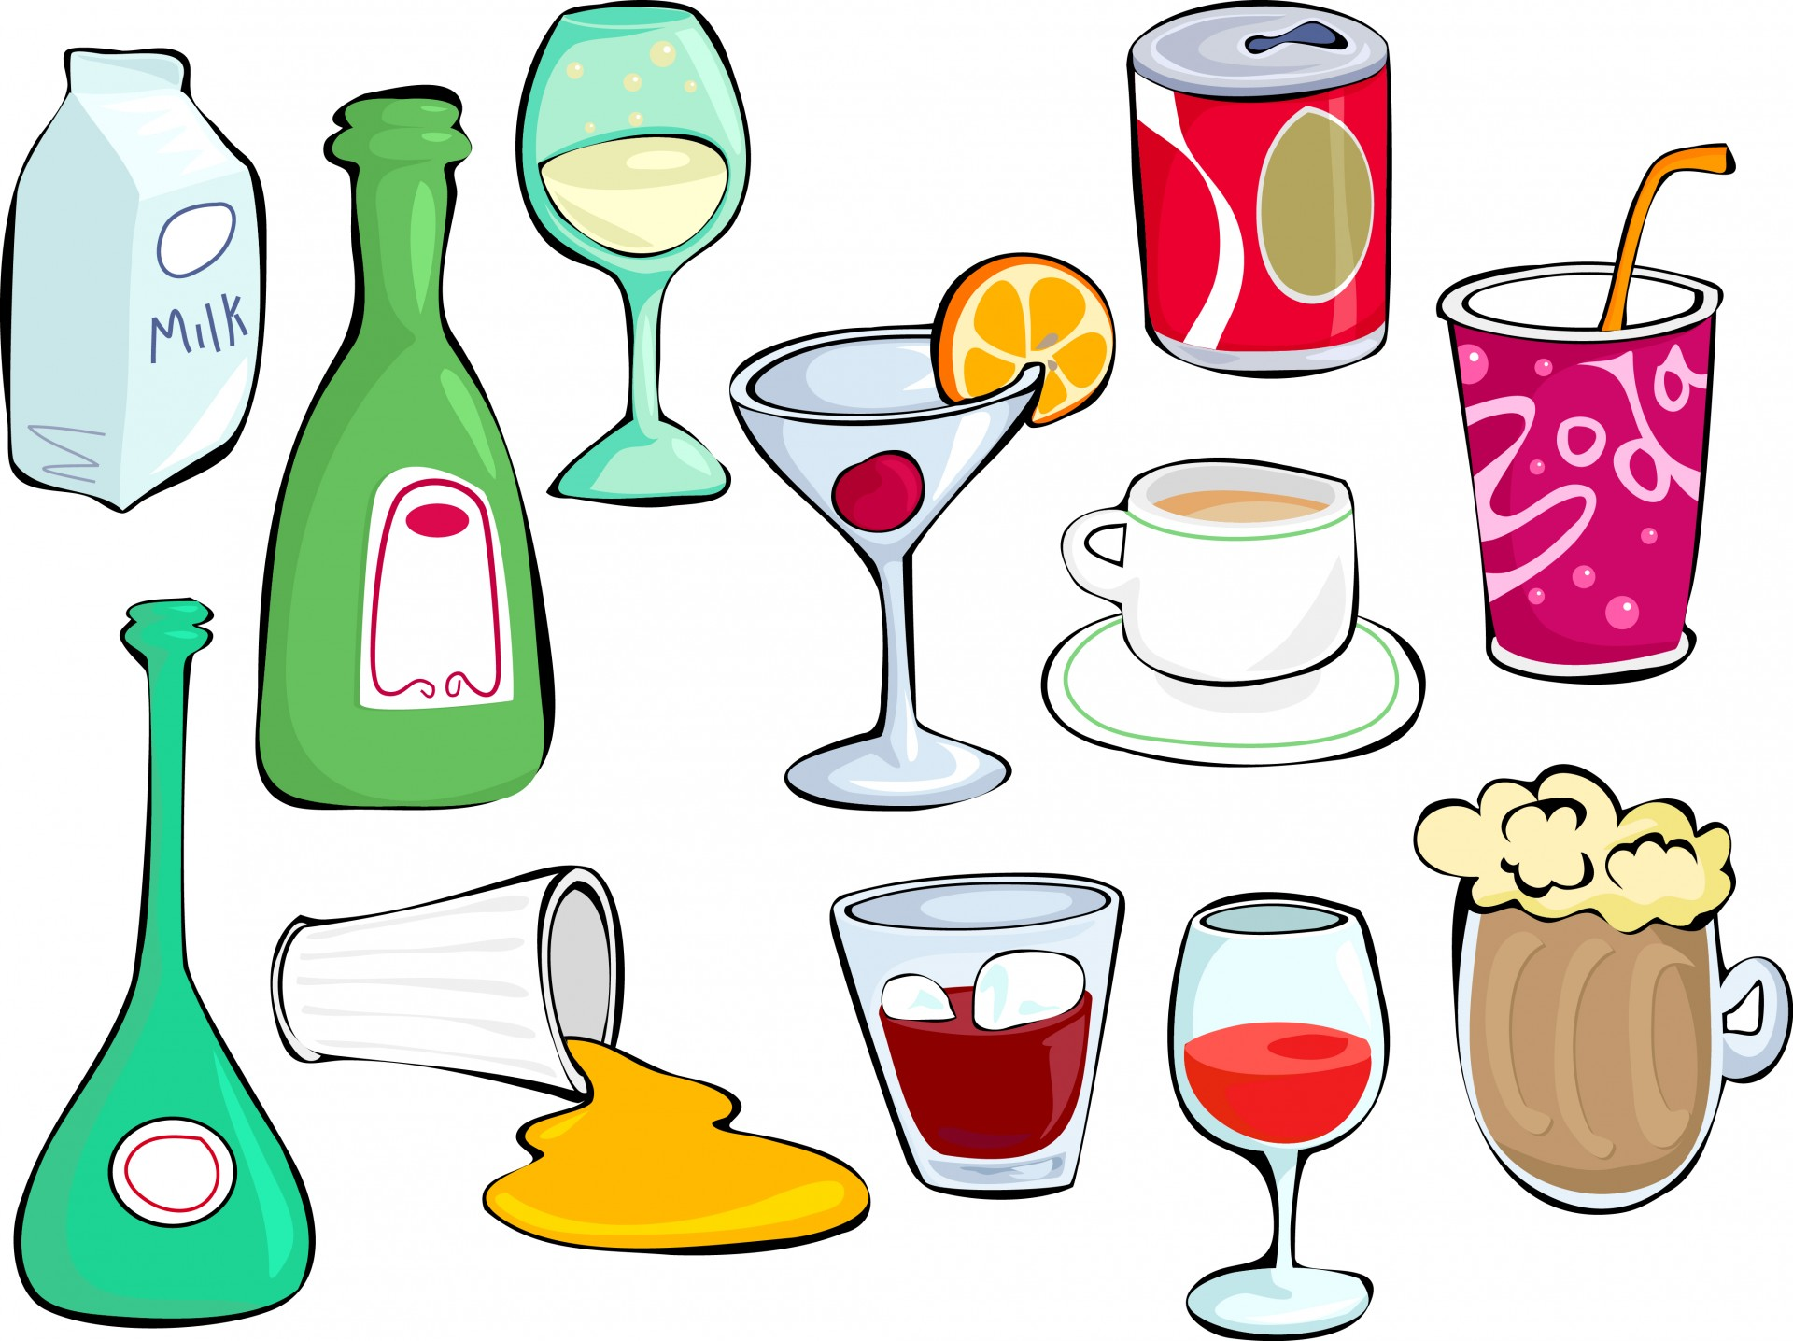
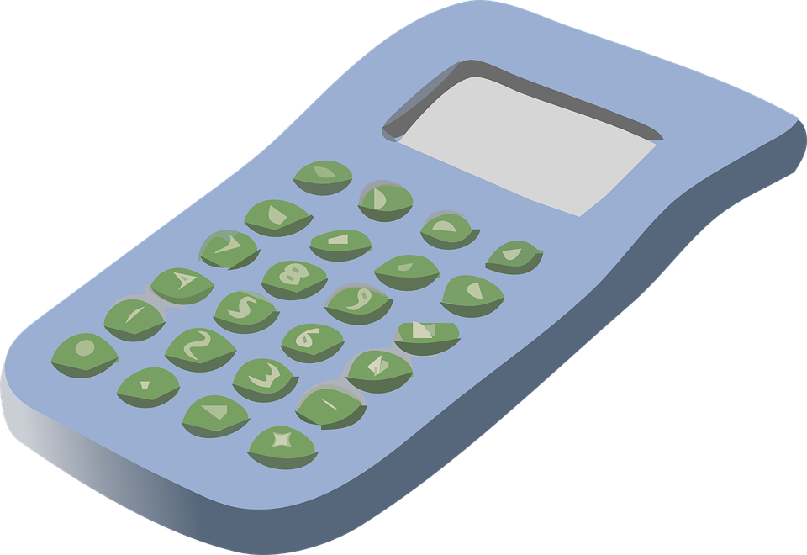
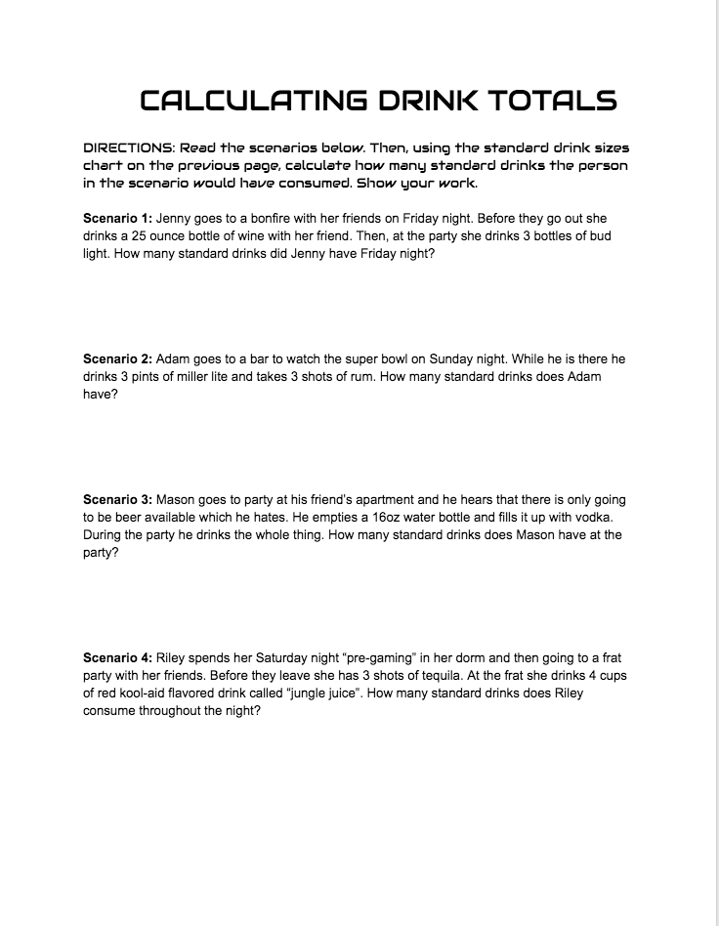
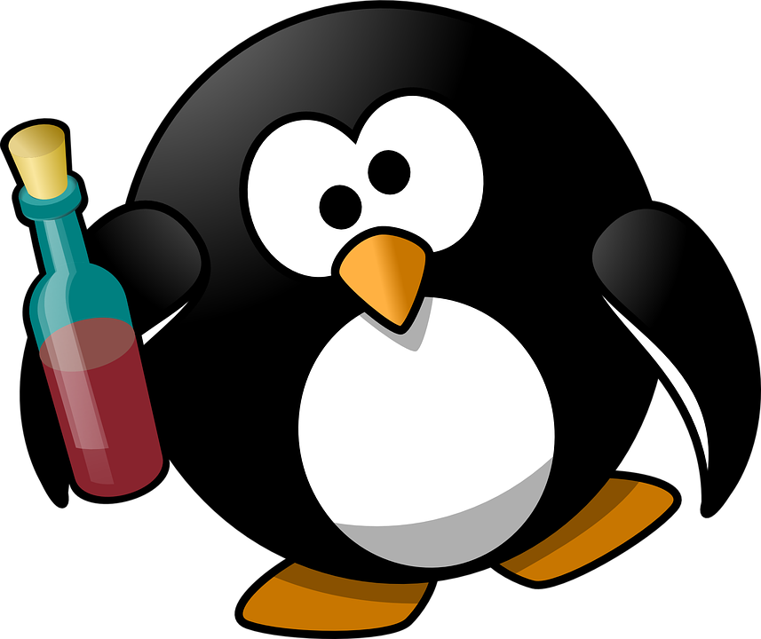
Calculating Drink Totals

Slide 28
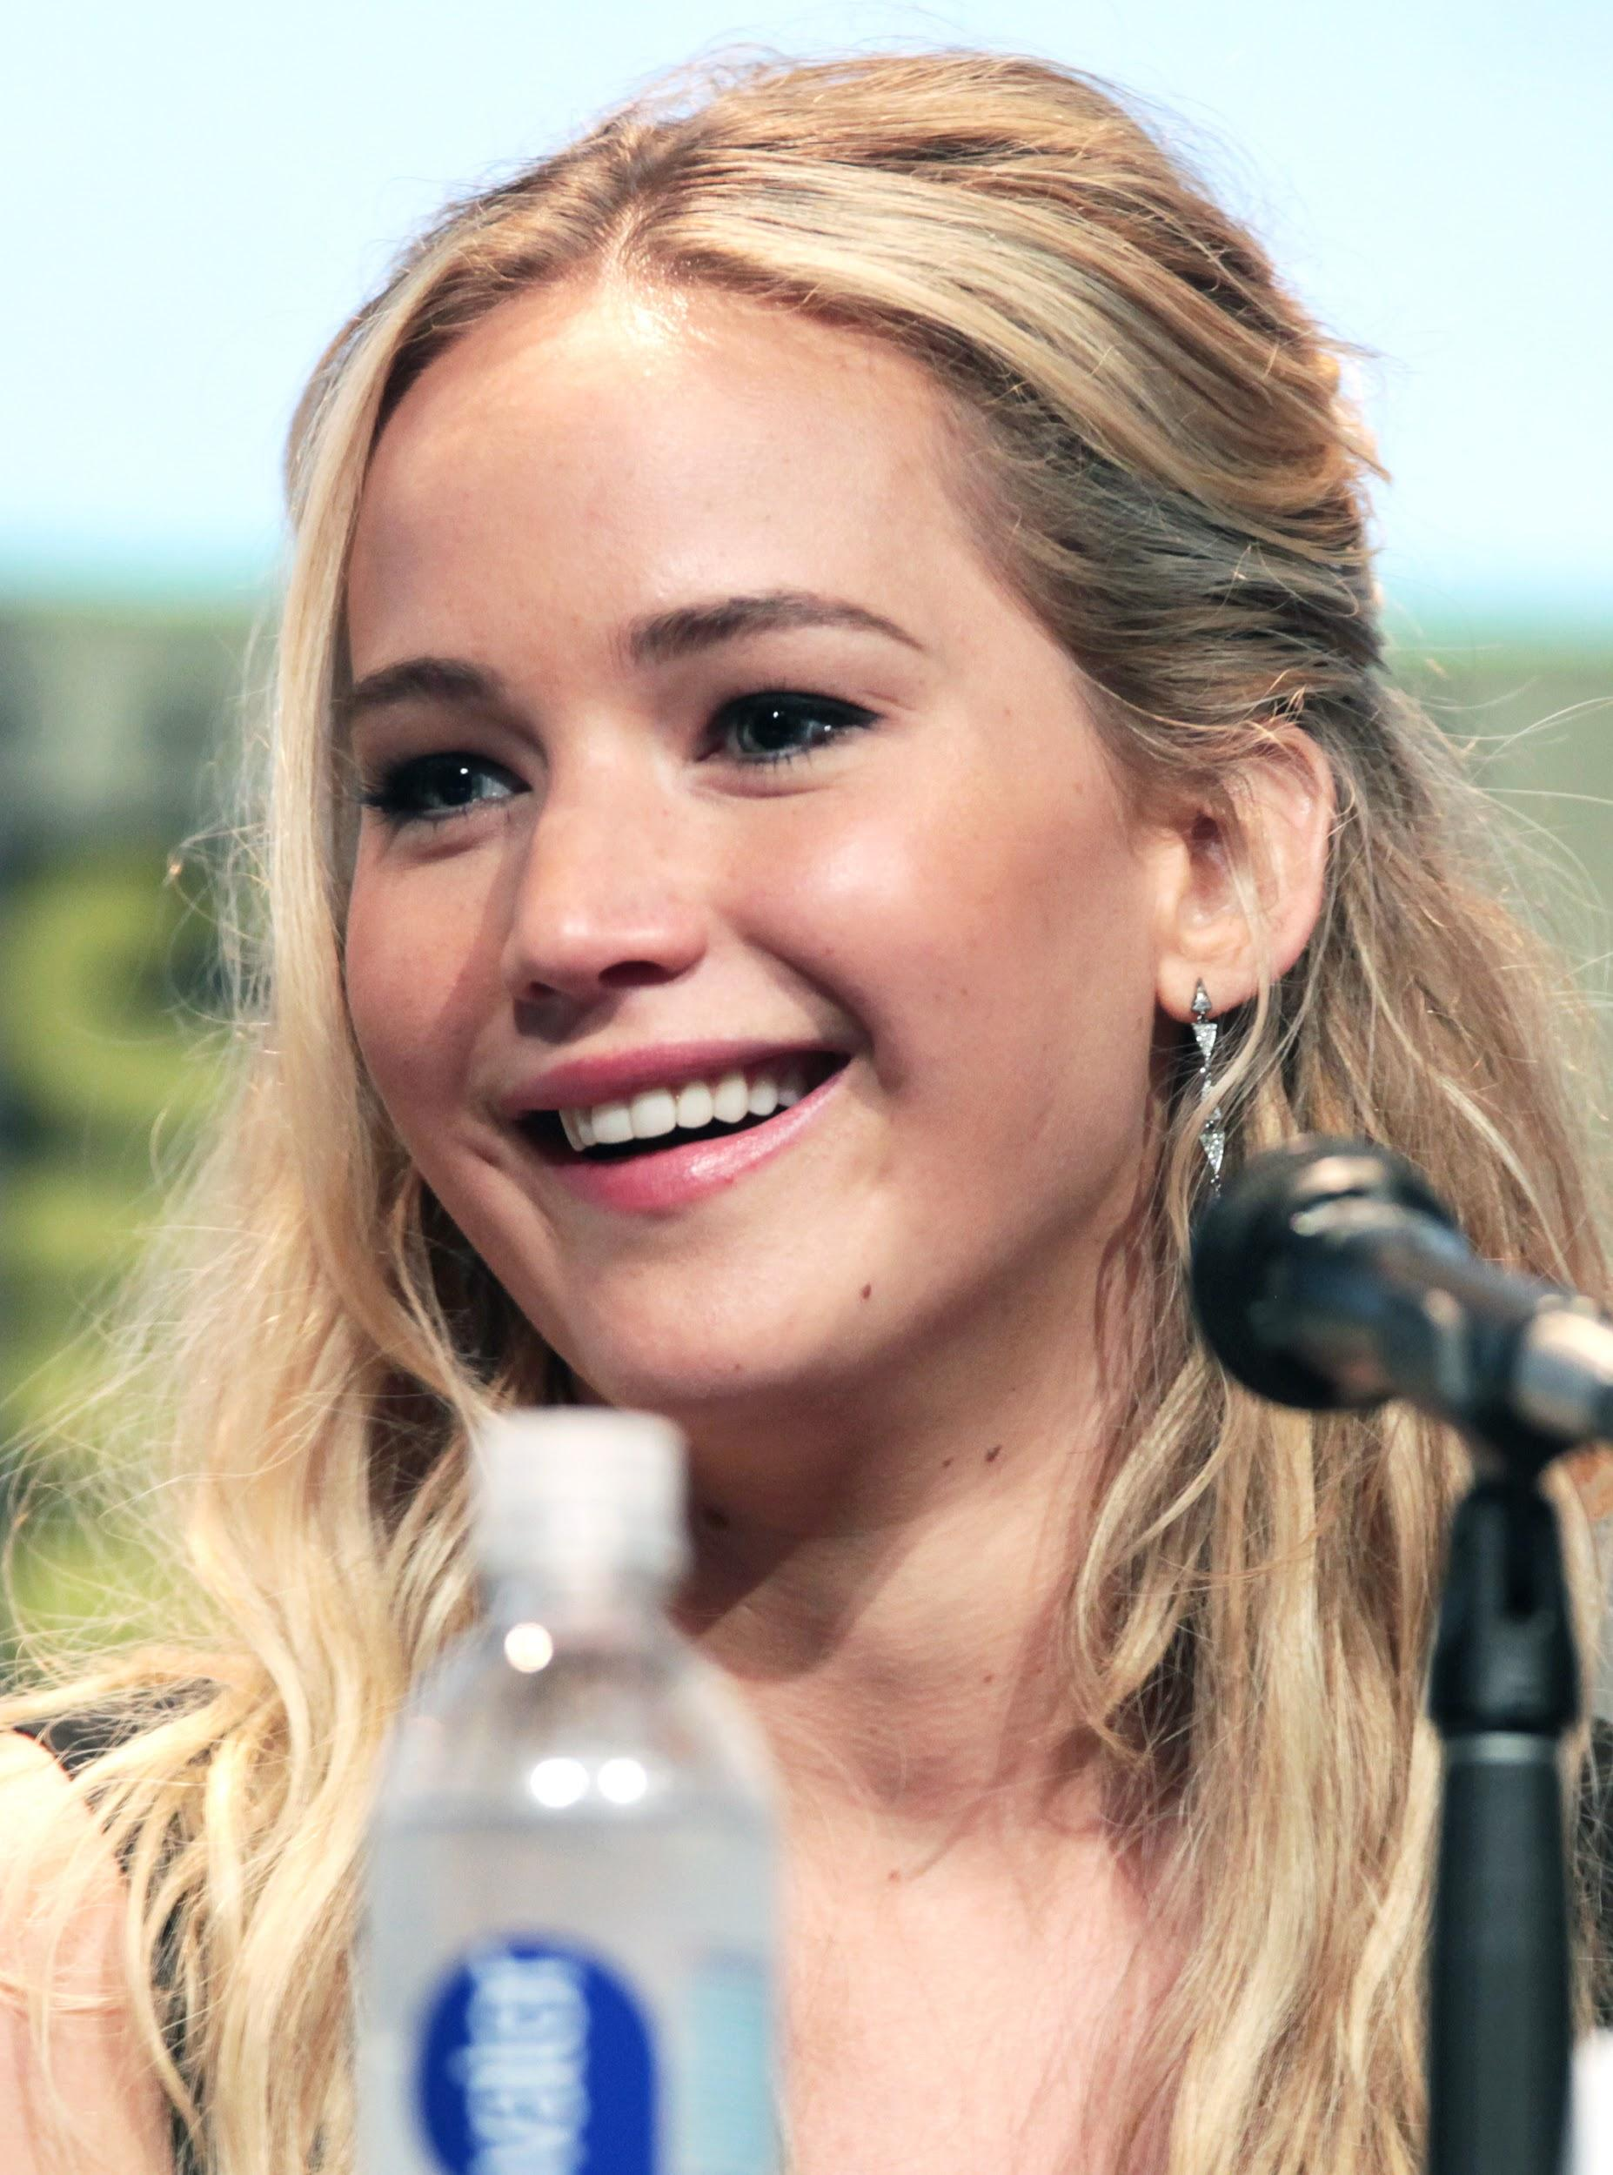
Jenny
25 ounces of wine = 5 drinks
3 bottles of bud light = 3 drinks

Slide 29
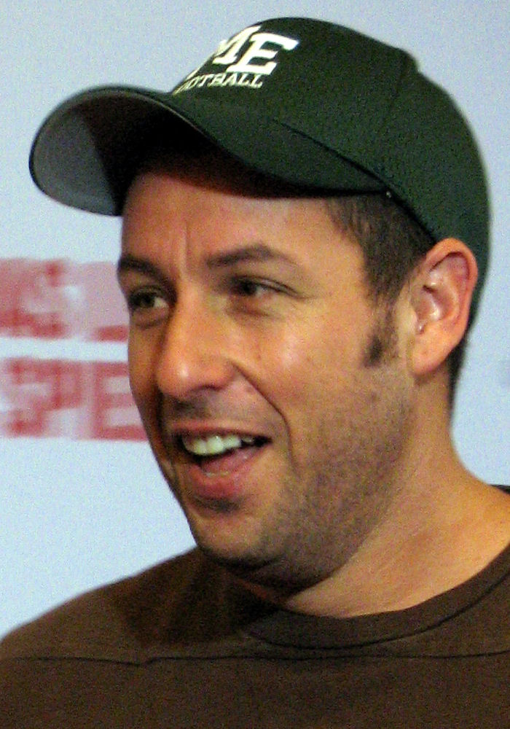
Adam
3 pints of Miller Lite = 4 drinks
3 shots of rum = 3 drinks

Slide 30
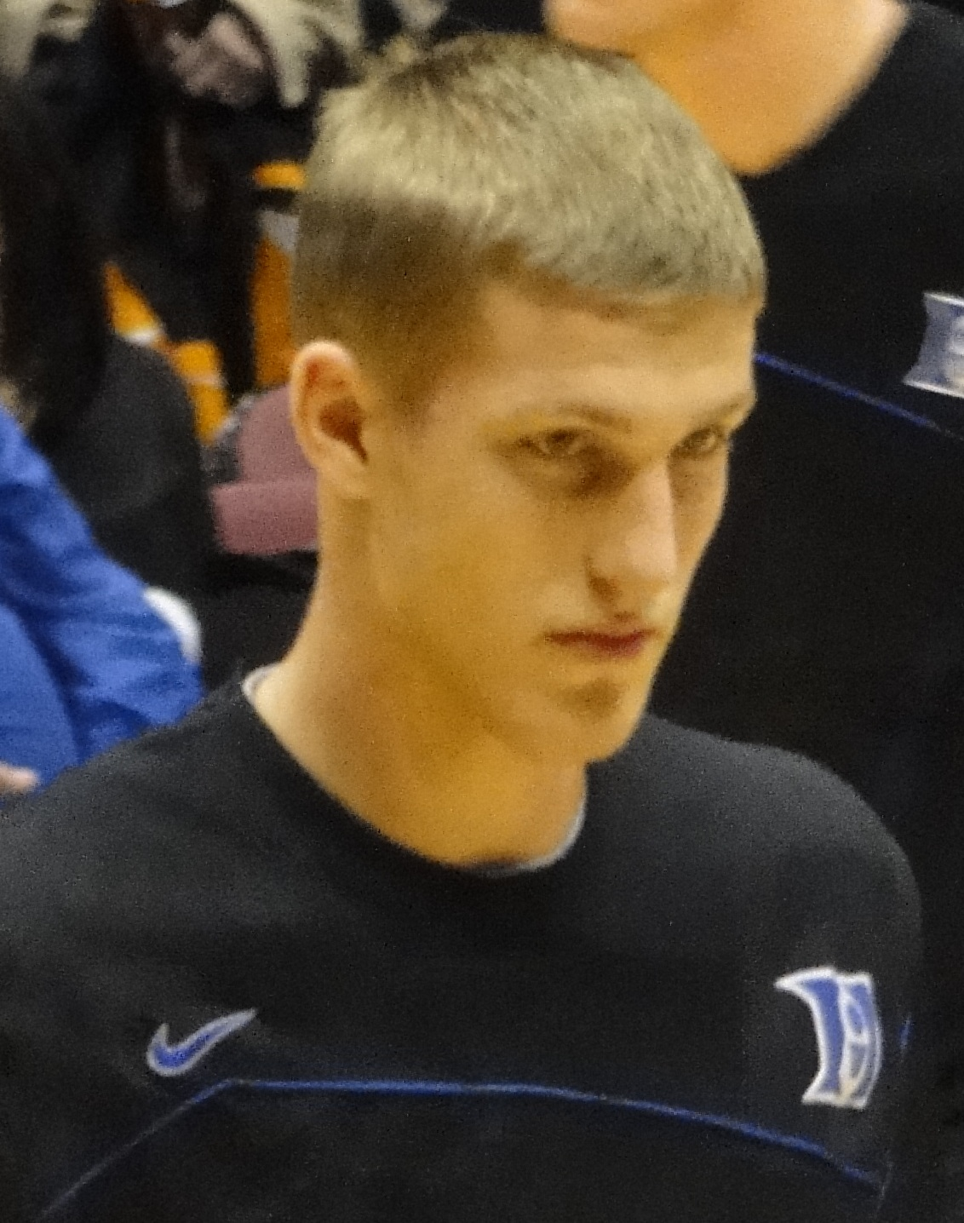
Mason
16 oz water bottle of vodka = 10.67 drinks

Slide 31
Riley
3 shots of tequila = 3 drinks
4 cups of jungle juice = ??????

Slide 32
BAC Effects

Slide 33
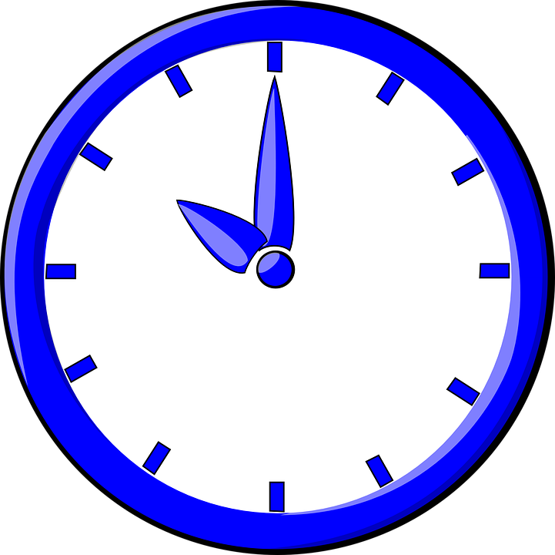
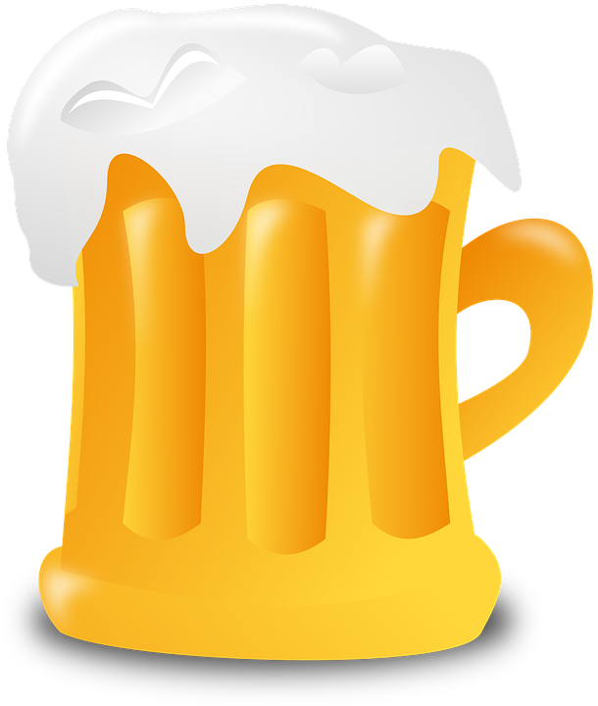
Alcohol is metabolized at what rate?
1 Drink Per Hour

Slide 34
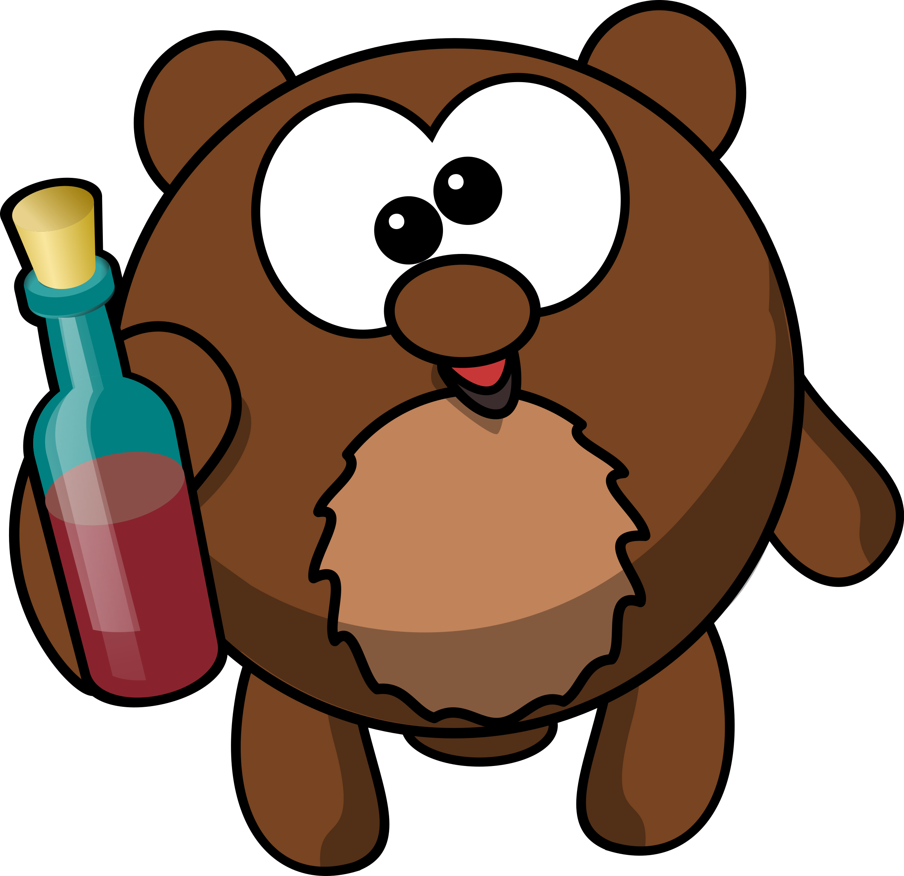
BAC of .02 - .04:
What are the effects?
Slight buzz in head, feel more at ease

Slide 35
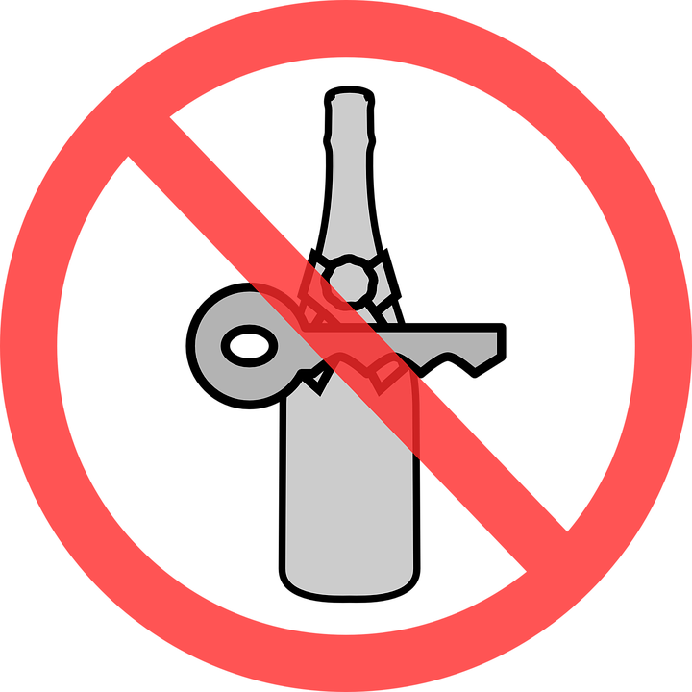
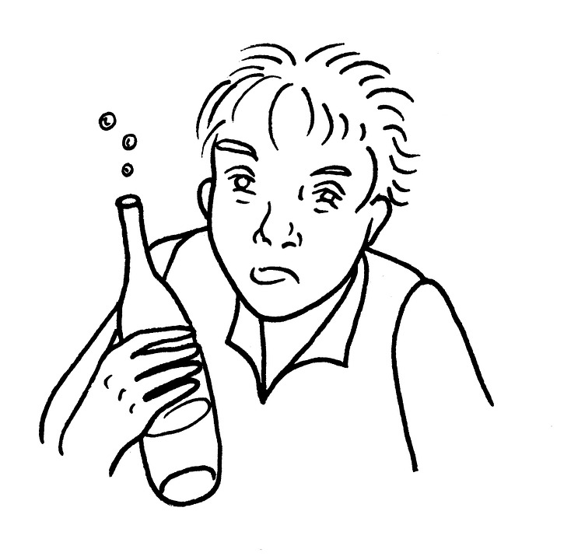
BAC of .07 - .09:
What are the effects?
Vision, hearing, reaction time, and speech are impaired
Judgement also inhibited
Illegal to drive (if 21 and older)

Slide 36
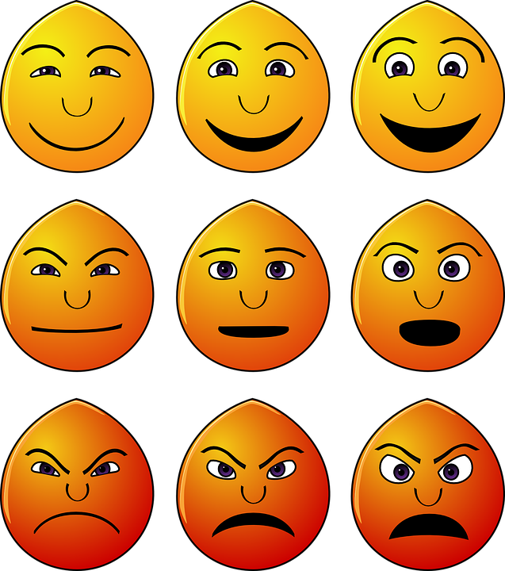
BAC of .10 - .15:
What are the effects?
Emotional responses are no longer regulated
Increased aggression
Decreased motor control

Slide 37
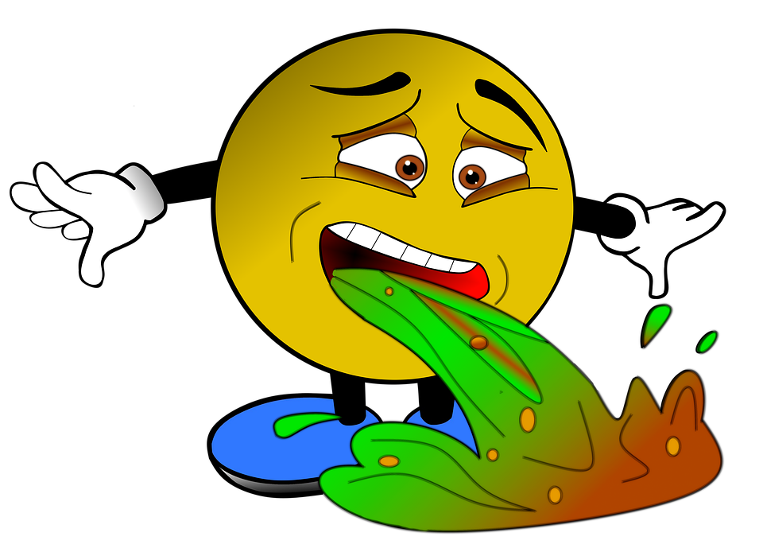
BAC of .16 - .19:
What are the effects?
Intense nausea
All previous symptoms are increased

Slide 38
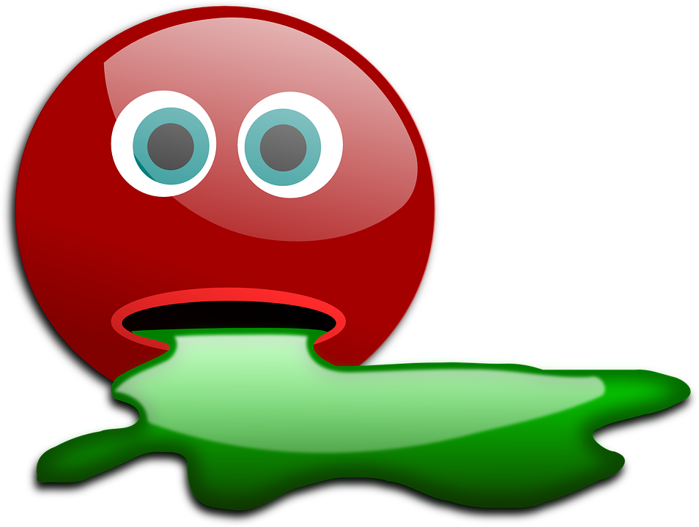
BAC of .20 - .25:
What are the effects?
Dazed and confused
Standing and walking seems impossible
Pain signals inhibited
Vomiting
Memory blackouts

Slide 39
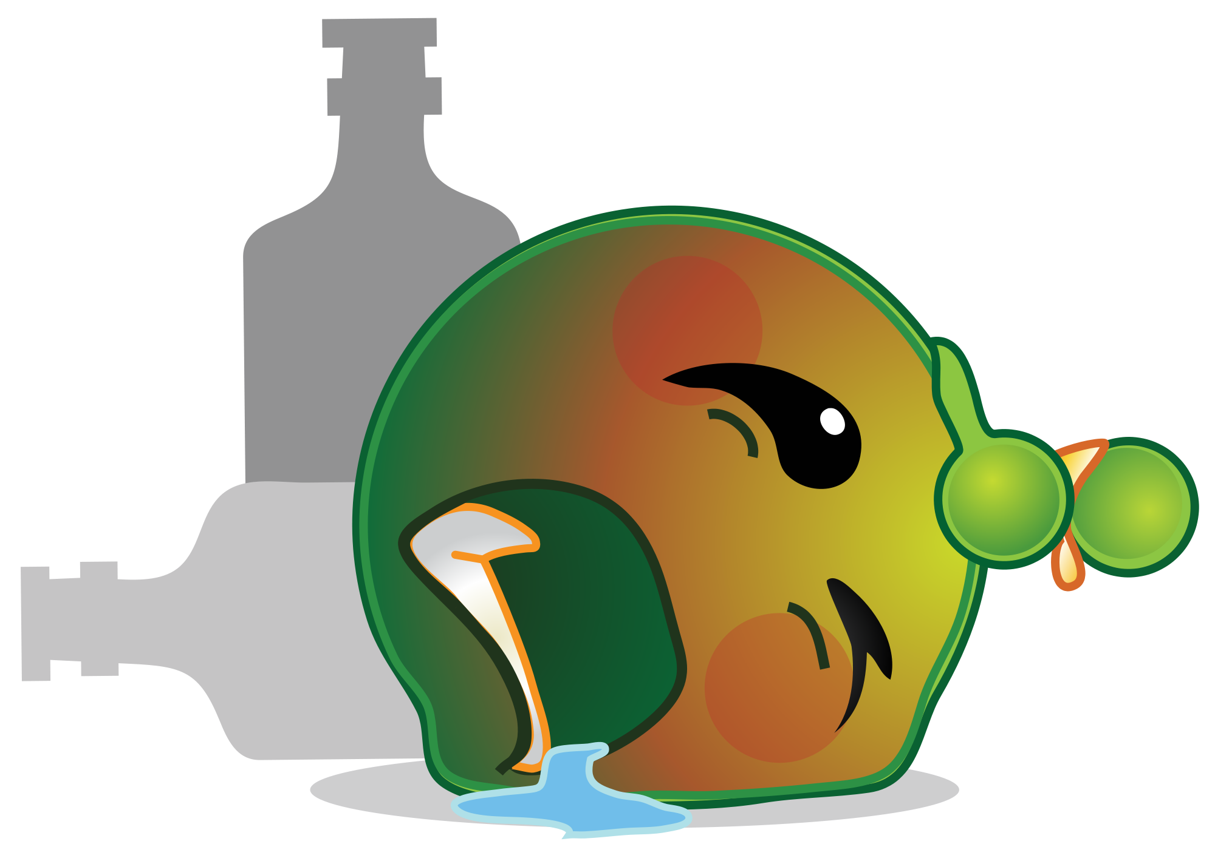
BAC of .30 - .40:
What are the effects?
Breathing, heart rate, blood pressure, and vomiting no longer regulated
Risk of choking on vomit = fatal

Slide 40
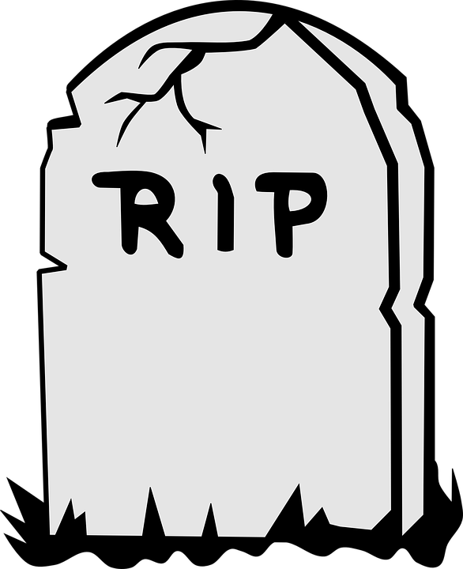
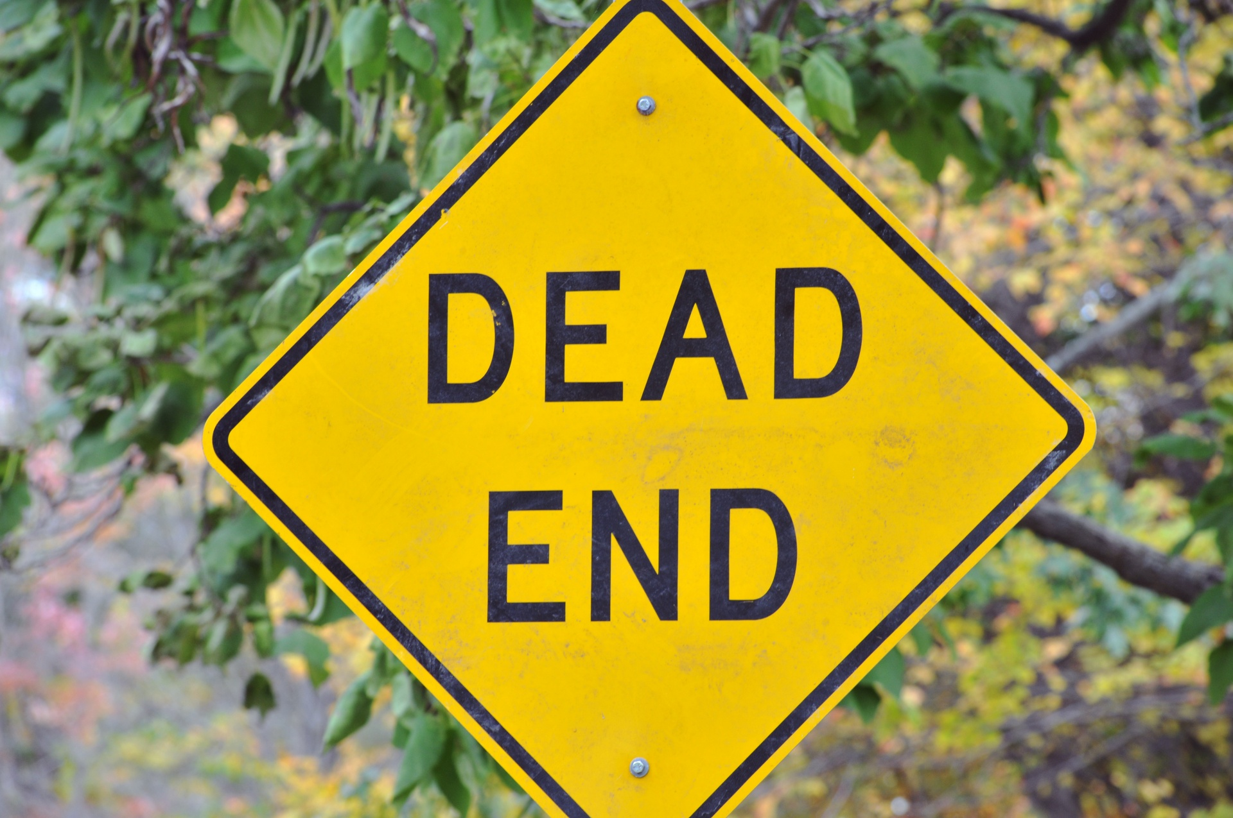
BAC of .40 and higher:: What are the effects?
Alcohol has turned off all communication in the brain
Coma and death possible

Slide 41
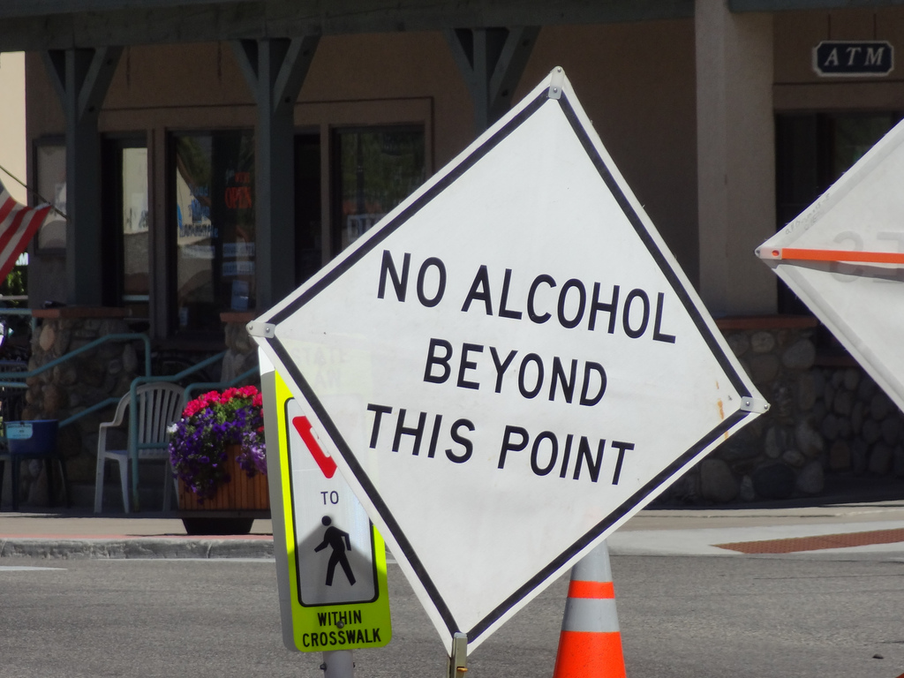
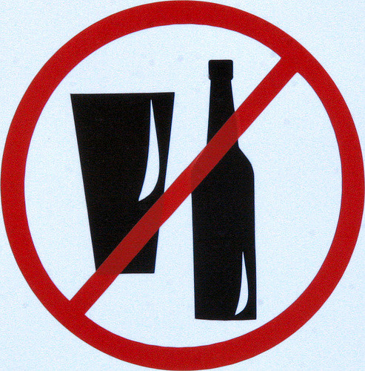
Why do some people decide not to drink?

Slide 42
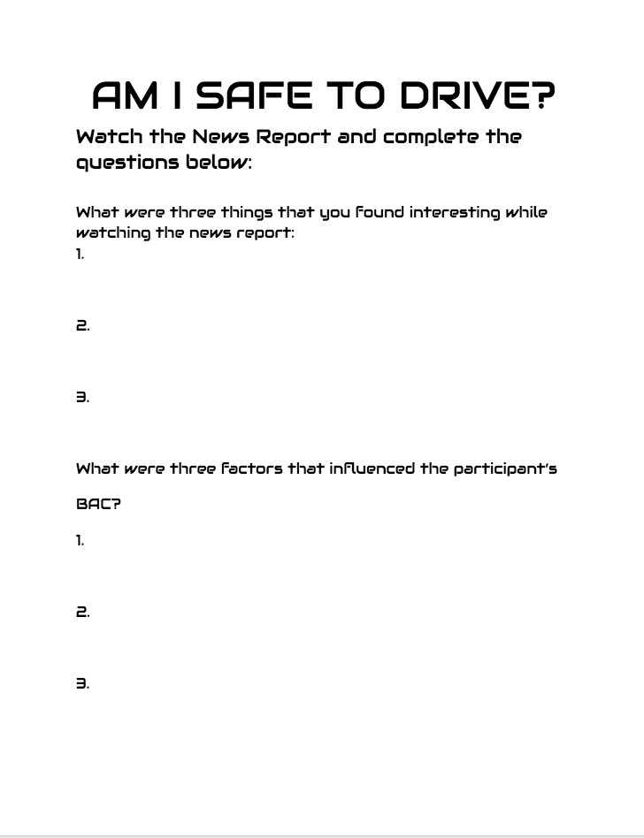
Am I Safe to Drive?
As you watch the video complete the worksheet.
3 interesting things
Factors that influence BAC

Slide 43
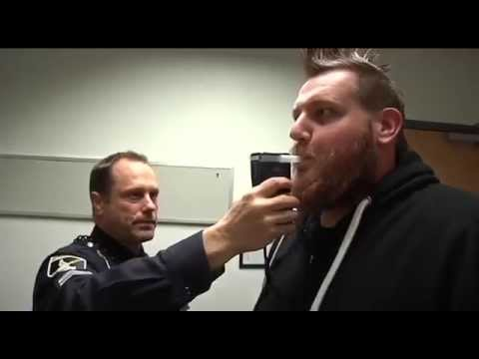

Slide 44
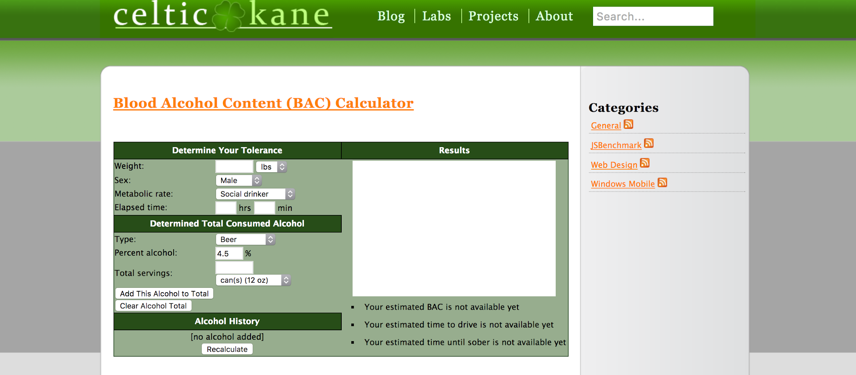
BAC Scenarios
http://celtickane.com/projects/blood-alcohol-content-bac-calculator/

Slide 45
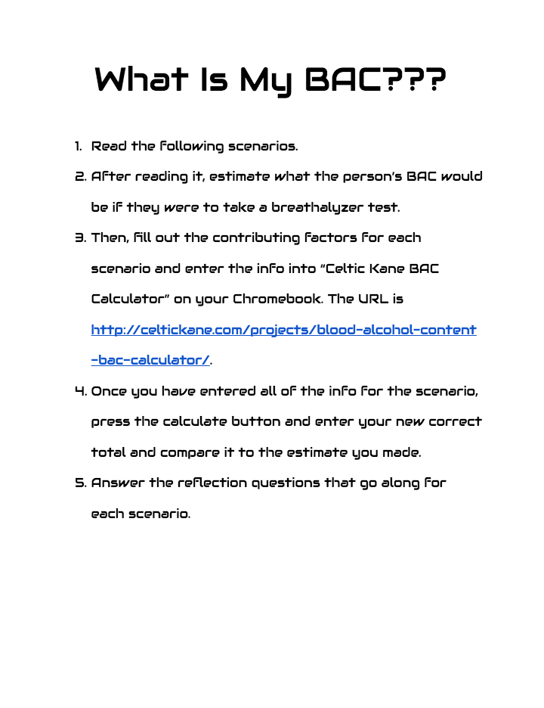
BAC Scenarios

Slide 46
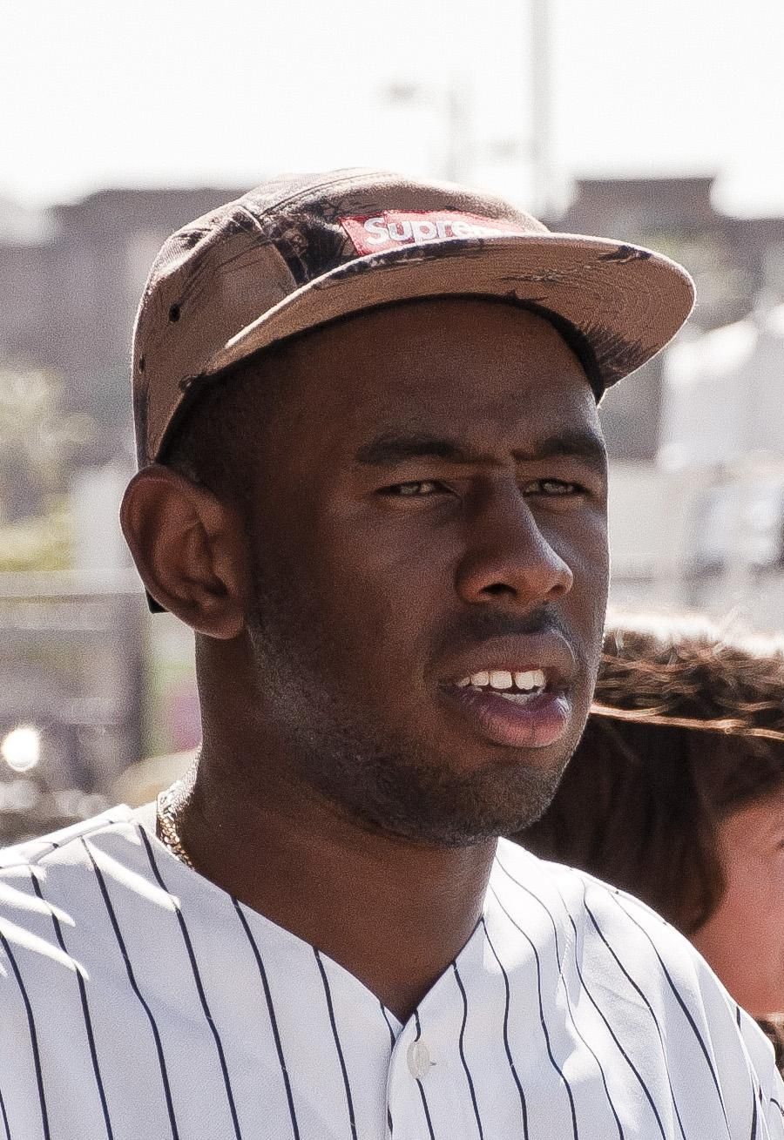
Tyler
BAC - .102
Tyler is the star quarterback on the high school football team. Standing 6’2” and weighing 200lbs he is being recruited by some big time college programs. Tyler is a social drinker and decides to go to a party after the game on Friday. He drinks a six pack of coors light and also has 3 shots of Fireball Whiskey over the course of 3.5 hours.

Slide 47
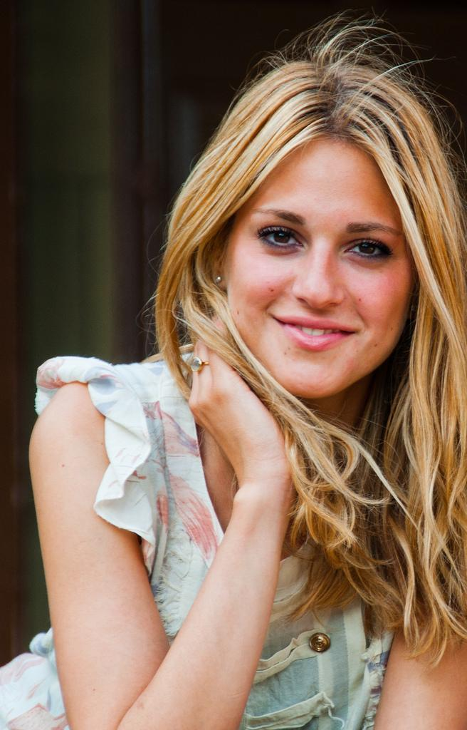
JoAnna
BAC - .375
JoAnna finishes her workout at the gym and weighs herself afterward where she reaches her goal weight of 140lbs. Her favorite band is playing at the BJC this evening and she has tickets to go with her friends. She rarely ever drinks and considers herself a cheap date, but since it is a special occasion they start drinking at 6PM before the concert at her apartment. JoAnna drinks 4 Mike’s Hard Lemonade bottles (12oz). She sneaks a water bottle with 12oz of Jack Daniels in the concert and finishes it by the end of the concert at midnight.

Slide 48
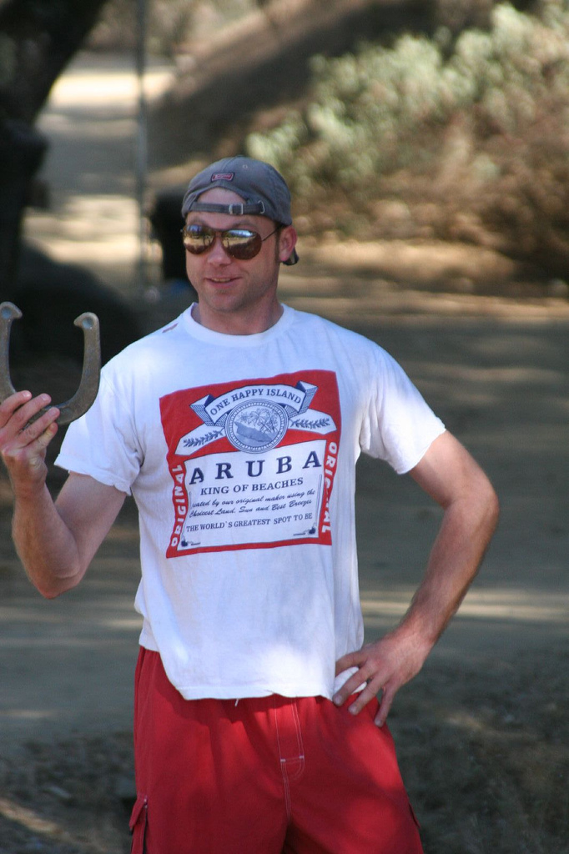
Ben
BAC - .167
Ben is the biggest partier among all his fraternity brothers. At just 145 lbs he can keep up with even the biggest guys in the frat. On saturday, it is a nice day out so they wake up and start drinking at 11:00AM. Ben drinks a six pack of Natural Ice beer and then a 40oz bottle of Colt 45. Later on he switches to drinking Vladimir Vodka (40%) and takes 6 shots of it before stopping drinking to leave at 7:30 to go the the basketball game on campus.

Slide 49
David
BAC - .14
David (168 pounds) is home alone for the weekend and is bored on Friday night and starts drinking his dad’s alcohol even though he is usually only a social drinker. He finishes a 6 pack of Budweiser pints and two regular sized glasses of Barefoot Wine from 5:30-11:30. He gets hungry so he stops drinking to drive to McDonald’s for something to eat. He figures it is ok since he has been drinking over a few hours now.

Slide 50
Remember…..
=

Slide 51
When in doubt…..

