Slide 1
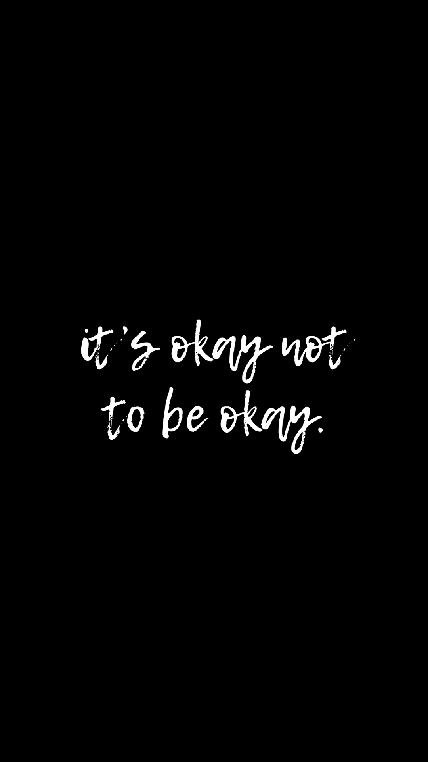
Mental Health

Slide 2
Mental Health
What is a “healthy” mental health?

Slide 3
Stigma
What is stigma?
What are some stigmas of mental health?
How can one help change this stigma?

Slide 4
Social Media
How does social media affect someone’s mental health(especially your age population)?
How can someone change this as far as how it is affect them as a person?
How can social media help with Mental Health?

Slide 5
School Environment
How can school help with Mental Health?
How can you help with Mental Health?

Slide 6
Coping Skills
What are coping skills?
Why is it important for someone to have coping skills?
What are some examples of coping skills that someone may use?
Give out index cards- write down 3 coping skills you use
Write down 2 people you can go to for help

Slide 7
Mental Health Myths-just to name a few
They are not normal- false, they are just average people that have to deal with a condition, just like if someone had diabetes, high blood pressure. They can live a productive and successful life.
They are crazy- false, the chemicals in the brain might be unbalanced which could cause some psychological and physical effects on their bodies- that maybe different than others
They have to take tons of medicine- false, yes some medication may be needed to help that person, cope and manage their mental health condition, but it would be like someone taking insulin for diabetes.
Question- why do young teens/adults not ask for help when struggling mentally?

Slide 8
Depression
Facts

Slide 9
Sadness vs Depression
It is okay to feel sad, discouraged, or have the blues at times. Life will give us unexpected hurdles- such as fights with friends, getting a bad grade, or moving to a new school.
Can you name any other situations where someone might feel sad?
People can manage these and over time will get over this feeling. It does not last long, it could last for a few hours, or even a few days. But, again the feeling goes away.

Slide 10
Depression
Is a STRONG mood where the blues you are experiencing do not go away easily.
In fact the feeling down, can last weeks, months, or even longer.
People think depression just affects someone mood, but it can affect their thinking, and can affect their daily life activities.
People with depression lose the joy in everyday life. They can have little to no energy, even to do the simple things like eating, getting dressed, etc.
What are some other daily activities do you think people with depression might not be able to do?

Slide 11
Signs of Depression
Negative mood or feelings of being hopeless
May feel unwanted, rejected, not want to do a thing
Start to stop doing what they have enjoyed- socially withdrawal, stop eating, stop caring what they look like etc
What are do you think are some other signs of depression?
Keep in mind- depression is not always feelings of being down, emotions can also be displayed by anger, irritability, easily annoyed.

Slide 12
Signs of depression-cont
Negative thinking- they believe things will not get any better
Low energy and motivation and concentration problems- feel tired, may sleep all day for days on end, have a hard time completing assignments or daily activities
Physical Problems- might lose or gain weight, upset stomach, may have headaches, sleeping problems
Social withdrawing- someone that is outgoing, you might notice them not wanting to hang out with others, or find someone going into their room a lot- not wanting to talk to others

Slide 13
Can Depression go unnoticed?
Do you think depression can go unnoticed?
Believe it or not some people may not notice they have depression- they do not recognize the symptoms and they start to think they are just a bad kid, or a weak student. It could come across that person has a bad attitude.
What ways can someone hide they may be suffering from depression?

Slide 14
Anxiety
Anxiety among teens is normal among stressful situations- such as taking exams, having to give a speech in front of a crowd.
But, some teens have such severe anxiety it can affect their friendships, family relationships, and their daily life.
According to the National Institute of Mental Health, approximately 25% of 13- to 18-year-olds have an anxiety disorder, and just under 6% have a severe anxiety disorder.
Besides the ones mentioned- what are some other situations that could cause someone to have anxiety?

Slide 15
Hidden Signs of Anxiety
Emotional changes- unexplained outbursts, restlessness, feeling on edge
Social Changes- avoiding friend, avoiding social gatherings, stop doing activities you have always done
Physical changes- headaches(often), stomach issues, changes in eating habits,
Sleep habits- may not be sleeping much at all(too much on the mind), sleeping too much, toss and turning while sleeping, nightmares
Poor School Performance- grades dropping all of a sudden, failure to turn in school assignments, avoiding doing school work(due to be overwhelmed)
Do you think Social Media has an affect on Teen Anxiety, if so how?

Slide 16
How is Anxiety and Depression diagnosed and what treatments are available?
A parent, friend, or a relative can recognize signs. A health care professional will be the one to diagnose a person with anxiety or depression.
Treatments:
Medications- prescribed by a doctor
Counseling- one on one or a support group(may feel for more comfortable knowing other peers dealing with the same issues etc), talk to a trusted adult, sibling
Coping skills- such as drawing, reading and exercise- so important you find the right ones for yourself
What are other examples of coping skills can you think of?

Slide 17
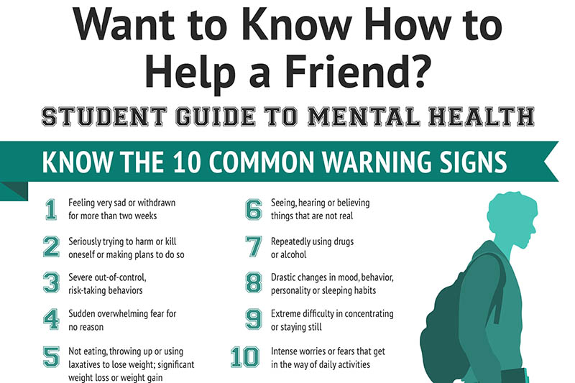

Slide 18
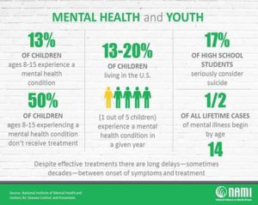

Slide 19
Other Mental Health Conditions
Bipolar Disorder- otherwise known as manic/depressive disorder- there are two classifications- Bipolar Type 1 and Bipolar Type 2. A person experiences “highs and lows” episodes.
OCD- Obsessive Compulsive Disorder- where the person has recurring unwanted thoughts, ideas, obsessions, that make them feel driven to do something repeatedly- Example- shutting off a light switch 10x’s before the person can leave the room
Phobias- persistent, excessive fear of a person, object,activity or animal- causes extreme fear in the person’s mind.
ADHD(attention deficit hyperactivity disorder)- A chronic condition including attention difficulty, hyperactivity, and impulsiveness.
Can you name a Phobia someone might have?

Slide 20
Eating Disorders- Body Images- how their mind sees themselves
Bulimia- where someone will eat a large amount of food in a short period of time that consists of a ton of calories. Then the person will feel guilty and use different methods to get rid of the food. Most of the time it will be by vomiting But, some will use laxatives or exercise excessively.
Anorexia- where the person sees themselves as “obese” and will starve themselves. They will consume little to no calories. If they eat, they usually count their calories and restricts their calorie intake significantly
Binge Eating- eating a large amount of food very quickly, even when no hungry, and to the point of being uncomfortable and lack of control when eating

Slide 21
Eating Disorders- Body Images- how their mind sees themselves
Pica- eating items that are not food, things like hair, ice, dirt, and chalk to name a few
Body Dysmorphic Disorder-in which you can't stop thinking about one or more perceived defects or flaws in your appearance — a flaw that appears minor or can't be seen by others. But you may feel so embarrassed, ashamed and anxious that you may avoid many social situations.

Slide 22
NAMI-National Alliance on Mental Illness
Has great resources to help kids, teens, young adults, adults, seniors
Each state/city has a NAMI organizations
They even offer online support groups, and in person support groups
In order to fight the “stigma” of mental health people need to be educated with the correct information and be OPEN to talk about it

Slide 23
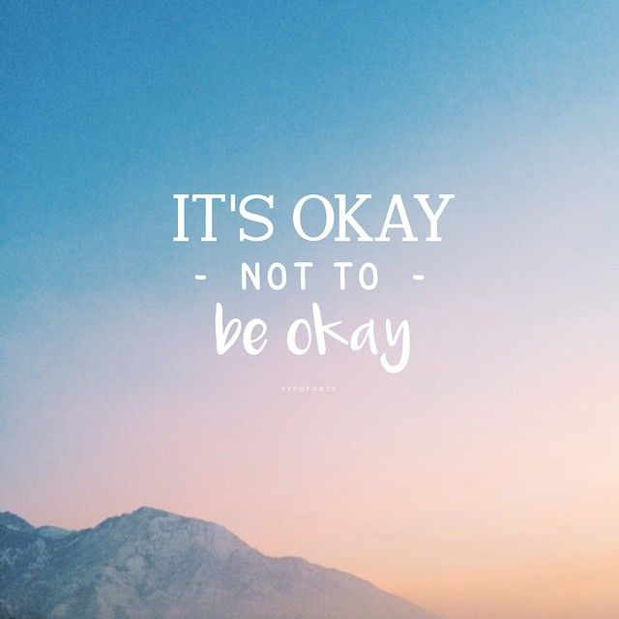
Remember
YOU are YOU! Mental Health Conditions does NOT define who you are!

Slide 24
Remember

