Slide 1
Socially Conscious
Social Networking

Slide 2
Which of the following social media accounts do you have?
Instagram
SnapChat
Facebook
Twitter
YouTube Channel
Online Gaming or Video Game
Other

Slide 3
In what ways does social networking positively affect peer relationships?

Slide 4
In what ways does social networking negatively affect peer relationships?

Slide 5
Social Media Pros Cons
Stimulates creativity
Connect with family and friends (old & new)
See what people are doing
Feelings of affirmation & support
Freedom/independence
Self Exposure/Career Promotion
A place for activism
Helps with homework
Communication
Networking (LinkedIn)
Emotional detachment/escapism
Self-Exposure (TMI)
Is it all truthful?
Info is archived (college/employer)
Cyberbullying
Social Combat
Peer pressure
Purposeful Exclusion
Identity theft
Online Predators
Addiction / Less Sleep
Notes:
Show Slide summarizing the pros and the cons (from previous students)
Intorduce the cyberbullying video clip.

Slide 6
When using social media, I want to see if my posts are getting likes and comments?
Yes
No

Slide 7
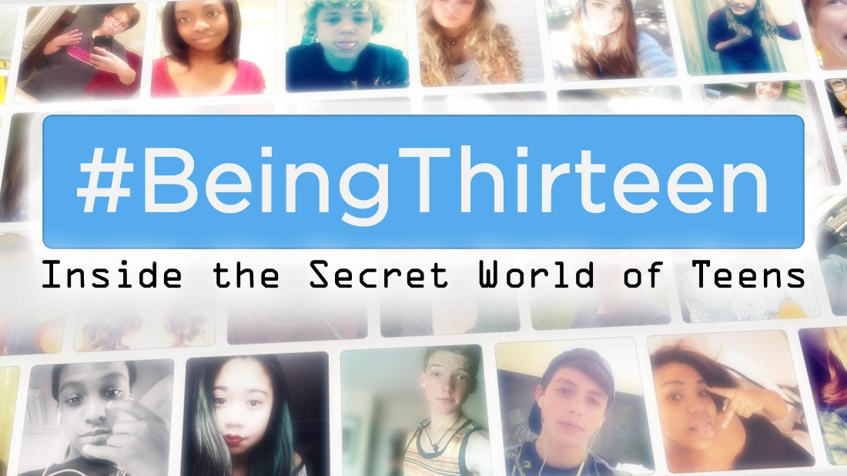
61% said, I want to see if my posts are getting likes and comments.

Slide 8
When using social media, I want to make sure no one is saying mean things about me.
Yes
No

Slide 9
21% said, I want to make sure no one is saying mean things about me.

Slide 10
Have you ever felt excluded by peers online?
Yes
No

Slide 11
47% said, I feel excluded by peers online.

Slide 12
How is cyberbullying different than traditional bullying?

Slide 13
What do cyberbullying and traditional bullying both have in common?

Slide 14
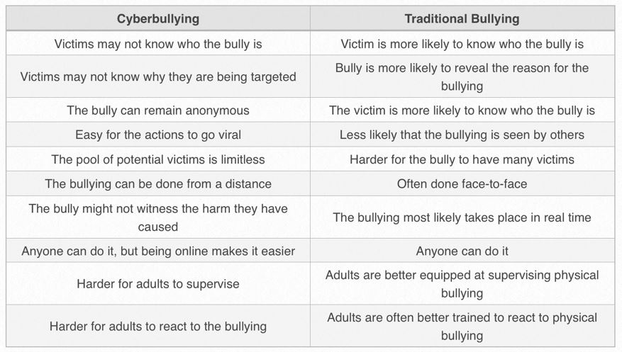
Cyberbullying vs. Traditional Bullying

Slide 15
Would you rather be bullied online or in person?
Online
In Person
Notes:
Ask students why, this generates some great discussion.

Slide 16
What should you do if you are being bullied or harassed online?
Print out the evidence
Delete the drama
Show a trusted adult – parent, teacher, administrator
Do NOT respond or provoke the bully
Block the bully

Slide 17
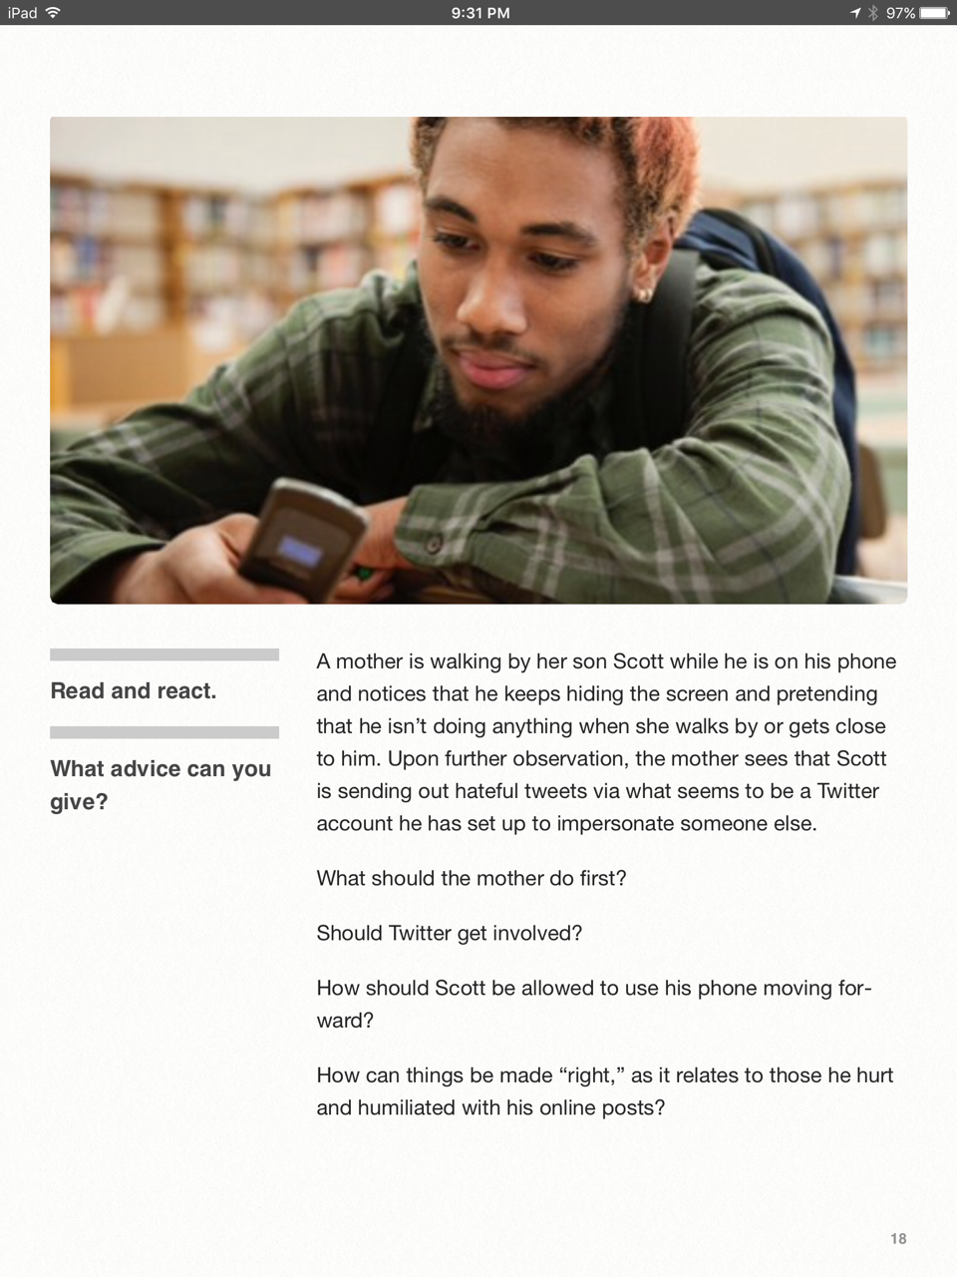
Notes:
Optional - You can use this scenario to discuss a “real-life” situation with your class

Slide 18
Have you ever posted something online that you wish you had not?
Yes
No

Slide 19
How can social networking impact someone’s emotional health in a positive and/or negative way?
Can you think of some examples and how that might impact someone’s emotional health?

Slide 20
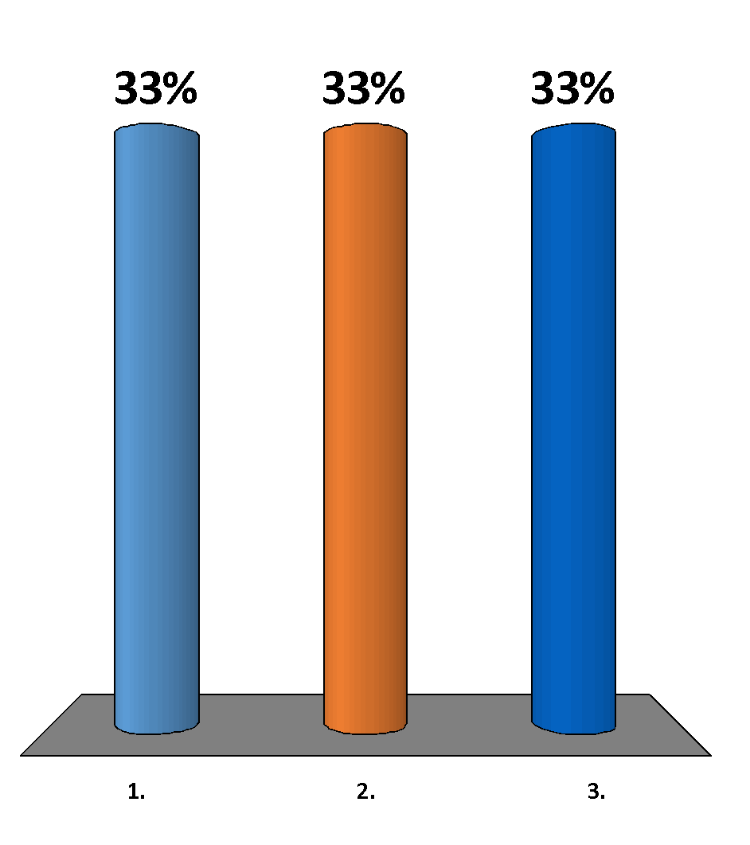
If a college or employer wanted to see my social media right now I would…
Have nothing to hide, please take a look!
Need to clean a few things up (ex: pics, posts, etc.)
Refuse to show them, I have some things to hide.

Slide 21
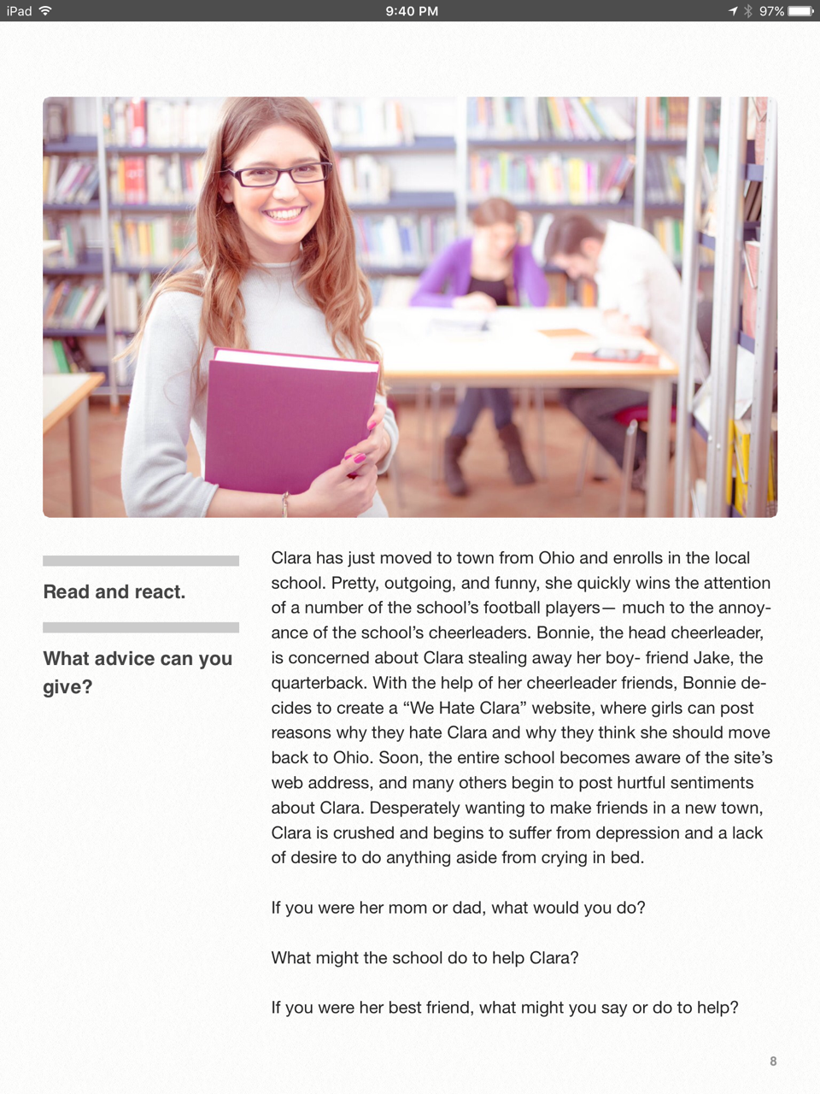
Notes:
Here’s another scenario to discuss as a class or in small groups

Slide 22
I would describe my “digital footprint” as...
Positive, something I’m proud of
Not sure, I’ve never really thought about it
Somewhat negative, I realize I should clean a few things up

Slide 23
If you were to give a 5th grader advice about appropriate social networking and use of social media, what would you say?

Slide 24
What you post…
is PERMANENT
Notes:
Some key takeaways..

Slide 25
Anytime you post something online, think about it as a nationally televised press conference
Notes:
Some key takeaways..

Slide 26
Just because you can, does not mean you should.
Notes:
Some key takeaways..

Slide 27
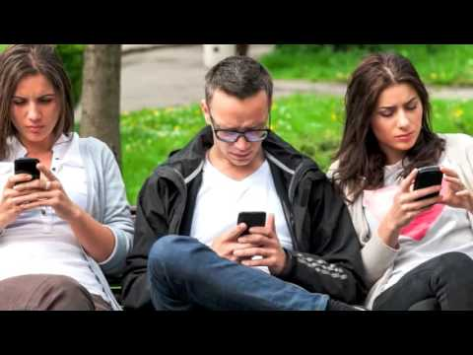
Notes:
The Digital Literacy Rap - You can show this as a fun way to wrap up the lesson.

Slide 28
Social Networking Reflection &
Advocacy Campaign
Notes:
see assessment attached with lesson - Social Networking Reflection & Advocacy Campaign

