Slide 1

STEP UP! DEPRESSION
AND
SUICIDE

Slide 2
Setting the Tone:
This presentation is meant to promote thought and discussion. I recognize that the sensitive or personally-relevant material presented may generate an emotional reaction for you and the participants around you. Therefore, I ask that you remain mindful of these sensitivities.
Notes:
Read slide out loud, then say:
There are three parts to today’s presentation.
First, we’re going to talk about the symptoms and red flags around depression and suicidal ideation.
Next, we’ll talk about how to Step Up to help people who may be struggling with these issues.
Finally, we’ll practice our bystander intervention skills in groups with three scenarios.
If at any time during this unit or anytime for that matter, you feel you would like to talk about this more or you need help, please let me know. I am here for you.

Slide 3
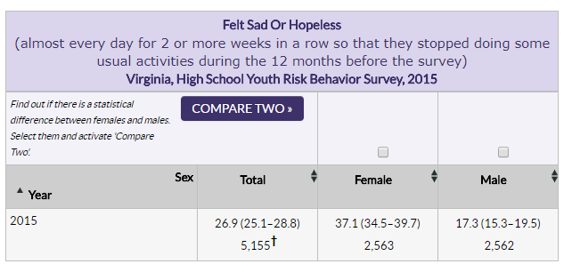
Virginia YRBS Data from 2015

Slide 4
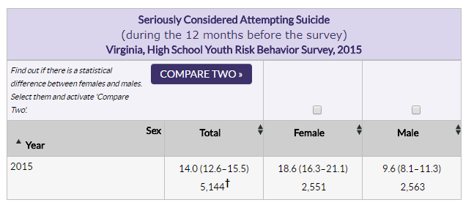
Virginia YRBS Data from 2015

Slide 5
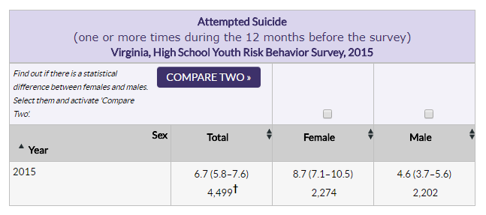
Virginia YRBS Data from 2015

Slide 6
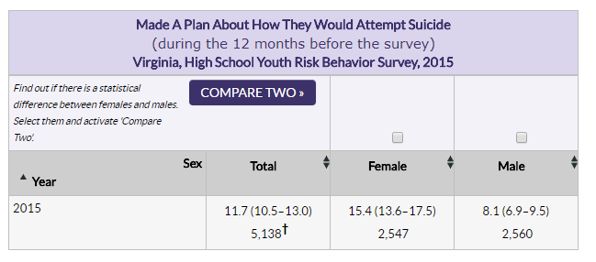
Virginia YRBS Data from 2015

Slide 7

CAUSES OF DEPRESSION
Depression is more than just feeling “down.” It is a serious illness
Research tells us that factors contribute to the onset of depression, including:
changes in brain chemistry
genetics
changes in hormone level
certain medical conditions
stress
grief or difficult life circumstances.

Slide 8

RISK FACTORS FOR DEPRESSION
Significant stressful events
Pressure in the environment
Injury or other medical conditions
Identity issues
Failure to live up to personal or external expectations
Problems with parents/friends/family/romantic partner
Substance abuse
Trouble in school; being expelled from school
Loss of any major relationship, including through death
Notes:
Significant stressful events – death, divorce, abuse, transitions/life changes, loss of romantic relationship/ friendship – Now what? Who am I?
Pressure – Academic, Athletic, Personal, Financial
Injury – short or long term. Other medical conditions
Identity as a person – too much of their identity is tied to being an “athlete”
Failure to live up to personal or external expectations
Significant change in team status
Problems with coaches/teammates/roommates/romantic partner
Substance abuse (individuals may choose to cope by using alcohol or other drugs)
Being fired; being expelled from school
Loss of any major relationship, including through death

Slide 9

SYMPTOMS OF A MAJOR DEPRESSIVE EPISODE
5 or more of the following 9 symptoms nearly every day for at least 2 weeks.
  1. Depressed mood* [or irritability]
  2. Markedly diminished interest or pleasure in activities*
  *One of these must be present
Notes:
As a bystander, think about what you might observe in a person or what might their friend/roommate/etc. report to you.

Slide 10

DIAGNOSTIC CRITERIA, CONT’D
  3. Significant weight loss (w/o dieting) or gain or increase or decrease in appetite
  4. Insomnia or excessive sleep
  5. Physically agitated or slowed down
  6. Fatigue or loss of energy
  7. Feelings of worthlessness or excessive or inappropriate guilt
  8. Diminished ability to think or concentrate; or indecisiveness
  9. Recurrent thoughts of death or suicidal ideation

Slide 11

KEY POINTS ABOUT SUICIDE
If you have a feeling that a person may be thinking about suicide, you should ask about it.
Asking about suicidal thoughts will not ‘put ideas into a person’s head.’ If you are concerned enough to ask, it’s likely that the person has already thought about it.
Asking someone about possible suicidal thoughts opens up communication and reduces the risk of an impulsive act.
Suicide is preventable. You don’t have to be a mental health professional to save a life. Initiating conversation is key.
Notes:
It is possible that a person who is depressed is thinking about suicide. It is very important that you ask the person about whether they have been thinking of suicide.
The most important thing is to ask the question and open up the conversation so that you can encourage people to get help.
You can say something like this: “I’m really concerned about how you’re doing. I’m wondering if you are considering suicide.”
The only truly ineffective way of asking about suicide is to say, “You’re not suicidal, are you?” This shuts down the conversation because it implies discomfort with the topic and that you are hoping for them to say ‘no.’

Slide 12

RED FLAGS FOR EMOTIONAL DISTRESS (OTHER THAN DIAGNOSTIC CRITERIA FOR DEPRESSION)
Mood swings; impulsive acts; reckless behavior.
Neglect of personal care.
Making negative remarks about one’s self, one’s life, or the future.
Reports of feeling misunderstood or rejected.
Poor coping skills.
Withdrawing from friends/family.
All-or-nothing thinking.
Marked decrease in academic or athletic/extracurricular activities.
Intentional self injury.
Giving away possessions.
Making comments about no longer being around.
Notes:
We’re now going to look at some red flags that indicate emotional distress. These red flags are indicators that stepping up may be warranted. The more red flags you notice, the more you should consider stepping up.
Mood swings; impulsive acts; reckless behavior.
Neglect of personal care (e.g., not bathing); deteriorating physical appearance.
Making negative remarks about one’s self, one’s life, or the future.
Reports of feeling misunderstood or rejected.
Poor coping skills (e.g., using alcohol, drugs)
Withdrawing from friends/teammates. (e.g., declining invitations to go places with a group of friends)
All or nothing thinking.
Marked decrease in academic or athletic performance
Intentional self injury.
Giving away possessions.
Making comments about no longer being around.

Slide 13

WHAT TO DO:
Have a safety plan before beginning the conversation.
Describe specific situations or behaviors that concern you.
Keep your statements brief.
Reflect feelings.
Help them to begin to contemplate that a change is needed.
Avoid labels, judgments, or critical statements
LISTEN – find out what is going on in their lives.
Repeat (1) the evidence, (2) your concern, and (3) that you feel strongly that they need to seek help
Notes:
Before beginning, identify any emergency resources you might need in case the person discloses that s/he is imminently suicidal. This may be your counseling center’s emergency number, your campus police, etc.
Then, identify the most important things you’d like to say.
Try to find a time when neither of you is upset, tired, distracted, etc.
Be specific about behavioral things you have seen or heard which cause your concern. For example:
You haven’t been to class for 2 weeks.
I don’t see you anymore – you’re in your room a lot.
The text message you sent me last night about ‘not being able to take it anymore’ really worried me.
I’m concerned about your eating (or sleeping) lately.
You seem sad or down.
Keep your statements brief; allow the person time to respond.
Reflect feelings. “I’m hearing a lot of sadness in your voice.” “You’ve become really hopeless . . .”
Avoid labels, judgments, or critical statements such as:
What’s wrong with you!?
You always….
You shouldn’t feel worried about that – it’s no big deal.
Help them to begin to contemplate that a change is needed. Plant seeds that a change may be a good idea.
"I'm saying this because I care.“ is a hard thing for a person to argue with.
LISTEN – find out what is going on in their lives.
Repeat (1) the evidence, (2) your concern, and (3) that you feel strongly that they be evaluated by someone who is properly trained.
Speak positively about counseling.
Consult, consult, consult [Know the limits of your competence and when to reach out for assistance!]

Slide 14

WHAT NOT TO DO:
Don't be afraid to ask about suicidal thoughts.
Don’t give simplistic solutions.
Don't keep secrets.
Don't gossip.
Don’t assume that this is a one-time conversation.
Notes:
Don't be afraid to ask about suicidal thoughts.
Don’t give simplistic solutions. (e.g., Why don’t you just eat—everything would be ok..)
Don't keep secrets. [You may need to call your counseling center, Dean of Students, etc. for support.]
Don't gossip. [There is a difference between gossiping and consulting.]
This is NOT likely to be a 1-time conversation. Be patient, repeatedly expressing your concerns, and checking in to see how the person is doing.

Slide 15

HOW TO REFER
Explain that you are concerned, that you want to be supportive, and that there is wisdom in soliciting the help of someone with expertise.
Give positive reasons for your referral. Try to point out the benefits of counseling and working toward behavior change or self-improvement.
Indicate that a counselor may help him or her work through the situation more effectively.
Even suggesting an appointment just to “check it out” can make a difference.

Slide 16

WHAT IF I GET A HESITANT OR NEGATIVE RESPONSE?
Ask why they object to seeing a counselor. Respond to those concerns
Encourage a one-time visit,
  “And if you don’t see any potential benefit from seeing the counselor again, you don’t have to schedule a second.”
Ask, “What have you got to lose?”

Slide 17

WHAT IF A DEPRESSED, BUT NON-SUICIDAL, PERSON REFUSES HELP?
Convey your ongoing concern and your willingness to offer support in the future.
The person might not want to burden you.
The person may prefer to talk a friend or family member rather than a counselor.
In any of these cases, follow-up in the coming days.
Notes:
If the person insists that things are okay, convey your ongoing concern and your willingness to offer support in the future. If you observe additional signs that the person is struggling in the following weeks, approach him/her again to share what you’ve observed and offer to listen.
The person might not want to burden you. In this case, you might remind the person that the Counseling Center is a place where s/he can talk confidentially about whatever s/he may be concerned about.
The person may prefer to talk a friend or family member rather than a counselor. Therefore, ask, “Is there someone you are talking to about what you’re going through, say a friend or family member?” If the person says ‘no,’ you could ask, “Who do you trust well enough that you might talk with them about what you’re going through?”
In any of these cases, follow-up in the coming days. Continue to be accepting and non-judgmental, and invite further conversation and support.

Slide 18
WHAT IF A SUICIDAL
PERSON REFUSES HELP?
Explain that you are deeply concerned by what they have shared with you.
State that you cannot, in good conscience, leave them alone after this conversation.
Explain that because you care so much about the other person that you are going to need to take steps to keep them safe.
Offer to take the person to the nearest hospital emergency room for a professional assessment; or call 911, go directly to social work, tell their parents. Do something!!!!

Slide 19
SCENARIOS

Slide 20
THREE ROLE PLAYS
Spread out, if possible.
Three rounds with approximately 5 minutes of role-play for each scenario.
One person is the depressed person, one person is stepping up out of concern, and one person is the observer.
Rotate roles after each scenario.

Slide 21
SCRIPT FOR INTERVENTION:
I CARE
I SEE
I FEEL
I WONDER
I WILL
Repeat (1) the evidence, (2) your concern, and (3) that you feel strongly that they need to seek help
Notes:
Before starting your conversation, learn about local/campus referrals and remember that you are not a therapist– boundaries are important.
Here are some other tips:
Talk to the person alone in a private setting.
Allow the person to talk freely.
Give yourself plenty of time for the conversation.
I CARE (some general statement of caring about the other person)
I SEE (specific behaviors you've noticed that concern you)
I FEEL (concerned, etc.)
I WANT (to see you get help)
I WILL (help you look for resources, go with you to your first counseling appt, etc.)

Slide 22
DEBRIEFING EACH ROLE PLAY: 5 MINUTES
Between scenarios, you will debrief the role play in the following way:
For the intervener: How did it feel to step up? What did you say/do that you thought was effective? Was there anything that you would have done a bit differently if you were to do this role play again?
For the depressed student: How did it feel to be helped? What was particularly helpful? What might have helped to make this exchange even more helpful?
For the observer: What did you see/hear that you thought was helpful? Is there anything else that might have made this exchange even more helpful?

Slide 23
SCENARIO #1
Your friend’s parents are getting divorced, and their mom recently told them that they’re selling the house they grew up in. You’ve heard them crying a number of times, and their have been drinking a lot more than usual. They seem irritable a lot of the time and wrestles with insomnia. They have made comments that their to blame for their parents’ struggles, and said that it would be better if they weren’t around. What do you do?

Slide 24
SCENARIO #2
Your teammate has been reacting slowly on the court for the past month. Their concentration seems ‘off,’ and you’re beginning to worry that these changes could cause an injury. In addition, you notice that they have been wearing the same t-shirt and jeans nearly every day for the past two weeks and has been on the phone with their parents every time you’ve seen them. All of this is highly unusual, as they are usually on point, social, and well-groomed. What do you do?

Slide 25
SCENARIO #3
A friend of yours recently broke up with their romantic partner. They have seemed down lately and has told you that going to practice and being with the team just isn’t as fun as it used to be. They nap a lot and misses class sometimes. You notice that they picks at their food during lunch and often says their not hungry. When you have invited them to do things with you lately, they have declined. What do you do?

Slide 26
DEBRIEF (5 MINUTES)
For the intervener: How did it feel to step up? What did you say/do that you thought was effective? Was there anything that you would have done a bit differently if you were to do this role play again?
For the depressed student: How did it feel to be helped? What was particularly helpful? What might have helped to make this exchange even more helpful?
For the observer: What did you see/hear that you thought was helpful? Is there anything else that might have made this exchange even more helpful?

Slide 27
LARGE GROUP DEBRIEF
Reconvene as a larger group to discuss what it was like to step up– and what it was like to be helped. What themes emerged? What were the major take-aways from this role-play series?
Notes:
Facilitator should ask, “What questions do you have for me– whether it be about depression, suicide, or stepping up to either?”

