Slide 1
Emotional First Aid

Slide 2
Step 1: Watch Ted Talk
https://www.youtube.com/watch?v=F2hc2FLOdhI

Slide 3
Step 2: Read Article https://ideas.ted.com/7-ways-to-practice-emotional-first-aid/
Psychologist Guy Winch lays out seven useful ways to reboot your emotional health … starting right now.

Slide 4
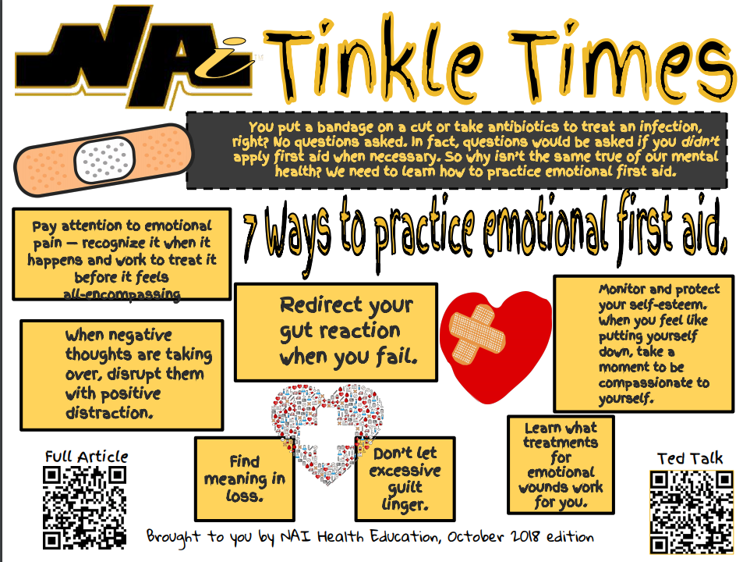
Step 3: Look at Sample Tinkle Times

Slide 5
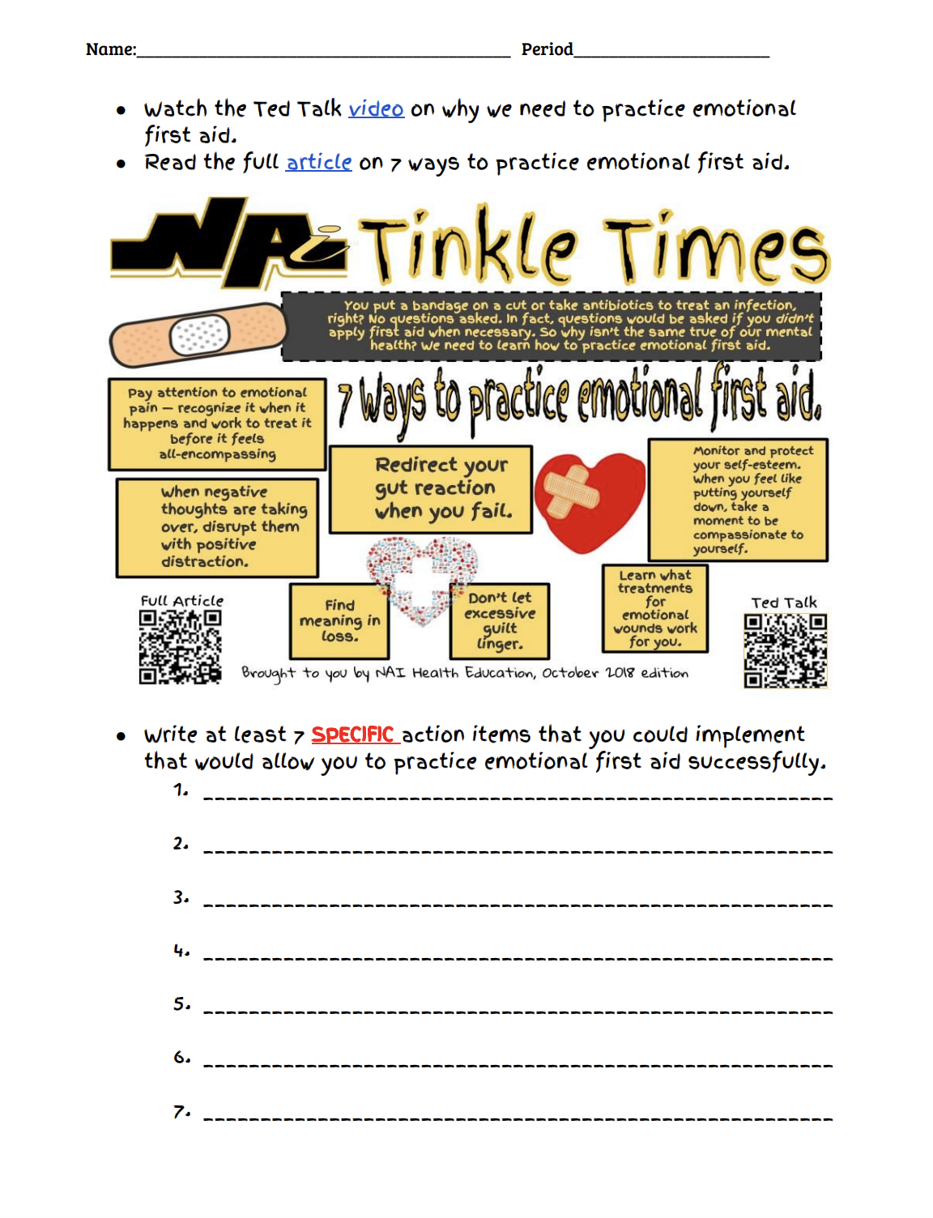
Step 4: Create an Action Plan

Slide 6
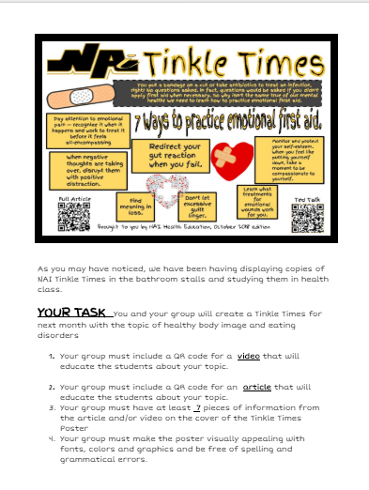
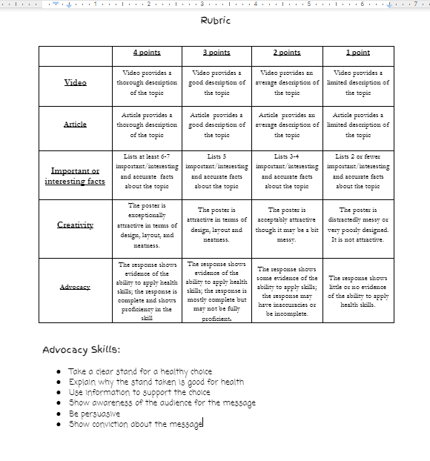
Step 5: Create your own Tinkle Times

Slide 7
Step 6:Vote for Favorite Tinkle Times
Look over all of the Tinkle Times projects and vote for your favorite one.

Slide 8
Step 7: Hang winning Tinkle Times
The winning Tinkle Times will be hung in all of the bathroom stalls.

