Slide 1
The Do Over
Second Chances
Communication Skills

Slide 2
do-o·ver Dictionary result for do-over /ˈdo͞oˌōvər/ noun | Meaning of Do Over an instance or chance of doing something for a second or further time, after an unsuccessful or unsatisfactory first attempt.

Slide 3
Dilema: We have all had arguments with someone, that when we looked back on the situation and reflected, it was not our finest hour. We did not use as many effective communication strategies as we should have. We may have hurt others’ feelings or damaged relationships. Wouldn’t it be nice to have a do-over?

Slide 4
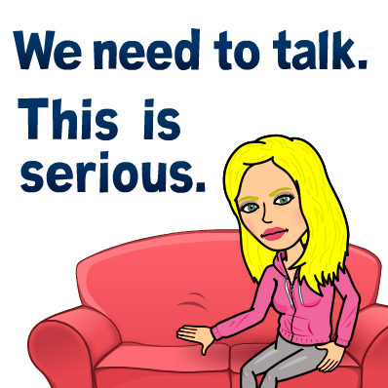
Task: Using your storyboard Illustrate the original argument with as much detail as you can remember. Now, after reviewing the communication skills, re-illustrate the scenario using the positive communication skills .

Slide 5
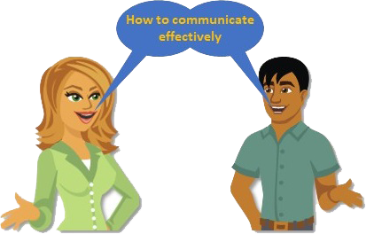

Slide 6
Clear Message | Roadblocks not used Students can clearly explain situations or how they feel. | Roadblocks used blaming, name calling, globalizing, expected mind reading, sarcasm, interrupting, insulting. Instead, students should be able to communicate the clear message.

Slide 7
Active Listening | Listens without interrupting | Interrupts the speaker

Slide 8
Encouragement | Encourages the speaker | Does not encourage the speaker

Slide 9
Restating what was said. | Clearly and accurately restates what was said Asks clarifying questions | Does not accurately restates what was said Does not ask clarifying questions.

Slide 10
Turning negative into positive | Successfully reframes a negative feeling into a positive | Doesn’t reframe a negative situation or feeling into a positive

Slide 11
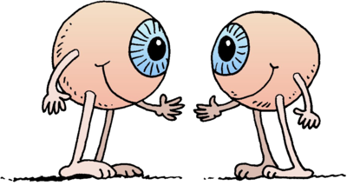
Eye Contact | Attention on speaker | Attention not on speaker

Slide 12
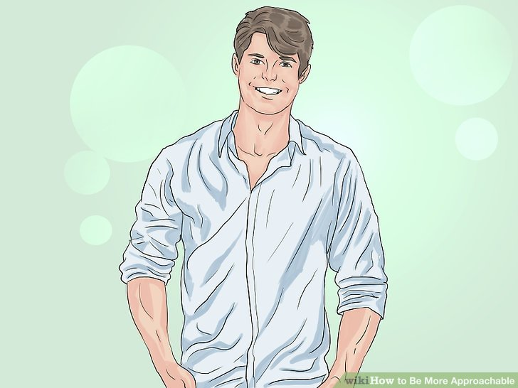
Body Language | Confident posture Comfortable distance Open hands Inviting facial expressions | Slouching posture Too close--Too far Blocking hands Negative facial expressions

Slide 13
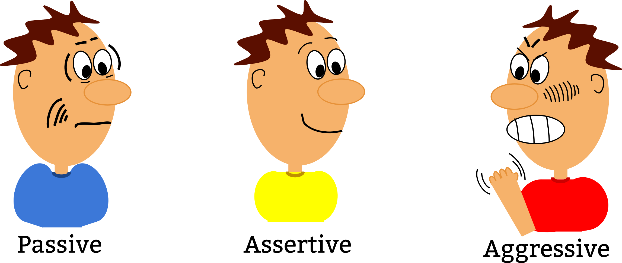
Assertiveness | Assertive | Aggressive Passive

Slide 14
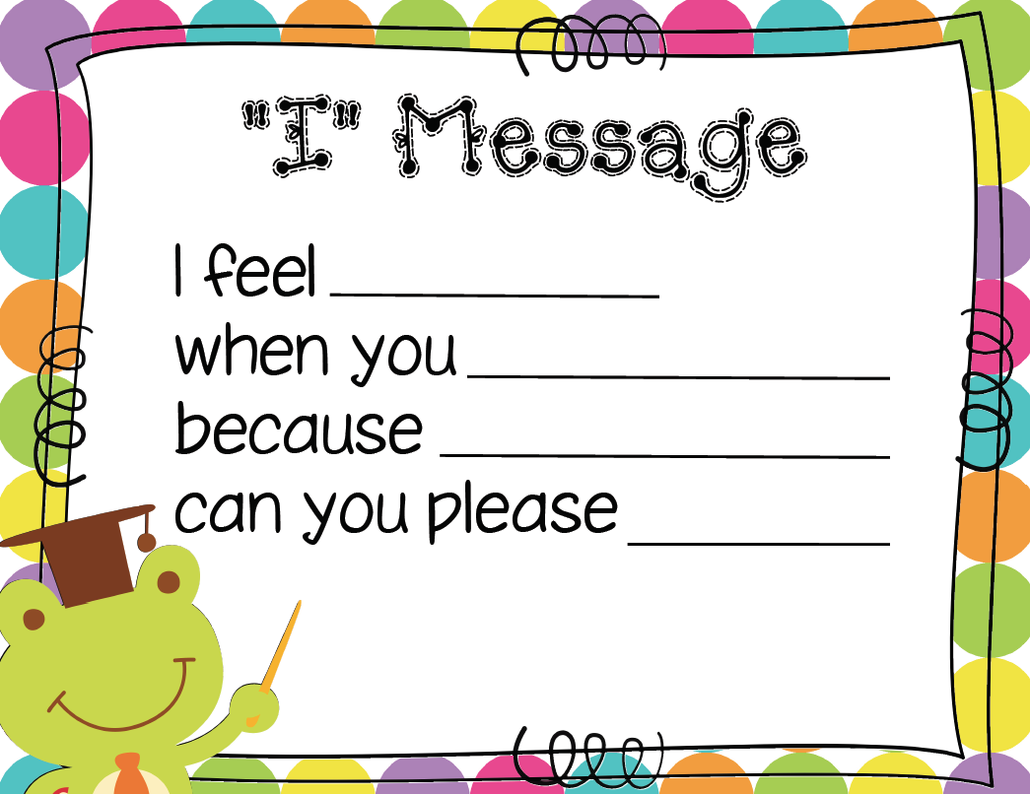
I-messages | I-message used I feel ______________ when ______________ Because it __________ Please, I would like you to ___ | I-message not used

Slide 15
Ask for help | Effectively asks for help if needed | Does not effectively ask for help

Slide 16
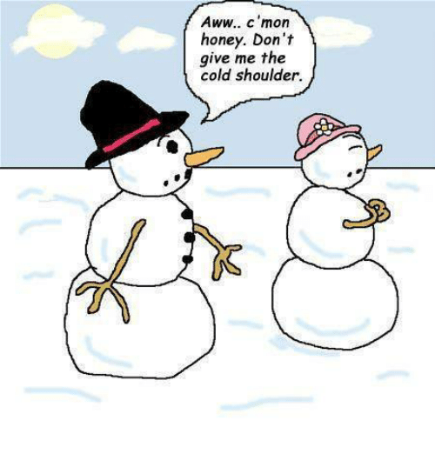
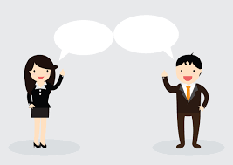
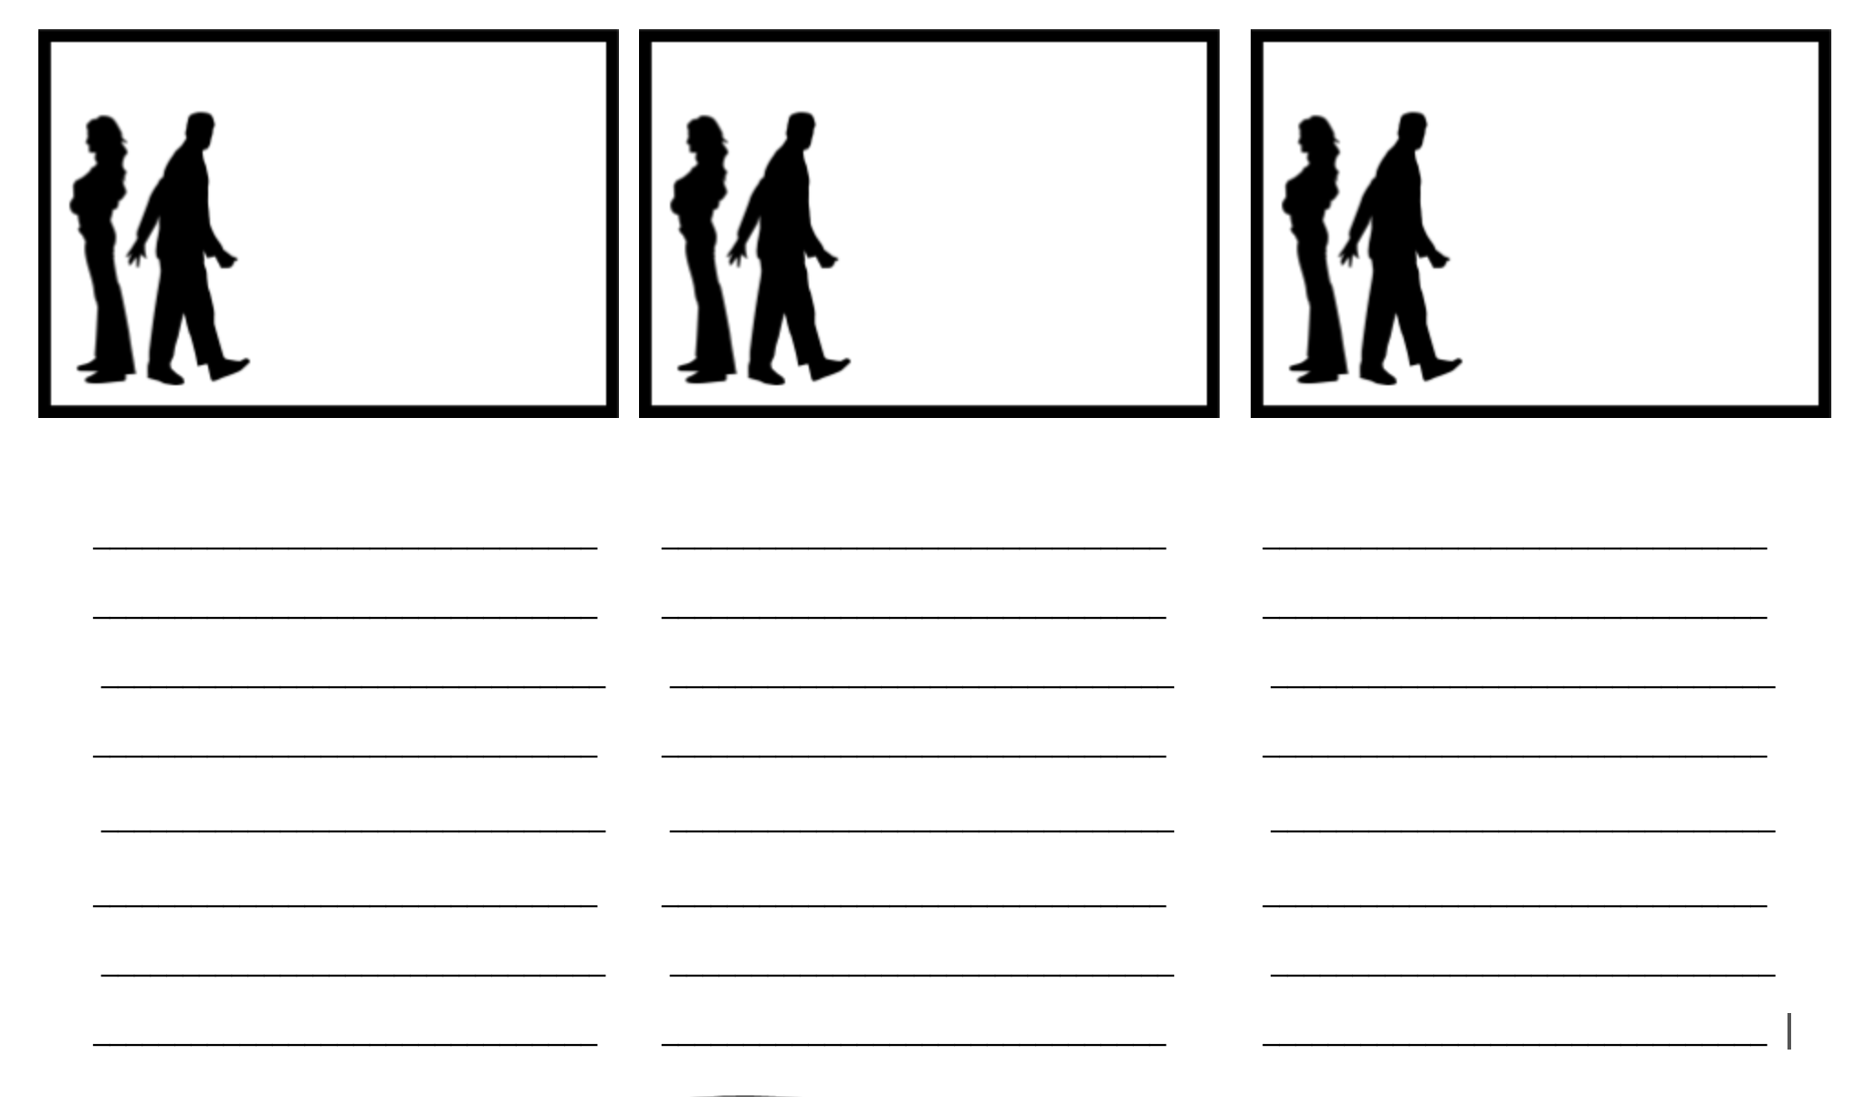
Draw and write the verbal and non-verbal elements of the conversation.

Slide 17
Draw and write the verbal and non-verbal elements of the conversation.

