Slide 1


Slide 2
Nearly 45,000 lives lost to suicide in 2016(CDC, 2018).

Slide 3
54%. More than half of people who died by suicide did not have a known mental health condition (CDC, 2018).

Slide 4




Who is at Risk for Suicide?
Suicide does not discriminate. People of all genders, ages, and ethnicities can be at risk for suicide. But people most at risk tend to share certain characteristics. The main risk factors for suicide are:
Depression, other mental disorders, or substance abuse disorder
A prior suicide attempt
Family history of a mental disorder or substance abuse
Family history of suicide
Family violence, including physical or sexual abuse
Having guns or other firearms in the home
Incarceration, being in prison or jail
Being exposed to others' suicidal behavior, such as that of family members, peers, or media figures.
Many people have some of these risk factors but do not attempt suicide. Suicide is not a normal response to stress. It is however, a sign of extreme distress, not a harmless bid for attention.

Slide 5

SUICIDE THE WARNING SIGNS
Same signs as depression
  Loss of energy
  Change in sleep patterns
  Withdrawal from usual activities
Radical changes in personality
  Outgoing becomes withdrawn
  Shy person becomes aggressive
Severe depression
Actions
  Stops doing things he/ she enjoys
  Gives away belongings
  Decline in school performance
Things a person says
  “I don’t want to live anymore.”
  “They’ll be sorry when I’m gone.”
Suffered a major trauma
  Moving to a new place
  Losing boyfriend/ girlfriend
  Friend/ family member dies
  Going through family divorce
Signs can be deceptive
  Someone who has been severely depressed suddenly becomes happy and carefree
  May think person is better and over the depression
  Why might they really be happy?

Slide 6

SUICIDE HOW TO HELP A SUICIDAL PERSON
DO
  Trust your feelings if you believe the person is suicidal
  Take seriously a suicidal person’s threats
  Tell the suicidal person how concerned you are and how much you care about him/ her
  Talk calmly with the suicidal person – show interest and compassion
  Find professional help for the suicidal person
  Stay with the suicidal person until help arrives
DO NOT
  Dare the suicidal person to go ahead and make the attempt
  Judge the suicidal person
  Analyze the suicidal person’s motives
  Argue or try to convince the suicidal person of reasons why he/ she should not attempt suicide
  Keep the suicidal person’s self- destructive thoughts or actions a secret
  Leave a suicidal person alone

Slide 7

SUICIDE HELPING YOURSELF
If you have been feeling depressed, remember that no matter how overwhelming the problems in life may seem, SUICIDE IS NEVER A SOLUTION.
Knowing some specific symptoms of mental disorders can help a person determine if he or she should seek help
- you feel trapped with no way out –you worry all of the time
- your feelings affect your sleep, eating habits, school work, or relationships
- Your family and friends express concern about your behavior – aggressive, violent, reckless
- you are becoming involved with alcohol/drugs

Slide 8

BEING SUPPORTIVE OF A FRIEND / GETTING HELP
Use “I” messages.
Speak calmly and clearly.
Listen carefully.
Show respect and empathy.
Confide in a trusted adult.
Guidance Counselors / SAT Team
Call: look up local or national hotlines
ACT: Acknowledge the problem
Communicate concern Tell someone who could help

Slide 9
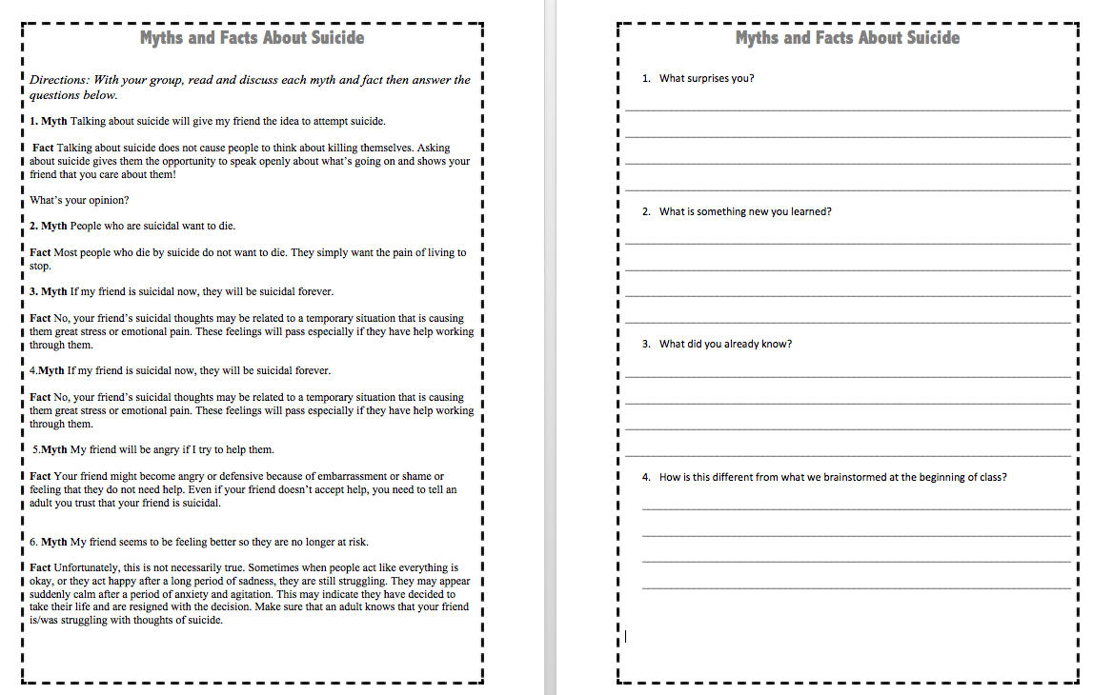
Myth and Facts About Suicide
Directions: With your small group, read and discuss each myth and fact then answer the questions.
Why is this topic such a misconception?

Slide 10

Myth or Fact?
Someone who is suicidal is determined to die

Slide 11
Myth
Suicidal people often feel an overwhelming sense of distress and want this to end. When people are suicidal, they’re usually feeling alone or like they’re a burden to others and are in need of emotional support. Access to support at the right time can prevent suicide.

Slide 12

Myth or Fact?
Only people with mental health conditions are suicidal

Slide 13
Myth
Suicidal behaviour indicates deep unhappiness, not necessarily a mental health issue. Many people living with mental health issues aren’t suicidal, and not all people who take their own lives have a mental health issue.

Slide 14

Myth or Fact?
Talking about suicide is a bad idea and might be considered encouragement

Slide 15
Myth
Given the widespread stigma around suicide, most people who are thinking about suicide don’t know who to talk to about it. Rather than encouraging suicidal behaviour, talking openly about what is going on can give them other options, or the time to rethink their decision.

Slide 16
Each One Teach One Activity
You have received a strip of paper with a fact relating to suicide. Read and become familiar with your fact.
When I say “go,” stand up from your seat and find other people to individually share your fact with. Take time to listen carefully to the fact that they have to share with you.
Only share your fact with one person at a time, not with a group. Move carefully through the group trying to reach as many people individually as possible with your fact.
When you see my hand raised in the air, please raise yours as well and stop where you are in sharing your fact. Then quietly return to your seat

Slide 17
13 Common Causes of Suicide
Mental Illness
Traumatic Experience
Bullying
Personality Disorder
Drug Addiction/ Substance Abuse
Eating Disorders
Unemployment
8. Social Isolation/ Loneliness
9. Relationship Problems
10. Genetics/ Family History
11. Terminal Illness
12. Chronic Pain
13. Financial Problems

Slide 18
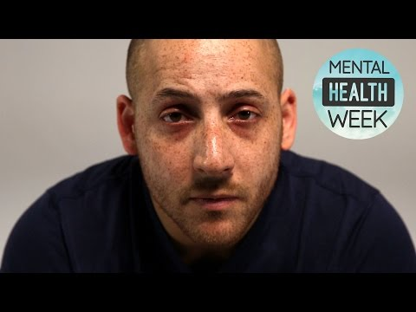
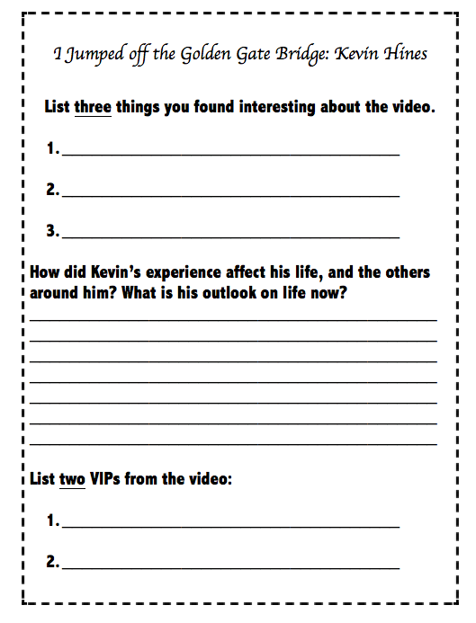
I Jumped off the Golden Gate Bridge: Kevin Hines

Slide 19
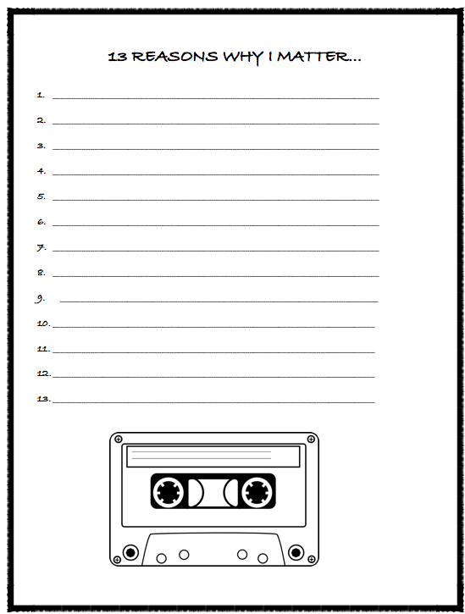
13 Reasons Why You Matter
List 13 reasons why you matter.
Values, beliefs, self-worth, and importance.

Slide 20

13 Reasons Why Not
List 13 reasons Why Not
  Consequences, reasons not to, etc.

Slide 21
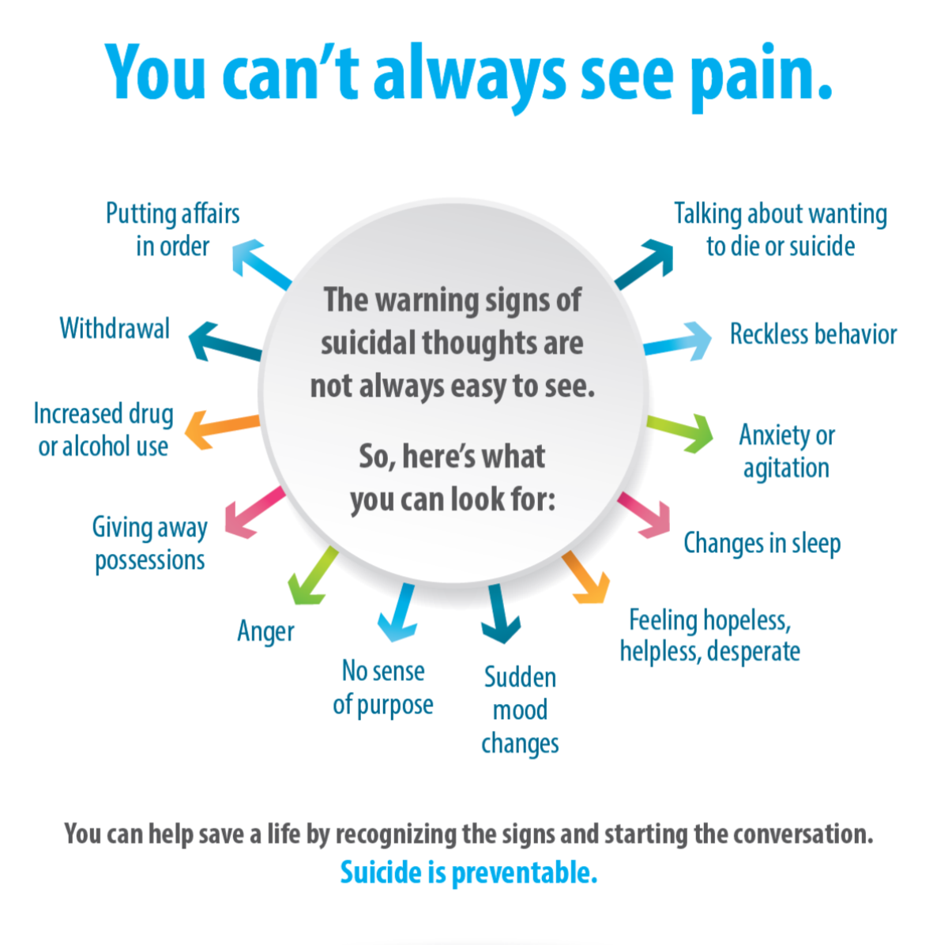
Suicide Prevention

Slide 22

How can you be a lifesaver?
ACT:
Acknowledge: Take it seriously, and be willing to listen.
Care: Take the initiative, and voice your concern.
Treatment: Get professional help immediately.

Slide 23

How can you be a lifesaver?

Slide 24

Exit Review:
List 3 common causes of suicide.
List 2 warning signs.
List 1 resource that can help someone at risk seek help.

