Slide 1
Doctor Diagnosis

Slide 2
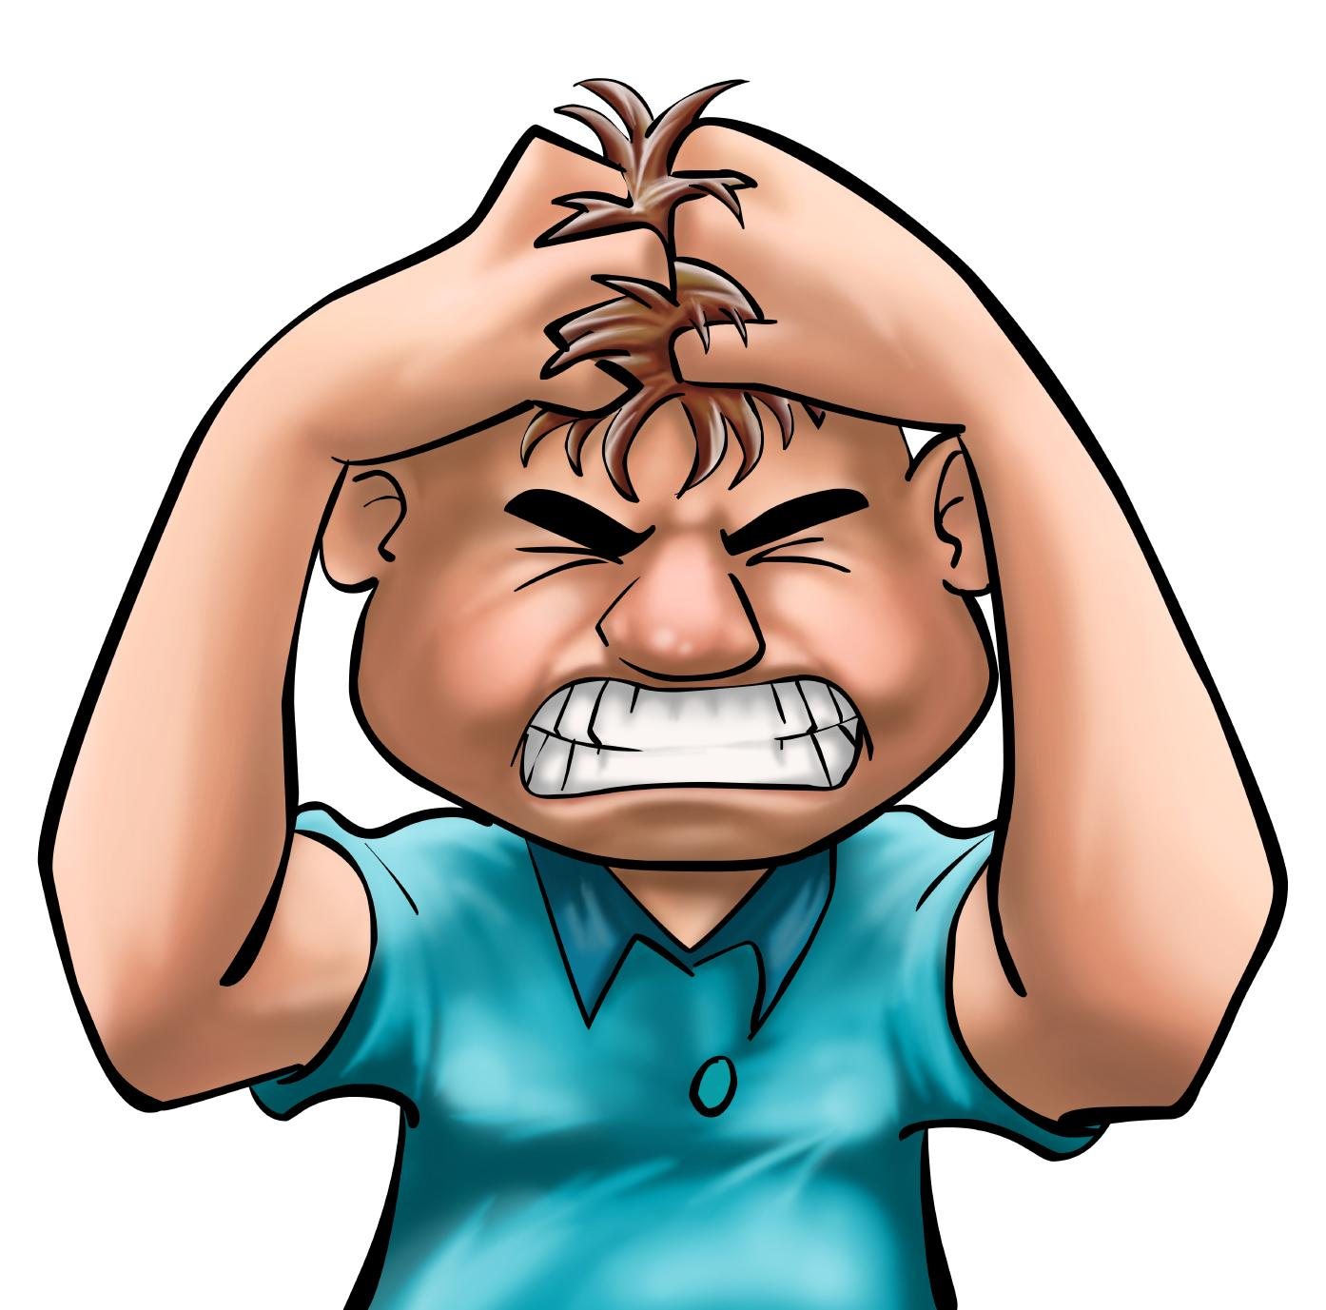
Stress and Stress Management

Slide 3

What is Stress?
The term “stress” actually refers to the body’s reactions to any demand placed upon it.
Stress can be good and bad.

Slide 4
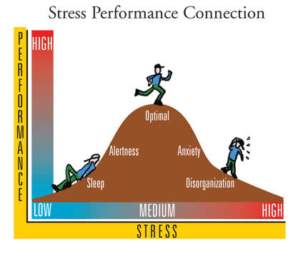

Slide 5
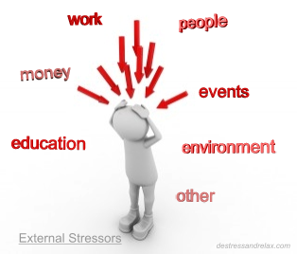
What is a stressor?
Any factor that causes stress
Examples: body image, money, friends, family, school

Slide 6
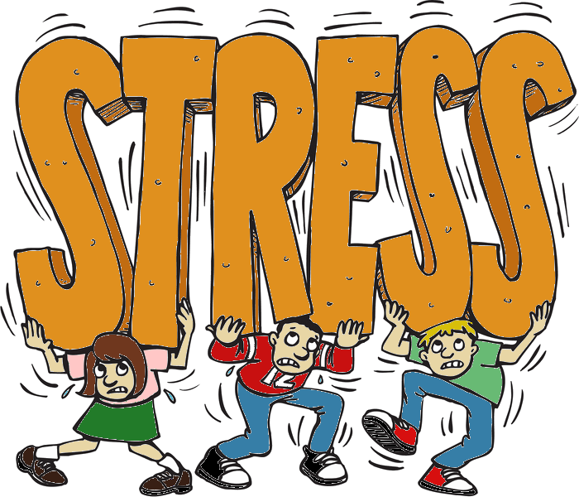
My Top Stressors

Slide 7
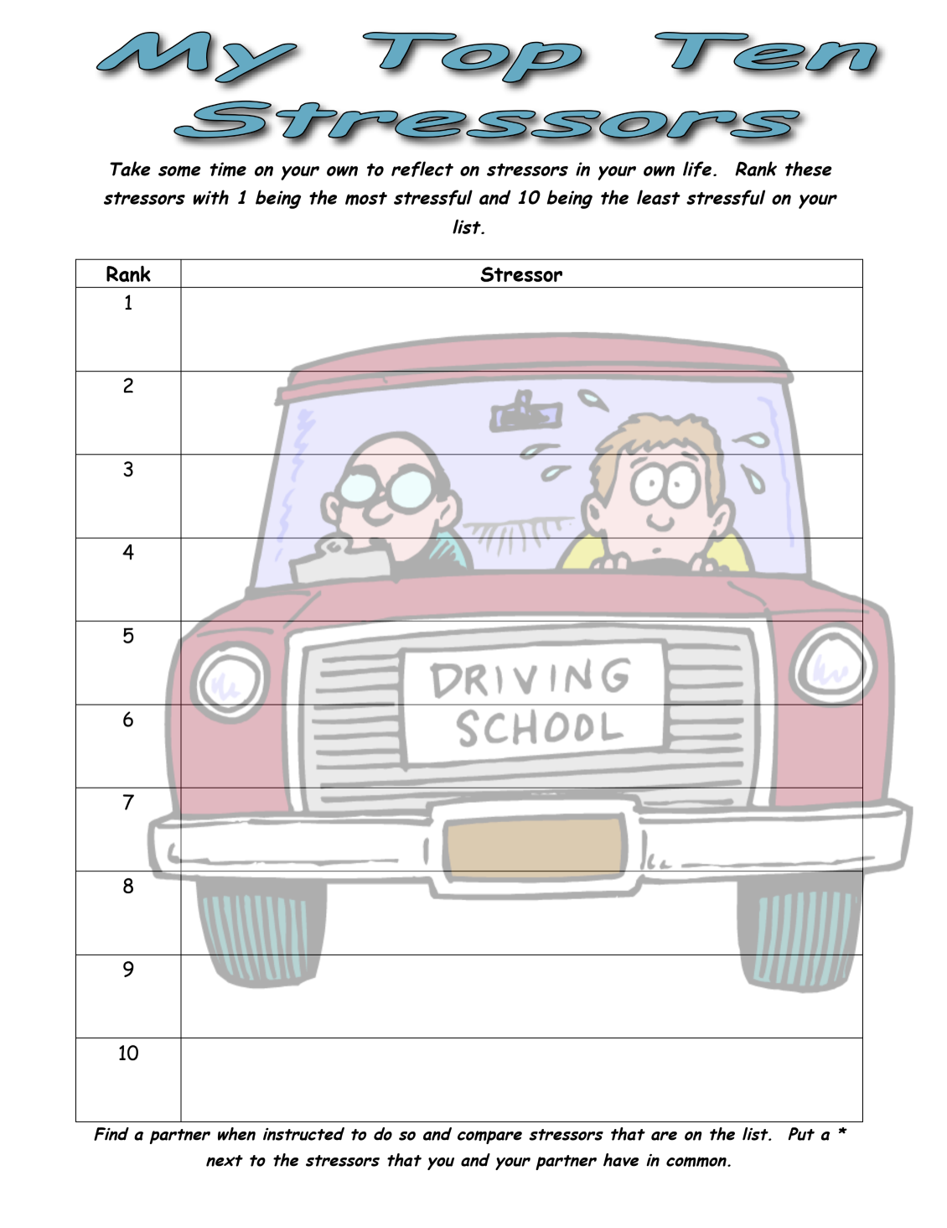
Rank your stressors from 1-10 as how stressful they are right now. 1 is the most stressful and 10 is the least stressful

Slide 8
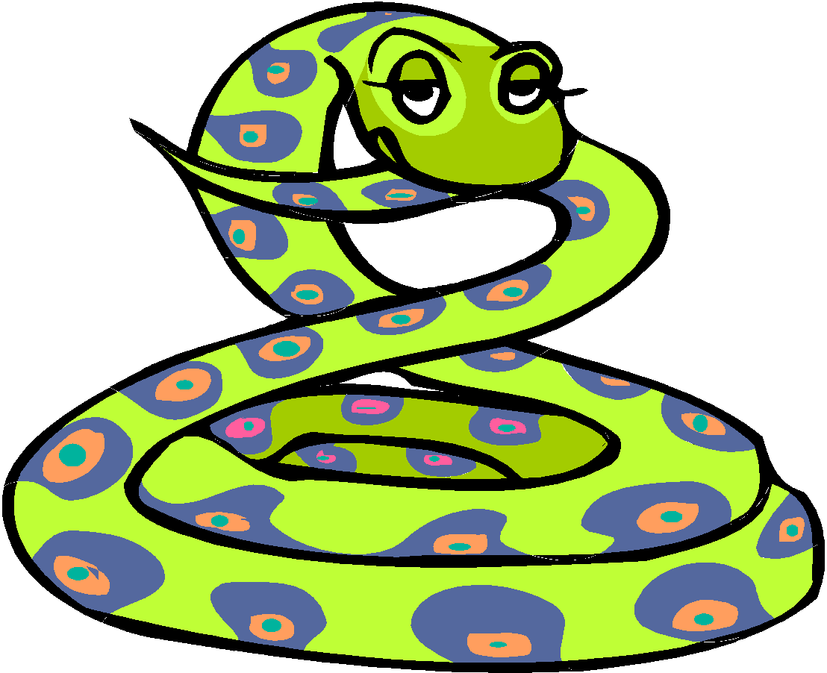
Perception
A meaning given to an event or occurrence based on a person’s previous experience or understanding. Threatening or non-threatening.

Slide 9
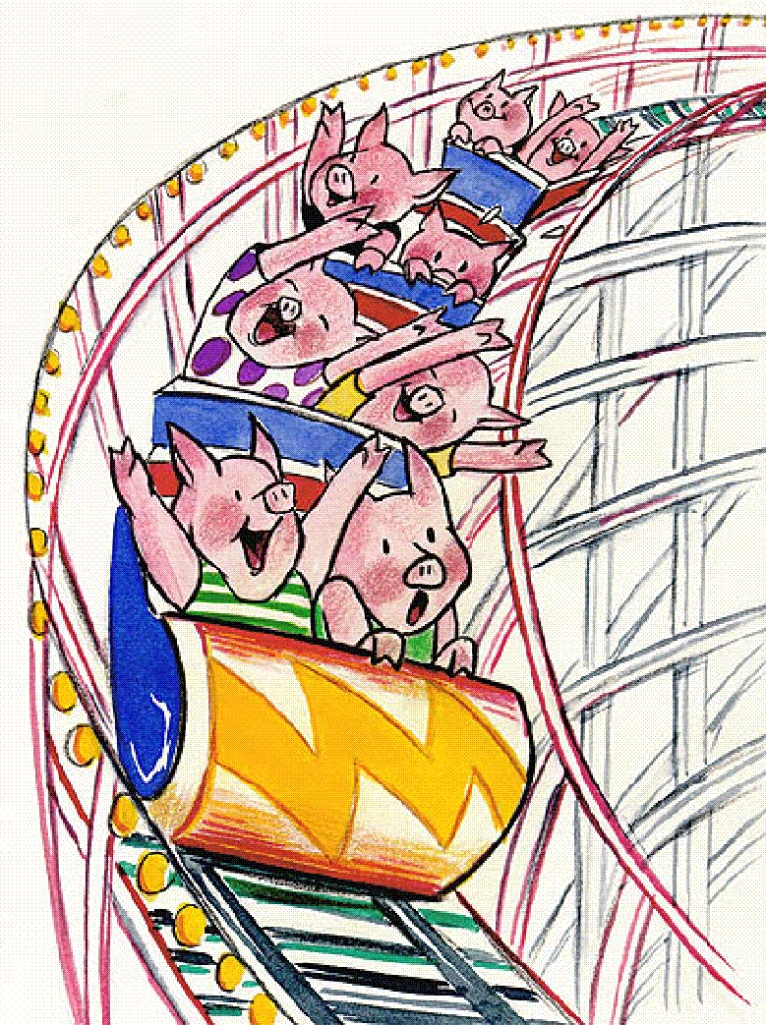

Eustress
Good stress
Is stress that provides a welcome challenge

Slide 10
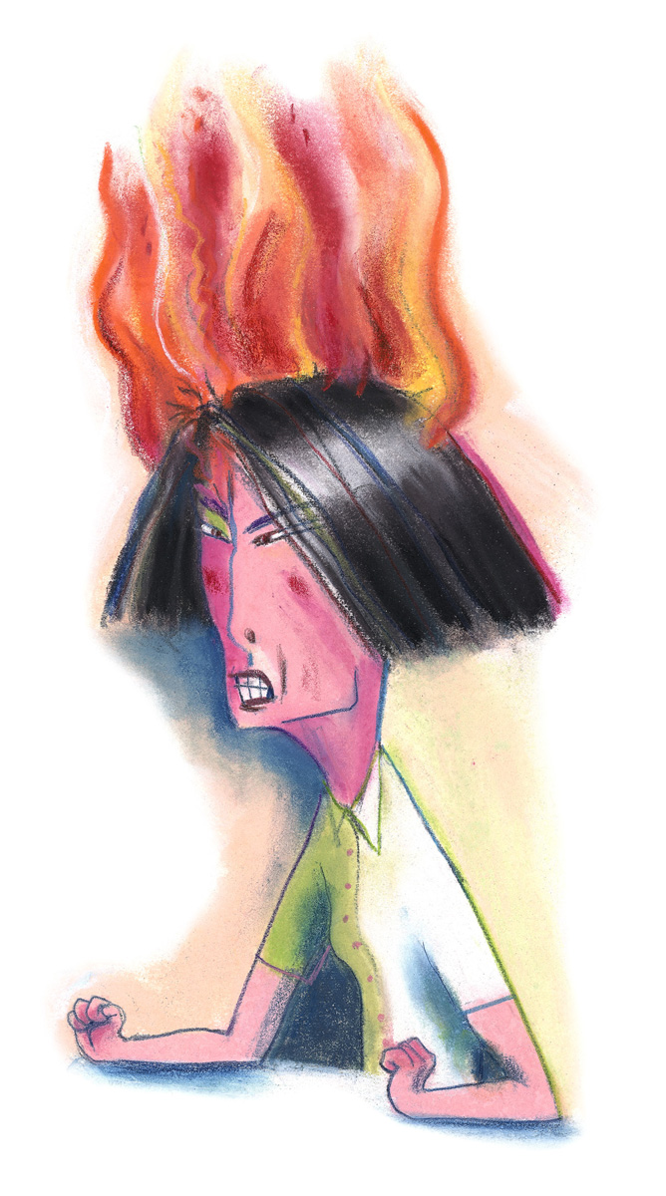
Distress
Bad stress
Is stress that is perceived as negative

Slide 11
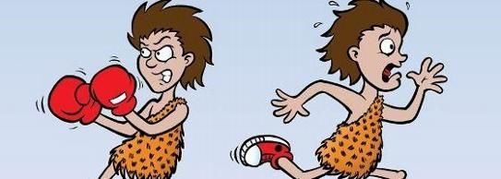
Fight
or
Flight
Objective: To be able to identify at least 7 ways that Fight or Flight affects our bodies.

Slide 12
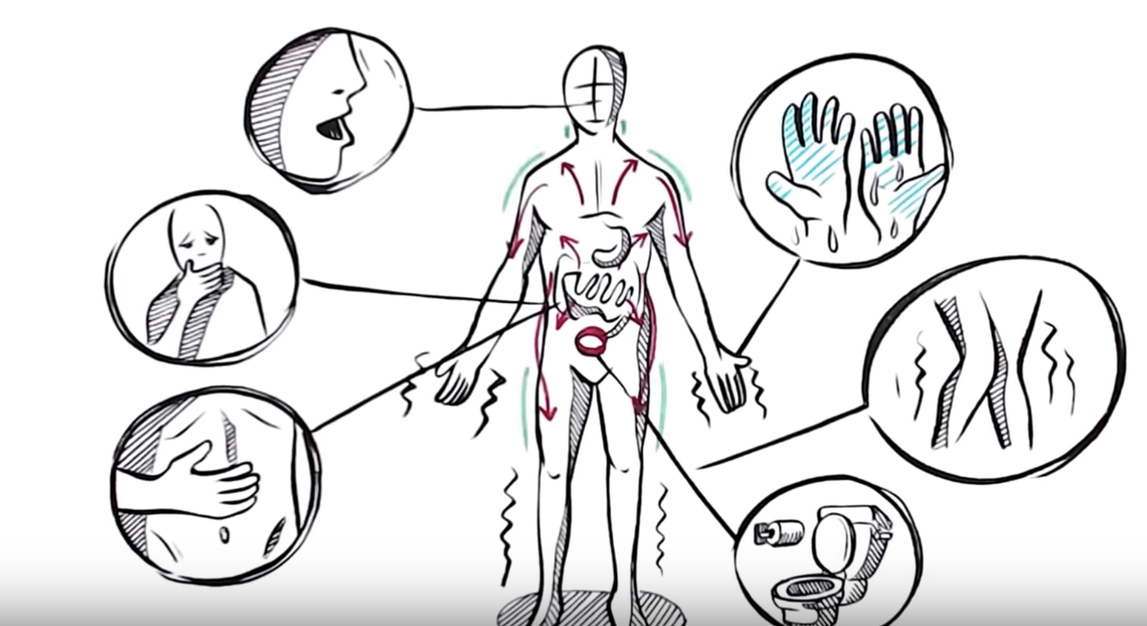
Watch this video on Fight or Flight

Slide 13
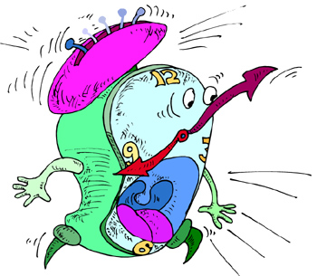
What happens to the following during the alarm stage?
Pupils
Hearing
Saliva
Heart rate
Blood pressure
Bronchioles
Digestion
Blood flow to muscles
Muscles

Slide 14
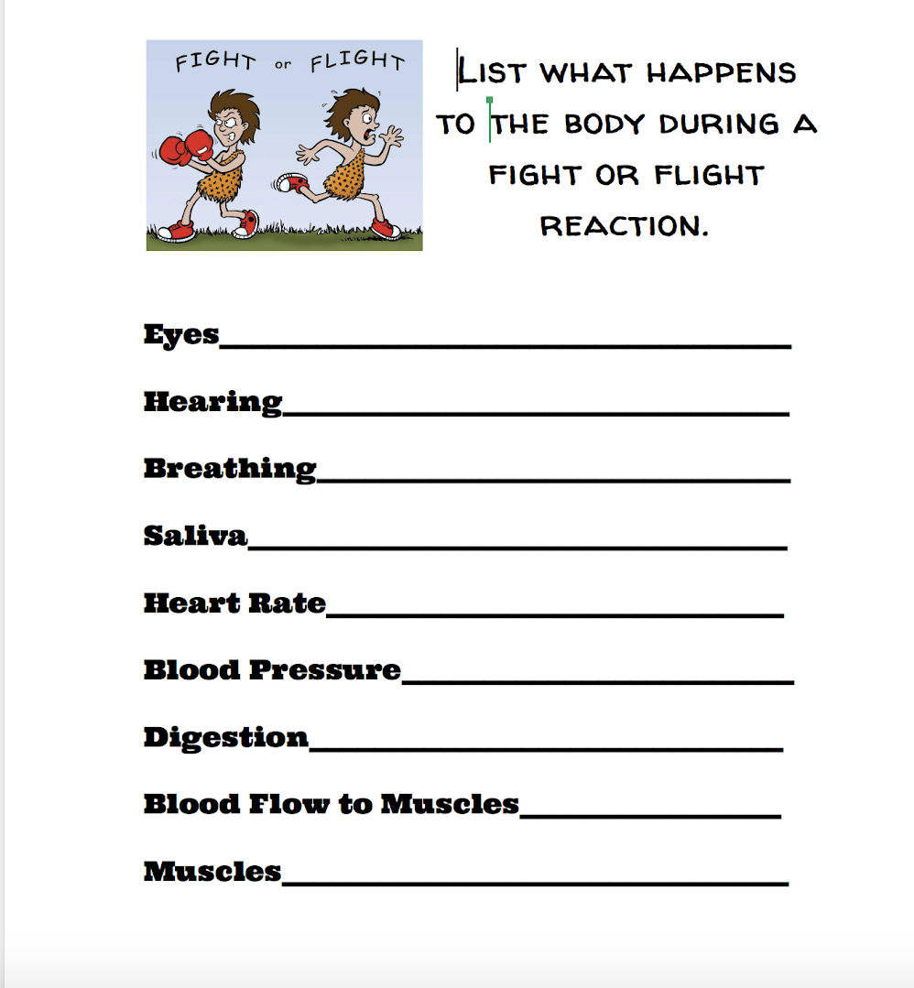

Slide 15

Pupils
Dilate

Slide 16

Hearing
Sharpens

Slide 17
Breathing
Increases

Slide 18
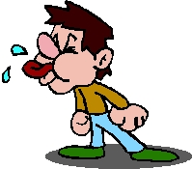
Saliva
Decreases

Slide 19
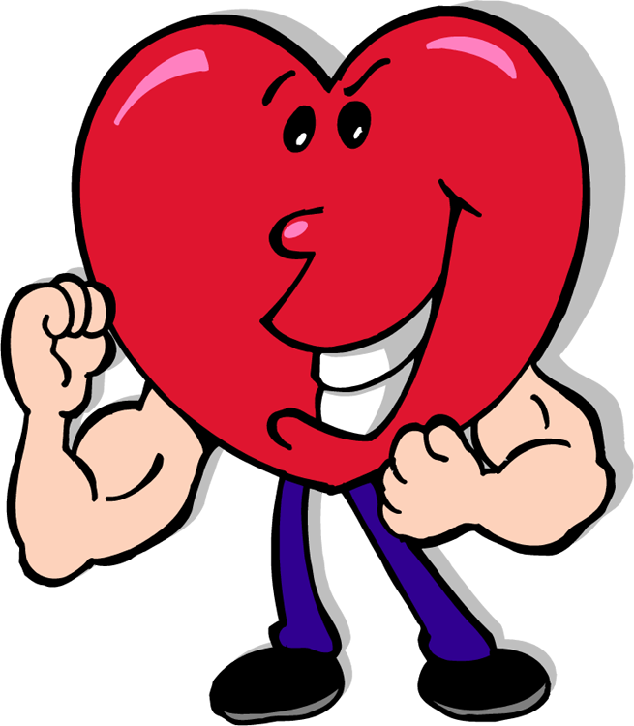
Heart rate
Increases

Slide 20
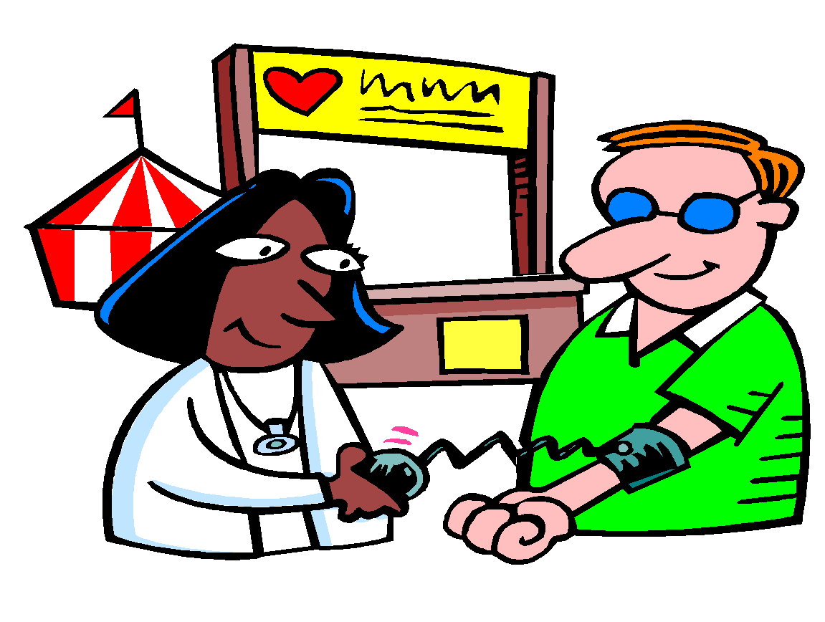
Blood pressure
Increases

Slide 21
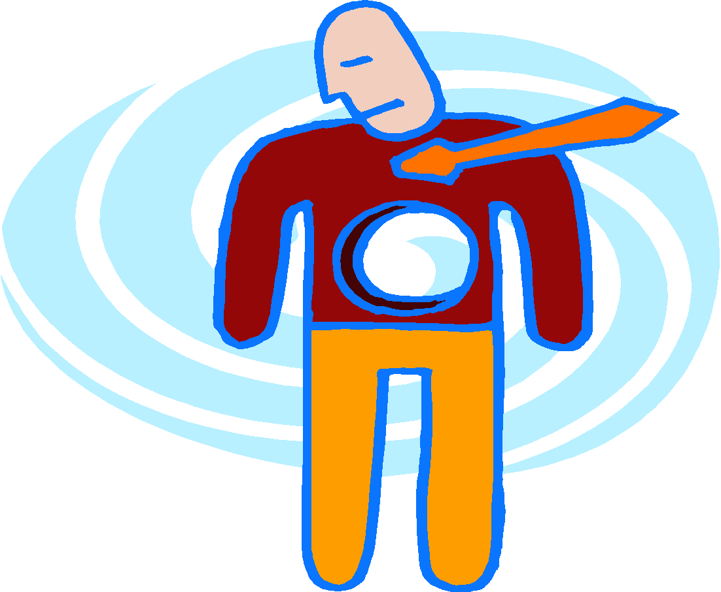
Digestion
Slows

Slide 22
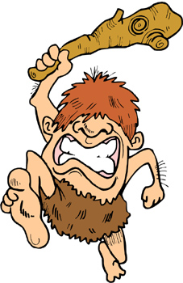
Blood flow to muscles
Increases

Slide 23
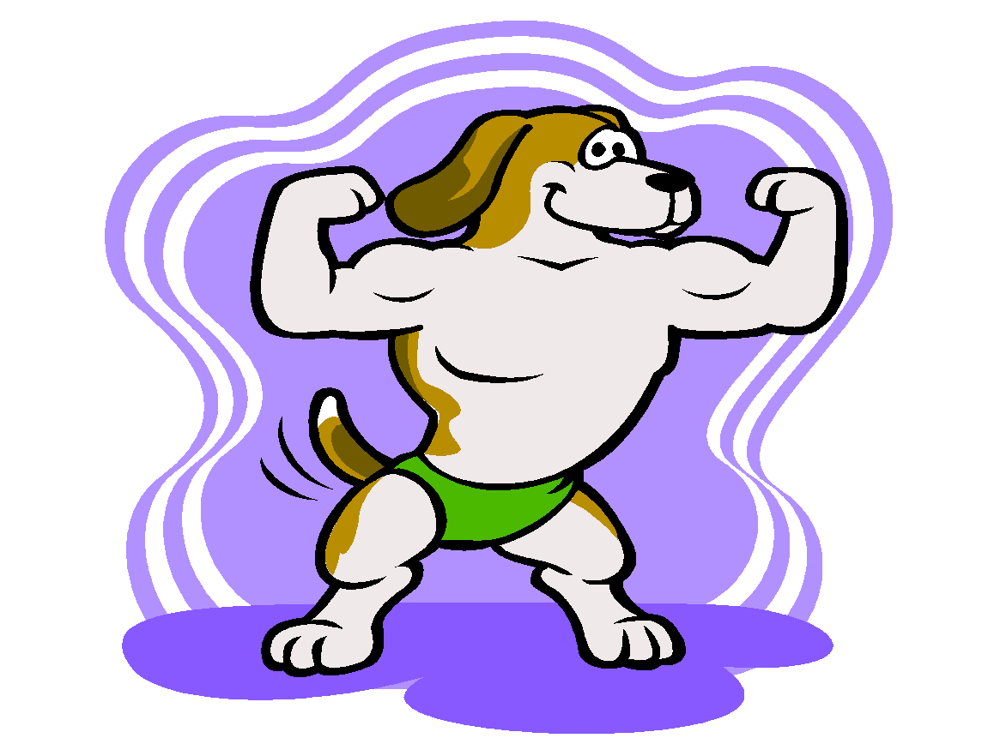
Muscles
Tighten

Slide 24
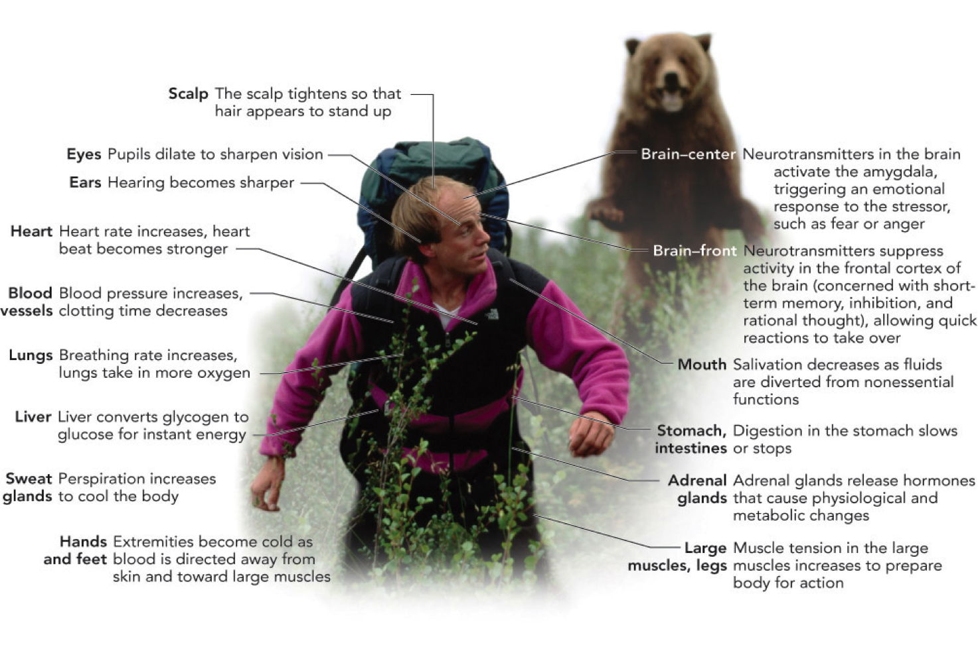

Slide 25
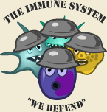
Stress and Immunology
Stress can decrease your white blood cell count which will lead to poor health.
Immunological system includes the following white blood cell groups which identify and destroy foreign substances:
Phagocytes-destroyers
Lymphocytes
T cells
B cells

Slide 26
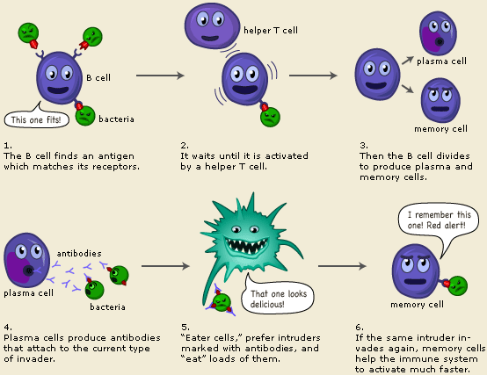

Slide 27
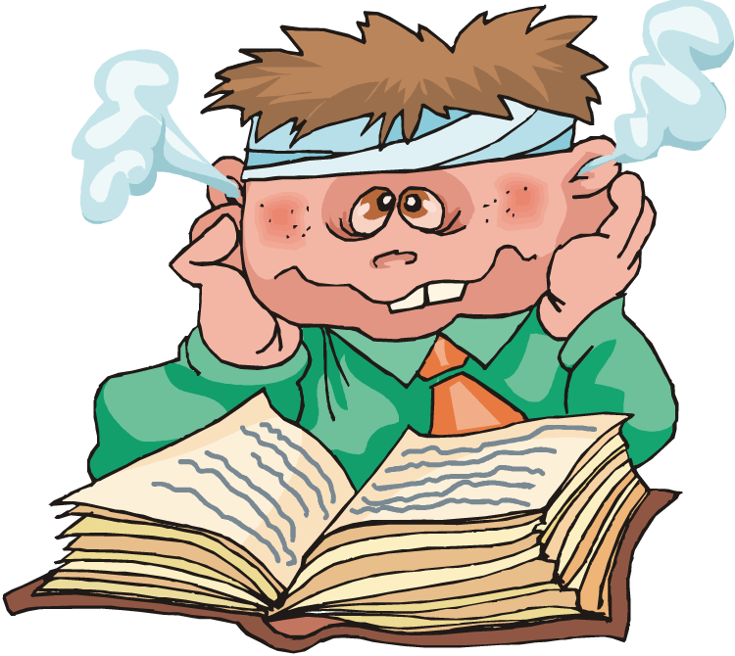
Life is tough, Let’s De-stress

