Slide 1
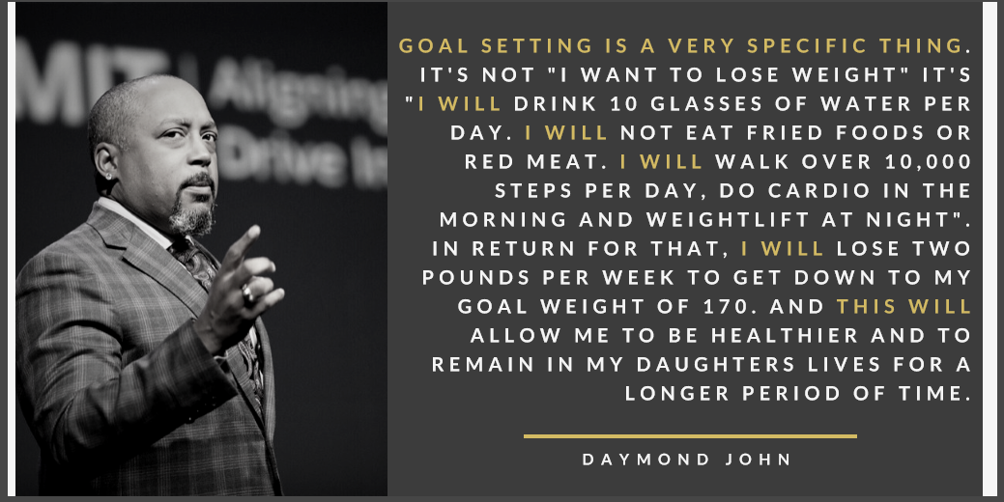

Slide 2
Achieving your goals takes thought and consideration. What steps do you feel are involved in setting and accomplishing a goal?
Instant Activity

Slide 3
Lesson Objectives
Describe how setting goals can affect health
List the steps of effective goal setting
State a SMART goal to address your fitness based on your self-assessment results.
Work through a goal-setting process to enhance health outcomes

Slide 4
Imagine you are about to graduate from high school. What do you hope happens next? What goals do you have?
What do you envision yourself doing? College? Military? Apprenticeship? Job? Something else?
Think – Pair – Share

Slide 5
Next, what would you need to do to make sure your post-high school goals happen?
List two or three short-term goals you would set to be sure you reach that outcome.
Think – Pair – Share

Slide 6
Form pairs to share your post graduation goals. Explain how your goals will lead to the desired outcome for the next step after high school
Think – Pair – Share

Slide 7
Why Set Goals?
To help you reach your dreams and to set up a plan to make sure you can get there.
Important to remember that short-term goals can help us achieve our long-term, future goals and help us to be successful

Slide 8
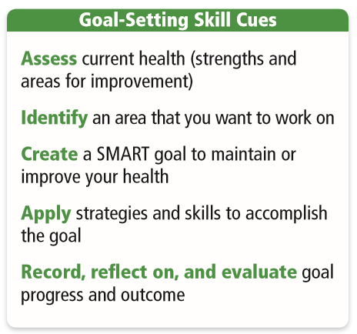

Slide 9
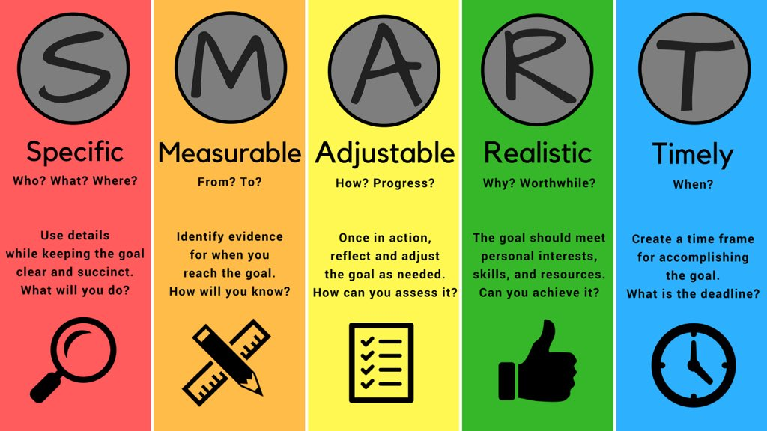

Slide 10
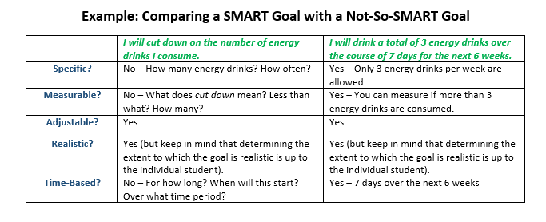

Slide 11
Scenario - Julian
Julian is a sophomore who stays after school each day to hangout with his friends before arriving home after 4:30pm. When he gets home, he grabs a snack and heads to the family room in the basement. He turns on the TV, opens his phone to Snapchat, and frequently texts with his friends. His mom has suggested in the past that he do his homework as soon as he gets home, but Julian feels the need for a break before tackling that. Around 7pm each night, his family has dinner together, and no electronics are allowed. After dinner, Julian’s chores are to clear the table and help with dishes. Julian loves TV and has something to watch each night at 8pm; he does his homework while he watches.
He recently discovered that sophomore year is harder than freshman year, even though his methods of doing what he’s supposed to do in class and for homework haven’t changed at all. Julian received mostly A’s last year, but have quickly slipped to B’s and C’s now. As a result, he’d like to make a change in his life.

Slide 12
Specific – What does Julian specifically want to accomplish?
Measureable – How can he measure his progress over time?
Adjustable – Is this something you think he can adjust if it is too easy or too hard?
Realistic – How realistic is it that he achieves this goal? Too hard? Too easy?
Time-bound – How long do you think it should take for him to accomplish this goal? Set a time in the shorter term to check progress.

Slide 13
Now it is your turn to write a Fitness Goal!

