Slide 1
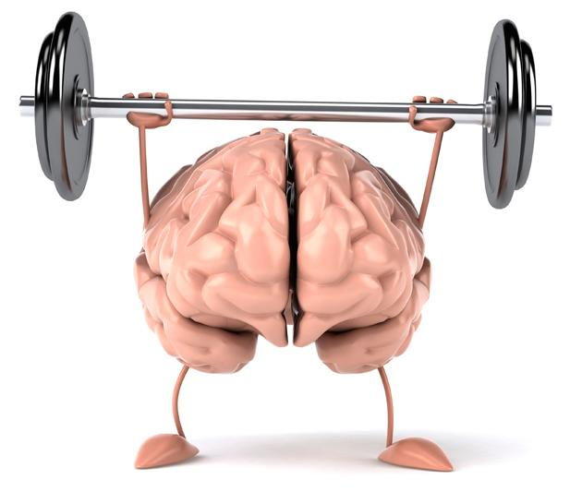
Spark Your Brain!

Slide 2
Exercise & The Brain - What do you know?
Notes:
Have students complete the Pre-Assessment here. The intent of this assessment is not to issue students a grade, but as a formative assessment to see what they know. Score it against the 6 point rubric and store for your own records. The goal is that you will see if students show growth in their learning.

Slide 3
The Brain & Exercise
“We don’t stop playing because we grow old, we grow old because we stop playing.”
-Ben Franklin
“If the body be feeble, the mind will not be strong.”
-Thomas Jefferson

Slide 4
Jigsaw Activity
Directions:
You will be in groups of 4.
Decide on who is going to read which article (#1-4).
Read your article (This should take less than 5 mins)
Then, all people reading article 1 will get together to discuss the key findings. All people reading article 2, article 3, etc...will do the same thing with their articles (5 mins)
Then...you will return to your original group and take 1 min each to teach them the key takeaways to your article...however… you will....

Slide 5

Walk & Talk
Each of you will have ONE minute to summarize the key takeaways from your article and share it with the rest of your group.

Slide 6




Total Body
Rock, Paper, Scissors!

Slide 7

Rock, Paper, Scissors
1st time beat your opponent

Slide 8
Rock, Paper, Scissors
2nd time lose to your opponent

Slide 9
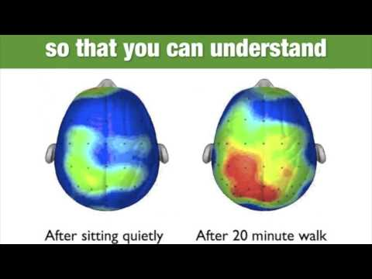

Slide 10
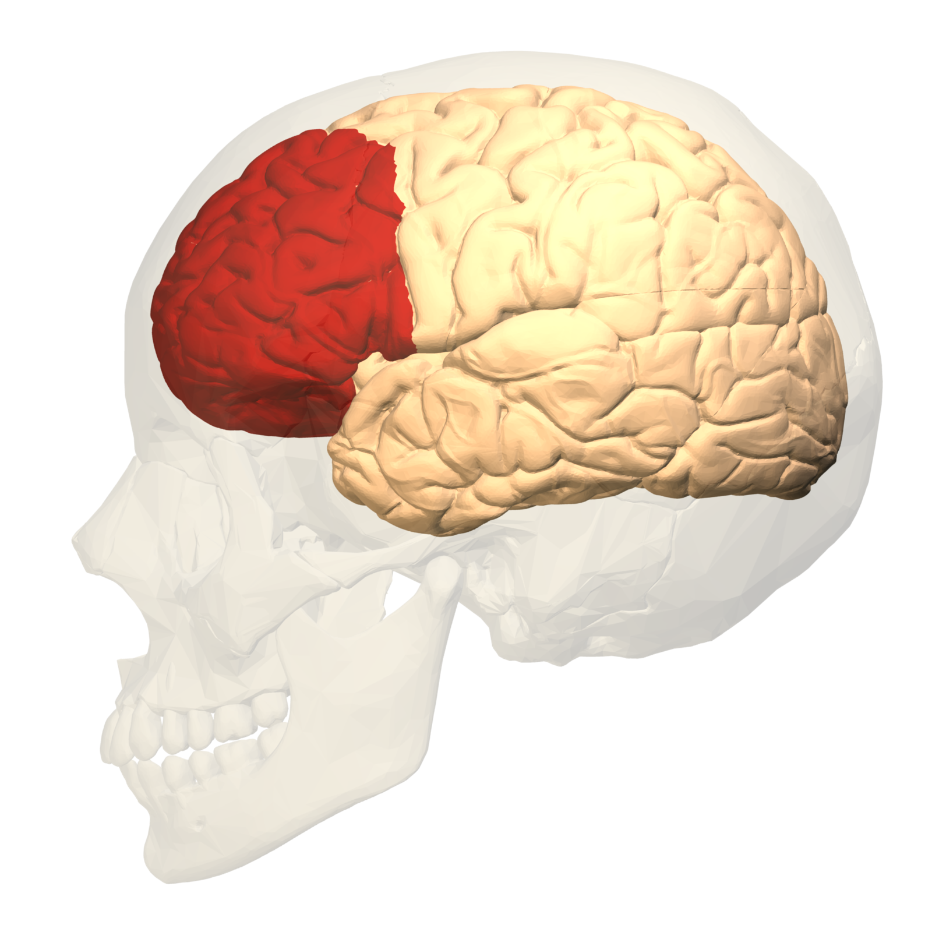
Play uses all the functions of the prefrontal cortex of the brain. The same part of the brain that learners use for critical thinking, flexible reasoning, and creativity.
It is critical for things like..
decision-making, focus and attention
Prefrontal cortex

Slide 11
Deep in temporal lobe of the brain is a key structure critical for your ability to form and retain new long term memories for facts and events. This structure is called the
hippocampus.
It is critical for things like..
creating, organizing, and storing memories...AND…emotions
(helps connect memories & emotions)
Temporal lobe

Slide 12
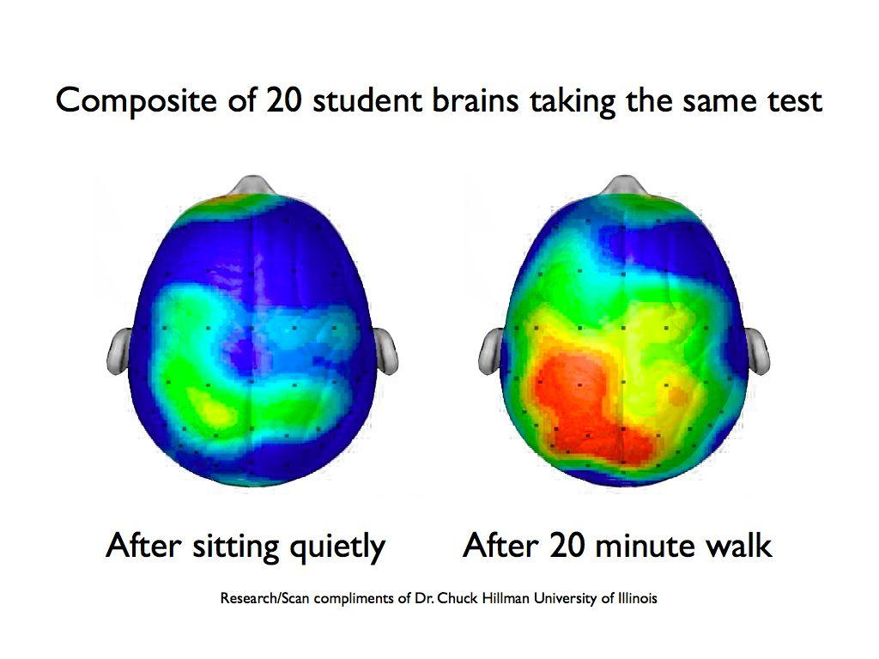

Slide 13
When you move your body, there is increased oxygen and blood flow to the brain.
Exercise decreases the free radicals that can build up and be toxic and shield us from stress.
When we sit all day the blood is not flowing.
“When the bum is numb, the brain is drained”

Slide 14

Did you know you can…
beat stress
lift your mood
fight memory loss
sharpen your intellect
and function better than ever
...simply by elevating your heart rate and breaking a sweat!

Slide 15

Got B.D.N.F.?
Brain Derived Neurotrophic Factor
It nourishes neurons
It is like for the brain

Slide 16
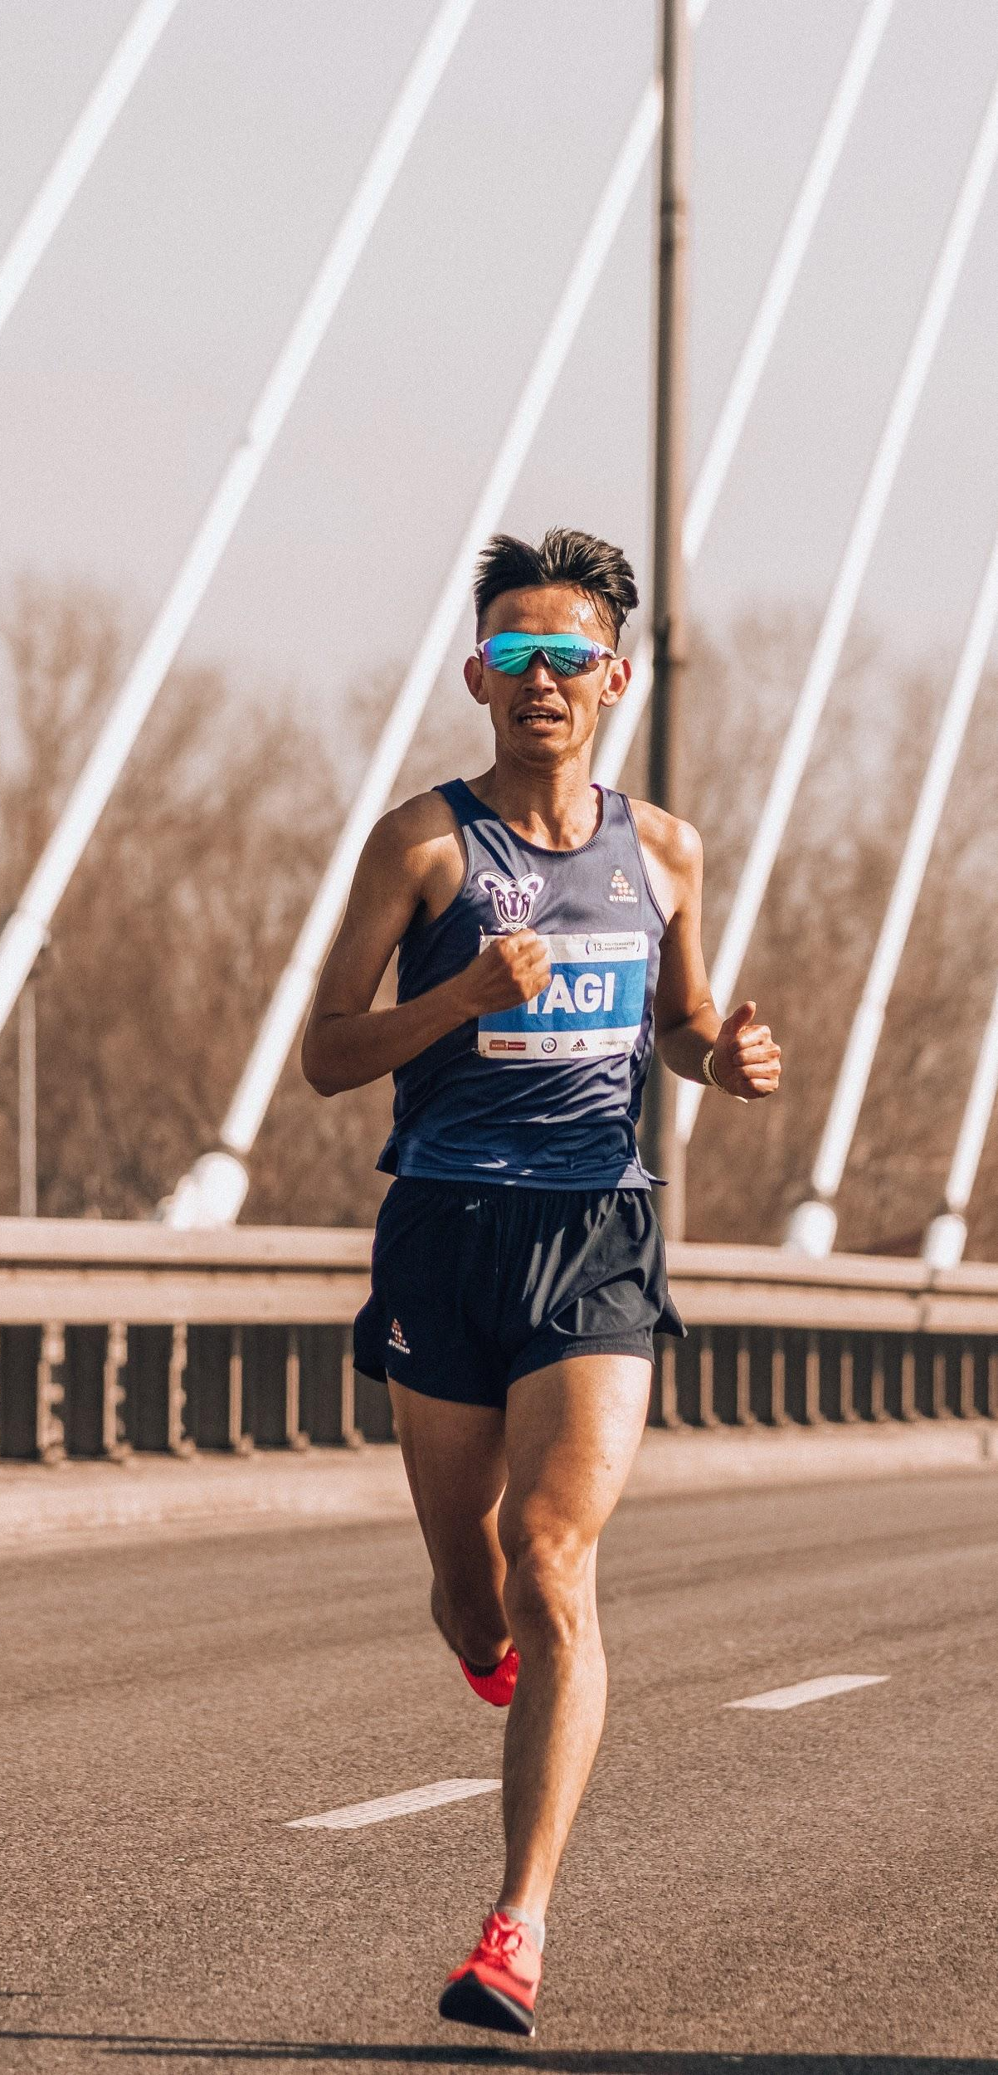
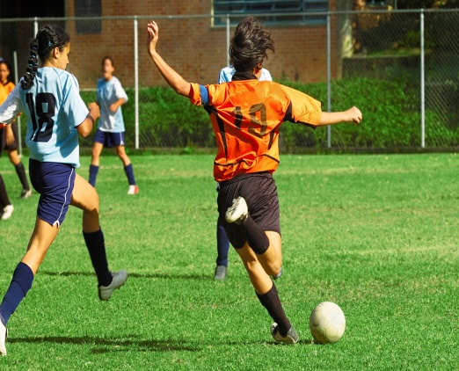

A brain that's low on BDNF shuts itself off to new information, and groups that are deprived of this chemical are not as quick or sharp as those with adequate amounts.

Slide 17
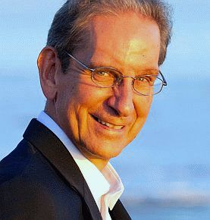
“I call exercise ‘Miracle-Gro for the brain’. Exercise keeps brain cells healthy in a way that playing chess and other highly cognitive activities do not.”
Dr. John Ratey - Psychiatrist, Harvard Medical School

Slide 18


Slide 19
Neurogenesis
Until the mid-90s it was thought that the adult loss of nerve cells was irrevocable, but studies over the past decade have overturned that assumption, showing that "neurogenesis" (formation of nerve tissue) in some parts of the brain can be induced easily with exercise.

Slide 20
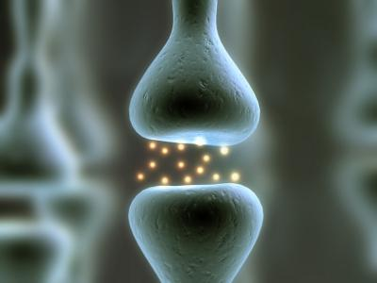
Exercise Optimizes Brain Function
Improved Neuron Connectivity
at the Synapse Junction

Slide 21

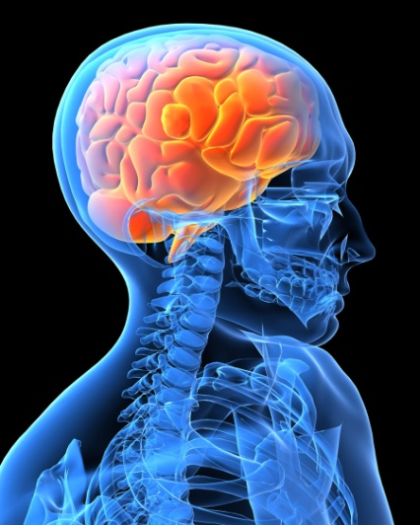
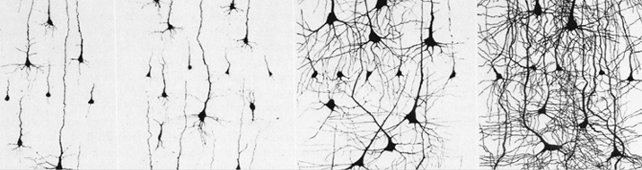
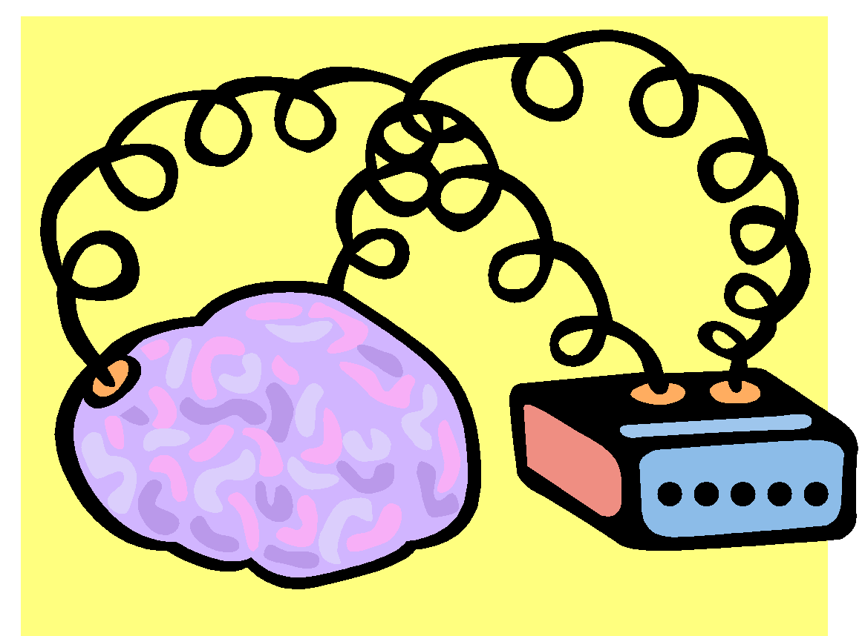
Exercise Creates
New Brain Cells
=
New Learning Enhances Brain Cells with More Connections

Slide 22
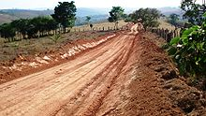


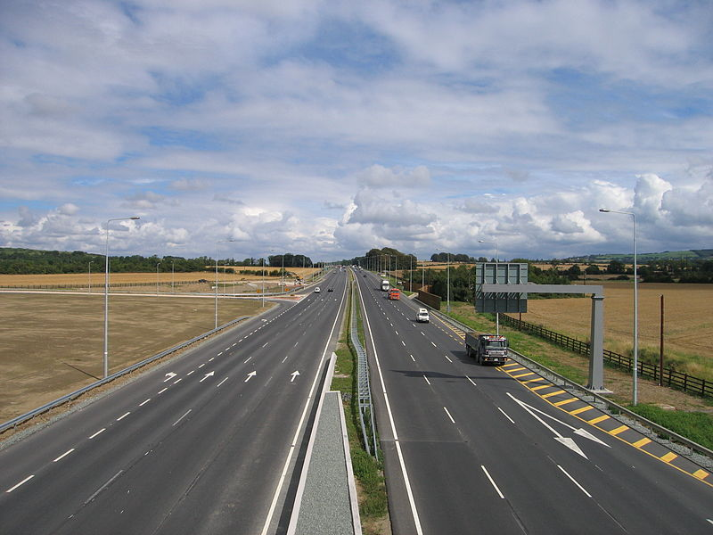

Activity Builds the Brain’s Pathways
Aerobic Exercise creates new and better circuits
Non-Exerciser’s Pathways Exercisers’ Pathways
Photo by Sarah 777at the English Wikipedia project
Fotolia ##30472717
Fotolia #13408404
Notes:
Aerobic activity releases the neurotrophin BDNF which Dr. John Ratey of Harvard terms Miracle Gro for the brain. The amount of exercise is in direct proportion to the amount of BDNF produced and new brain cells birthed. Not surprisingly, studies have shown a student’s academic improvement is in direct proportion to the amount of exercise received. Upgraded neural pathways translates into better learning.

Slide 23
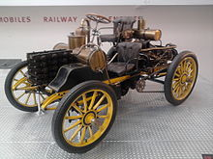

Activity Improves Signaling
Messages delivered more efficiently
Non-Exerciser’s Transmissions Exerciser’s Transmissions
Fotolia #24863095
Fotolia #20946423
Notes:
The SPEED of information transfer throughout the brain’s circuits is greatly enhanced. Messages not only have better pathways but travel at greater rates. Anyone who has upgraded from dial-up internet service to ? has experienced firsthand the impact and value of speedier, more efficient signaling.

Slide 24
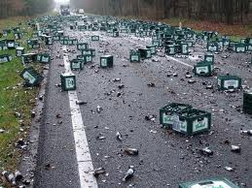

Exercise Improves the Synapses
Astrocytes clean the connections more efficiently
Non-Exercisers’ Synapse Exercisers’ Synapse
Wikipedia Commons file photo
Wikipedia Commons file photo
Notes:
Since the brain is the primary user of O2 efficiency is enhanced with increased blood flow and the subsequent increase in the volume of oxygen and other nutrients

Slide 25

Endorphins
Serotonin
Dopamine
Norepinephrine
Glutamate

Slide 26

Neurochemistry
Dopamine
Reward
Pleasure
Motivation/Drive
Attention
Appetite
Sex
Aggression
Mood
Cognitive
Function
Norepinepherine
Serotonin
Alertness
Concentration
Energy
Obsessions
Compulsions
Memory
Anxiety
Impulse
Irritability

Slide 27
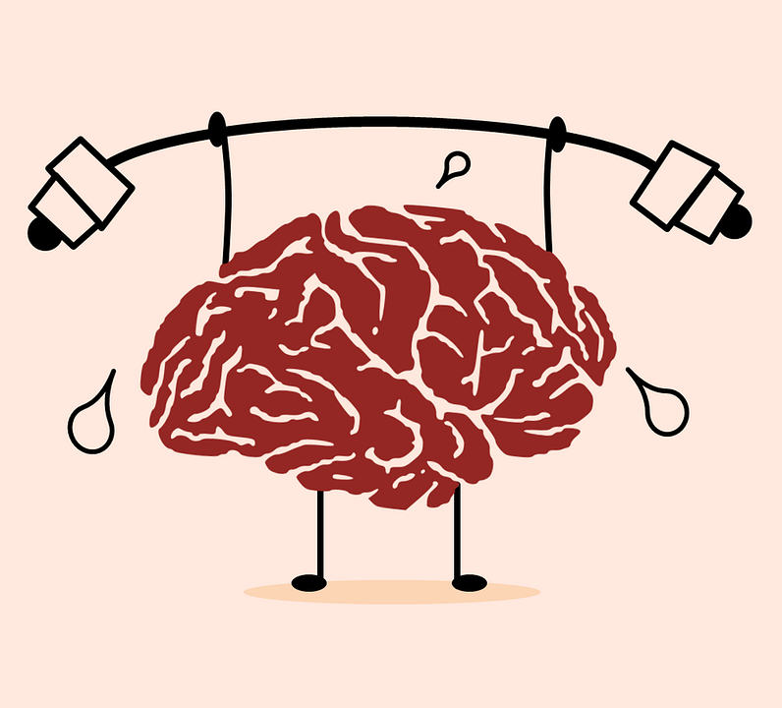
EXERCISE PREPARES THE MIND
for LEARNING
Improves Impulse Control
Improves Behavior
Improves Attention
Decreases Restlessness
Improves Arousal - Lessens Fatigue
Improves Motivation

Slide 28
Exercise also improves
Mood
Wakefulness
Focus
Motivation
Reaction Time

Slide 29


Sleep Hygiene
Well rested students show a 22% increased ability to be creative.
Sleep is important in memory formation, organization, retention, and RETRIEVAL.
8 hours is needed..1st 6 hours the “OUTSIDE BRAIN” IS AT WORK
LAST 2 HOURS THE INSIDE BRAIN IS AT WORK
THERE IS NO SHORTCUT!
Dr. John Medina “Brain Rules”

Slide 30
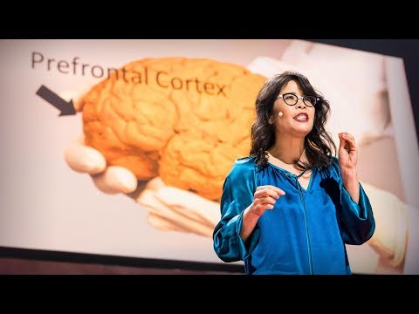

Slide 31
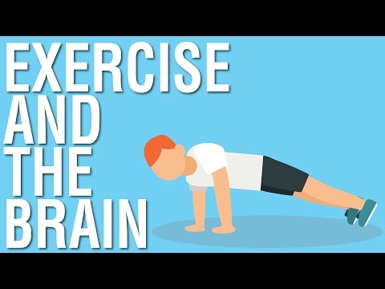
Extra Resource

