Slide 1
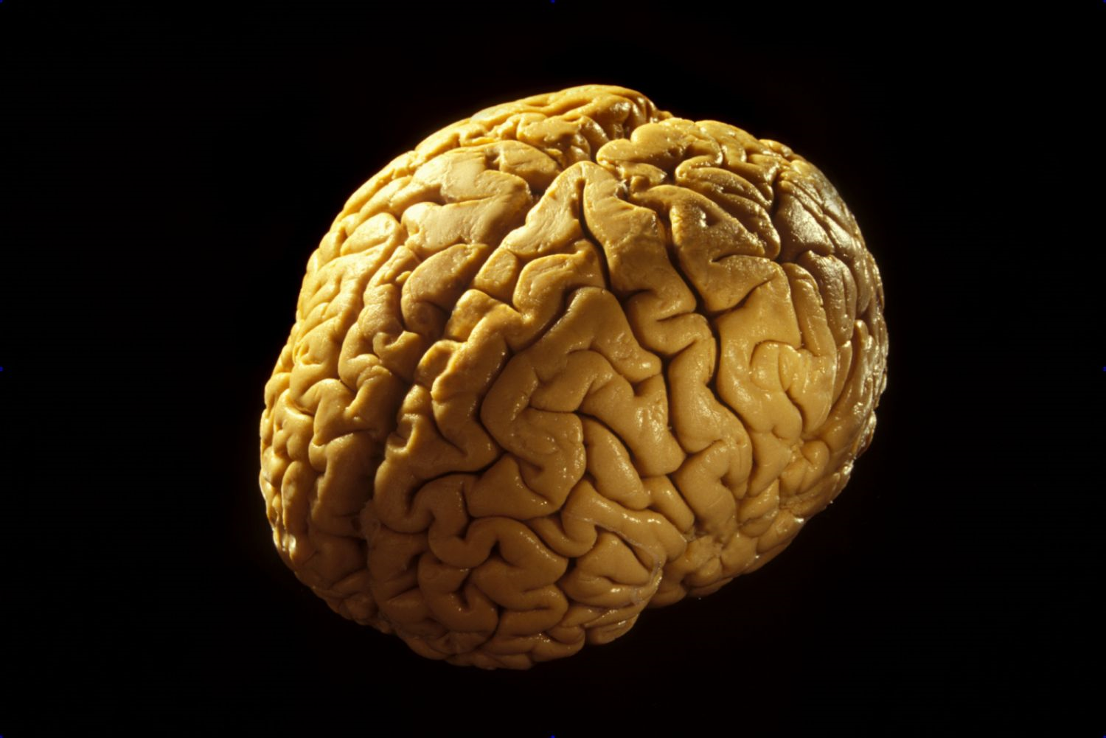
The human brain

Slide 2
Major structures of the human brain
Parietal Lobe | Occipital Lobe
Frontal Lobe | Temporal Lobe
Cerebellum | Cerebrum
Brain Stem

Slide 3
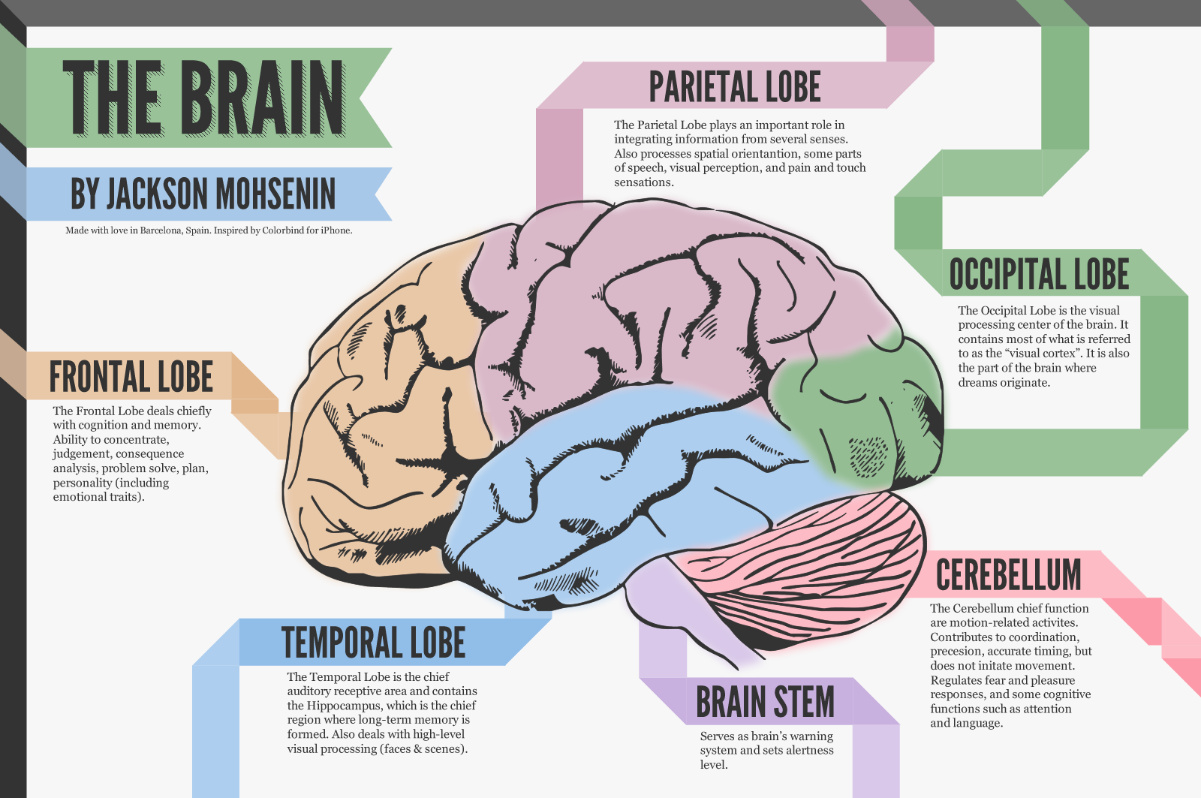

Slide 4
Brain Anatomy: Diagram Activity
Provide a blank sheet of paper to students
Students may use their textbook, online resources, or the previous slide to create a drawing of the major structures of the brain:
  Use a different color for each anatomical part and
  Include the name and function of each part using the same color they used to draw that part of the brain.
Include the sense that each part of the brain interprets and controls.

Slide 5
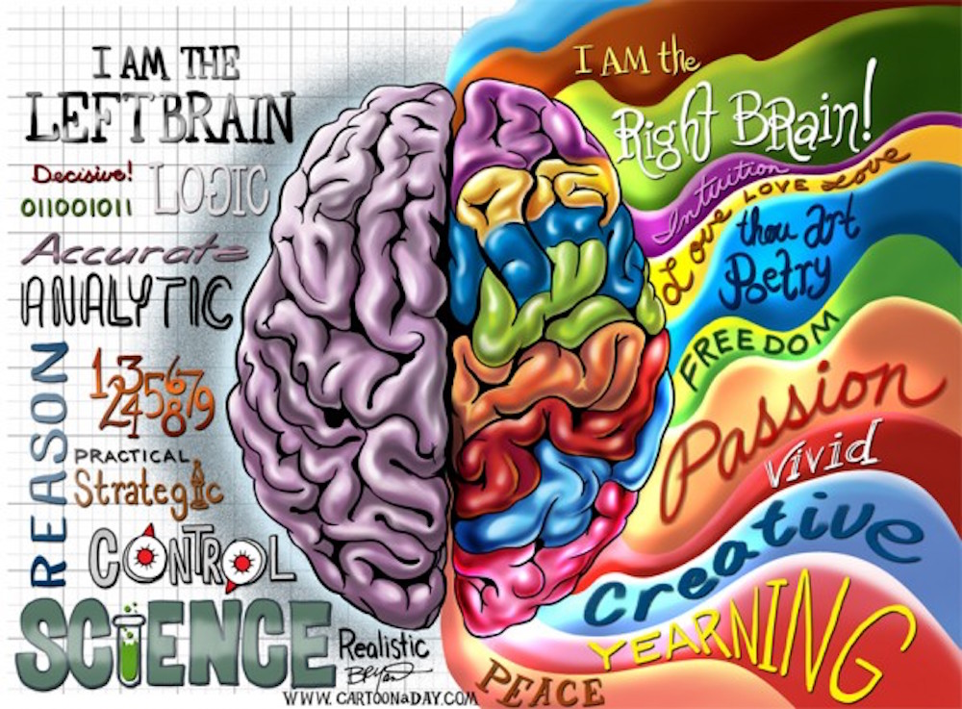
Hemispheres of the brain

Slide 6
Do you have a dominant side of the brain?
Some brain researchers believe that people have a dominant side of their brain. (Left brain dominant or right brain dominant.)
Other researchers believe that the left and right brain dominance theory is a myth and was never completely proven.
The ultimate goal is to use your whole brain when you are engaged in an activity.
However, for the fun of it, lets see if you have a dominant side of the brain according to a simple brain dominance test.
http://www.edu-nova.com/apps/brain_dominance.html

Slide 7
Right and left brain chart activity
Create a chart detailing the various brain activities each hemisphere of the brain is believed to control.
Include activities you believe are controlled by each hemisphere.
Also, list activities you enjoy and are good at, and which side of the brain you think controls that activity.

Slide 8
Protection of the brain
Skull or Cranium – The bony structure that provides outer protection for the brain.
Under lying tissues – Under the skull there are various layers of protective tissues that also help protect the brain.
Cerebrospinal fluid – Creates a fluid protective layer between the skull and the brain to add a fluid cushioning effect for the brain.

Slide 9
Major diseases affecting the brain
( Define Terms)
Meningitis | Encephalitis
Parkinson’s Disease | Brain Abscess
Alzheimer’s Disease | Epilepsy
Stroke | Brain Tumor
Autoimmune Conditions | Lou Gehrig’s Disease

Slide 10
Brain Injuries – TBI and Concussions
Traumatic Brain Injury - Traumatic brain injury (TBI) happens when a bump, blow, jolt, or other head injury causes damage to the brain.
Concussion - The term concussion describes an injury to the brain resulting from an impact to the head. By definition, a concussion is not a life-threatening injury, but it can cause both short-term and long-term problems.

Slide 11
Symptoms of Brain Injuries
  Loss of consciousness
  Sensitivity to light
  Sensitivity to loud noises
  Confusion
  Headache
  Nausea or vomiting
  Blurred vision
  Loss of short term memory (you may not remember the actual injury and the events some time before or after the impact)
  Perseverating (repeating the same thing over and over)

Slide 12
Tips to maintain Proper brain health
Every brain changes with age, and mental function changes along with it. Mental decline is common, and it's one of the most feared consequences of aging. But cognitive impairment is not inevitable.
Here are 12 ways you can help maintain brain function.
1. Get mental stimulation
  Through research with mice and humans, scientists have found that brainy activities stimulate new connections between nerve cells and may even help the brain generate new cells.
2. Get physical exercise
  Research shows that using your muscles also helps your mind. Exercise also spurs the development of new nerve cells and increases the connections between brain cells (synapses). This results in brains that are more efficient, plastic, and adaptive.

Slide 13
Brain health continued
3. Improve your diet
  Good nutrition can help your mind as well as your body. For example, people that eat a Mediterranean style diet that emphasizes fruits, vegetables, fish, nuts, unsaturated oils (olive oil) and plant sources of proteins are less likely to develop cognitive impairment and dementia.
4. Improve your blood pressure
  High blood pressure in midlife increases the risk of cognitive decline in old age.
5. Improve your blood sugar
  Diabetes is an important risk factor for dementia. (Define Dementia….)
6. Improve your cholesterol
  High levels of LDL ("bad") cholesterol are associated with an increased the risk of dementia.

Slide 14
Brain Health Continued
7. Consider low-dose aspirin
  Some observational studies suggest that low-dose aspirin may reduce the risk of dementia, especially vascular dementia.
8. Avoid tobacco
  Avoid tobacco in all its forms.
9. Don't abuse alcohol
  Excessive drinking is a major risk factor for dementia. If you choose to drink, limit yourself to two drinks a day.

Slide 15
Brain health continued
10. Care for your emotions
  People who are anxious, depressed, sleep-deprived, or exhausted tend to score poorly on cognitive function tests.
11. Protect your head
  Moderate to severe head injuries, even without diagnosed concussions, increase the risk of cognitive impairment.
12. Build social networks

Slide 16
Summary writing activity
Write a summary paragraph concerning the ways to keep your brain healthy and young through out your life.
Include the ways you plan to help keep your brain healthy.
Provide examples of what you are currently doing to keep your brain healthy.
Highlight or circle all brain vocabulary words you use in your summary paragraph.

