Slide 1
Anatomy and Role of the Nerve Cell in the Nervous System

Slide 2
Lesson Objective:
The student will be able to identify and describe:
    Types of nerve cells
    Nerve cell anatomy
    Disease affecting nerve cells
    Care and health of the nerve cell

Slide 3
Types of Nerve Cells
Sensory nerves- Detects and carries sensory information towards the central nervous system.
  Five senses
    Touch – Skin – Skin receptors
    Smell – Nose – Olfactory nerves
    Sight – Eyes - Optical nerves
    Hearing – Ears – Auditory nerves
    Taste – Tongue – Taste buds

Slide 4
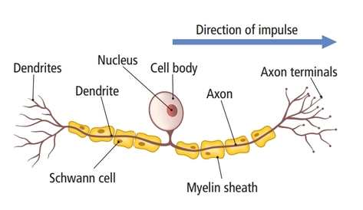
Sensory Nerves
Sensory nerves— These are the nerves that send messages to the brain or the spinal cord from the sense organs.

Slide 5
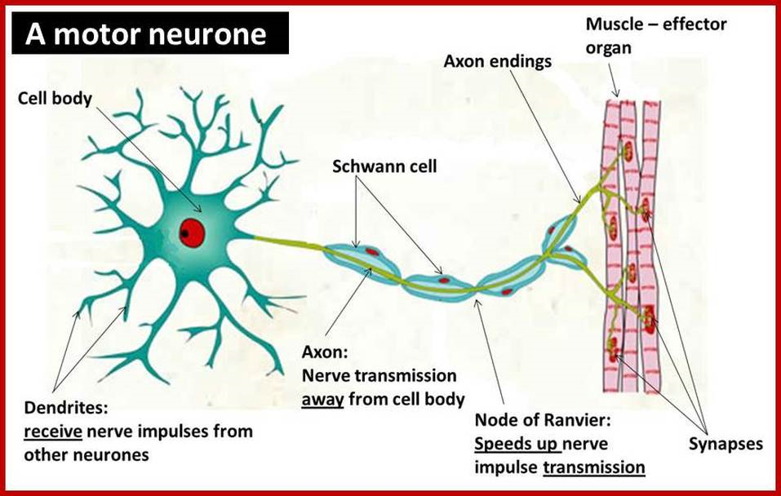
Motor Nerves
Motor Nerves— Motor nerves are those nerves those that carry the messages in the form of a response from the brain or the spinal cord to other parts of the body such as the muscles and glands.

Slide 6
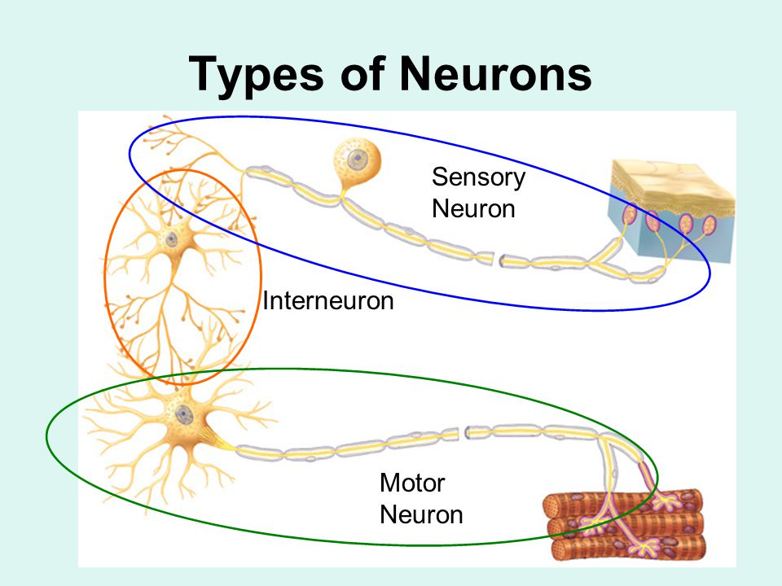
Interneurons
Interneurons or connecting neurons carry nervous impulses between sensory and motor neurons.

Slide 7
Anatomy of a Nerve Cell
Major structures
  Neuron – The name for a nerve cell
  Cell body – The main nerve cell structure containing the nucleus
  Axons – Carries nerve impulses away from the cell body
  Dendrites- Carries information towards the cell body
  Myelin – Protective covering of the nerve cell
  Nucleus – Interprets sensory information transmitted to the cell body

Slide 8
Diseases Affecting Nerve Cells
Epilepsy
Multiple Sclerosis
ALS – Lou Gehrig’s Disease
Alzheimer’s Disease
Stroke
Add definitions

Slide 9
Care of Nerve Cells
Monitor your eating patterns and make sure to eat semi-regularly so as to not deplete the glucose your neurons use for energy
Eat a balanced diet that includes good levels of B-12 and D vitamins, as well as healthy fats
Avoid smoking and drinking excessive alcohol
Keep up with a solid sleep schedule, as sleep helps strengthen circuits within the nervous system which can help with memory

Slide 10
Nerve Cell Care Continued
Exercise your nervous system and brain with activities like writing by hand or playing mind games like Sudoko
Take part in exercise that is appropriate for your body; aim to exercise at least three times a week
Maintain a healthy weight as many conditions, such as diabetic neuropathy, are closely linked to obesity or overweight
Avoid, or limit, environmental factors that can cause nerve damage, such as repetitive motions or exposure to toxic chemicals

Slide 11
Activity
Using a blank sheet of paper draw a diagram of a neuron.
Include the major anatomical components and include a brief definition of each anatomical part.
Color each anatomical component a different color and write the definition the the same color.
Include arrows indicating the direction of the transmission of a nervous impulse impulse.

Slide 12
Writing Assignment
Write a summary paragraph explaining the ways to maintain the health of your nerve cells and how you plan to include those practices into your daily life.

