Slide 1
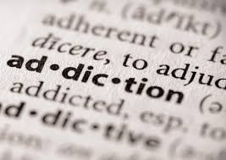

Slide 2
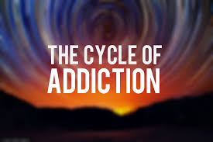

Slide 3
addiction
Notes:
Addiction is defined as a chronic, relapsing brain disease that is characterized by compulsive drug seeking and use, despite harmful consequences. It is considered a brain disease because drugs change the brain; they change its structure and how it works. These brain changes can be long lasting and can lead to many harmful, often self-destructive, behaviors.

Slide 4
euphoria
Notes:
Euphoria: A pleasurable state of altered consciousness; one reason for the preference of one addictive behavior or substance over another

Slide 5
dysphoria
Notes:
Dysphoria: The opposite of euphoria

Slide 6
tolerance
Notes:
Tolerance: Condition in which one must increase their use of a drug for it to have the same effect

Slide 7
withdrawal
Notes:
Withdrawal: The abrupt decrease in or removal of one’s regular dosage of a psychoactive substance

Slide 8
abuse
Notes:
Abuse - the repeated use of drugs to produce pleasure, alleviate stress, and/or alter or avoid reality. It also includes using prescription drugs in ways other than prescribed or using someone else’s prescription.

Slide 9
dependence
Notes:
Dependance: A state in which an organism functions normally only in the presence of a drug.

Slide 10
CYCLE OF ADDICTION
CURIOSITY
EXPERIMENT WITH DRUG
EUPHORIA
DYSPHORIA
TOLERANCE
&
LESSER
EUPHORIA
WITHDRAWAL
GREATER
DYSPHORIA
GREATER
DRUG USE
ELEVATED
DRUG DOSES
RELIEF FROM WITHDRAWAL
WITHDRAWAL
DEPENDENCE
ON DRUG

Slide 11

Use
Curiosity
Experiment with drug
Euphoria
Dysphoria

Slide 12
USE
EXPERIMENT
WITH
DRUG
CURIOSITY
DYSPHORIA
EUPHORIA

Slide 13


Slide 14

Experiment with drug

Slide 15

Euphoria

Slide 16

Dysphoria

Slide 17
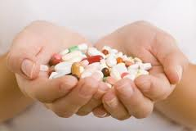
Abuse
Withdrawal
Elevated Drug use
Tolerance
Lesser Euphoria
Greater Dysphoria

Slide 18
ABUSE
TOLERANCE
&
LESSER
EUPHORIA
DRUG
GREATER
DRUG USE
GREATER
DYSPHORIA
WITHDRAWAL

Slide 19
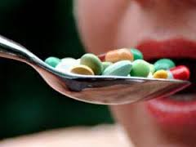
greater drug use

Slide 20
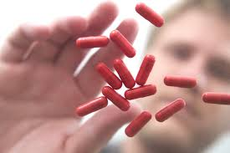

Tolerance
Lesser
Euphoria

Slide 21
Greater Dysphoria

Slide 22
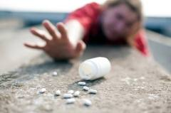
Withdrawal

Slide 23
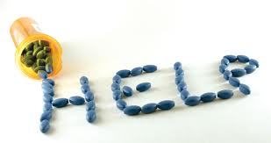
Dependency
Elevated drug doses
Relief from withdrawal
Withdrawal
Addiction

Slide 24
DEPENDENCY
ELEVATED
DRUG DOSES
RELIEF FROM WITHDRAWAL
DEPENDENCE
ON DRUG
WITHDRAWAL

Slide 25
Elevated drug use

Slide 26

Relief from withdrawal

Slide 27
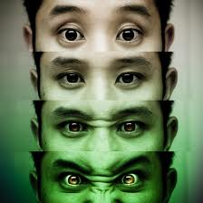
Withdrawal

Slide 28
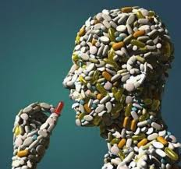
Dependency

Slide 30
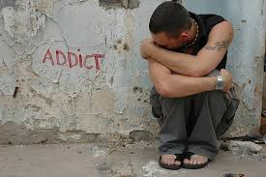

Slide 31

A young person is feeling pain and discomfort because of family or school problems.
They look for ways to feel better, so he or she starts to take drugs.

Slide 32

At first, the drugs seem to work because they dull the pain the person is trying to escape from. So the person keeps taking the drug.

Slide 33

From this point, it often doesn't take long for the person to become addicted because he or she has developed a physical dependence—an addiction—to the substance.

Slide 34

At this stage, a serious downward spiral begins. The person will sacrifice anything—family, friends, school, or work—for drugs. Changed by drugs both physically and mentally, the person is now an addict.

