Slide 1

Directions
1- Choose a mental health condition from the list.
2- Perform your research and fill in the information on the word document.
3- Watch this video
4- Use your research to complete your One Pager.
Criteria for your One Pager:
Choose one of the templates below or build your own
Delete all of the slides that you do not use
Use short phrases and bullet points where applicable
Organize your information in a clear way
The name of your mental health condition should be prominent on the page
Use images and clipart to add some visual appeal
Choose font color wisely- coordinate them with your image colors but do not use yellow or lime green fonts!!

Slide 2
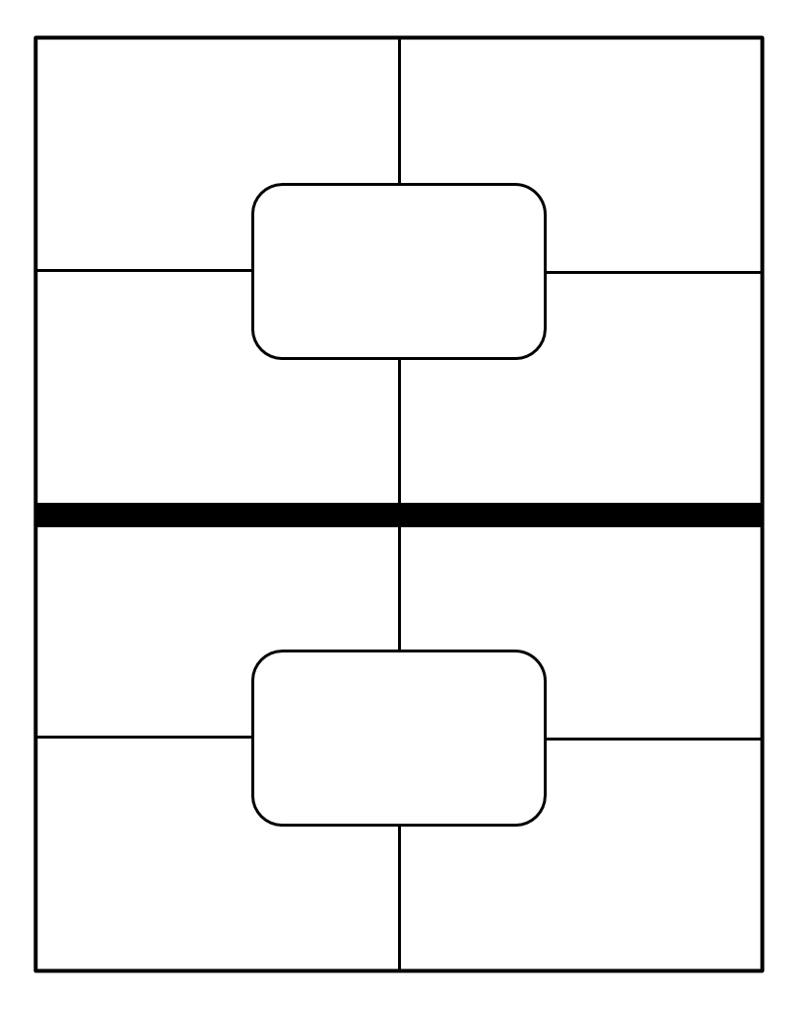

is a set of symptoms — feeling jittery, sleeping problems, trouble concentrating — that someone develops after they experience something harmful, terrifying, or upsetting.
May have nightmares, images of the event
May feel numb and unattached
Have anxiety
SAMPLE
PTSD
Treatment- talk therapy
1.5% diagnosed
Get help from parents, doctors, school counselor
Relaxation tips, support groups
Mental
Diagnosed by a doctor
Health
Awareness
How can support?- talk to them and listen to their feeling
Affects become distant, can not relate to family and friends
Encourage Treatment

Slide 3
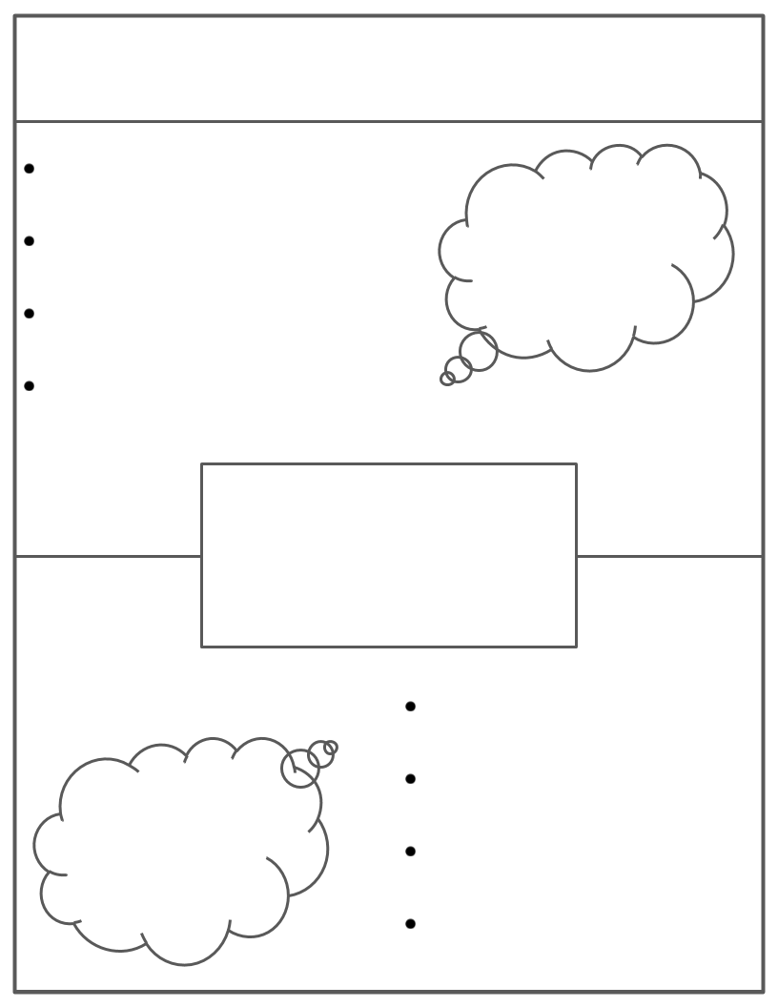



Mental Health Awareness
SAMPLE
Unusual shifts in moods, energy, activities levels, doing normal daily activities
Family/friend support- just be there! Listen to the person, educate yourself about Bipolar
Physical Symptoms include- extreme energy, little to no sleep for days, racing thoughts and speech, risky behavior, extreme fatigue
Affects teen by: losing friends, grades dropping, could destroy family relationships
Treatment- medication & counseling
Bipolar Disorder(manic/depressive disorder
Diagnosed by a health professional
Diagnosed by a physical exam, physiatric assessment, mood/behavior charting
About 2.9% of teens are diagnosed
Can get help from a trusted adult, counselor, other peers
Can get help through support groups and Mental Health Organizations

Slide 4
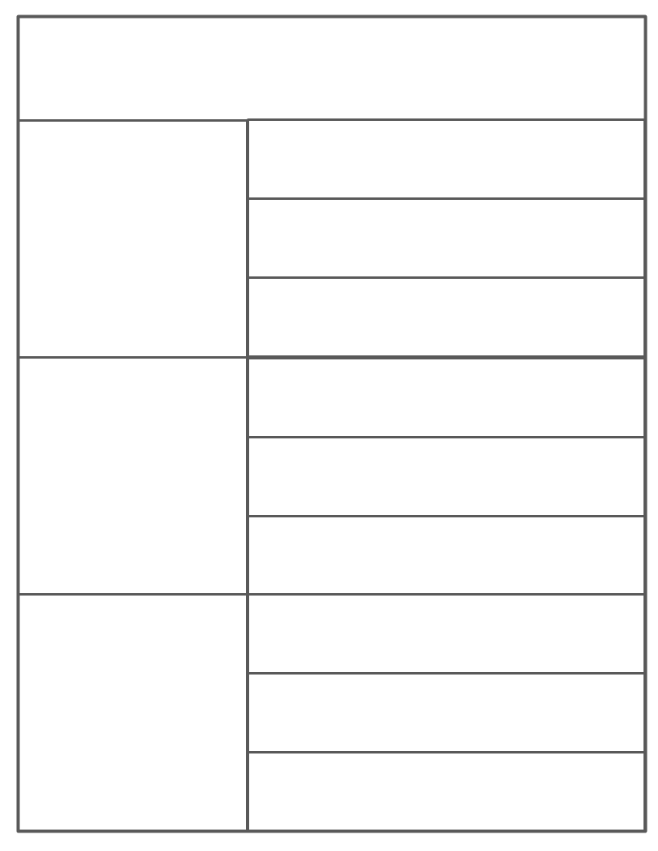

Slide 7


Slide 8
