Slide 1

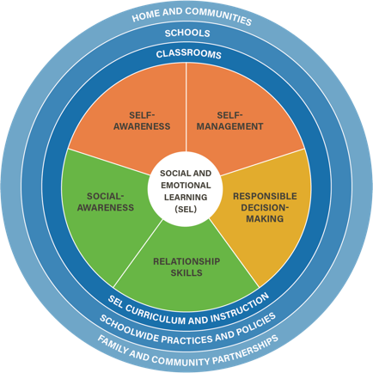
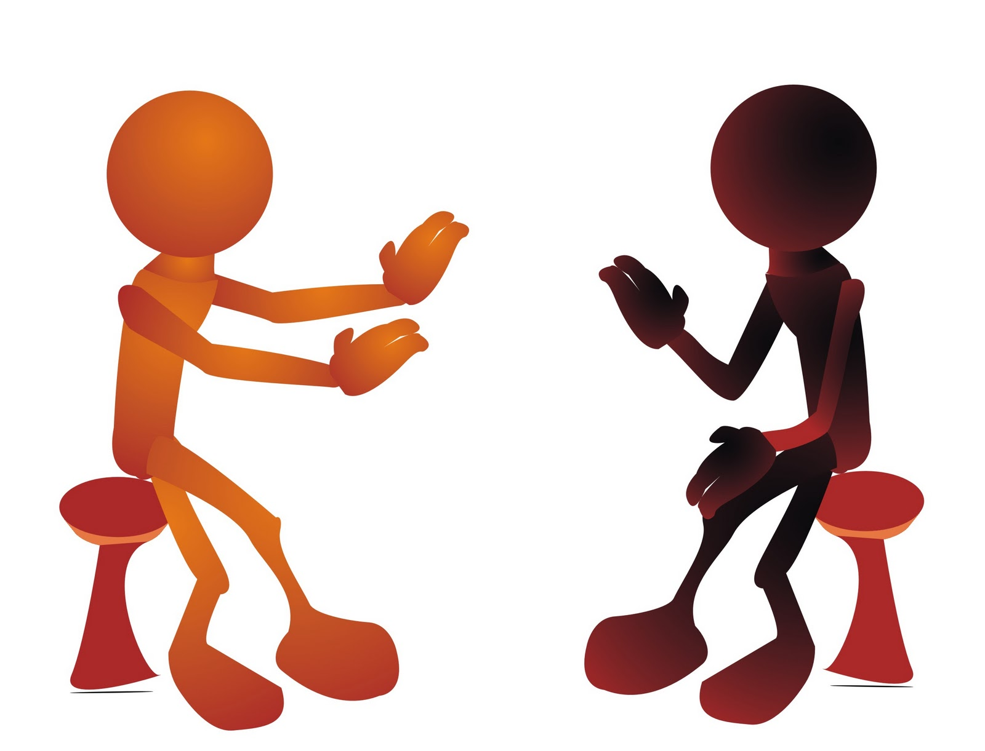
Social Emotional Learning Unit
Lesson 3

Slide 2
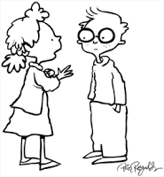
Objectives
7.1t Differentiate between passive, aggressive, and assertive communication. Relationship Skills- Communication Skills

Slide 3
Review Social-Awareness
Social-awareness
  The ability to take the perspective of and empathize with others, including those from diverse backgrounds and cultures. The ability to understand social and ethical norms for behavior and to recognize family, school, and community resources and supports. (CASEL.org)

Slide 4
Review Social-Awareness
  Growth mindsets—the belief that students learn more or become smarter if they work hard and persevere. Students may learn more, learn it more quickly, and view challenges and failures as opportunities to improve their learning and skills.
  Empathy- the feeling that you understand and share another person's experiences and emotions; the ability to share someone else's feelings.

Slide 5
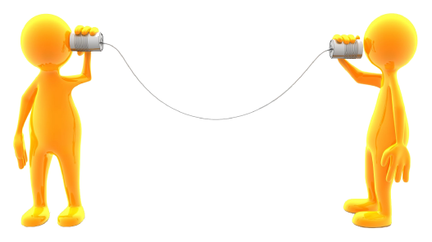
Relationship Skills
Relationship skills
  The ability to establish and maintain healthy and rewarding relationships with diverse individuals and groups. The ability to communicate clearly, listen well, cooperate with others, resist inappropriate social pressure, negotiate conflict constructively, and seek and offer help when needed. (CASEL.org)
  Introduce the sub-competencies
    Communication
    Social Engagement
    Relationship building
    Teamwork

Slide 6
Conflict Resolution, Part I.
Four types of attitudes
Aggressive – I win/You Lose
Passive – You win/I Lose
Passive-Aggressive – I lose/You Lose
Assertive – I win/You Win

Slide 7
Conflict Resolution, Part I: The Sort
  Each group gets one packet. Each packet contains a paper with the following headings
    Aggressive
    Passive
    Passive-aggressive
    Assertive
  The packet also contains several attitudes that represent each of the four types of communication. Sort the quotes under the appropriate heading and reflect on
      Which attitude is best for resolving conflict so the conflict stays resolved?
      Which attitude is the hardest to deal with and why?
      Which attitude is the hardest one to keep if you are in a conflict? Why?

Slide 8
Conflict Resolution, Part II: The Prompts
  Each group receives conflict resolution prompts. Work to get to a win/win resolution
  If you don’t know what to do, put your red circle up; if you have a question, put the yellow circle up; if you understand and don’t need any help, put the green circle up
  When finished, present with the goal of providing Win/Win resolution to the conflict

Slide 9

End of class review
1. What are Relationship Skills?
2. What are the four attitudes about conflict resolution?
3. Why is getting to Win/Win a good idea?
4. How will you use these skills in your personal life?

Slide 10

Exit ticket
How will this lesson help you improve your communication skills?

Slide 11
Be healthy—Cope healthy

