Slide 1

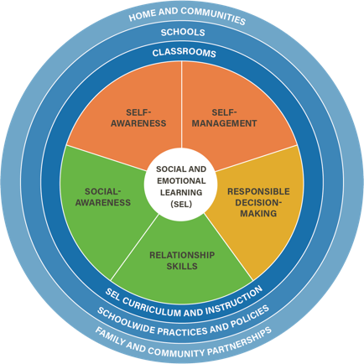
Social Emotional Learning Unit
Lesson 4

Slide 2
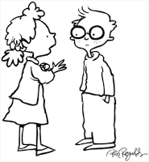
Objectives
7.1 The student will identify and explain essential health concepts to understand personal health.
7.3m Demonstrate how to influence others to make positive health choices. (Decision Making Skills)
7.1t Differentiate between passive, aggressive, and assertive communication. Relationship Skills- Communication Skills

Slide 3

Review communication skills
Aggressive: I Win/You Lose
Passive: You Win/I lose
Passive-aggressive: I Lose/You Lose
Assertive: I Win/You Win
This Photo by Unknown Author is licensed under CC BY-NC-ND

Slide 4

Summative assessment-Chapter Book
The summative assessment for this social-emotional learning unit is an autobiography that contains how you demonstrate self and social-awareness, decision-making, and communication skills in and how the SEL skills improve the quality of your life (socially, personally, or academically).
The book contains two pictures per chapter and a reflection at the end.
Each chapter is no longer than one page.

Slide 5
Chapter 1 – Self-awareness
Identifying emotions
  Select one sub-component of Self-Awareness and give an example of how it improves the quality of life (socially, personally, or academically).
  Include two pictures.
Self-confidence
Recognizing strengths
Accurate self-perception
Self-efficacy

Slide 6
Chapter 2 – Social Awareness
  Select one sub-component of Social-Awareness and give an example of how it improves the quality of your life (socially, personally, or academically).
  Include two pictures.
Perspective taking
Respect for others
Empathy
Appreciating Diversity

Slide 7

Chapter 3 – Decision making
  Give an example of a healthy choice that was made using the decision-making model.

Slide 8

Chapter 4 – Communication skills
  Give an example of when assertive communication was used and why it was a Win/Win

Slide 9

Chapter 5 – Reflection
  Reflect on the Social Emotional Skills and how they benefit a teen.

Slide 10
Rubric
Criteria | 4 | 3 | 2 | 1 | 0
Chapter 1 The student will identify and explain essential health concepts to understand personal health. (7.1) | The identification of how having Self-awareness improves your quality of life (socially, personally, or academically) is accurate. | The identification of how having Self-awareness improves your quality of life (socially, personally, or academically) is mostly accurate. | The identification of how having Self-awareness improves your quality of life (socially, personally, or academically) has some inaccuracies. | The identification of how having Self-awareness improves your quality of life (socially, personally, or academically) is in accurate. | Not enough evidence to score.

Slide 11
Be healthy—Cope healthy

