Slide 1
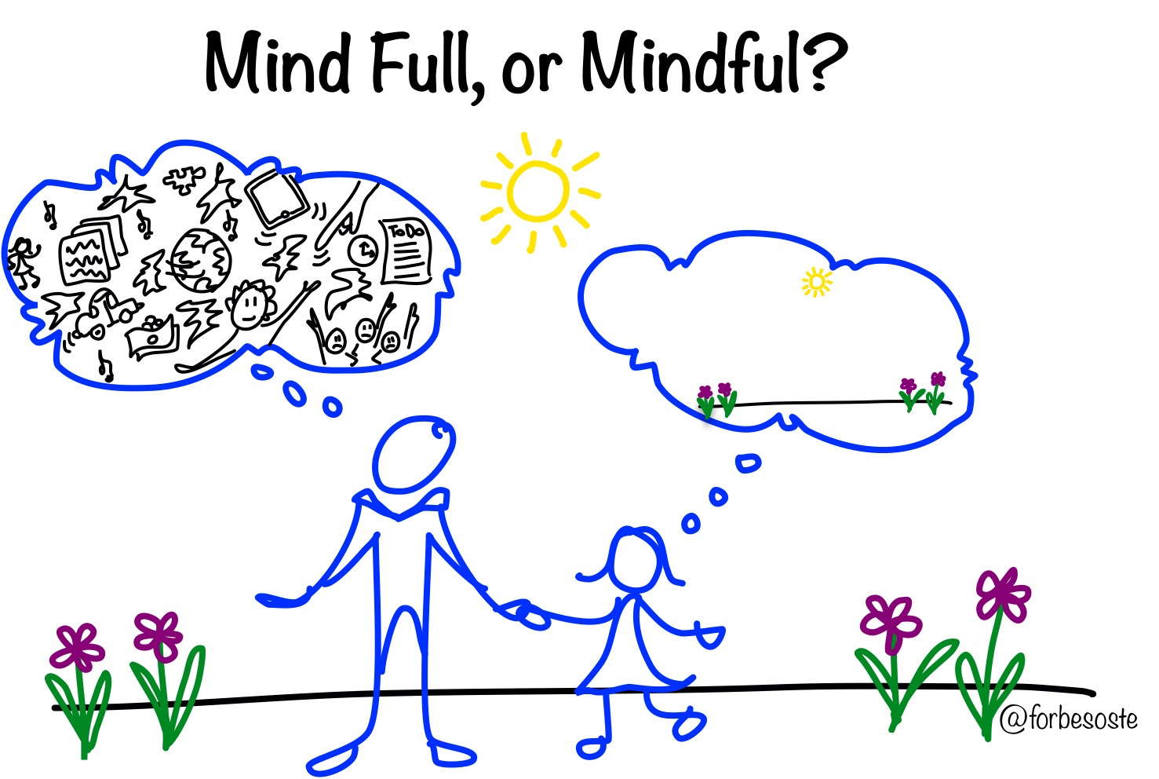
Mindfulness Unit
Lesson 3

Slide 2



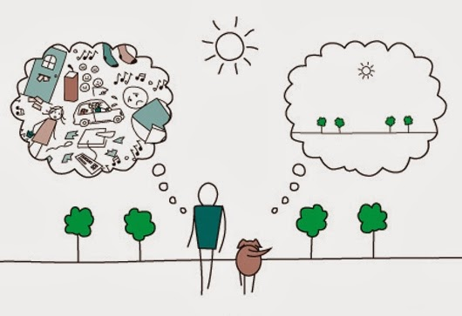
Objectives
Analyze the benefits of stress management and stress reduction techniques
Explain the benefits of emotional flexibility, stress management, and stress-reduction techniques for emotional health.

Slide 3

Let’s review!
z

Slide 4
Let’s review breathing!

Slide 5
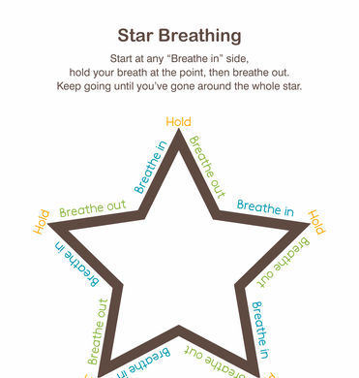
Breathing exercises
Practice either the Star breathing exercise

Slide 6

Breathing exercises
Practice either the Rainbow breathing exercise

Slide 7
Review healthy coping strategies by filling out the stress log
Stressful Situation | How I dealt with it | Healthy/Unhealthy

Slide 8
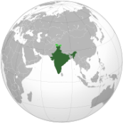
What is Yoga?
Yoga began more than 3000 years ago in India. Yoga is a Sanskrit (ancient language of the east) and it means to unite the mind, body, and spirit.
Yoga includes physical exercise but also includes balance between the mind, body, and breathing.
Yoga poses can help the body relax.

Slide 9
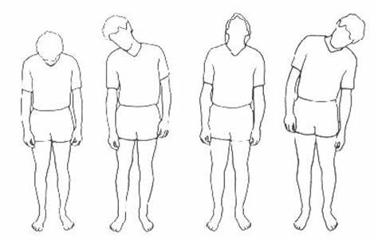
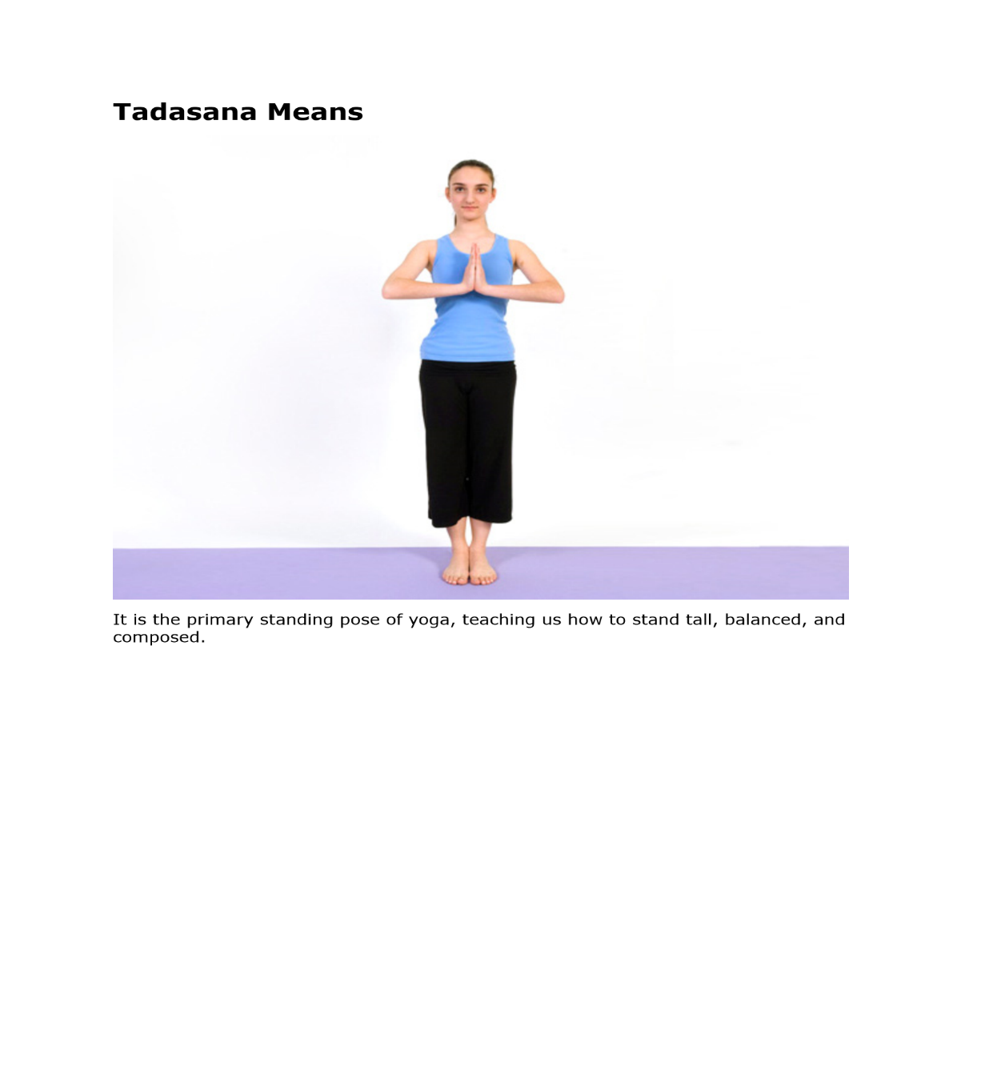
When to use Yoga
  Before a test (neck and shoulder rolls, squeeze and relax fingers and hands)
  While studying (neck and shoulder rolls and tree pose)
  Before going to bed (Yoga stand, Forward fold)

Slide 10
A fun introduction to Yoga
Teen Yoga and Mindfulness Explained. https://teenyoga.com/

Slide 11
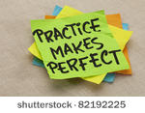
Let’s practice!

Slide 12
Head and Neck Roll

Slide 13
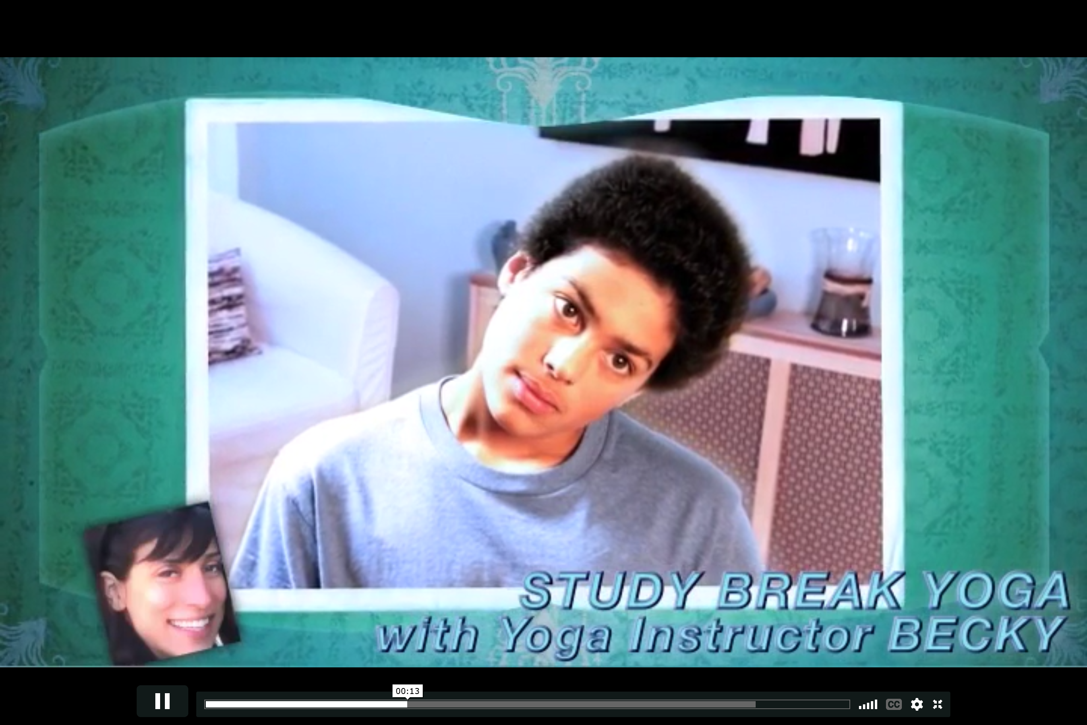
Neck stretch
https://teenshealth.org/en/teens/yoga-stress.html?WT.ac=t-ra

Slide 14
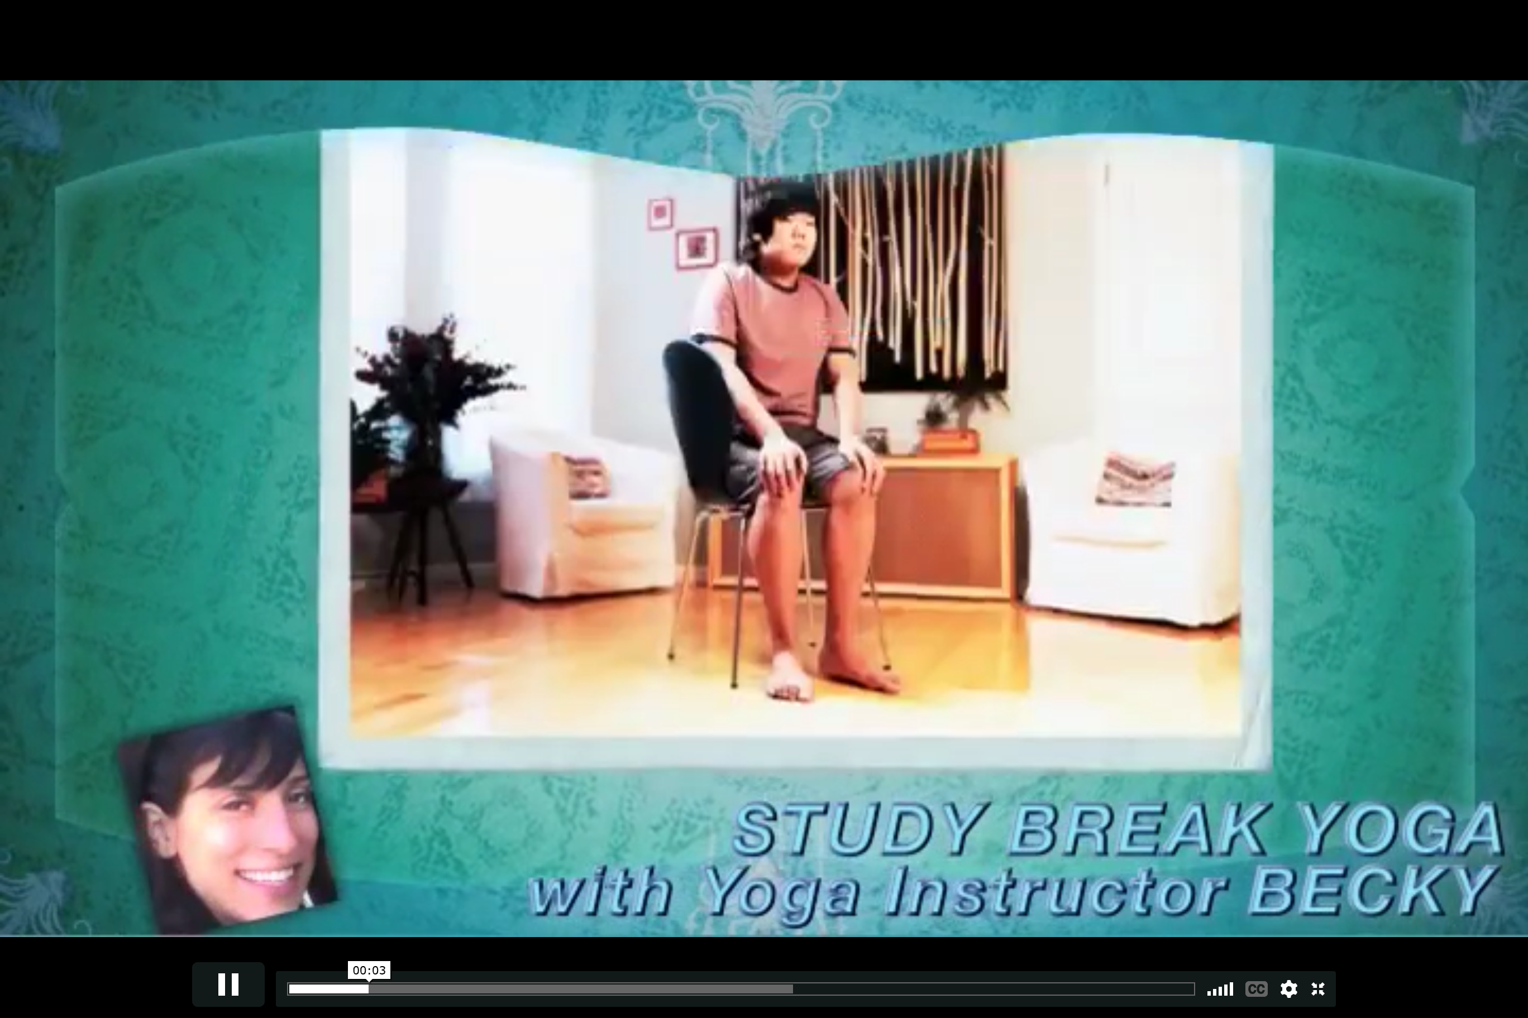
Seated Forward Fold
https://teenshealth.org/en/teens/yoga-stress.html?WT.ac=t-ra

Slide 15
Yoga Poses

Slide 16
Yoga Standing Pose
z

Slide 17
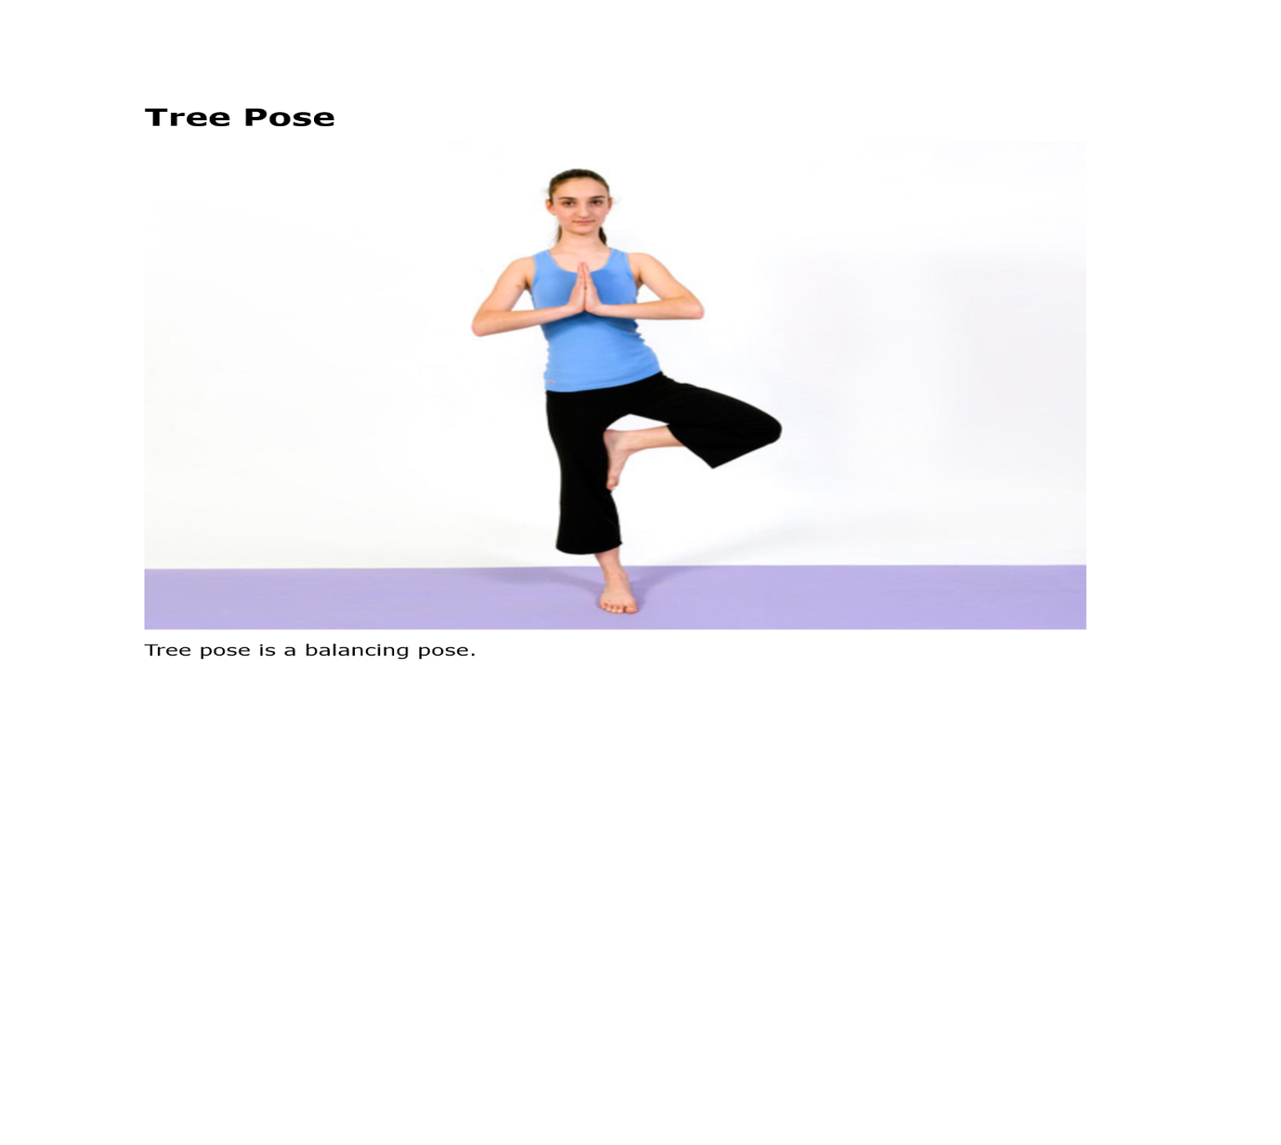
Yoga Tree Pose
z

Slide 18
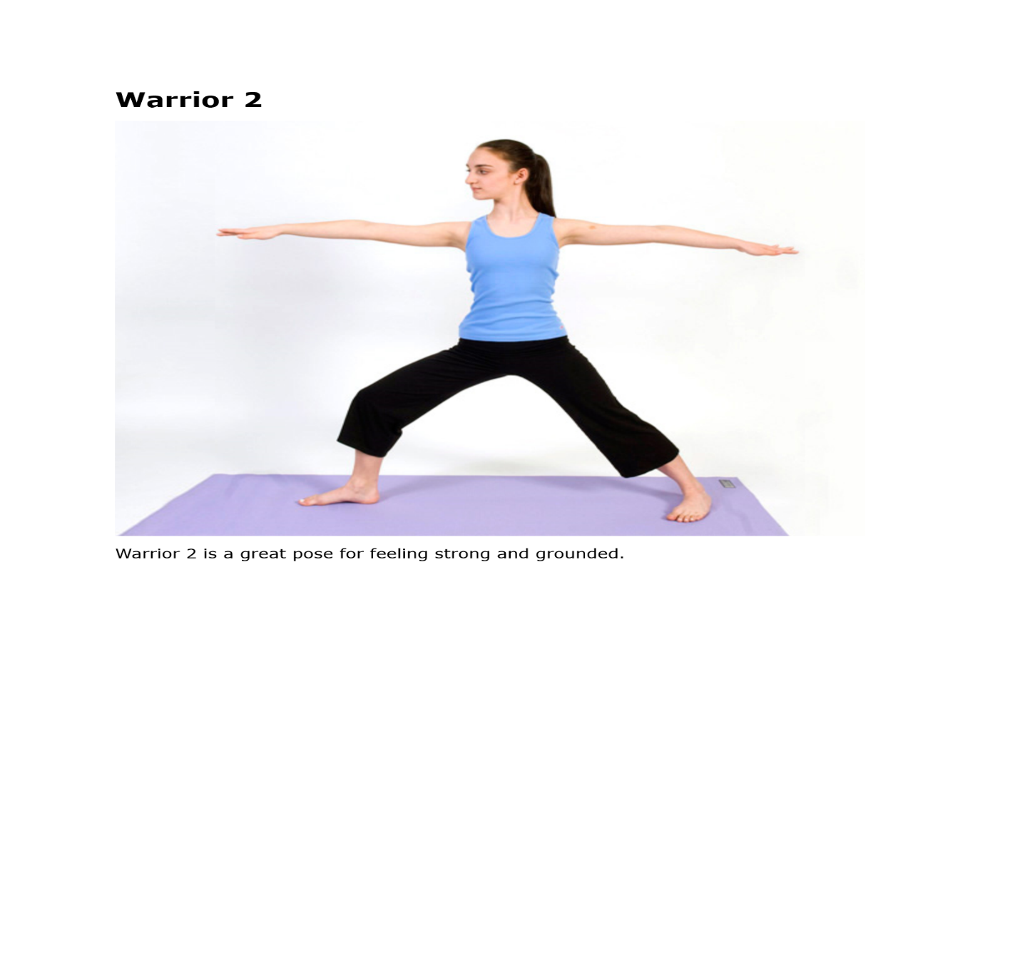
Yoga Warrior Pose
z

Slide 19
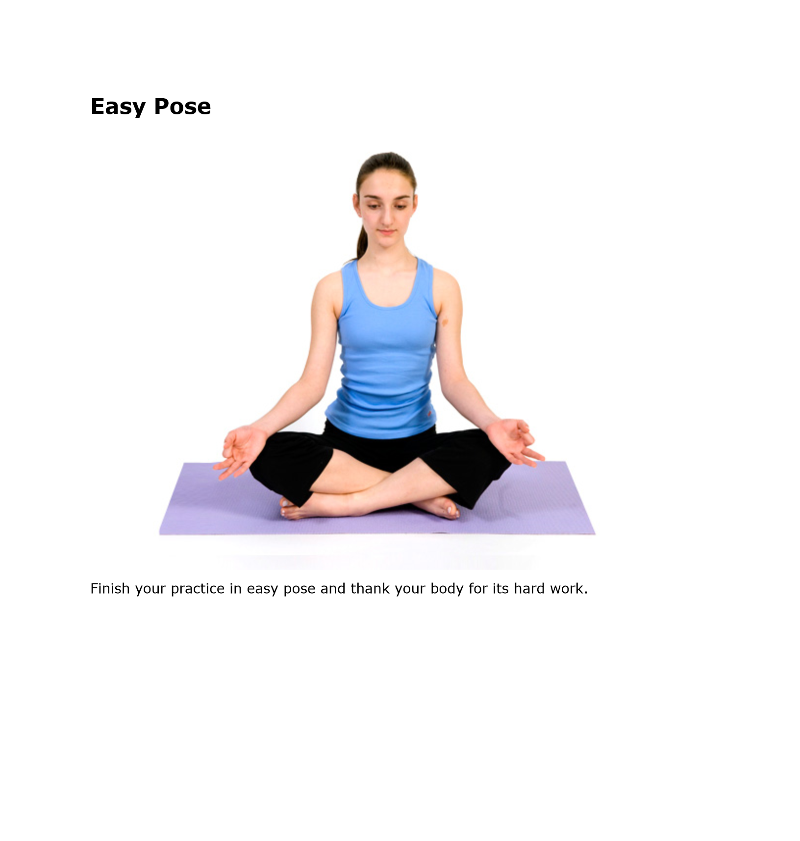
Yoga Easy Pose
z

Slide 20
End of class review
1. What is the benefit of keeping a stress log?
2. What else does Yoga contain besides the components of mind, body, and breathing ?
When are some good times to practice Yoga?
What is one Yoga exercise?
Demonstrate one Yoga pose.

Slide 21
Exit ticket
Explain the benefits of Yoga to reach emotional flexibility and stress-reduction for emotional health. (7.2p)

Slide 22
Be healthy—Cope healthy

