Slide 1
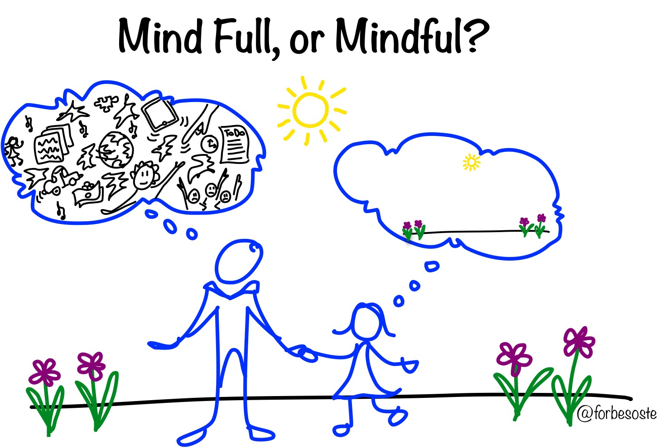
Mindfulness Unit
Lesson 2

Slide 2
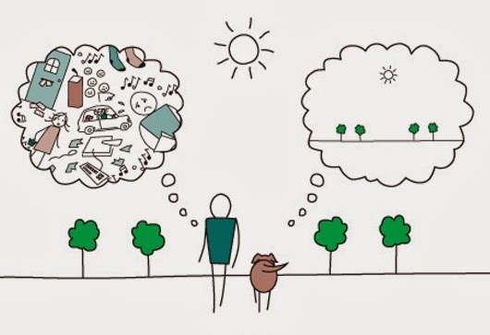
Objectives
Analyze the benefits of stress management and stress reduction techniques
Explain the benefits of emotional flexibility, stress management, and stress-reduction techniques for emotional health.

Slide 3
Let’s review!
z

Slide 4
What are some benefits of coping with stress in a healthy way?
listen better to others | be more patient | stay calm under stress
pay attention better | pay attention better | avoid getting upset too easily
get along better | be less distracted | slow down instead of rush
gain self-control | learn more | get tasks finished
 | feel happier and enjoy things more

Slide 5
Let’s review breathing!

Slide 6
Breathing Exercise

Slide 7
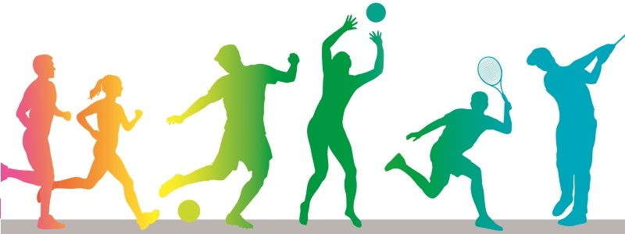
How to be Mindful
Think of how you concentrate when trying to do something difficult. You position yourself just right, concentrate on what you are trying to do, tune out distracting sounds, and go for it!
The more you practice mindfulness, the better you get.

Slide 8
Benefits of practicing being mindful
makes it easier to be mindful every day.
helps you feel calmer when stressed.
helps you focus when you have to something difficult.
Improves attention

Slide 9
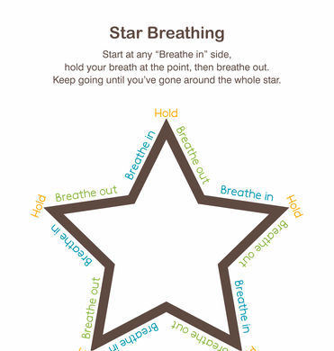
More breathing!
z

Slide 10
More breathing!
https://www.bing.com/videos/search?q=rainbow+breathing+exercise&view=detail&mid=0CE542BDB14A3422C3380CE542BDB14A3422C338&FORM=VIRE

Slide 11
Mindful Stress Reduction Techniques
BEEMS
B | Balance school-work with activities you enjoy
E | Eat healthy foods
E | Exercise 60 minutes each day
M | Manage responsibilities by keeping a calendar or planning app to keep track of chores, practice, school-work
S | Sleep 10 hours of sleep each night.

Slide 12
#1 BEEMS graphic organizer-Mindfully Decreasing Stress Buildup
Carson is stressed!!! He loves to fish on the weekends. It is very relaxing to him and calms him down. But during the week….he is not calm at all. He works hard and gets good grades but he is always stressed. He is often late for school because of his brothers, some of his peers are annoying to him, he eats well at school but prefers snack foods at home. Carson needs help! For each of the BEEMS Healthy Mindful circles, suggest ways to help Carson be more mindful and reduce his stress.
BEEMS
Sleep
Exercise
Balance
Food
Manage
Reflection: Explain the benefits of emotional flexibility, stress management, and stress-reduction techniques for emotional health. (7.2p)

Slide 13
#2 BEEMS graphic organizer-Mindfully Decreasing Stress Buildup
Mary has a science fair project due at the end of the month. She is stressed because science is hard for her and the team partners are not doing any work. They always have an excuse. To make things worse, next trimester she starts basketball and she doesn’t know how to play. She is afraid everyone will make fun of her. Sometimes she pretends to be sick so she doesn’t have to go to school.
Mary needs help!!! For each of the BEEMS Healthy Mindful circles, suggest ways to help Mary be more mindful and reduce her stress.
BEEMS
Sleep
Exercise
Balance
Food
Manage
Reflection: Explain the benefits of emotional flexibility, stress management, and stress-reduction techniques for emotional health. (7.2p)

Slide 14
End of class review
1. What is one benefit of practicing Mindfulness?
2. How do you practice Star breathing?
How do you practice Rainbow breathing?
What is one healthy suggestion you can give a peer who is experiencing stress?

Slide 15
Be healthy—Cope healthy

