Slide 1
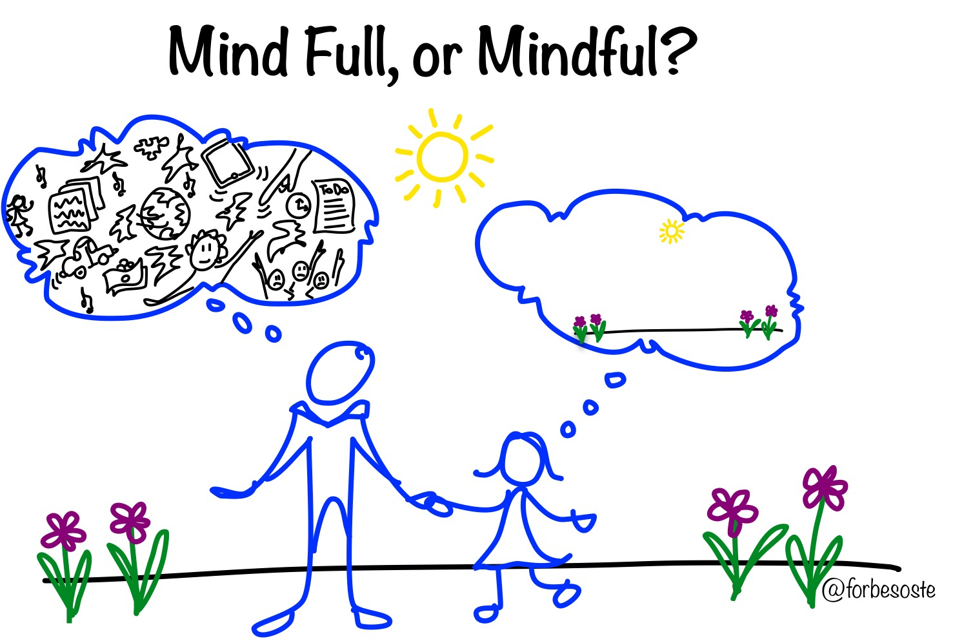
Mindfulness Unit
Lesson 1

Slide 2
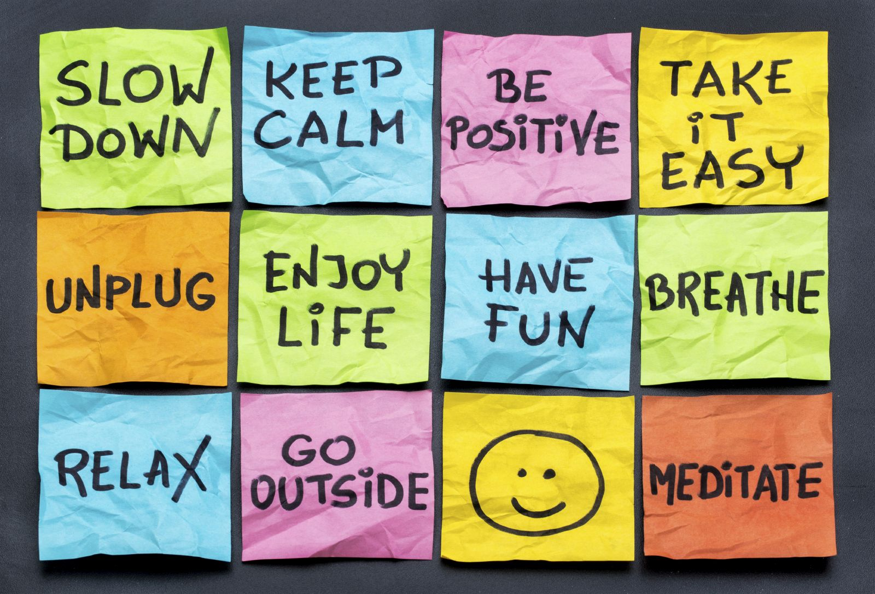
Objectives
Analyze the benefits of stress management and stress reduction techniques
Explain the benefits of emotional flexibility, stress management, and stress-reduction techniques for emotional health.

Slide 3
Class activity
Sources of stress
Let’s take a look at the newsprint on the walls.
On a sticky note, write down the sources of your stress then when I give you the signal, post the note on the newsprint that most closely matches your stress.

Slide 4
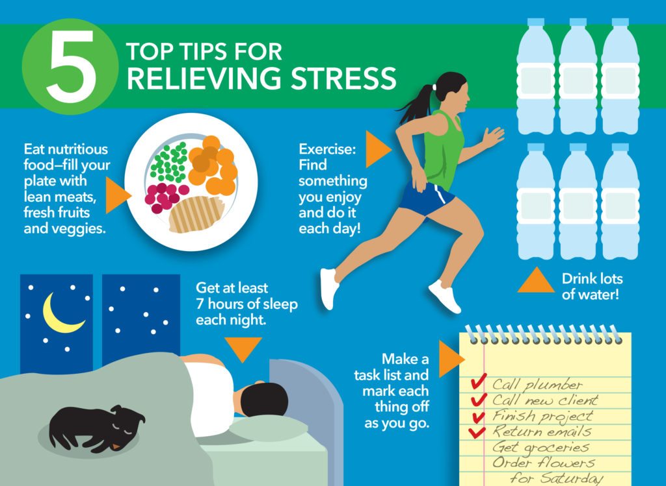
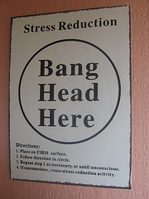
Coping with stress
Healthy coping strategies
Unhealthy coping strategies

Slide 5
What are some benefits of coping with stress in a healthy way?
listen better to others | be more patient | stay calm under stress
pay attention better | pay attention better | avoid getting upset too easily
get along better | be less distracted | slow down instead of rush
gain self-control | learn more | get tasks finished
 | feel happier and enjoy things more

Slide 6
Breathing Exercise

Slide 7
Peer Coaching
Breathing | Check
Breathe in for four counts 1-2-3-4
Hold the breath for 7 counts 1-2-3-4-5-6-7
Release the breath slowly for 8 counts 1-2-3-4-5-6-7-8

Slide 8
End of class review
1. What was the largest source of stress for our class?
2. What was one healthy coping strategy?
What was one unhealthy coping strategy? Why was it unhealthy?
What are three benefits of managing stress in a healthy way?
How will this class help you when you are experiencing stress?

Slide 9
Be healthy—Cope healthy

