Slide 1
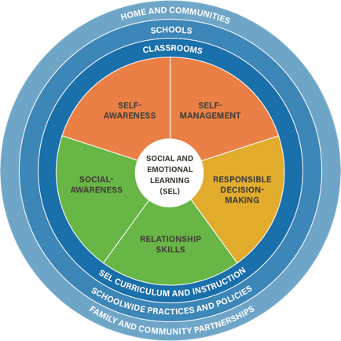
Social Emotional Learning Unit
Lesson 1

Slide 2
Objectives
7.1 The student will identify and explain essential health concepts to understand personal health.
7.3m Demonstrate how to influence others to make positive health choices.

Slide 3
Social Emotional Learning Competencies

Slide 4
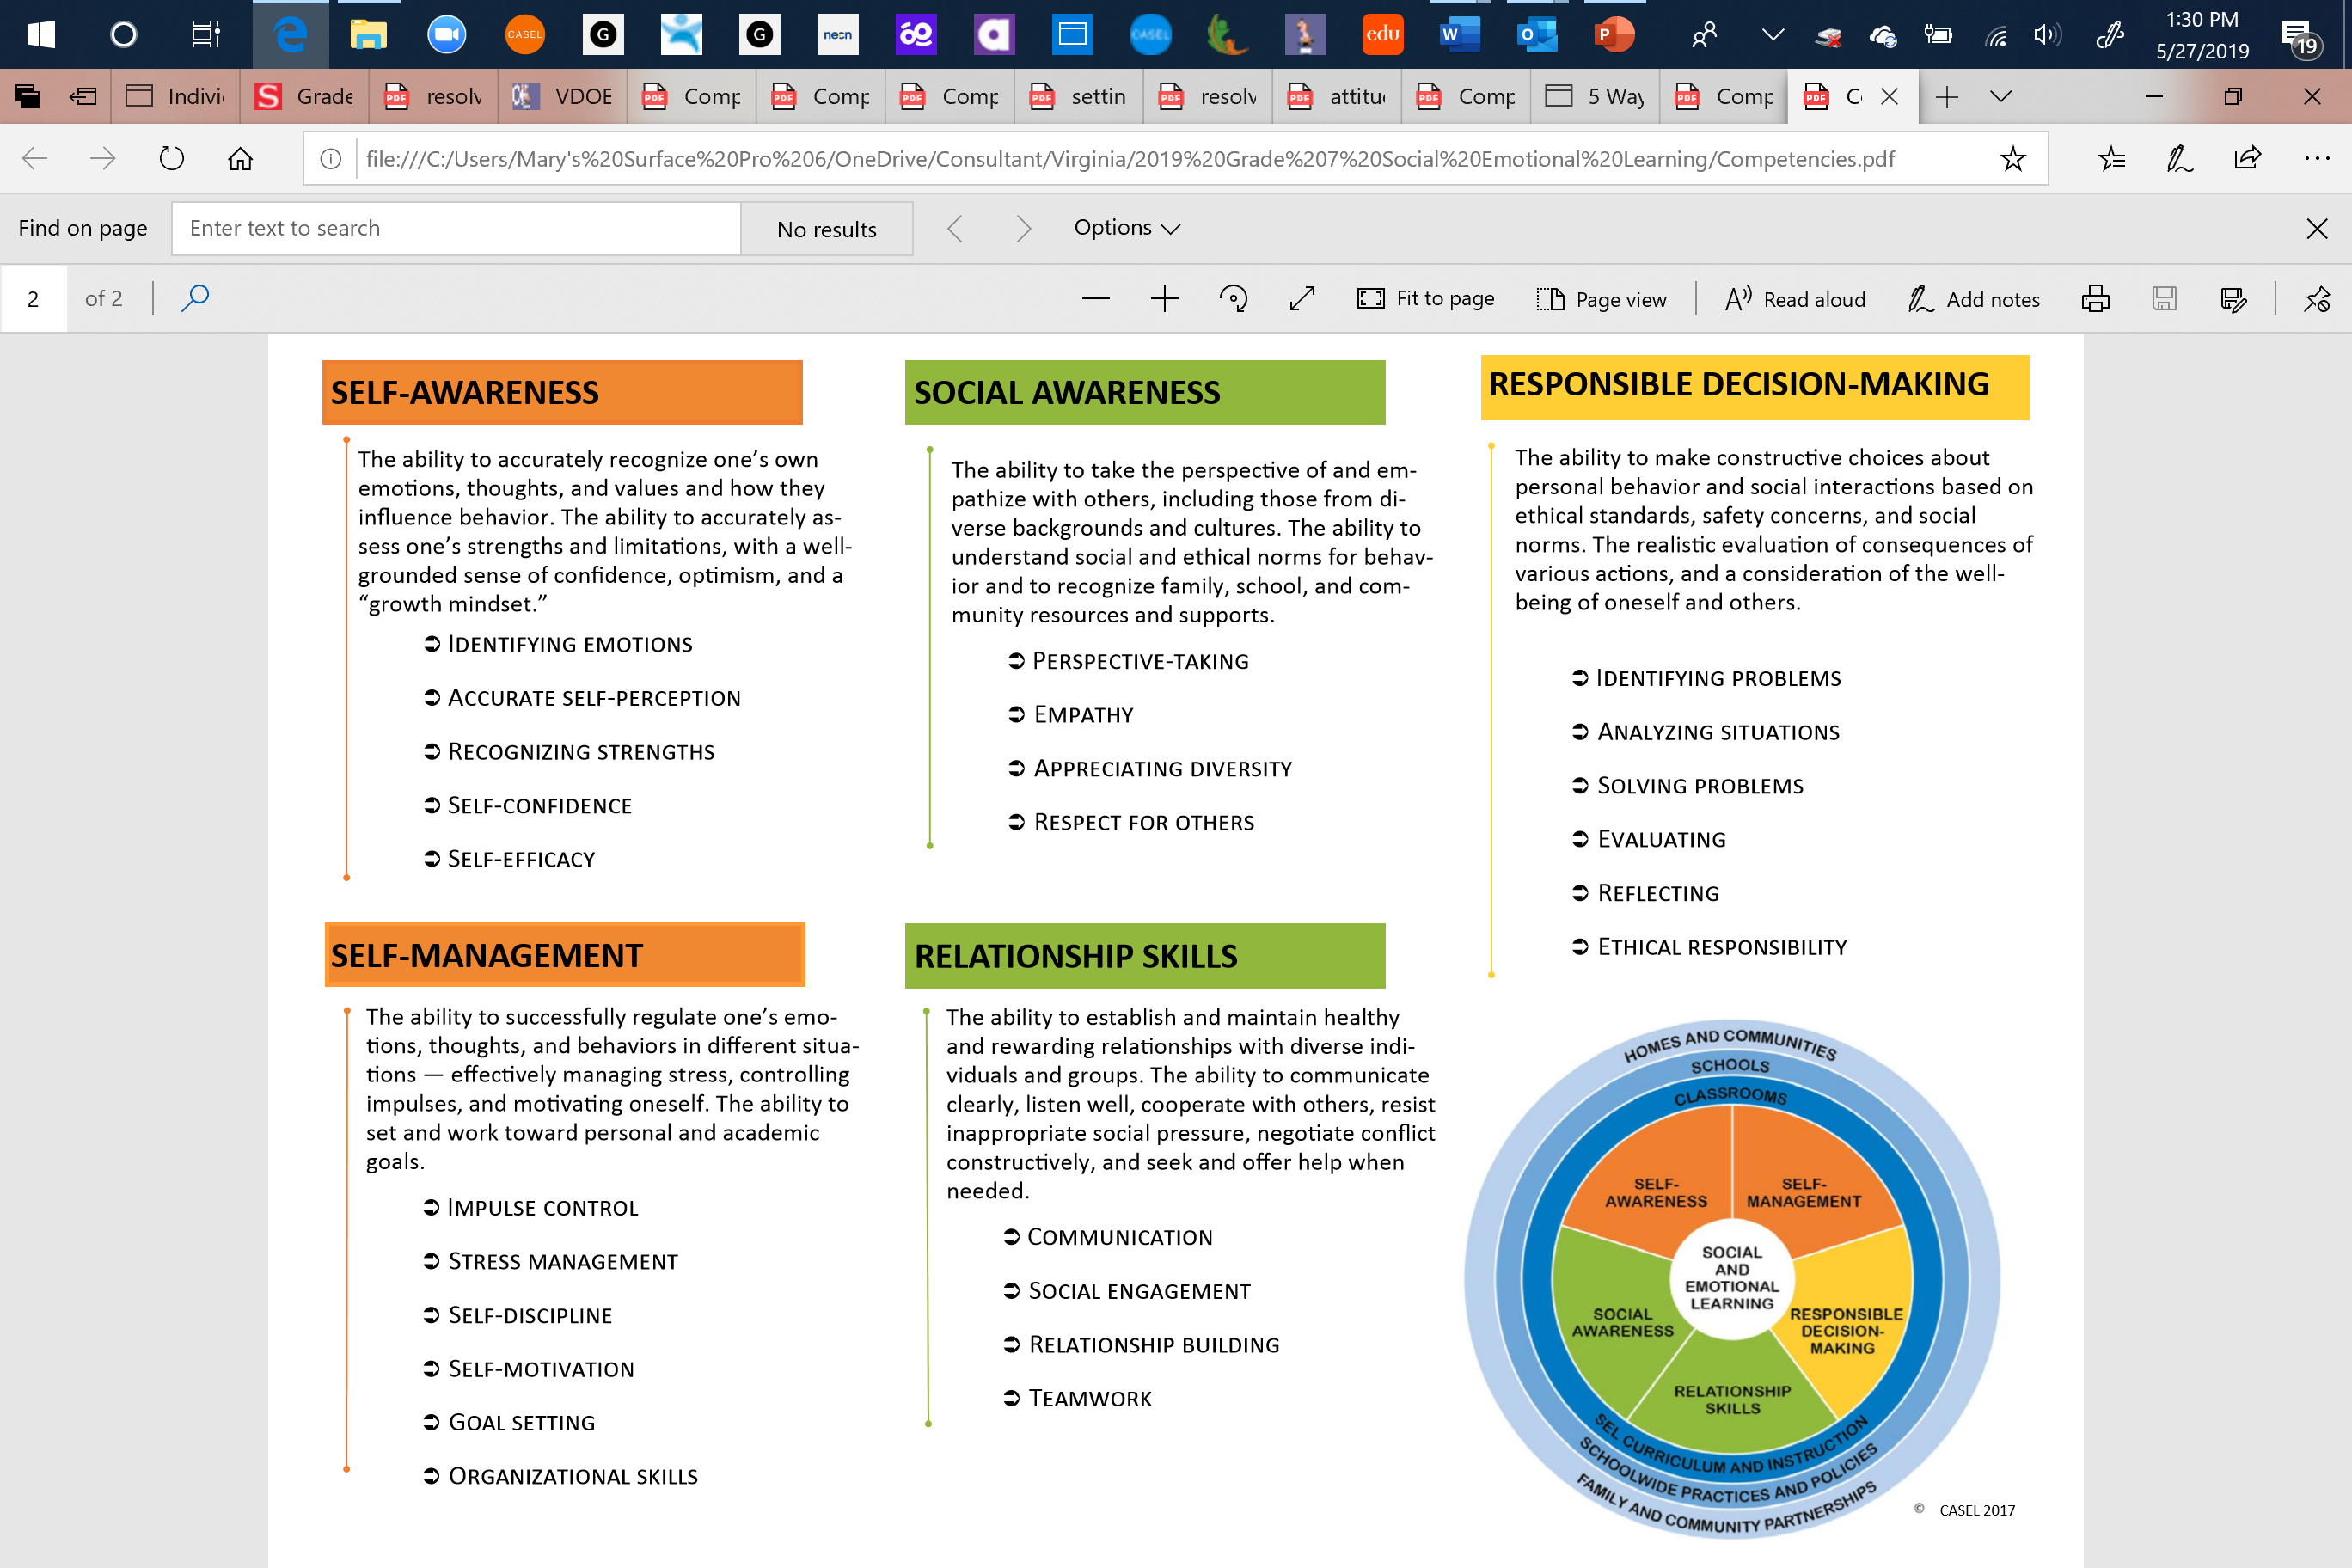
Social Emotional Sub-competencies

Slide 5
Getting to know yourself better!

Slide 6
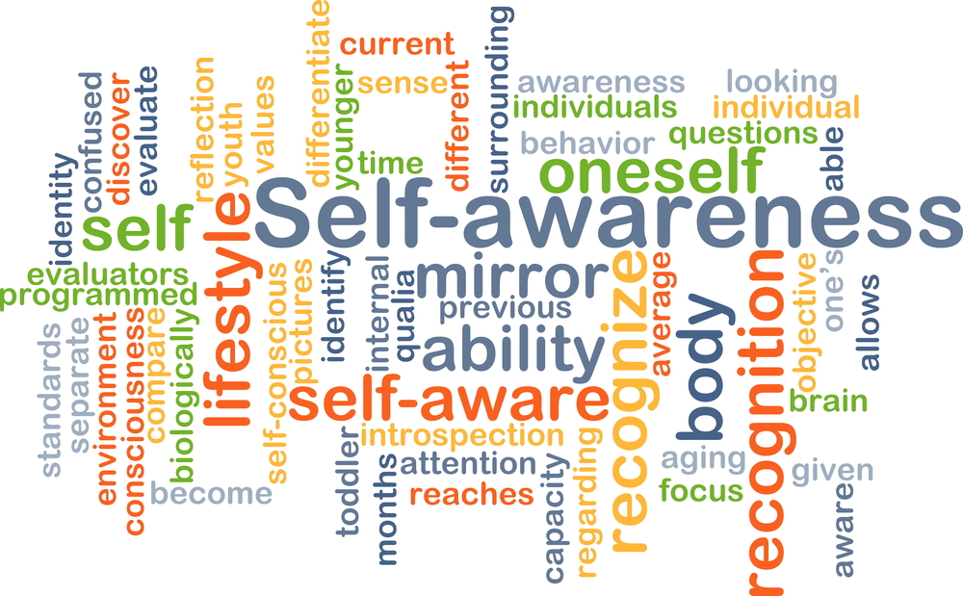
Self Awareness
SELF-AWARENESS
The ability to accurately recognize one’s own emotions, thoughts, and values and how they influence behavior. The ability to accurately assess one’s strengths and limitations, with a well grounded sense of confidence, optimism, and a “growth mindset.”
Identifying emotions
Accurate self-perception
Recognizing strengths
Self-confidence
Self-efficacy

Slide 7
Self-Assessment worksheet

Slide 8
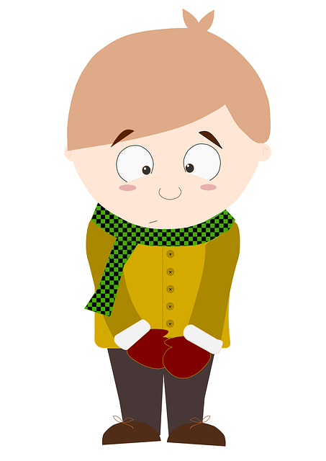
Introvert/Extrovert
Introvert: a shy person : a quiet person who does not find it easy to talk to other people
Extrovert: a friendly person who likes being with and talking to other people : an outgoing person

Slide 9
Introvert/Extrovert worksheet

Slide 10
Andrea is new to school. She hasn’t made any friends yet. She was an athlete in her other school but she is not sure she is good enough for team. How can you help Andrea make a healthy choice?
What is the problem?
What is the decision to be made?
The Problem-solving/Decision Making Model
Option | Pros | Cons | Decision
What are the healthy options?
Reflection: Did you make the right decision? Is it a healthy decision?
How did this decision affect Andrea’s self-awareness?

Slide 11
Practice
Prompt #1 – Alicia
Prompt #2- Berto

Slide 12
End of class review
1. What is self-awareness?
2. What are the different parts of self-awareness?
3. What is an introvert?
4. What is an extrovert?
5. What has being an introvert/extrovert got to do with Self-awareness.
6. How can you use problem solving to increase self-awareness?

Slide 13
Exit ticket
How will this lesson help you appreciate being more self-aware and being able to make a healthy decision?

Slide 14
Be healthy—Cope healthy

