Slide 1

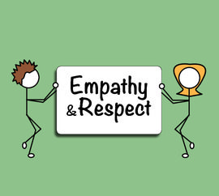
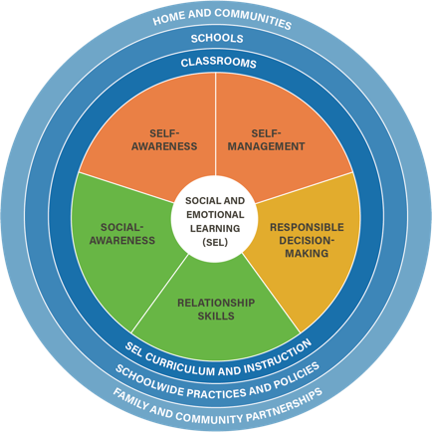
Social Emotional Learning Unit
Lesson 2

Slide 2
Objectives
7.1 The student will identify and explain essential health concepts to understand personal health.
7.3m Demonstrate how to influence others to make positive health choices. (Communication Skills)

Slide 3
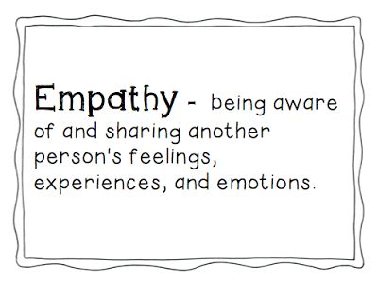
Social Emotional Learning Competencies

Slide 4
Set and Growth Mindsets
Growth mindset
The belief that students learn more or become smarter if they work hard and persevere.
Students may learn more, learn it more quickly, and view challenges and failures as opportunities to improve their learning and skills.

Slide 5
Set/Growth Mindset worksheet

Slide 6
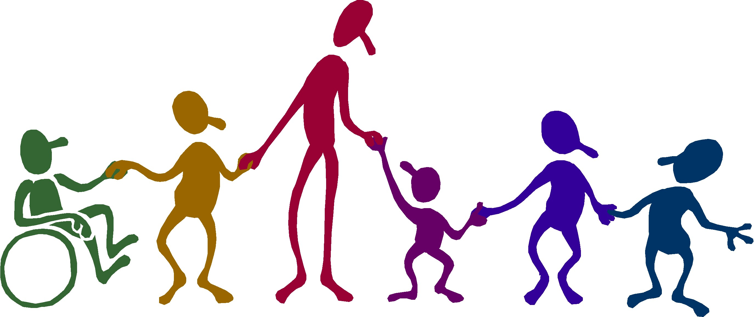
Social Awareness
  The ability to take the perspective of and empathize with others, including those from diverse backgrounds and cultures. The ability to understand social and ethical norms for behavior and to recognize family, school, and community resources and supports.
  Sub-competencies
    Perspective taking
    Empathy
    Appreciating Diversity
    Respect for others

Slide 7
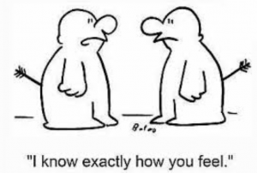
Empathy
The feeling that you understand and share another person's experiences and emotions; the ability to share someone else's feelings.

Slide 8
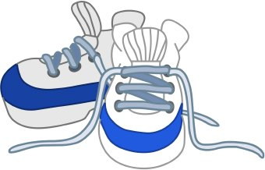
Walk a Mile in Another Peer’s Sneakers

Slide 9

End of class review
1. What is social-awareness?
2. What are the different parts of social-awareness?
3. What is a growth mindset? How does it contribute to social-awareness?
4. Give one example of how to demonstrate empathy.

Slide 10

Exit ticket
How will this lesson help you practice being empathetic?

Slide 11
Be healthy—Cope healthy

