Slide 1
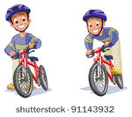
Healthy Decisions
Lesson 6
Safe Riding: Using a Bicycle helmet

Slide 2
Objectives
7.1m Recognize harmful and risky behaviors.
7.2o Describe how peers influence healthy and unhealthy behaviors.

Slide 3
Why we need to learn about bicycle safety
Middle School Youth Risk Behavior Survey, 2017
Rarely Or Never Wore A Bicycle Helmet (among students who had ridden a bicycle)
Location: Virginia | Total | Female | Male
 | 59.4 (54.3–64.2) 2,047 | 57.0 (51.4–62.4) 1,004 | 61.7 (56.2–67.0) 1,034
https://nccd.cdc.gov/youthonline/App/Results.aspx?TT=B&OUT=0&SID=MS&QID=M6&LID=LL&YID=RY&LID2=&YID2=&COL=&ROW1=&ROW2=&HT=&LCT=&FS=&FR=&FG=&FA=&FI=&FP=&FSL=&FRL=&FGL=&FAL=&FIL=&FPL=&PV=&TST=&C1=&C2=&QP=&DP=&VA=CI&CS=Y&SYID=&EYID=&SC=&SO=

Slide 4
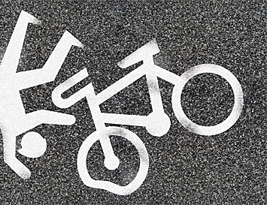
Why we need to learn about bicycle safety
Children (5-14 years) and adolescents (15-19 years) have the highest rates of nonfatal bicycle-related injuries, accounting for more than one-third of all bicycle-related injuries seen in U.S. emergency departments.³ https://www.cdc.gov/motorvehiclesafety/bicycle/index.html
Bicycle helmets reduce the risk of head and brain injuries in the event of a crash.⁵ All bicyclists, regardless of age, can help protect themselves by wearing properly fitted bicycle helmets every time they ride. https://www.cdc.gov/motorvehiclesafety/bicycle/index.html
This Photo by Unknown Author is licensed under CC BY-ND

Slide 5
Why do these helmets fit improperly?

Slide 6
Fitting your Bike Helmet
nhtsa.gov/staticfiles/nti/bicycles/pdf/8019_Fitting-A-Helmet.pdf

Slide 7
Practice Prompt
Jeremy and Jack have been best friends since 6th grade. Both boys want to try out for the soccer team but know they need to increase their endurance, so they decided that they would bike to and from school to get ready for the soccer team tryouts.
Jeremy has a “cool” helmet and always follows the rules of the road. His parents have taught him how to be safe when biking. Jack doesn’t wear a helmet or when he does, he wears it on the back of the head and sometimes doesn’t click the strap.
Jack rode to Jeremy’s house to show him his bike. His helmet was clipped to the handle bars. Jeremy asked about his helmet and Jack told him he didn’t plan on wearing it because it was uncomfortable. Jeremy reminded Jack of the boy in their class that had a brain injury because he had a bike accident and didn’t wear a helmet. Jack wasn’t convinced and told Jeremy he would be careful.
Knowing how his parents felt about bicycle safety, Jeremy told Jack he couldn’t ride with him if he didn’t wear his helmet. He offered to try and fit his helmet so it would keep him safe and be comfortable.

Slide 8
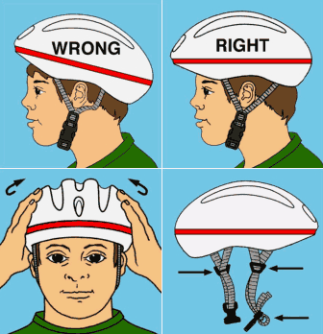
Your Challenge
Your challenge is to help Jeremy properly fit Jack’s helmet so they can ride to school.
Use the step by step directions to properly fit the helmet. Check off progress on the self-check handout.
If you need help, place your yellow card on your desk. If you understand what to do, place the green card on the desk. If you don’t know what to do, place the red card on the desk. (Red, Yellow, Green cards)
This Photo by Unknown Author is licensed under CC BY

Slide 9
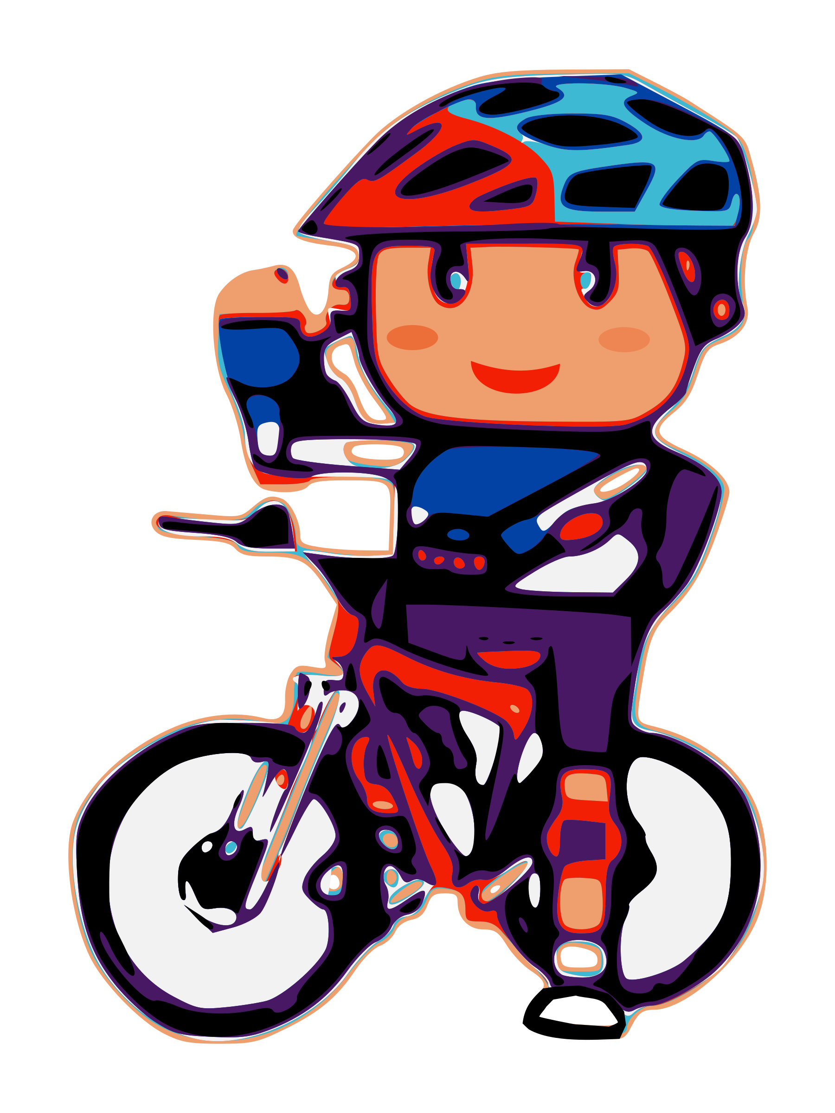
Properly Fitting a Helmet Self Check
Step | Complete | Working on it | Not even close!
Step 1-Size: Adjust until the helmet is snug.
Step 2-Position: One or two finger widths above the eyebrow.
Step 3-Side straps: Straps form a V slightly in front of the ears.
Step 4-Buckles: Center the buckle under the chin.
Step 5-Chin Strap: No more than one or two fingers fit under the strap.
Step 6-Final fitting
Does your helmet fit right? Yawn. Is the helmet snug? If not, readjust.
2. Does the helmet rock back more than 2 fingers from the eyebrow? If it does, shorten the strap and try again.
3. Does the helmet rock forward into your eyes? If it does, shorten the strap and try again.
4. Roll the rubber band down to the buckle. All four straps must go through the rubber band.

Slide 10
Review questions
Why do we need to know how to properly fit a bicycle helmet? (7.1m)
Describe how peers can positively influence another peer? (7.2o)
What is the first step in fitting a helmet?
What is the second step in fitting a helmet?
What is the third step in fitting a helmet?
What is the fourth step in fitting a helmet?
What is the fifth step in fitting a helmet?
What is the sixth step in fitting a helmet?

