Slide 1
Healthy Decisions
Lesson 7
Safe Riding: Following the rules of the road

Slide 2
Objectives
7.1m Recognize harmful and risky behaviors such as not following the rules of the road.
7.2o Describe how peers influence healthy and unhealthy behaviors about bicycle safety.

Slide 3
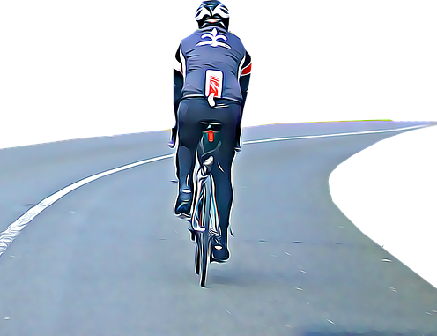
Rules of the Road
1. Always ride on the right side of the street in the same direction as the traffic. Never ride against traffic.

Slide 4
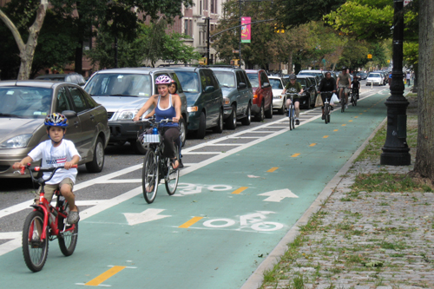
Rules of the Road
Try to use bike lanes or designated bike routes whenever you can. In some places, it's illegal to ride on the sidewalk.

Slide 5
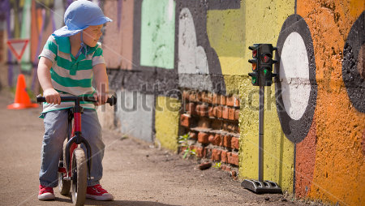
Rules of the Road
Always stop and check for traffic in both directions when leaving your driveway, an alley, or a curb. Some people in cars just don't see cyclists.

Slide 6
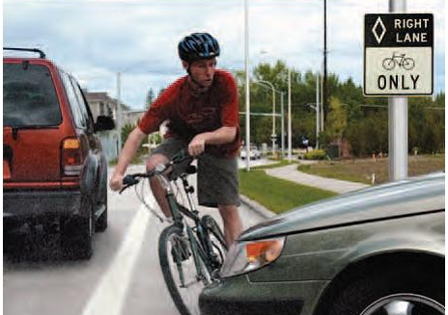
Rules of the Road
Watch traffic closely for turning cars or cars pulling out of driveways.

Slide 7
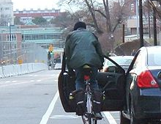
Rules of the Road
Don't ride too closely to parked cars — doors can open suddenly!

Slide 8
Rules of the Road
Stop at all stop signs and obey red lights just as cars do.
Take special care at intersections.
It's a good idea to walk your bike across busy intersections using the crosswalk and following traffic signals.

Slide 9
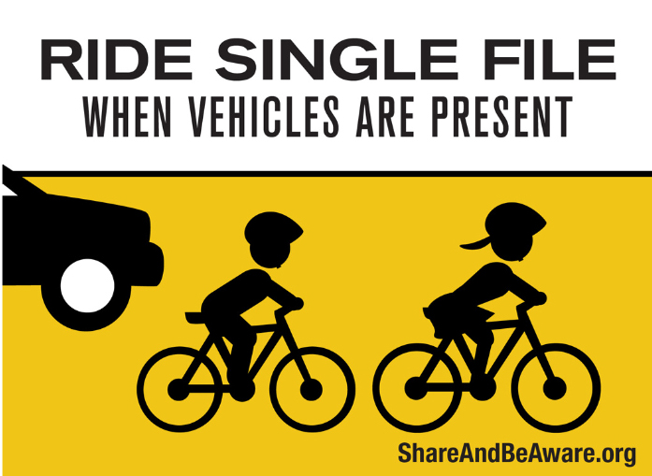
Rules of the Road
If you're cycling with friends, ride single file.

Slide 10
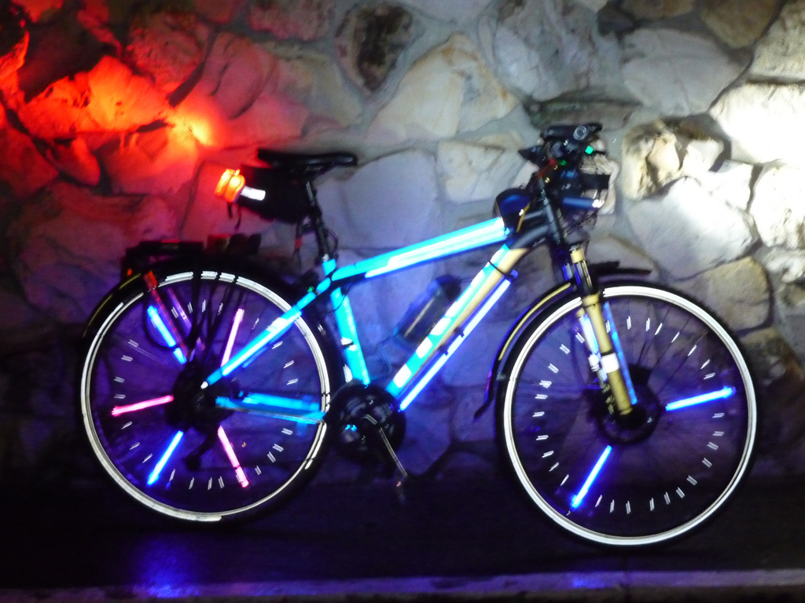
Rules of the Road
If you ride when it's dark, be sure to have reflectors on your bike and a battery-operated headlight.
This Photo by Unknown Author is licensed under CC BY-NC

Slide 11
Rules of the Road
Don't wear headphones while biking — you need to hear what's going on around you.

Slide 12
Rules of the Road-Hand Signals
Show me the signal for a left turn!

Slide 13
Rules of the Road-Hand Signals
Show me the signal for Stop!

Slide 14
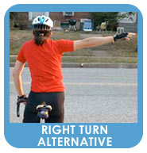
Rules of the Road-Hand Signals
Show me both signals for right turn!

Slide 15
Review questions
Why do we need to know the bicycle rules of the road? (7.1m)
Describe how peers can positively influence another peer? (7.2o)
Which side of the street should you ride your bike?
What should you do before entering into traffic?
Why shouldn’t you listen to music while riding?
What do you do when the traffic light is red?
Show the two signals for a right turn.
Show me the signal for a left turn.
Show me the signal for stop.

Slide 16
Lesson review
Post-test to determine what was learned.
This Photo by Unknown Author is licensed under CC BY-NC-ND

