Slide 1
Eating Disorders
“Recovery is Possible”
-Unknown

Slide 2
What is Body image?
Pause for Discussion
Notes:
The way you see your body

Slide 3
How can you develop a positive body image?
Pause for Discussion
Notes:
Appreciate the things your body does daily, focus on what you like about yourself

Slide 4
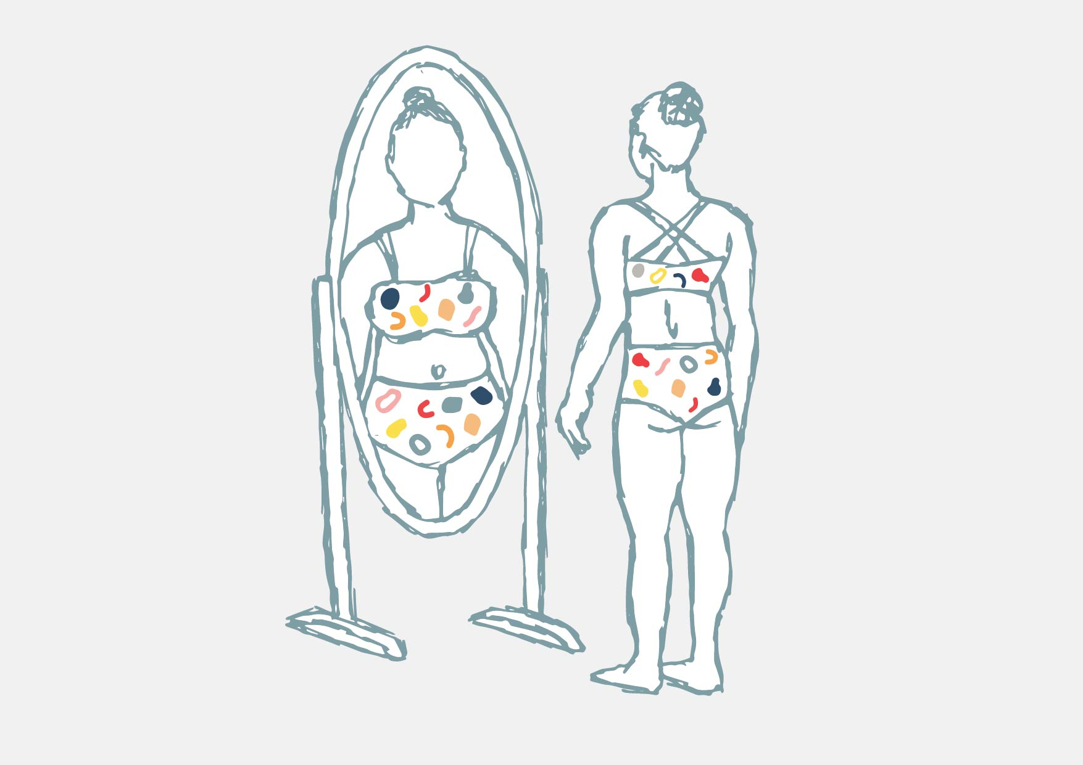
Body image and Eating Disorders
Body image is closely related to eating disorders
A person who has an unhealthy body image may be at a higher risk for developing an eating disorder
Source: Pixbay

Slide 5
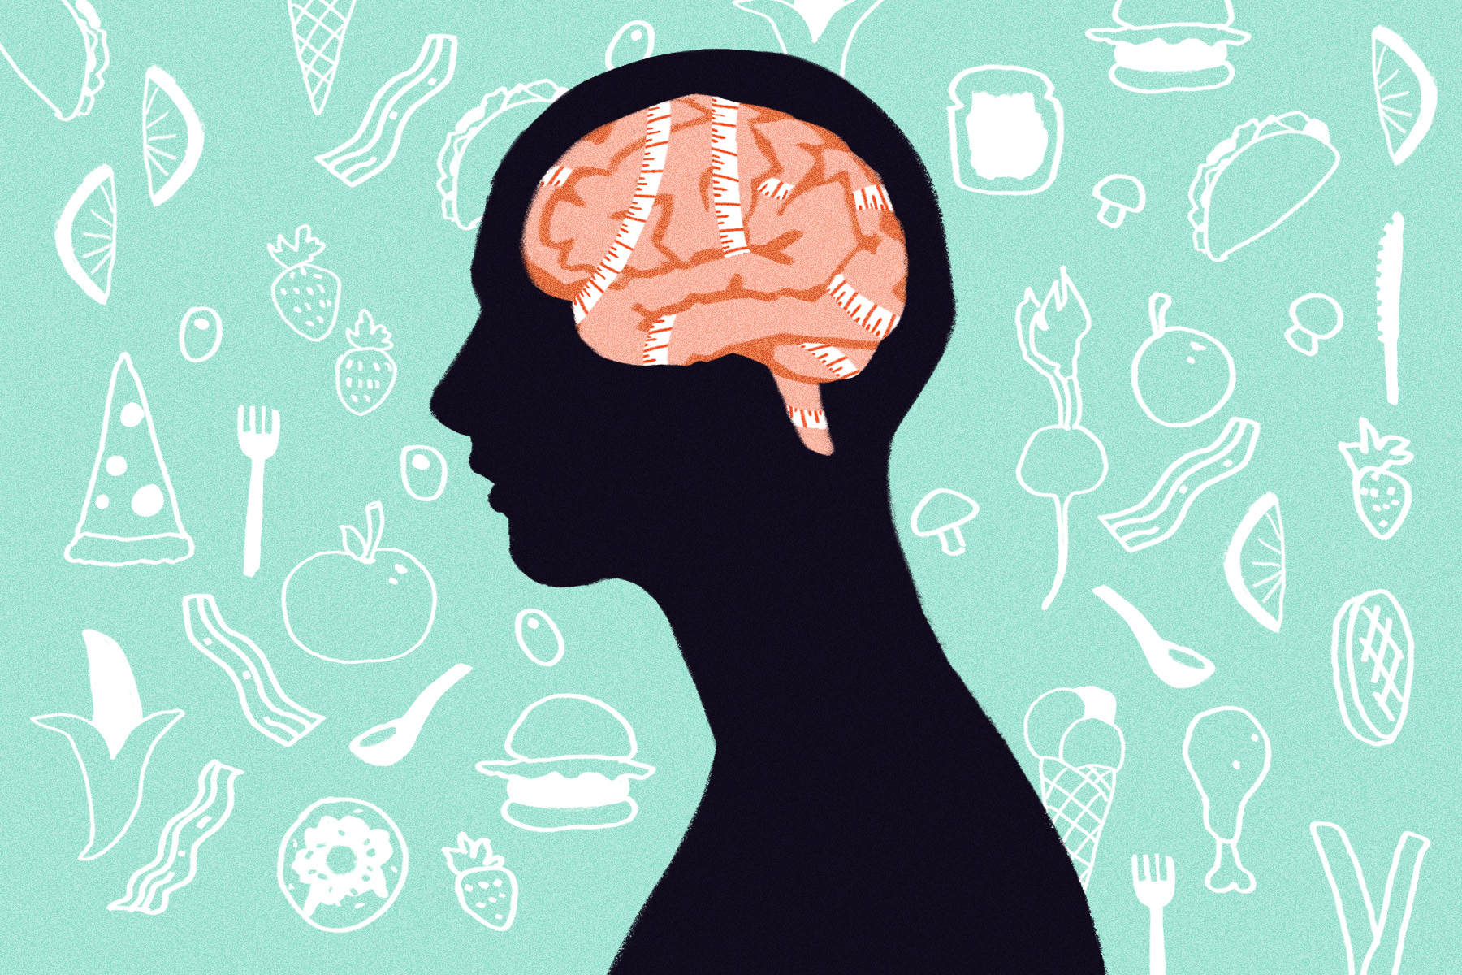
Eating Disorders
Eating disorders are extreme eating behaviors that can lead to serious illness or even death
Eating disorders are very common among all genders and age groups
Teens are especially vulnerable to eating disorders due to the physical changes that take place during puberty
Source: Pixbay

Slide 6
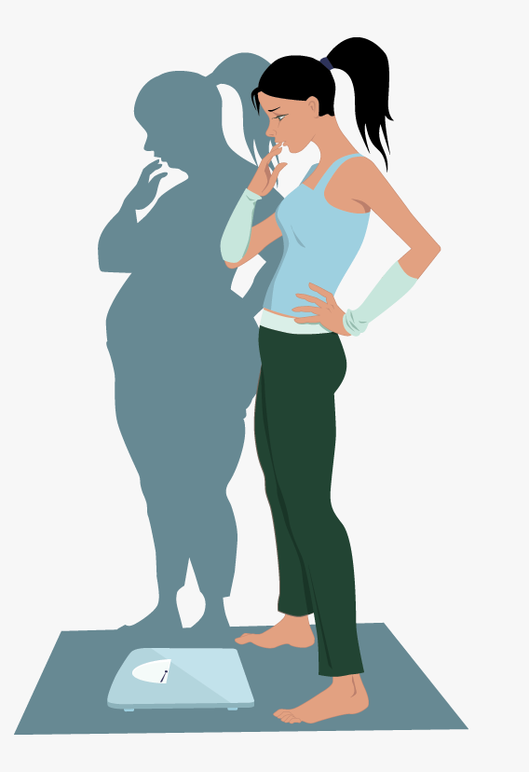
Types of Eating Disorders
Anorexia Nervosa: An eating disorder in which a strong fear of gaining weight leads people to starve themselves on purpose
People with anorexia eat far fewer calories than they
need to stay healthy
They may also exercise excessively
Even after becoming extremely thin people
with anorexia will still see themselves as overweight
Can cause brittle bones, heart failure, temperature
regulation issues, kidney failure and depression
Source: Pixbay

Slide 7
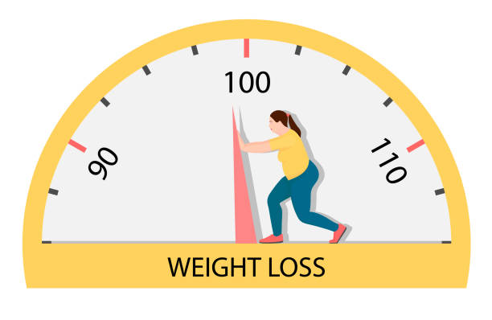
Types of Eating Disorders
Bulimia Nervosa: Eating disorder where
a person repeatedly eats large amounts of
food and purges
People can purge by vomiting, laxatives or excessive physical activity
Bulimia robs the body of nutrients and damages the kidneys, liver, colon and heart
The coating on the teeth may wear off due to vomiting and the body may become dehydrated
Source: Pixbay

Slide 8

Types of Eating Disorders
Binge Eating Disorder: Eating disorder where a person repeatedly eats unusually large amounts of food at one time and feel a lack of control during binges (eating episodes)
The most common eating disorder in the United States
Also known as compulsive eating
Individuals can develop health problems related to being overweight including heart disease, diabetes or cancer
The guilt that comes with compulsive eating can cause depression, anxiety and low self-esteem

Slide 9
Treatment for Eating Disorders
Eating disorders are mental and emotional health issues that cause serious physical harm to your body
Medical treatment is needed to recover
Doctors, counselors and nutritionists work together to treat
Often times people do not recognize they have an eating disorder and friends and family can help them seek treatment
If you are concerned someone may have an eating disorder talk to a trusted adult right away, the sooner the person receives treatment the better chance they have at recovery

Slide 10
Application: Word UN-Scramble
Your teacher will give each person a letter that spells out one of the eating disorder vocabulary terms from today’s lesson.
You must work with your team to line up correctly and unscramble the vocabulary term
Each letter will only be used once
Only one team will unscramble at a time

Slide 11

Exit Ticket
What is the relationship between body image and eating disorders?
Source: giphy.com

