Slide 1
Nutrition Facts
Serving Size
Servings Per Container
Amount Per Serving
Calories 170 Calories from Fat 110
% Daily Value*
Total Fat
16%
Saturated Fat
16%
Trans Fat
16%
Cholesterol
16%
Sodium
16%
Total Carbohydrate
16%
Fiber
16%
Sugars
16%
Protein
16%
Vitamin A 2%
●
Vitamin C 2%
Vitamin A 2%
●
Vitamin C 2%
Vitamin A 2%
●
Vitamin C 2%
Vitamin A 2%
●
Vitamin C 2%
Vitamin A 2%
●
Vitamin C 2%
* Percent Daily Values are based on a 2,000 calorie diet. Your daily values may be higher or lower depending on your caloric needs.
Calories: 2,000 2,500
Total Fat Less Than 65g 80g
Sat Fat Less Than 20g 25g
Cholesterol Less Than 300mg 300mg
Sodium Less Than 2,400mg 2,400mg
Total Carbohydrate 300g 375g
Dietary Fiber 25g 30g

Slide 2
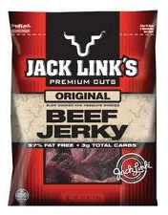
Nutrition Facts
Jack Link’s Beef Jerky Original (1 oz)
Serving Size 1 oz (28g)
Servings Per Container 3.5
Amount Per Serving
Calories 80 Calories from Fat 10
% Daily Value*
Total Fat 1g
2%
Saturated Fat 0g
0%
Trans Fat 0g
0%
Cholesterol 20mg
7%
Sodium 590mg
25%
Total Carbohydrate 3g
1%
Fiber 0g
0%
Sugars 3g
Protein 15g
Vitamin A 0%
●
Vitamin C 0%
Calcium 0%
●
Iron 8%
INGREDIENTS: BEEF, WATER, SUGAR, LESS THAN 2% SALT, CORN SYRUP SOLIDS, DRIED SOY SAUCE (SOYBEANS, SALT, WHEAT), HYDROLYZED CORN AND SOY PROTEIN, MONOSODIUM GLUTAMATE, MALTODEXTRIN, FLAVORINGS, SODIUM ERYTHORBATE, SODIUM NITRITE. CONTAINS: WHEAT AND SOY
* Percent Daily Values are based on a 2,000 calorie diet. Your daily values may be higher or lower depending on your caloric needs.
Calories: 2,000 2,500
Total Fat Less Than 65g 80g
Sat Fat Less Than 20g 25g
Cholesterol Less Than 300mg 300mg
Sodium Less Than 2,400mg 2,400mg
Total Carbohydrate 300g 375g
Dietary Fiber 25g 30g

Slide 3
Nutrition Facts
Fage Total 2% Greek Yogurt Plain (1 cup)
Serving Size 1 Container (200g)
Servings Per Container 1
Amount Per Serving
Calories 150 Calories from Fat 35
% Daily Value*
Total Fat 4g
6%
Saturated Fat 3g
15%
Trans Fat 0g
0%
Cholesterol 10mg
3%
Sodium 65mg
3%
Total Carbohydrate 8g
3%
Fiber 0g
0%
Sugars 8g
Protein 20g
Vitamin A 2%
●
Vitamin C 0%
Calcium 20%
●
Iron 0%
INGREDIENTS: GRADE A PASTEURIZED SKIMMED MILK AND CREAM, LIVE ACTIVE CULTURES ( L BULGARICUS, S THERMOPHILOS, L ACIDOPHILUS, BIFIDUS, L CASEI).
* Percent Daily Values are based on a 2,000 calorie diet. Your daily values may be higher or lower depending on your caloric needs.
Calories: 2,000 2,500
Total Fat Less Than 65g 80g
Sat Fat Less Than 20g 25g
Cholesterol Less Than 300mg 300mg
Sodium Less Than 2,400mg 2,400mg
Total Carbohydrate 300g 375g
Dietary Fiber 25g 30g

Slide 4
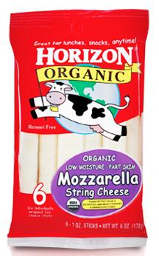
Nutrition Facts
Horizon Organic String Cheese (1 piece)
Serving Size 1 stick (28g)
Servings Per Container 6
Amount Per Serving
Calories 80 Calories from Fat 50
% Daily Value*
Total Fat 6g
9%
Saturated Fat 3.5g
18%
Trans Fat 0g
0%
Cholesterol 15mg
5%
Sodium 200mg
8%
Total Carbohydrate <1g
0%
Fiber 0g
0%
Sugars 0g
Protein 8g
Vitamin A 4%
●
Vitamin C 0%
Calcium 20%
●
Iron 0%
Vitamin D 0%
●
INGREDIENTS: CULTURED ORGANIC PASTEURIZED PART-SKIM MILK, SALT, MICROBIAL ENZYMES NON-ANIMAL, RENNETLESS).
* Percent Daily Values are based on a 2,000 calorie diet. Your daily values may be higher or lower depending on your caloric needs.
Calories: 2,000 2,500
Total Fat Less Than 65g 80g
Sat Fat Less Than 20g 25g
Cholesterol Less Than 300mg 300mg
Sodium Less Than 2,400mg 2,400mg
Total Carbohydrate 300g 375g
Dietary Fiber 25g 30g

Slide 5
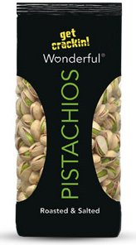
Nutrition Facts
Wonderful Pistachios, Unshelled (1oz)
Serving Size 30g without shells
Servings Per Container 3.5
Amount Per Serving
Calories 160 Calories from Fat 120
% Daily Value*
Total Fat 14g
22%
Saturated Fat 1.5g
8%
Trans Fat 0g
0%
Cholesterol 0mg
0%
Sodium 160mg
7%
Total Carbohydrate 8g
3%
Fiber 3g
12%
Sugars 2g
Protein 6g
Vitamin A 2%
●
Vitamin C 0%
Calcium 4%
●
Iron 6%
Thiamin 15%
●
Vitamin B₆ 20%
Phosphorus 15%
●
Magnesium 10%
INGREDIENTS: PISTACHIOS, SALT
Copper 20%
●
Manganese 20%
* Percent Daily Values are based on a 2,000 calorie diet. Your daily values may be higher or lower depending on your caloric needs.
Calories: 2,000 2,500
Total Fat Less Than 65g 80g
Sat Fat Less Than 20g 25g
Cholesterol Less Than 300mg 300mg
Sodium Less Than 2,400mg 2,400mg
Total Carbohydrate 300g 375g
Dietary Fiber 25g 30g

Slide 6
Nutrition Facts
Larabar Peanut Butter & Jelly
Serving Size 1 bar (48g)
Servings Per Container 1
Amount Per Serving
Calories 210 Calories from Fat 90
% Daily Value*
Total Fat 10g
16%
Saturated Fat 1.5g
7%
Trans Fat 0g
0%
Cholesterol 0mg
0%
Sodium 50mg
2%
Total Carbohydrate 27g
9%
Fiber 4g
16%
Sugars 19g
Protein 6g
Vitamin A 0%
●
Vitamin C 0%
Calcium 2%
●
Iron 4%
Niacin 10%
●
Folic Acid 10%
Phosphorus 10%
●
Potassium 10%
INGREDIENTS: DATES, PEANUTS, UNSWEETENED CHERRIES, SEA SALT
Copper 10%
●
* Percent Daily Values are based on a 2,000 calorie diet. Your daily values may be higher or lower depending on your caloric needs.
Calories: 2,000 2,500
Total Fat Less Than 65g 80g
Sat Fat Less Than 20g 25g
Cholesterol Less Than 300mg 300mg
Sodium Less Than 2,400mg 2,400mg
Total Carbohydrate 300g 375g
Dietary Fiber 25g 30g

Slide 7
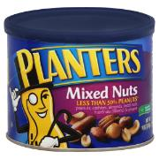
Nutrition Facts
Planters Mixed Nuts (1 oz)
Serving Size 28 g
Servings Per Container 10
Amount Per Serving
Calories 170 Calories from Fat 140
% Daily Value*
Total Fat 15g
23%
Saturated Fat 2g
10%
Trans Fat 0g
0%
Cholesterol 0mg
0%
Sodium 90mg
4%
Total Carbohydrate 5g
2%
Fiber 2g
8%
Sugars 1g
Protein 6g
Vitamin A 0%
●
Vitamin C 0%
Calcium 4%
●
Iron 8%
INGREDIENTS: PEANUTS, ALMONDS, CASHEWS, BRAZIL NUTS, HAZELNUTS (FILBERTS), PECANS, PEANUT AND/OR COTTONSEED OIL, SEA SALT.
* Percent Daily Values are based on a 2,000 calorie diet. Your daily values may be higher or lower depending on your caloric needs.
Calories: 2,000 2,500
Total Fat Less Than 65g 80g
Sat Fat Less Than 20g 25g
Cholesterol Less Than 300mg 300mg
Sodium Less Than 2,400mg 2,400mg
Total Carbohydrate 300g 375g
Dietary Fiber 25g 30g

Slide 8
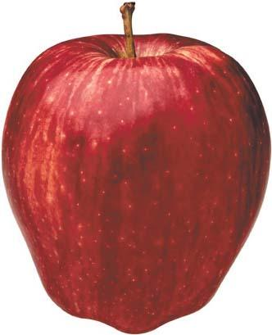
Nutrition Facts
Apple
Serving Size 1 medium (3”) (182g)
Servings Per Container
Amount Per Serving
Calories 95 Calories from Fat 3
% Daily Value*
Total Fat 0.3g
0%
Saturated Fat 0.1g
0%
Trans Fat 0g
0%
Cholesterol 0mg
0%
Sodium 2mg
0%
Total Carbohydrate 25.1g
8%
Fiber 4.4g
17%
Sugars 18.9g
Protein 0.5g
Vitamin A 2%
●
Vitamin C 14%
Calcium 1%
●
Iron 1%
INGREDIENTS:
* Percent Daily Values are based on a 2,000 calorie diet. Your daily values may be higher or lower depending on your caloric needs.
Calories: 2,000 2,500
Total Fat Less Than 65g 80g
Sat Fat Less Than 20g 25g
Cholesterol Less Than 300mg 300mg
Sodium Less Than 2,400mg 2,400mg
Total Carbohydrate 300g 375g
Dietary Fiber 25g 30g

Slide 9
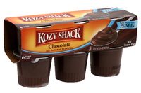
Nutrition Facts
Kozy Shack Chocolate Pudding (1cup)
Serving Size 1 pudding cup
Servings Per Container 6
Amount Per Serving
Calories 110 Calories from Fat 10
% Daily Value*
Total Fat 1g
2%
Saturated Fat 1g
5%
Trans Fat 0g
0%
Cholesterol 5mg
2%
Sodium 110mg
5%
Total Carbohydrate 20g
7%
Fiber 4g
16%
Sugars 15g
Protein 4g
Vitamin A 4%
●
Vitamin C 0%
Calcium 10%
●
Iron 2%
INGREDIENTS: LOW FAT MILK (VITAMIN A & D), SUGAR, MODIFIED TAPIOCA STARCH, INULIN (CHICORY ROOT EXTRACT), COCOA PROCESSED WITH ALKALI, SALT, CARRAGEENAN, NATURAL FLAVORS
* Percent Daily Values are based on a 2,000 calorie diet. Your daily values may be higher or lower depending on your caloric needs.
Calories: 2,000 2,500
Total Fat Less Than 65g 80g
Sat Fat Less Than 20g 25g
Cholesterol Less Than 300mg 300mg
Sodium Less Than 2,400mg 2,400mg
Total Carbohydrate 300g 375g
Dietary Fiber 25g 30g

Slide 10
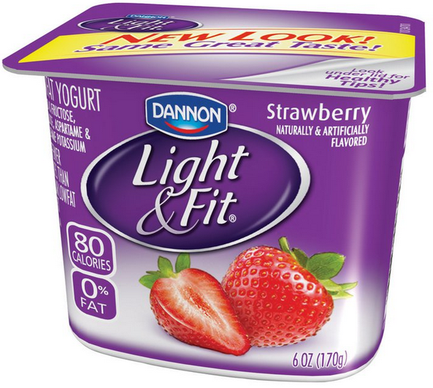
Nutrition Facts
Dannon Light & Fit Strawberry Yogurt
Serving Size 1 Container (170g)
Servings Per Container 1
Amount Per Serving
Calories 80 Calories from Fat 0
% Daily Value*
Total Fat 0 g
0%
Saturated Fat 0g
0%
Trans Fat 0g
0%
Cholesterol <5mg
1%
Sodium 80mg
3%
Total Carbohydrate 16g
5%
Fiber 0g
0%
Sugars 11g
Protein 5g
INGREDIENTS: NONFAT YOGURT (CULTURED GRADE A NONFAT MILK, MODIFIED FOOD STARCH, FRUCTOSE, KOSHER GELATIN, VITAMIN A PALMITATE, VITAMIN D₃) WATER, STRAWBERRIES, FRUCTOSE, CONTAINS LESS THAN 1% OF MODIFIED CORN STARCH, NATURAL AND ARTIFICIAL FLAVORS, SODIUM CITRATE, ASPARTAME, POTASSIUM SORBATE (TO MAINTAIN FRESHNESS), MALIC ACID, ACESULFAME POTASSIUM, SUCRALOSE, RED 40.
CONTAINS ACTIVE YOGURT CULTURES INCLUDING L. ACIDOPHILUS
PHENYLKETONURICS:
CONTAINS PHENYLALANINE
Vitamin A 8%
●
Vitamin C 0%
Calcium 15%
●
Vitamin D 15%
Riboflavin 20%
●
Potassium 7%
Phosphorus 15%
●
* Percent Daily Values are based on a 2,000 calorie diet. Your daily values may be higher or lower depending on your caloric needs.
Calories: 2,000 2,500
Total Fat Less Than 65g 80g
Sat Fat Less Than 20g 25g
Cholesterol Less Than 300mg 300mg
Sodium Less Than 2,400mg 2,400mg
Total Carbohydrate 300g 375g
Dietary Fiber 25g 30g

Slide 11
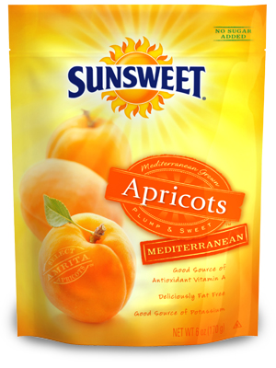
Nutrition Facts
Sunsweet Apricots Mediterranean (6 pieces)
Serving Size 1 ½ oz (about 6 pieces)
Servings Per Container 4
Amount Per Serving
Calories 100 Calories from Fat 0
% Daily Value*
Total Fat 0g
0%
Saturated Fat 0g
0%
Trans Fat 0g
0%
Cholesterol 0mg
0%
Sodium 25mg
1%
Total Carbohydrate 23g
8%
Fiber 3g
10%
Sugars 18g
Protein 1g
Vitamin A 10%
●
Vitamin C 0%
Calcium 2%
●
Iron 4%
INGREDIENTS: DRIED APRICOTS, PRESERVATIVES (SULFUR DIOXIDE AND POTASSIUM SORBATE)
* Percent Daily Values are based on a 2,000 calorie diet. Your daily values may be higher or lower depending on your caloric needs.
Calories: 2,000 2,500
Total Fat Less Than 65g 80g
Sat Fat Less Than 20g 25g
Cholesterol Less Than 300mg 300mg
Sodium Less Than 2,400mg 2,400mg
Total Carbohydrate 300g 375g
Dietary Fiber 25g 30g

Slide 12
Nutrition Facts
Kellogg’s Nutri-Grain Cereal Bar (1 bar)
Serving Size 1 bar (37g)
Servings Per Container 6
Amount Per Serving
Calories 120 Calories from Fat 30
% Daily Value*
Total Fat 3g
5%
Saturated Fat .5g
3%
Trans Fat 0g
0%
Cholesterol 0mg
0%
Sodium 110mg
5%
Total Carbohydrate 24g
8%
INGREDIENTS: CRUST: WHOLE GRAIN OATS, ENRICHED FLOUR (WHEAT FLOUR, NIACIN, REDUCED IRON, VITAMIN B1 [THIAMIN MONONITRATE], VITAMIN B2 [RIBOFLAVIN] , FOLIC ACID), WHOLE WHEAT FLOUR, SOYBEAN OIL, HIGH FRUCTOSE CORN SYRUP, SOLUBLE CORN FIBER, SUGAR, CALCIUM CARBONATE, WHEY, WHEAT BRAN, SALT, CELLULOSE, POTASSIUM BICARBONATE, CINNAMON, MONO- AND DIGLYCERIDES, SOY LECITHIN, NATURAL AND ARTIFICIAL FLAVOR, WHEAT GLUTEN, NIACINAMIDE, VITAMIN A PALMITATE, CARRAGEENAN, ZINC OXIDE, REDUCED IRON, GUAR GUM, VITAMIN B6 (PYRIDOXINE HYDROCHLORIDE) , VITAMIN B1 (THIAMIN HYDROCHLORIDE), VITAMIN B2 (RIBOFLAVIN) , FOLIC ACID. FILLING: HIGH FRUCTOSE CORN SYRUP, CORN SYRUP, APPLE PUREE CONCENTRATE, GLYCERIN, SUGAR, SODIUM ALGINATE, MODIFIED CORN STARCH, MALIC ACID, METHYLCELLULOSE, CALCIUM PHOSPHATE, CINNAMON, CITRIC ACID, CARAMEL COLOR.
CONTAINS WHEAT, MILK AND SOY INGREDIENTS.
Fiber 3g
10%
Sugars 12g
Protein 2g
Vitamin A 15%
●
Vitamin C 0%
Calcium 20%
●
Iron 10%
Thiamin 15%
●
Riboflavin 25%
Niacin 25%
●
Vitamin B₆ 25%
Folic Acid 10%
●
Zinc 10%
* Percent Daily Values are based on a 2,000 calorie diet. Your daily values may be higher or lower depending on your caloric needs.
Calories: 2,000 2,500
Total Fat Less Than 65g 80g
Sat Fat Less Than 20g 25g
Cholesterol Less Than 300mg 300mg
Sodium Less Than 2,400mg 2,400mg
Total Carbohydrate 300g 375g
Dietary Fiber 25g 30g

Slide 13
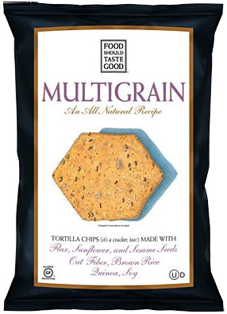
Nutrition Facts
Food Should Taste Good Multigrain Chips (1 oz)
Serving Size 1 oz (28g/about 10 chips)
Servings Per Container 6
Amount Per Serving
Calories 140 Calories from Fat 60
% Daily Value*
Total Fat 6g
10%
Saturated Fat .5g
3%
Trans Fat 0g
0%
Cholesterol 0mg
0%
Sodium 65mg
2%
Total Carbohydrate 18g
6%
Fiber 3g
12%
Sugars 1g
Protein 3g
Vitamin A 0%
●
Vitamin C 0%
Calcium 2%
●
Iron 6%
INGREDIENTS: STONE GROUND CORN, HIGH OLEIC SUNFLOWER OIL AND/OR SAFFLOWER OIL, BROWN RICE FLOUR, FLAX SEEDS, EVAPORATED CANE JUICE, OAT FIBER, SESAME SEEDS, SUNFLOWER SEEDS, QUINOA, SOY FLOUR, SEA SALT
* Percent Daily Values are based on a 2,000 calorie diet. Your daily values may be higher or lower depending on your caloric needs.
Calories: 2,000 2,500
Total Fat Less Than 65g 80g
Sat Fat Less Than 20g 25g
Cholesterol Less Than 300mg 300mg
Sodium Less Than 2,400mg 2,400mg
Total Carbohydrate 300g 375g
Dietary Fiber 25g 30g

Slide 14
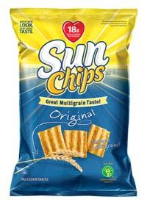
Nutrition Facts
Sun Chips Original (1 oz)
Serving Size 1 oz (28g)
Servings Per Container 1
Amount Per Serving
Calories 140 Calories from Fat 50
% Daily Value*
Total Fat 6g
10%
Saturated Fat 1g
5%
Trans Fat 0g
0%
Cholesterol 0mg
0%
Sodium 120mg
5%
Total Carbohydrate 19g
6%
Fiber 3g
10%
Sugars 2g
Protein 2g
Vitamin A 0%
●
Vitamin C 0%
Calcium 0%
●
Iron 2%
Vitamin E 6%
●
Thiamin 2%
Niacin 2%
●
Vitamin B₆ 2%
INGREDIENTS: WHOLE CORN, SUNFLOWER AND/OR CANOLA OIL, WHOLE WHEAT, WHOLE OAT FLOUR, RICE FLOUR, SUGAR, CORN BRAN, SALT, NATURAL FLAVOR, AND MALTODEXTRIN (MADE FROM CORN).
CONTAINS A WHEAT INGREDIENT
Phosphorus 4%
●
Magnesium 4%
* Percent Daily Values are based on a 2,000 calorie diet. Your daily values may be higher or lower depending on your caloric needs.
Calories: 2,000 2,500
Total Fat Less Than 65g 80g
Sat Fat Less Than 20g 25g
Cholesterol Less Than 300mg 300mg
Sodium Less Than 2,400mg 2,400mg
Total Carbohydrate 300g 375g
Dietary Fiber 25g 30g

Slide 15
Nutrition Facts
Nature Valley Crunchy Granola Bars (1 pack)
Serving Size 2 bars (42g)
Servings Per Container 1
Amount Per Serving
Calories 190 Calories from Fat 60
% Daily Value*
Total Fat 6g
9%
Saturated Fat .5g
3%
Trans Fat 0g
0%
Cholesterol 0mg
0%
Sodium 160mg
7%
Total Carbohydrate 29g
10%
Fiber 2g
8%
Sugars 12g
Protein 4g
Vitamin A 0%
●
Vitamin C 0%
Calcium 0%
●
Iron 4%
●
●
INGREDIENTS: WHOLE GRAIN OATS, SUGAR, CANOLA OIL, YELLOW CORN FLOUR, HONEY, SOY FLOUR, BROWN SUGAR SYRUP, SALT, SOY LECITHIN, BAKING SODA, NATURAL FLAOVR
CONATINS SOY; MAY CONTAIN PEANUT, ALMOND AND PECAN INGREDIENTS
* LABEL ALSO PROVIDES NUTRTIONAL INFORMATION FOR 1 BAR
●
* Percent Daily Values are based on a 2,000 calorie diet. Your daily values may be higher or lower depending on your caloric needs.
Calories: 2,000 2,500
Total Fat Less Than 65g 80g
Sat Fat Less Than 20g 25g
Cholesterol Less Than 300mg 300mg
Sodium Less Than 2,400mg 2,400mg
Total Carbohydrate 300g 375g
Dietary Fiber 25g 30g

Slide 16
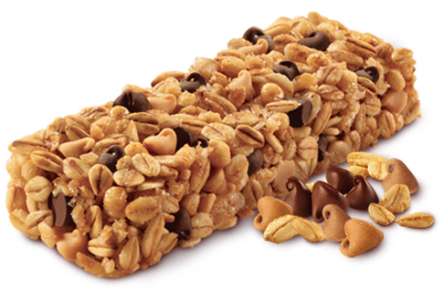
Nutrition Facts
Quaker Chewy Granola Bars (1 bar)
Serving Size 1 bar (24g)
Servings Per Container 1
Amount Per Serving
Calories 100 Calories from Fat 25
% Daily Value*
Total Fat 3g
4%
Saturated Fat 1g
4%
Trans Fat 0g
0%
Cholesterol 0mg
0%
Sodium 95mg
4%
Total Carbohydrate 17g
6%
INGREDIENTS: GRANOLA (WHOLE GRAIN ROLLED OATS, BROWN SUGAR, CRISP RICE [RICE FLOUR, SUGAR, SALT, MALTED BARLEY EXTRACT], WHOLE GRAIN ROLLED WHEAT, SOYBEAN OIL, WHOLE WHEAT FLOUR, SODIUM BICARBONATE, SOY LECITHIN, CARAMEL COLOR, NONFAT DRY MILK), CORN SYRUP, BROWN RICE CRISP (WHOLE GRAIN BROWN RICE, SUGAR, MALTED BARLEY FLOUR, SALT), PEANUT BUTTER SPREAD (PEANUTS, SUGAR, PALM OIL, SALT), SEMISWEET CHOCOLATE CHIPS (SUGAR, CHOCOLATE LIQUOR, COCOA BUTTER, SOY LECITHIN, VANILLA EXTRACT), INVERT SUGAR, PEANUT FLAVORED CHIPS (SUGAR, PALM KERNEL AND PALM OIL, PARTIALLY DEFATTED PEANUT FLOUR, LACTOSE, DRY WHEY, DEXTROSE, CORN SYRUP SOLIDS, SOY LECITHIN, SALT, VANILLIN [ARTIFICIAL FLAVOR]), CORN SYRUP SOLIDS, GLYCERIN. CONTAINS 2% OR LESS OF CALCIUM CARBONATE, SORBITOL, SALT, WATER, NATURAL AND ARTIFICIAL FLAVOR, BHT (PRESERVATIVE), CITRIC ACID.
CONTAINS WHEAT, SOY, PEANUT AND MILK INGREDIENTS.
MAY CONTAIN TRACES OF TREE NUTS.
Fiber 1g
4%
Sugars 7g
Protein 2g
Vitamin A 0%
●
Vitamin C 0%
Calcium 10%
●
Iron 2%
* Percent Daily Values are based on a 2,000 calorie diet. Your daily values may be higher or lower depending on your caloric needs.
Calories: 2,000 2,500
Total Fat Less Than 65g 80g
Sat Fat Less Than 20g 25g
Cholesterol Less Than 300mg 300mg
Sodium Less Than 2,400mg 2,400mg
Total Carbohydrate 300g 375g
Dietary Fiber 25g 30g

Slide 17
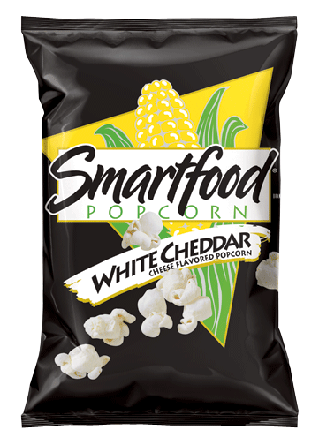
Nutrition Facts
Smartfood Popcorn White Cheddar (1 oz)
Serving Size 1 oz (28g)
Servings Per Container 1
Amount Per Serving
Calories 160 Calories from Fat 90
% Daily Value*
Total Fat 10g
15%
Saturated Fat 2g
10%
Trans Fat 0g
0%
Cholesterol 5mg
2%
Sodium 290mg
12%
Total Carbohydrate 14g
5%
Fiber 2g
8%
Sugars 2g
Protein 3g
Vitamin A 0%
●
Vitamin C 0%
Calcium 6%
●
Iron 2%
Potassium 3%
●
INGREDIENTS: POPCORN, VEGETABLE OIL (CORN, CANOLA, SOYBEAN, AND/OR SUNFLOWER OIL), CHEDDAR CHEESE (MILK, CHEESE CULTURES, SALT, ENZYMES), WHEY, BUTTERMILK, AND SALT.
CONTAINS MILK INGREDIENTS
* Percent Daily Values are based on a 2,000 calorie diet. Your daily values may be higher or lower depending on your caloric needs.
Calories: 2,000 2,500
Total Fat Less Than 65g 80g
Sat Fat Less Than 20g 25g
Cholesterol Less Than 300mg 300mg
Sodium Less Than 2,400mg 2,400mg
Total Carbohydrate 300g 375g
Dietary Fiber 25g 30g

Slide 18
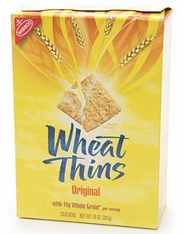
Nutrition Facts
Wheat Thins Original (1 oz)
Serving Size 1 oz
Servings Per Container 9
Amount Per Serving
Calories 140 Calories from Fat 45
% Daily Value*
Total Fat 5g
8%
Saturated Fat 1g
5%
Trans Fat 0g
0%
Cholesterol 0mg
0%
Sodium 230mg
10%
Total Carbohydrate 22g
7%
Fiber 2g
8%
Sugars 4g
Protein 2g
Vitamin A 0%
●
Vitamin C 0%
INGREDIENTS: WHOLE GRAIN WHEAT FLOUR, UNBLEACHED ENRICHED FLOUR (WHEAT FLOUR, NIACIN, REDUCED IRON, THIAMINE MONONITRATE {VITAMIN B1}, RIBOFLAVIN {VITAMIN B2}, FOLIC ACID), SOYBEAN OIL, SUGAR, CORNSTARCH, MALT SYRUP (FROM BARLEY AND CORN), SALT, INVERT SUGAR, LEAVENING (CALCIUM PHOSPHATE AND/OR BAKING SODA), VEGETABLE COLOR (ANNATTO EXTRACT, TURMERIC OLEORESIN). BHT ADDED TO PACKAGING MATERIAL TO PRESERVE FRESHNESS.
CONTAINS WHEAT
Calcium 2%
●
Iron 4%
* Percent Daily Values are based on a 2,000 calorie diet. Your daily values may be higher or lower depending on your caloric needs.
Calories: 2,000 2,500
Total Fat Less Than 65g 80g
Sat Fat Less Than 20g 25g
Cholesterol Less Than 300mg 300mg
Sodium Less Than 2,400mg 2,400mg
Total Carbohydrate 300g 375g
Dietary Fiber 25g 30g

Slide 19
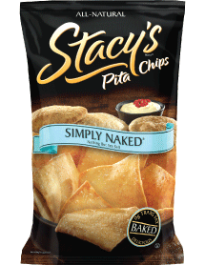
Nutrition Facts
Stacy’s Pita Chips Simply Naked (1 oz)
Serving Size 1 oz (28g/about 10 chips)
Servings Per Container 8
Amount Per Serving
Calories 130 Calories from Fat 45
% Daily Value*
Total Fat 5g
8%
Saturated Fat .5g
3%
Trans Fat 0g
0%
Cholesterol 0mg
0%
Sodium 270mg
11%
Total Carbohydrate 19g
6%
Fiber 1g
5%
Sugars 1g
Protein 3g
Vitamin A 0%
●
Vitamin C 0%
Calcium 0%
●
Iron 4%
INGREDIENTS: ENRICHED WHEAT FLOUR, (WHEAT FLOUR, NIACIN, REDUCED IRON, THIAMIN MONONITRATE, RIBOFLAVIN, FOLIC ACID), SUNFLOWER OIL (ROSEMARY EXTRACT, ASCORBIC ACID) AND/OR CANOLA OIL (ROSEMARY EXTRACT, ASCORBIC ACID), SEA SALT, WHOLE WHEAT FLOUR, AND LESS THAN 2% OF THE FOLLOWING: ORGANIC CANE SUGAR, OAT FIBER, YEAST, AND MALTED BARLEY FLOUR.
CONTAINS WHEAT INGREDIENTS
* Percent Daily Values are based on a 2,000 calorie diet. Your daily values may be higher or lower depending on your caloric needs.
Calories: 2,000 2,500
Total Fat Less Than 65g 80g
Sat Fat Less Than 20g 25g
Cholesterol Less Than 300mg 300mg
Sodium Less Than 2,400mg 2,400mg
Total Carbohydrate 300g 375g
Dietary Fiber 25g 30g

Slide 20
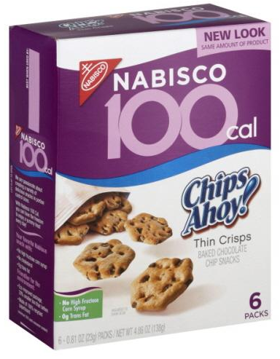
Nutrition Facts
Nabisco 100 Cal Chips Ahoy! This Crisps (1 pack)
Serving Size 23g
Servings Per Container 6
Amount Per Serving
Calories 100 Calories from Fat 25
% Daily Value*
Total Fat 3g
5%
Saturated Fat .5g
3%
Trans Fat 0g
0%
Cholesterol 0mg
0%
Sodium 140mg
6%
Total Carbohydrate 18g
6%
Fiber 1g
2%
Sugars 7g
Protein 1g
Vitamin A 0%
●
Vitamin C 0%
Calcium 0%
●
Iron 4%
INGREDIENTS: UNBLEACHED ENRICHED FLOUR (WHEAT FLOUR, NIACIN, REDUCED IRON, THIAMINE MONONITRATE [VITAMIN B1], RIBOFLAVIN [VITAMIN B2], FOLIC ACID), SUGAR, SEMISWEET CHOCOLATE CHIPS (SUGAR, CHOCOLATE, DEXTROSE, COCOA BUTTER, SOY LECITHIN, VANILLIN - ARTIFICIAL FLAVOR), CANOLA OIL, DEXTROSE, CORNSTARCH, LEAVENING (BAKING SODA AND/OR CALCIUM PHOSPHATE), SALT, NATURAL AND ARTIFICIAL FLAVOR. CONTAINS: WHEAT, SOY.
* Percent Daily Values are based on a 2,000 calorie diet. Your daily values may be higher or lower depending on your caloric needs.
Calories: 2,000 2,500
Total Fat Less Than 65g 80g
Sat Fat Less Than 20g 25g
Cholesterol Less Than 300mg 300mg
Sodium Less Than 2,400mg 2,400mg
Total Carbohydrate 300g 375g
Dietary Fiber 25g 30g

Slide 21
Nutrition Facts
Pepperidge Farm Goldfish Cheddar (1 oz)
Serving Size 55 pieces
Servings Per Container
Amount Per Serving
Calories 140 Calories from Fat 45
% Daily Value*
Total Fat 5g
8%
Saturated Fat .5g
3%
Trans Fat 0g
0%
Cholesterol 0mg
0%
Sodium 270mg
11%
Total Carbohydrate 19g
6%
Fiber 1g
5%
Sugars 1g
Protein 3g
Vitamin A 0%
●
Vitamin C 0%
Calcium 0%
●
Iron 4%
INGREDIENTS: UNBLEACHED ENRICHED WHEAT FLOUR (FLOUR, NIACIN, REDUCED IRON, THIAMINE MONONITRATE {VITAMIN B1}, RIBOFLAVIN {VITAMIN B2], FOLIC ACID), CHEDDAR CHEESE (CULTURED MILK, SALT, ENZYMES, ANNATTO), VEGETABLE OILS (CANOLA, SUNFLOWER AND/OR SOYBEAN), CONTAINS 2 PERCENT OR LESS OF: SALT, YEAST, SUGAR, AUTOLYZED YEAST, SPICES, LEAVENING (MONOCALCIUM PHOSPHATE, AMONIUM BICARBONATE, BAKING SODA) AND DEHYDRATED ONIONS.
* Percent Daily Values are based on a 2,000 calorie diet. Your daily values may be higher or lower depending on your caloric needs.
Calories: 2,000 2,500
Total Fat Less Than 65g 80g
Sat Fat Less Than 20g 25g
Cholesterol Less Than 300mg 300mg
Sodium Less Than 2,400mg 2,400mg
Total Carbohydrate 300g 375g
Dietary Fiber 25g 30g

Slide 22
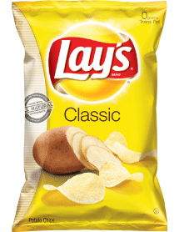
Nutrition Facts
Lay’s Classic Potato Chips (1 oz)
Serving Size 1 oz (28g/about 15 chips)
Servings Per Container 1
Amount Per Serving
Calories 160 Calories from Fat 90
% Daily Value*
Total Fat 10g
16%
Saturated Fat 1g
5%
Trans Fat 0g
0%
Cholesterol 0mg
0%
Sodium 170mg
7%
Total Carbohydrate 15g
5%
Fiber 1g
5%
Sugars less than 1g
Protein 2g
Vitamin A 0%
●
Vitamin C 10%
Calcium 0%
●
Iron 2%
Potassium 10%
●
Vitamin E 6%
INGREDIENTS: POTATOES, VEGETABLE OIL, (SUNFLOWER, CORN, AND/OR CANOLA OIL), AND SALT
NO PRESERVATIVES
Thiamin 4%
●
Niacin 6%
Vitamin B₆ 10%
●
Magnesium 4%
* Percent Daily Values are based on a 2,000 calorie diet. Your daily values may be higher or lower depending on your caloric needs.
Calories: 2,000 2,500
Total Fat Less Than 65g 80g
Sat Fat Less Than 20g 25g
Cholesterol Less Than 300mg 300mg
Sodium Less Than 2,400mg 2,400mg
Total Carbohydrate 300g 375g
Dietary Fiber 25g 30g

Slide 23
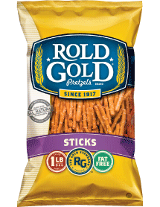
Nutrition Facts
Rold Gold Pretzel Sticks (1 oz)
Serving Size 1 oz (28g/about 53 pretzels)
Servings Per Container
Amount Per Serving
Calories 100 Calories from Fat 0
% Daily Value*
Total Fat 0g
0%
Saturated Fat 0g
0%
Trans Fat 0g
0%
Cholesterol 0mg
0%
Sodium 490mg
20%
Total Carbohydrate 23g
8%
Fiber 1g
4%
Sugars 1g
Protein 2g
Vitamin A 0%
●
Vitamin C 0%
●
Calcium 0%
●
Calcium 0%
Iron 8%
Iron 2%
Potassium 2%
●
Thiamin 8%
INGREDIENTS: ENRICHED FLOUR, (WHEAT FLOUR, NIACIN, REDUCED IRON, THIAMIN MONONITRATE, RIBOFLAVIN, FOLIC ACID), SALT, CORN SYRUP, AMMONIUM BICARBONATE, AND MALT EXTRACT
CONTAINS A WHEAT INGREDIENT
NO PRESERVATIVES
Riboflavin 6%
●
Niacin 6%
Phosphorus 2%
●
Magnesium 2%
* Percent Daily Values are based on a 2,000 calorie diet. Your daily values may be higher or lower depending on your caloric needs.
Calories: 2,000 2,500
Total Fat Less Than 65g 80g
Sat Fat Less Than 20g 25g
Cholesterol Less Than 300mg 300mg
Sodium Less Than 2,400mg 2,400mg
Total Carbohydrate 300g 375g
Dietary Fiber 25g 30g

Slide 24
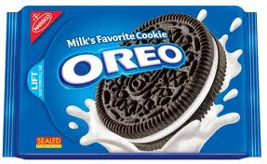
Nutrition Facts
Oreos (34g, 3 cookies)
Serving Size 34g
Servings Per Container 15
Amount Per Serving
Calories 160 Calories from Fat 60
% Daily Value*
Total Fat 7g
11%
Saturated Fat 2g
10%
Trans Fat 0g
0%
Cholesterol 0mg
0%
Sodium 160mg
7%
Total Carbohydrate 25g
8%
Fiber 1g
4%
Sugars 14g
Protein 1g
Vitamin A 0%
●
Vitamin C 0%
Calcium 2%
●
Iron 10%
INGREDIENTS: SUGAR, ENRICHED FLOUR (WHEAT FLOUR, NIACIN, REDUCED IRON, THIAMINE MONONITRATE {VITAMIN B1}, RIBOFLAVIN {VITAMIN B2}, FOLIC ACID), HIGH OLEIC CANOLA OIL AND/OR PALM OIL AND/OR CANOLA OIL, AND/OR SOYBEAN OIL, COCOA (PROCESSED WITH ALKALI), HIGH FRUCTOSE CORN SYRUP, CORNSTARCH, LEAVENING (BAKING SODA AND/OR CALCIUM PHOSPHATE), SALT, SOY LECITHIN (EMULSIFIER), VANILLIN - AN ARTIFICIAL FLAVOR, CHOCOLATE. CONTAINS: WHEAT, SOY.
* Percent Daily Values are based on a 2,000 calorie diet. Your daily values may be higher or lower depending on your caloric needs.
Calories: 2,000 2,500
Total Fat Less Than 65g 80g
Sat Fat Less Than 20g 25g
Cholesterol Less Than 300mg 300mg
Sodium Less Than 2,400mg 2,400mg
Total Carbohydrate 300g 375g
Dietary Fiber 25g 30g

Slide 25
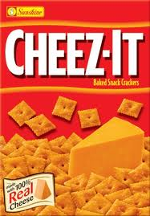
Nutrition Facts
Cheez-It Original (1 oz)
Serving Size 27 crackers (30g)
Servings Per Container
Amount Per Serving
Calories 150 Calories from Fat 70
% Daily Value*
Total Fat 8g
12%
Saturated Fat 2g
10%
Trans Fat 0g
0%
Cholesterol 0mg
0%
Sodium 230mg
10%
Total Carbohydrate 17g
6%
Fiber 1g
3%
Sugars 0g
Protein 3g
Vitamin A 2%
●
Vitamin C 0%
Calcium 4%
●
Iron 6%
INGREDIENTS: ENRICHED FLOUR (WHEAT FLOUR, NIACIN, REDUCED IRON, THIAMIN MONONITRATE [VITAMIN B1], RIBOFLAVIN [VITAMIN B2], FOLIC ACID), VEGETABLE OIL (SOYBEAN AND PALM OIL WITH TBHQ FOR FRESHNESS), CHEESE MADE WITH SKIM MILK (SKIM MILK, WHEY PROTEIN, CHEESE CULTURES, SALT, ENZYMES, ANNATTO EXTRACT FOR COLOR), CONTAINS TWO PERCENT OR LESS OF SALT, PAPRIKA, YEAST, PAPRIKA OLEORESIN FOR COLOR, SOY LECITHIN.
CONTAINS WHEAT, MILK, AND SOY INGREDIENTS
* Percent Daily Values are based on a 2,000 calorie diet. Your daily values may be higher or lower depending on your caloric needs.
Calories: 2,000 2,500
Total Fat Less Than 65g 80g
Sat Fat Less Than 20g 25g
Cholesterol Less Than 300mg 300mg
Sodium Less Than 2,400mg 2,400mg
Total Carbohydrate 300g 375g
Dietary Fiber 25g 30g

Slide 26
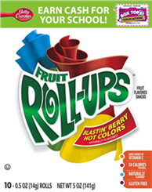
Nutrition Facts
Fruit Roll-Ups Blastin’ Berry Hot Colors (1 piece)
Serving Size 1 roll (14g)
Servings Per Container 10
Amount Per Serving
Calories 50 Calories from Fat 5
% Daily Value*
Total Fat 1g
1%
Saturated Fat 0g
0%
Trans Fat 0g
0%
Cholesterol 0mg
0%
Sodium 55mg
2%
Total Carbohydrate 12g
4%
Fiber 0g
4%
Sugars 7g
Protein 0g
Vitamin A 0%
●
Vitamin C 10%
Calcium 0%
●
Iron 0%
INGREDIENTS: PEARS FROM CONCENTRATE, CORN SYRUP, DRIED CORN SYRUP, SUGAR, PARTIALLY HYDROGENATED COTTONSEED OIL
CONTAINS 2% OR LESS OF: CITRIC ACID, SODIUM CITRATE, ACETYLATED MONOGLYCERIDES, FRUIT PECTIN, DEXTROSE, MALIC ACID, VITAMIN C (ASCORBIC ACID), NATURAL FLAVOR, COLOR (RED 40, YELLOWS 5 & 6, BLUE 1)
* Percent Daily Values are based on a 2,000 calorie diet. Your daily values may be higher or lower depending on your caloric needs.
Calories: 2,000 2,500
Total Fat Less Than 65g 80g
Sat Fat Less Than 20g 25g
Cholesterol Less Than 300mg 300mg
Sodium Less Than 2,400mg 2,400mg
Total Carbohydrate 300g 375g
Dietary Fiber 25g 30g

Slide 27
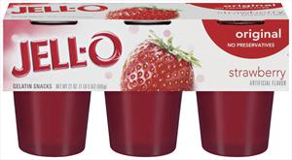
Nutrition Facts
Jell-O Cups (1 cup)
Serving Size 99g
Servings Per Container 6
Amount Per Serving
Calories 70 Calories from Fat 0
% Daily Value*
Total Fat 0g
0%
Saturated Fat 0g
0%
Trans Fat 0g
0%
Cholesterol 0mg
0%
Sodium 40mg
2%
Total Carbohydrate 17g
6%
Fiber 0g
4%
Sugars 17g
Protein 1g
Vitamin A 0%
●
Vitamin C 0%
Calcium 0%
●
Iron 0%
INGREDIENTS: WATER, HIGH FRUCTOSE CORN SYRUP. SUGAR, GELATIN, CONTAINS LESS THAN 0.5% OF ADIPIC ACID AND CITRIC ACID (FOR TARTNESS), SODIUM CITRATE (CONTROLS ACIDITY), RED 40, NATURAL AND ARTIFICIAL FLAVOR.
* Percent Daily Values are based on a 2,000 calorie diet. Your daily values may be higher or lower depending on your caloric needs.
Calories: 2,000 2,500
Total Fat Less Than 65g 80g
Sat Fat Less Than 20g 25g
Cholesterol Less Than 300mg 300mg
Sodium Less Than 2,400mg 2,400mg
Total Carbohydrate 300g 375g
Dietary Fiber 25g 30g

Slide 28
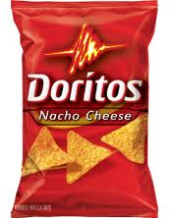
Nutrition Facts
Doritos Nacho Cheese (1 oz)
Serving Size 1 oz (28g/About 11 Chips)
Servings Per Container 15
Amount Per Serving
Calories 150 Calories from Fat 70
% Daily Value*
Total Fat 8g
12%
Saturated Fat 1.5g
6%
Trans Fat 0g
0%
Cholesterol 0mg
0%
Sodium 210mg
9%
Total Carbohydrate 17g
6%
Fiber 1g
4%
Sugars 1g
INGREDIENTS: WHOLE CORN, VEGETABLE OIL (SUNFLOWER, CANOLA, CORN, AND/OR SOYBEAN OIL), MALTODEXTRIN (MADE FROM CORN), AND LESS THAN 2& OF THE FOLLOWING: WHEAT FLOUR, SALT, CHEDDAR CHEESE (MILK, CHEESE CULTURES, SALT, ENZYMES), WHEY, MONOSODIUM GLUTAMATE, BUTTERMILK, ROMANO CHEESE (PART-SKIM COW’S MILK, CHEESE CULTURES, SALT, ENZYMES), WHEY PROTEIN CONCENTRATE, ONION POWDER, PARTIALLY HYDROGENATED SOYBEAN AND COTTONSEED OIL, CORN FLOUR, NATURAL AND ARTIFICIAL FLAVOR, DEXTROSE, TOMATO POWDER, LACTOSE, SPICES, ARTIFICIAL COLOR (INCLUDING YELLOW 6, YELLOW 5, RED 40), LACTIC ACID, CITIRC ACID, SUGAR, GARLIC POWDER, MILK, WHEY PROTEIN ISOLATE, CORN SYRUP SOLIDS, RED AND GREEN BELL PEPPER POWDER, SODIUM CASEINATE, DISODIUM INOSINATE, AND DISODIUM GUANYLATE
CONTAINS MILK AND WHEAT INGREDIENTS
Protein 2g
Vitamin A 2%
●
Vitamin C 0%
Calcium 0%
●
Iron 0%
Thiamin 2%
●
Vitamin B₆ 2%
* Percent Daily Values are based on a 2,000 calorie diet. Your daily values may be higher or lower depending on your caloric needs.
Calories: 2,000 2,500
Total Fat Less Than 65g 80g
Sat Fat Less Than 20g 25g
Cholesterol Less Than 300mg 300mg
Sodium Less Than 2,400mg 2,400mg
Total Carbohydrate 300g 375g
Dietary Fiber 25g 30g

Slide 29
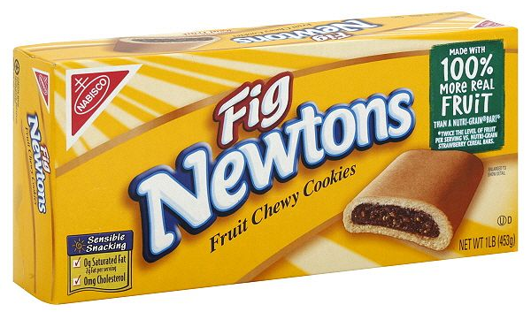
Nutrition Facts
Fig Newtons (1 oz)
Serving Size 31g
Servings Per Container 13
Amount Per Serving
Calories 110 Calories from Fat 20
% Daily Value*
Total Fat 2g
3%
Saturated Fat 0g
0%
Trans Fat 0g
0%
Cholesterol 0mg
0%
Sodium 130mg
5%
Total Carbohydrate 22g
7%
Fiber 1g
4%
Sugars 12g
Protein 1g
Vitamin A 0%
●
Vitamin C 0%
Calcium 2%
●
Iron 4%
INGREDIENTS: UNBLEACHED ENRICHED FLOUR (WHEAT FLOUR, NIACIN, REDUCED IRON, THIAMINE MONONITRATE [VITAMIN B1], RIBOFLAVIN [VITAMIN B2], FOLIC ACID), FIGS, HIGH FRUCTOSE CORN SYRUP, CORN SYRUP, SUGAR, SOYBEAN OIL, WHEY (FROM MILK), PARTIALLY HYDROGENATED COTTONSEED OIL, SALT, BAKING SODA, CULTURED DEXTROSE, CALCIUM LACTATE, MALIC ACID, SOY LECITHIN, NATURAL AND ARTIFICIAL FLAVOR, SULFUR DIOXIDE ADDED TO PRESERVE FRESHNESS. CONTAINS: WHEAT, MILK, SOY, SULFITES.
* Percent Daily Values are based on a 2,000 calorie diet. Your daily values may be higher or lower depending on your caloric needs.
Calories: 2,000 2,500
Total Fat Less Than 65g 80g
Sat Fat Less Than 20g 25g
Cholesterol Less Than 300mg 300mg
Sodium Less Than 2,400mg 2,400mg
Total Carbohydrate 300g 375g
Dietary Fiber 25g 30g

Slide 30
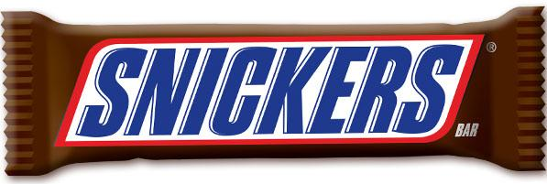
Nutrition Facts
Snickers Bar
Serving Size 2.07 oz (58.7g)
Servings Per Container 1 package
Amount Per Serving
Calories 280 Calories from Fat 130
% Daily Value*
Total Fat 14g
22%
Saturated Fat 5g
25%
Trans Fat 0g
0%
Cholesterol 5mg
2%
Sodium 140mg
6%
Total Carbohydrate 35g
12%
Fiber 1g
4%
Sugars 30g
Protein 4g
Vitamin A 0%
●
Vitamin C 0%
Calcium 4%
●
Iron 2%
INGREDIENTS: MILK CHOCOLATE (SUGAR, COCOA BUTTER, CHOCOLATE, LACTOSE, SKIM MILK, MILK FAT, SOY LECITHIN, ARTIFICIAL FLAVOR), PEANUTS, CORN SYRUP, SUGAR, SKIM MILK, BUTTER, MILK FAT, PARTIALLY HYDROGENATED SOYBEAN OIL, LACTOSE, SALT, EGG WHITES, ARTIFICAL FLAVOR
* Percent Daily Values are based on a 2,000 calorie diet. Your daily values may be higher or lower depending on your caloric needs.
Calories: 2,000 2,500
Total Fat Less Than 65g 80g
Sat Fat Less Than 20g 25g
Cholesterol Less Than 300mg 300mg
Sodium Less Than 2,400mg 2,400mg
Total Carbohydrate 300g 375g
Dietary Fiber 25g 30g

Slide 31
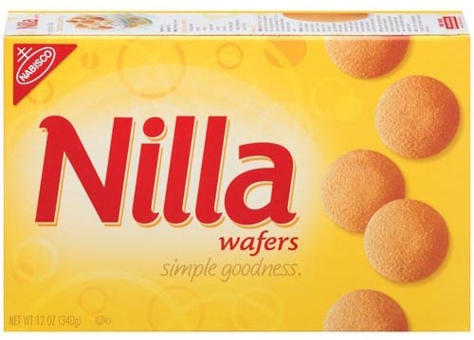
Nutrition Facts
Nilla Wafers (1 oz)
Serving Size 30g
Servings Per Container 11
Amount Per Serving
Calories 140 Calories from Fat 50
% Daily Value*
Total Fat 6g
9%
Saturated Fat 1.5g
8%
Trans Fat 0g
0%
Cholesterol 5mg
2%
Sodium 115mg
5%
Total Carbohydrate 21g
7%
Fiber 0g
0%
Sugars 11g
Protein 1g
Vitamin A 0%
●
Vitamin C 0%
Calcium 2%
●
Iron 4%
INGREDIENTS: UNBLEACHED ENRICHED FLOUR (WHEAT FLOUR, NIACIN, REDUCED IRON, THIAMINE MONONITRATE [VITAMIN B1], RIBOFLAVIN [VITAMIN B2], FOLIC ACID), SUGAR, SOYBEAN OIL, HIGH FRUCTOSE CORN SYRUP, PARTIALLY HYDROGENATED COTTONSEED OIL, WHEY (FROM MILK), EGGS, NATURAL AND ARTIFICIAL FLAVOR, SALT, LEAVENING (BAKING SODA AND/OR CALCIUM PHOSPHATE), EMULSIFIERS (MONO- AND DIGLYCERIDES, SOY LECITHIN). CONTAINS: WHEAT, MILK, EGG, SOY.
* Percent Daily Values are based on a 2,000 calorie diet. Your daily values may be higher or lower depending on your caloric needs.
Calories: 2,000 2,500
Total Fat Less Than 65g 80g
Sat Fat Less Than 20g 25g
Cholesterol Less Than 300mg 300mg
Sodium Less Than 2,400mg 2,400mg
Total Carbohydrate 300g 375g
Dietary Fiber 25g 30g

