Slide 2
1. Ear _____________________ are caused by germs from colds spreading to the middle ear.
2. _________________ loss and __________________ may be caused by injury, disease, and birth defect.
3. The best way to care for your ears is to protect them from ____________________ .
4. Never use ____________________ to clean out the inside of your ear.
infections
hearing
deafness
loud sounds
cotton swabs

Slide 3
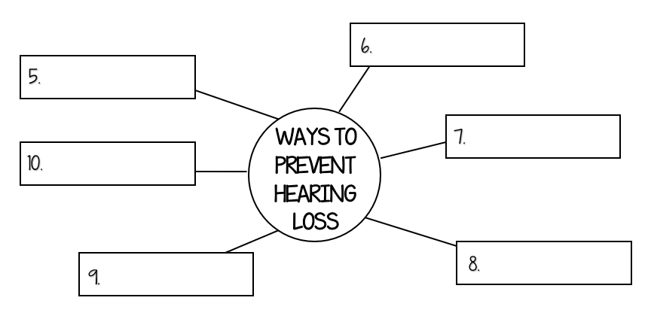
Clean earbuds
Regular checkups
Ear protection
Good health
Treat ear infections
Turn sound down

Slide 4
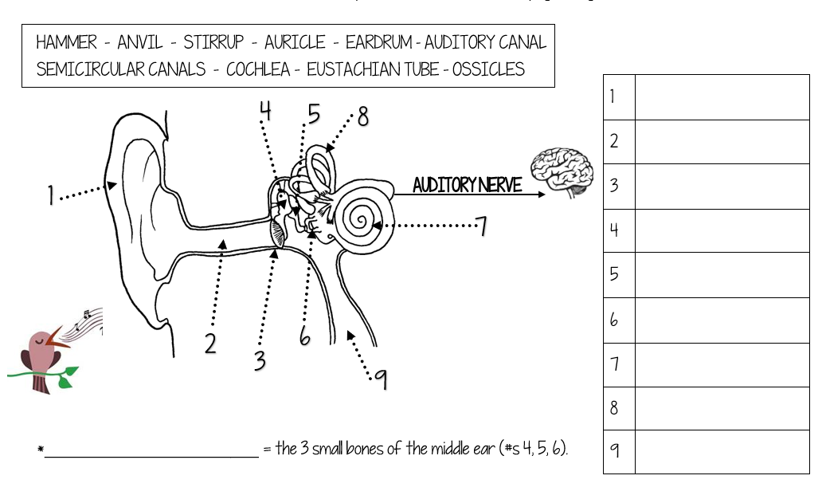
auricle
auditory canal
eardrum
hammer
anvil
stirrup
cochlea
semicircular canals
Ossicles
eustachian tubes

