Slide 1


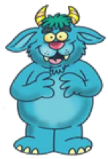


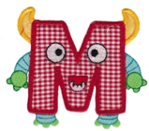
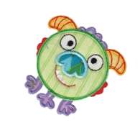
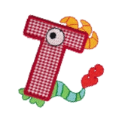

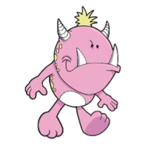


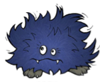

Mash

Slide 2
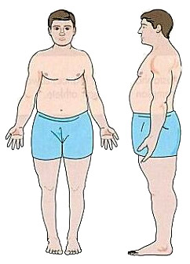
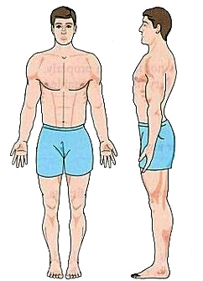
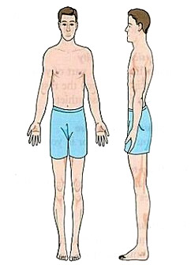
Mesomorph
Ectomorph
Endomorph

Slide 3

Ectomorph

Slide 4
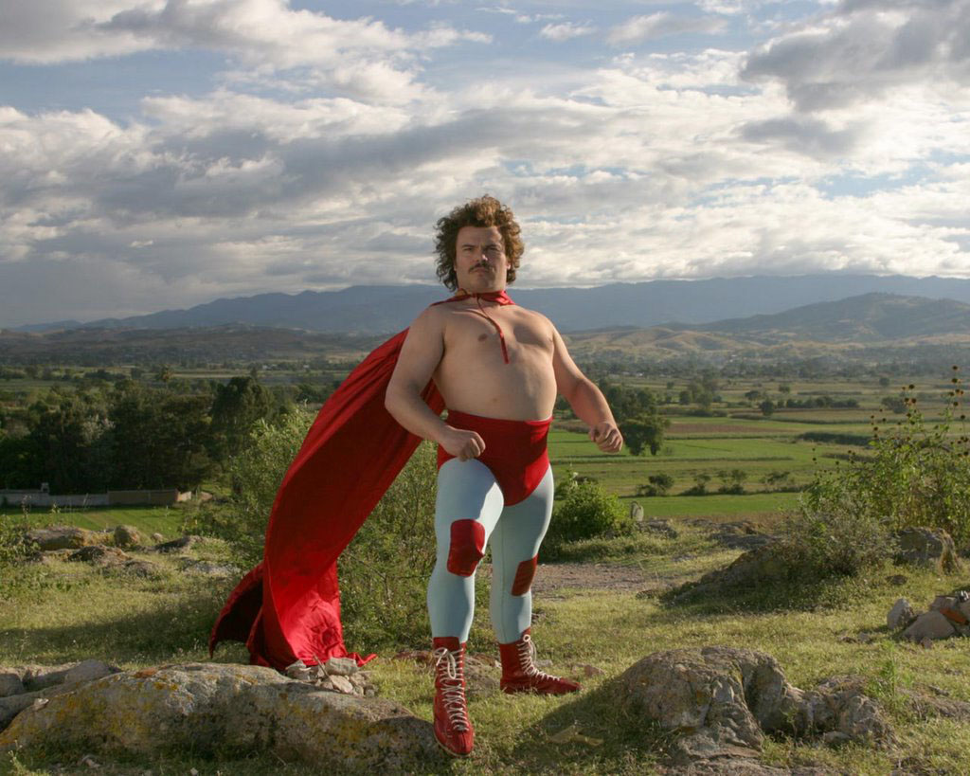
Endomorph

Slide 5

Mesomorph

Slide 6
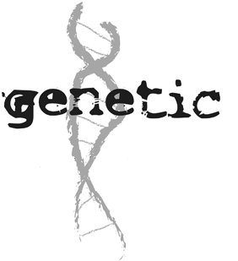

Slide 7
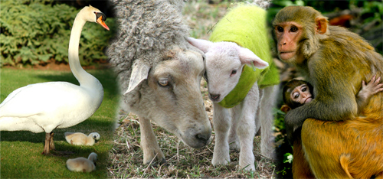
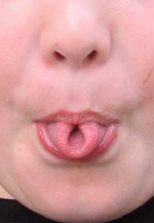
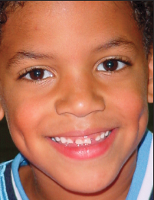
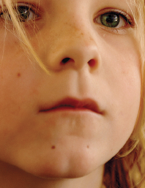
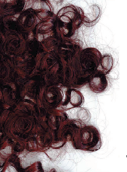
What is Genetics?
Genetics – study of how traits are passed from parent to offspring

Slide 8
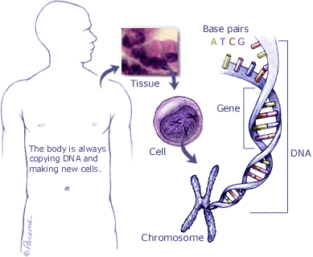
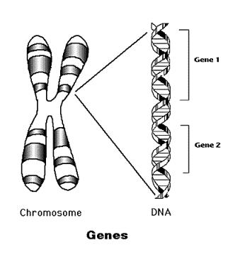
What are traits determined by?
Traits are determined by the genes on the chromosomes. A gene is a segment of DNA that determines a trait.

Slide 9
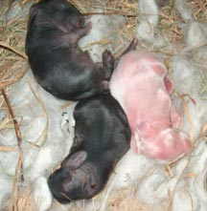
Dominant and Recessive Genes
Gene that prevents the other gene from “showing” – dominant
Gene that does NOT “show” even though it is present – recessive
Symbol – Dominant gene – upper case letter – T
Recessive gene – lower case letter – t
Recessive color
Dominant color

Slide 10
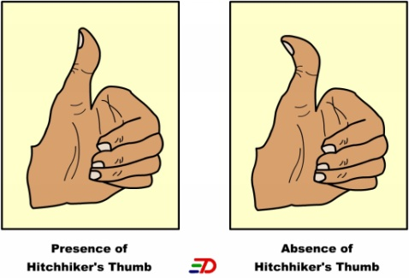
Example: Straight thumb is dominant to hitchhiker thumb T = straight thumb t = hitchhikers thumb
(Always use the same letter for the same alleles—
No S = straight, h = hitchhiker’s)
Straight thumb = TT
Straight thumb = Tt
Hitchhikers thumb = tt
* Must have 2 recessive alleles for a recessive trait to “show”

Slide 11
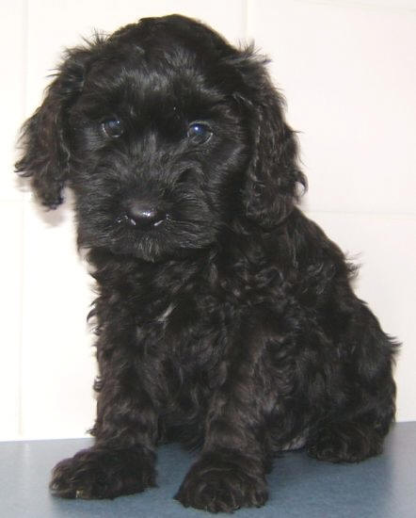
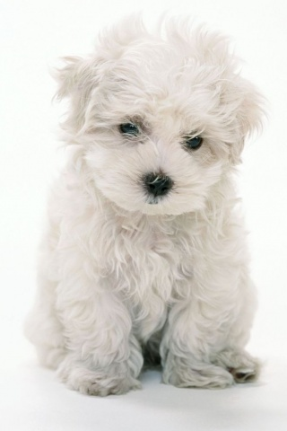
Both genes of a pair are the same –
homozygous or purebred
TT – homozygous dominant
tt – homozygous recessive
One dominant and one recessive gene – heterozygous or hybrid
Tt – heterozygous
BB – Black
Bb – Black w/ white gene
bb – White

Slide 12
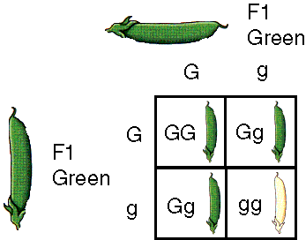
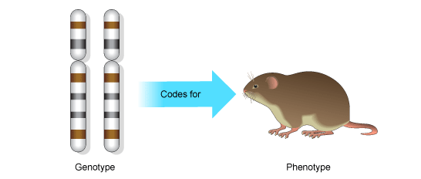
Genotype and Phenotype
Combination of genes an organism has (actual gene makeup) – genotype
Ex: TT, Tt, tt
Physical appearance resulting from gene make-up – phenotype
Ex: hitchhiker’s thumb or straight thumb

Slide 13
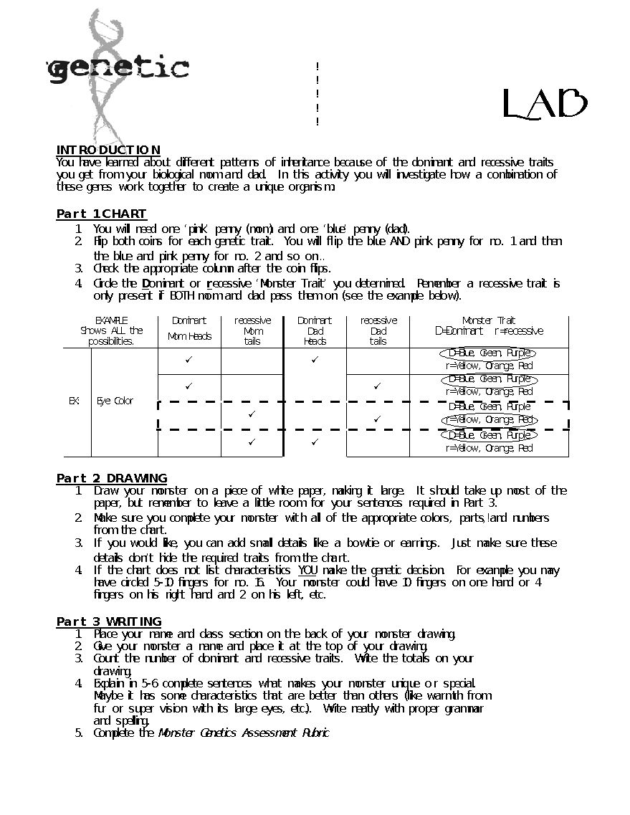

Slide 14
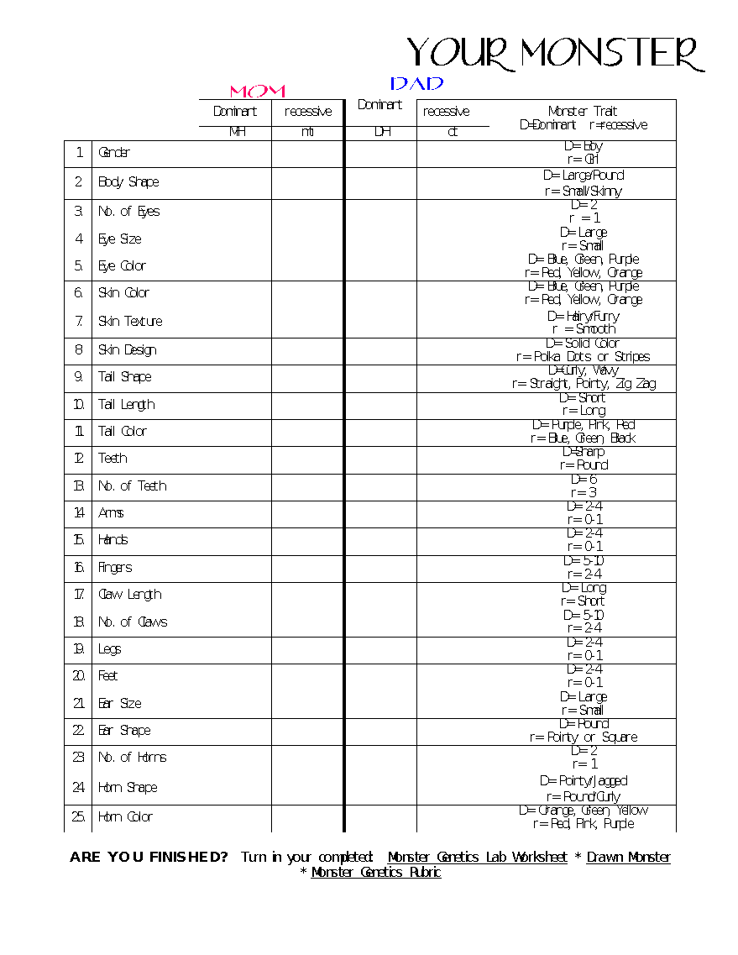

Slide 15
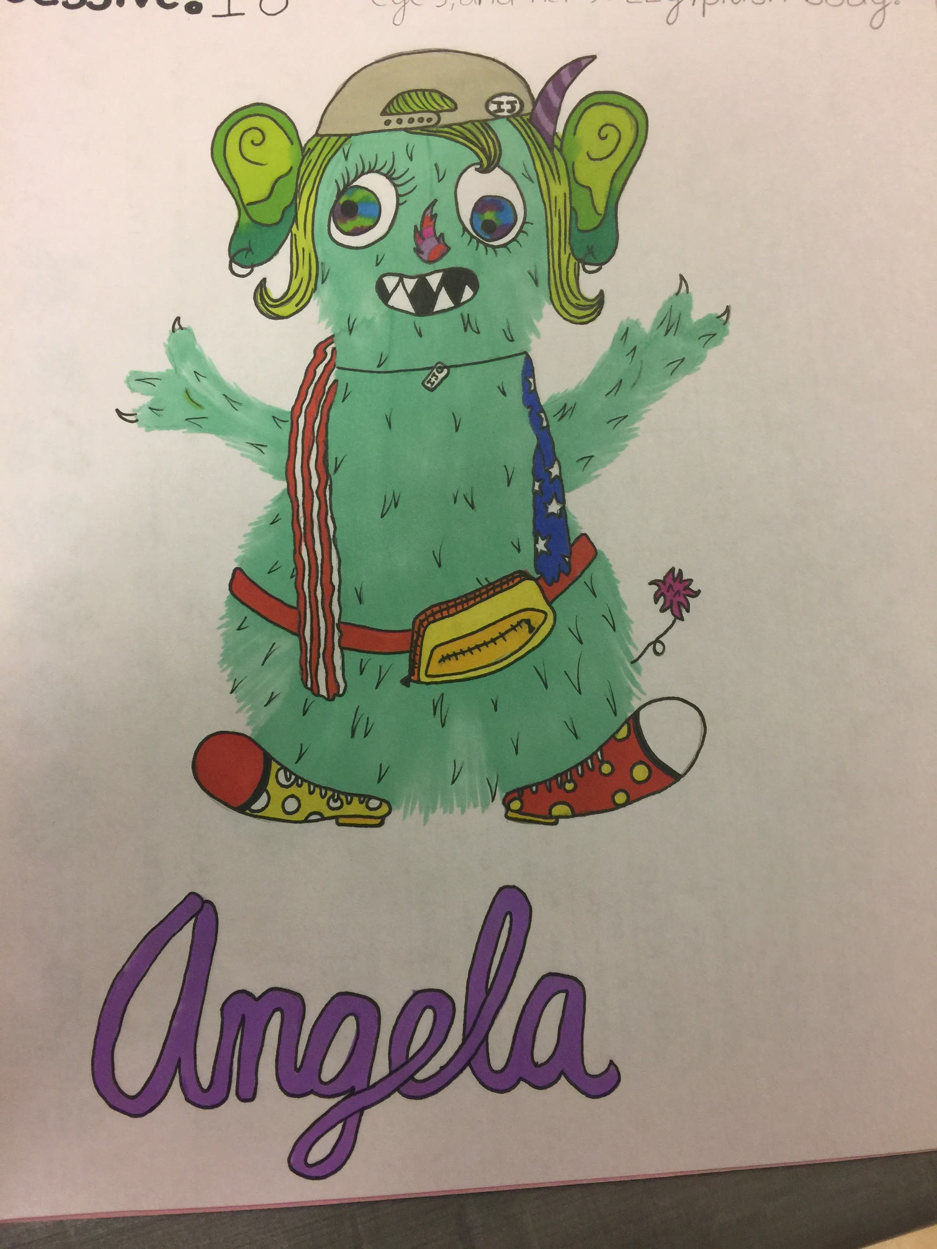
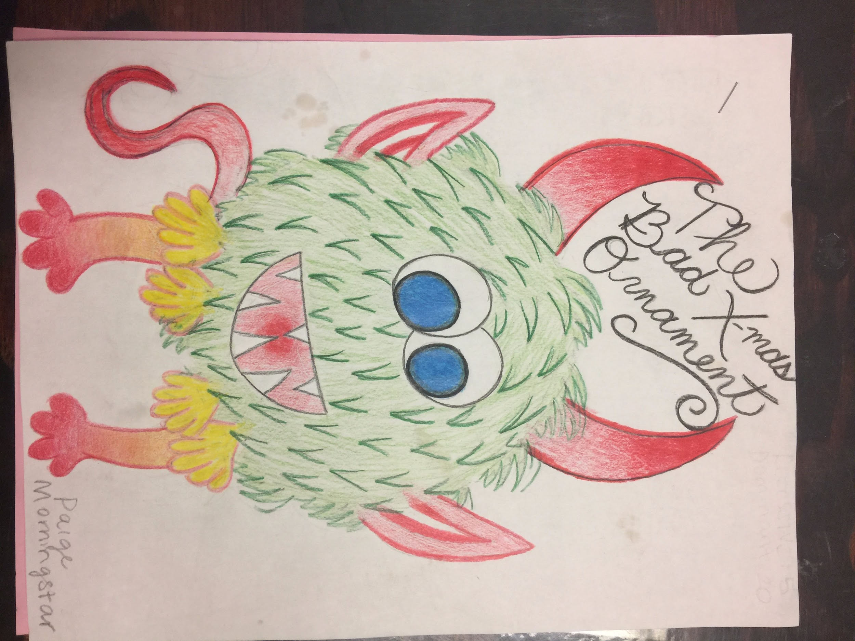
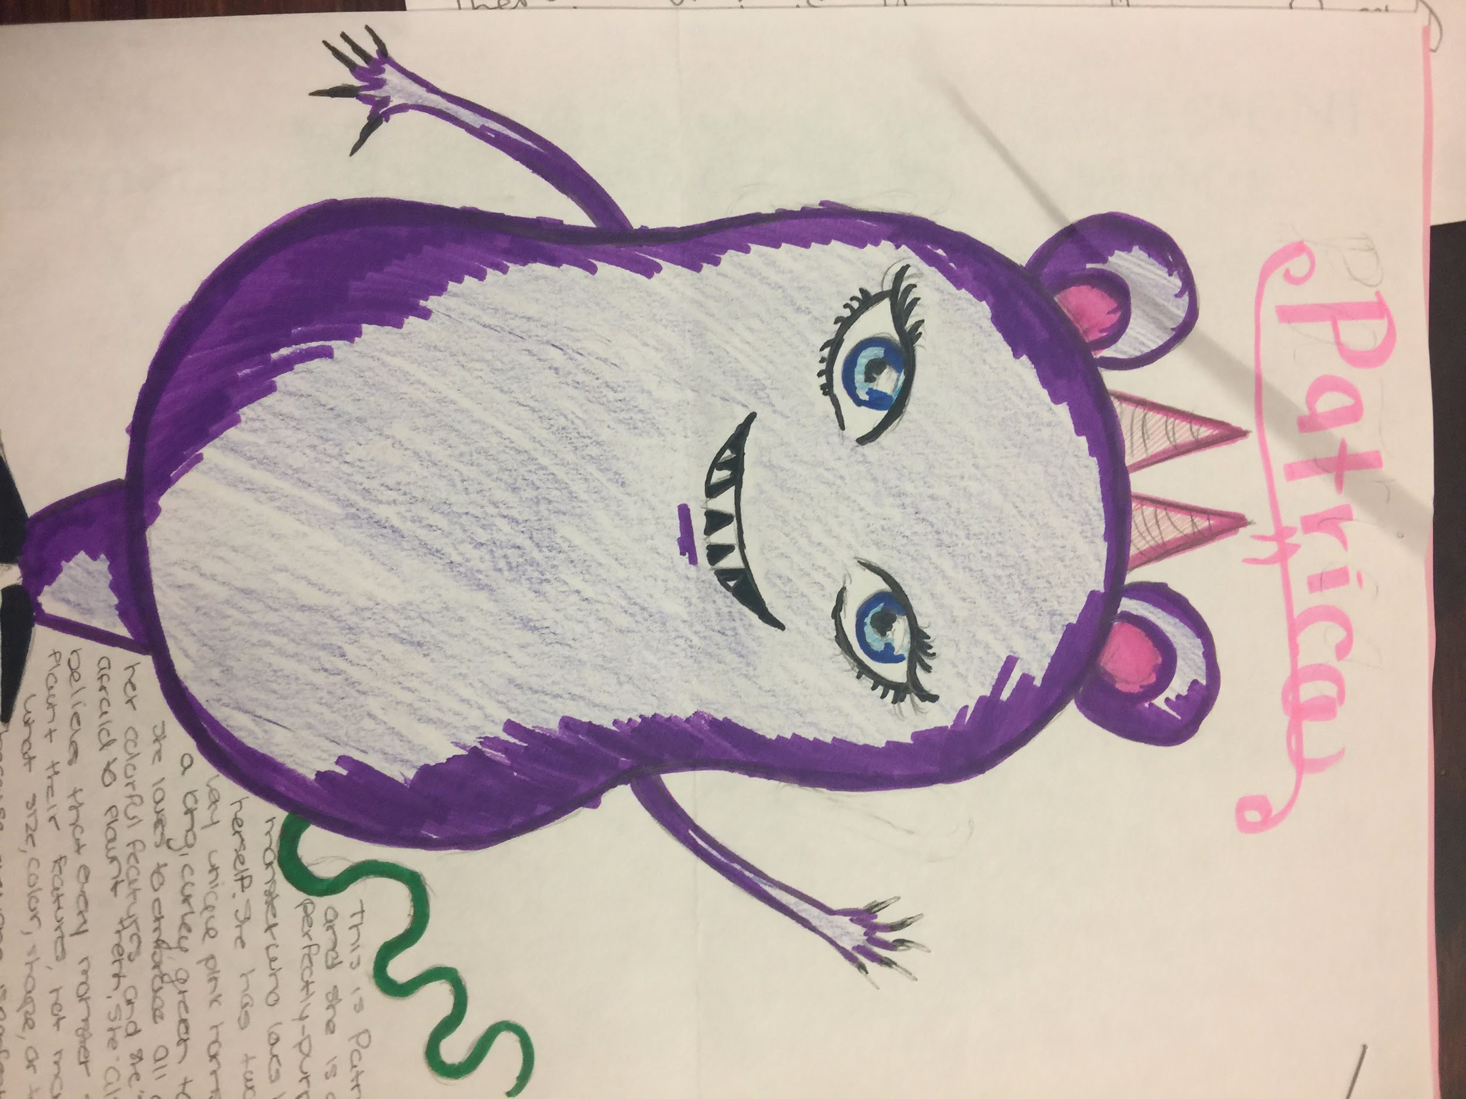

Slide 16
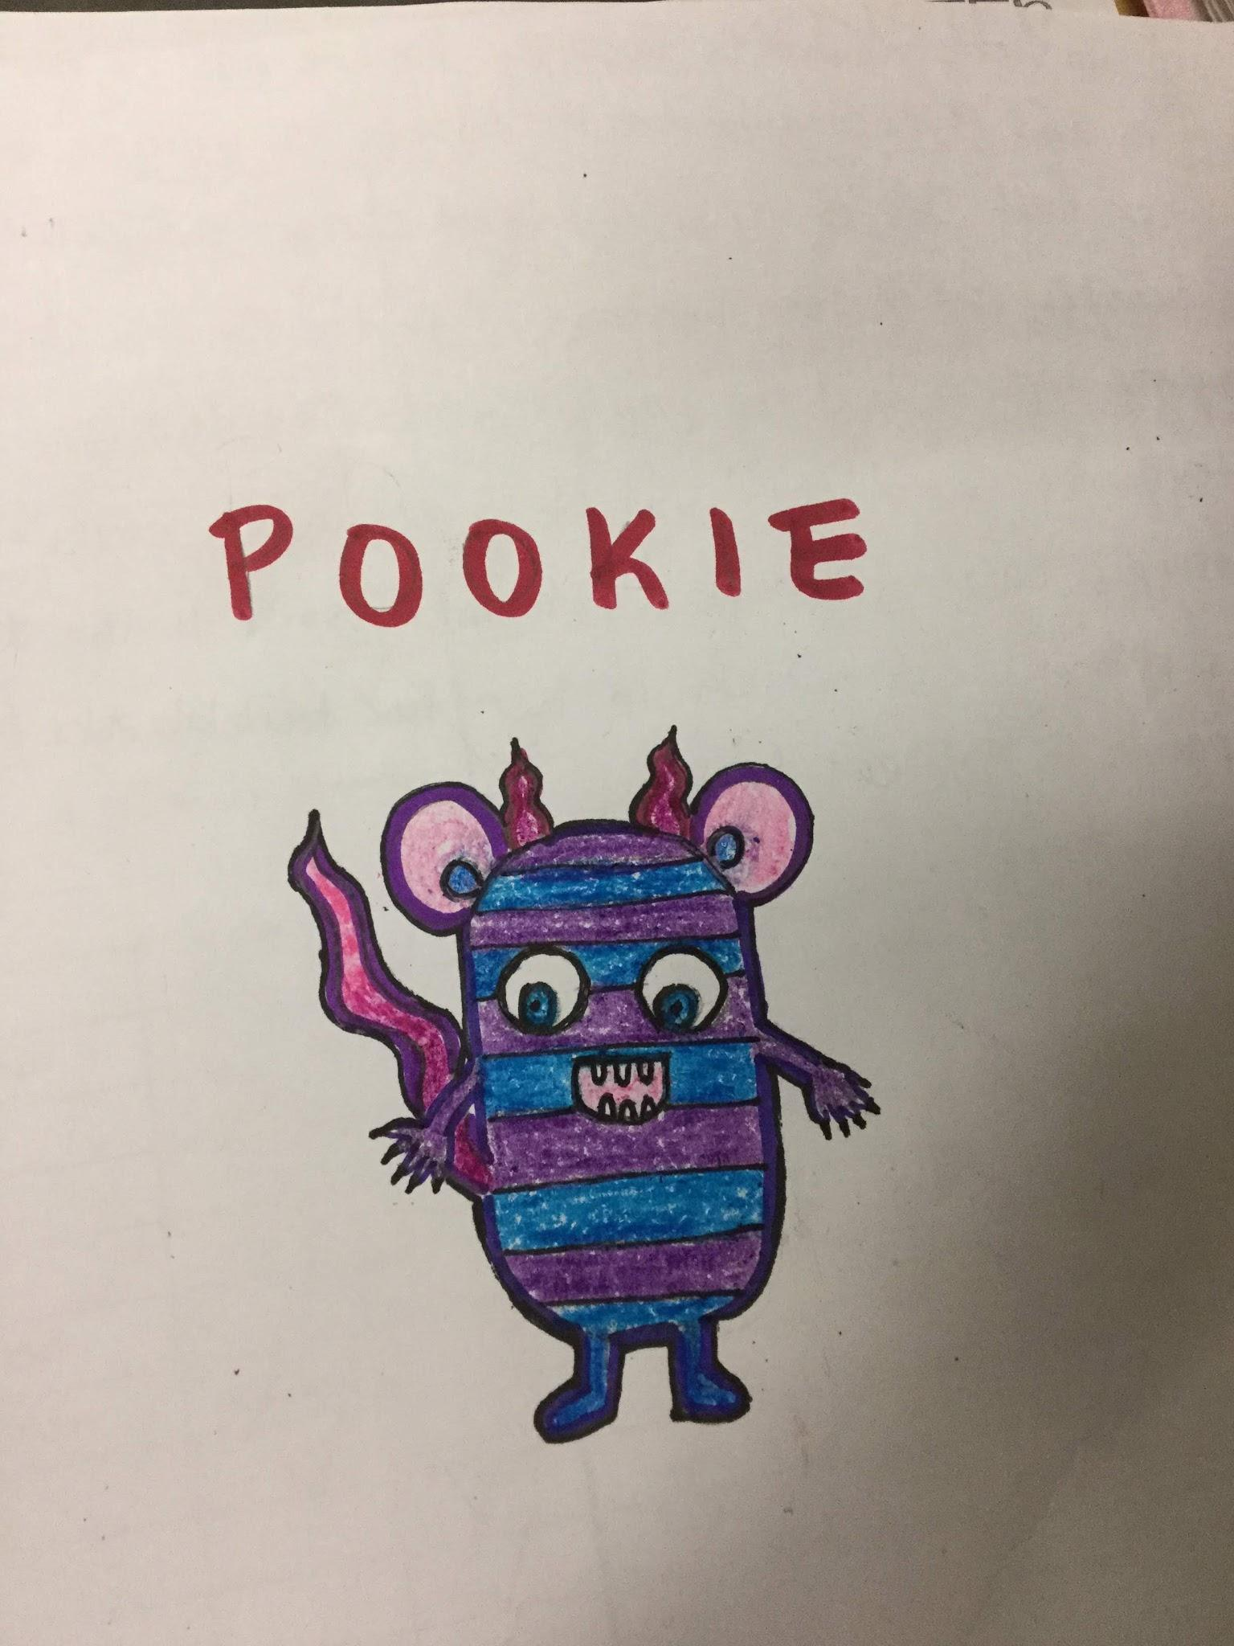
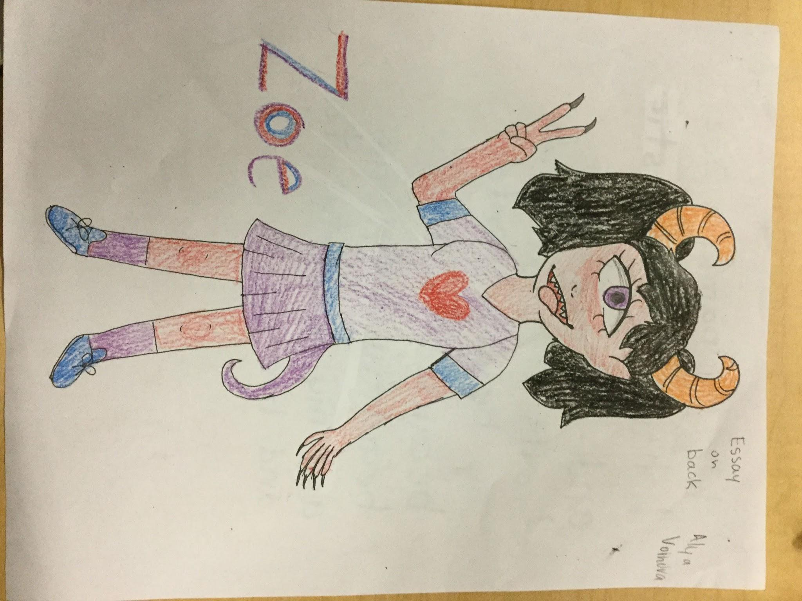
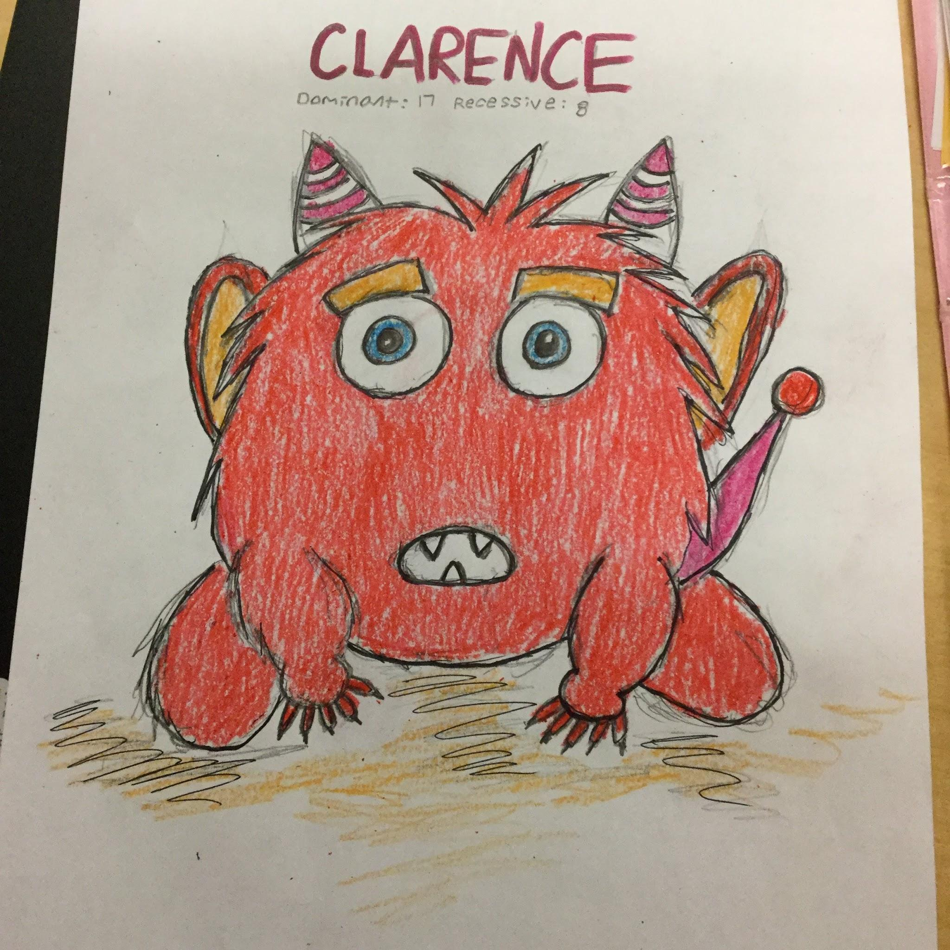

Slide 17
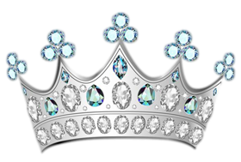


Slide 18
