Slide 1



This activity will be completed together; however, you need to mark your own papers with the correct answer.
Each number will be read aloud, and you are to hold up the color of paper you think the gender corresponds to during this time of your life ONLY.
Example:
After #1 GROWTH SPURT is read aloud, you would hold up
pink paper if you think a growth spurt only happens to girls
blue paper if a growth spurt only happens to boys
OR
both the pink and blue papers if a growth spurt happens to both boys and girls

Slide 2
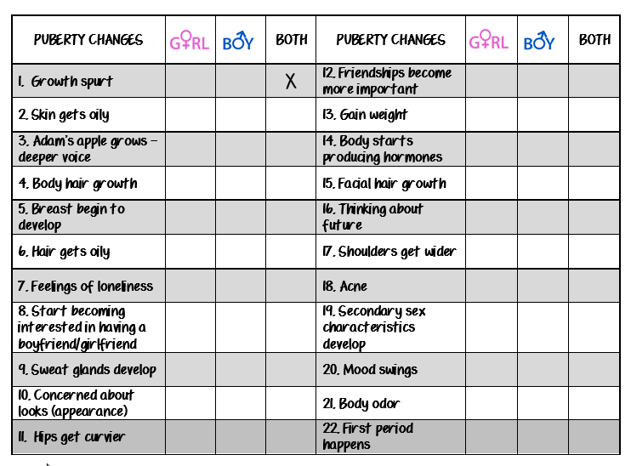
x
x
x
x
x
x
x
x
x
x
x
x
x
x
x
x
x
x
x
x
x

Slide 3
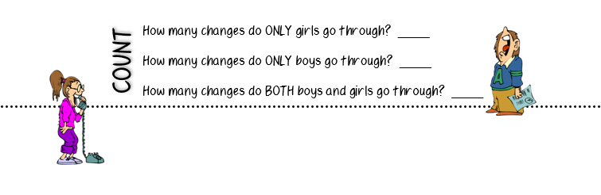

3
3
16
Boys and girls BOTH go through a lot during adolescence. These changes are NORMAL, occur at DIFFERENT TIMES, and part of becoming an ADULT.

Slide 4

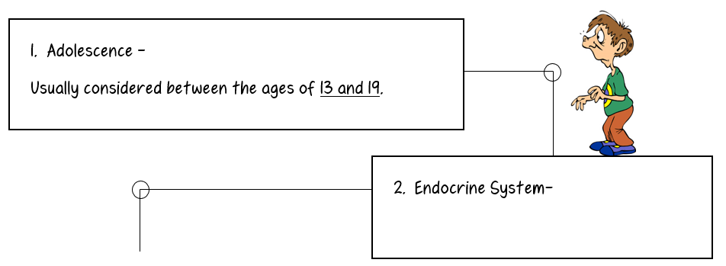
Time period between childhood and adulthood.
Produces hormones that regulate growth and development.

Slide 5
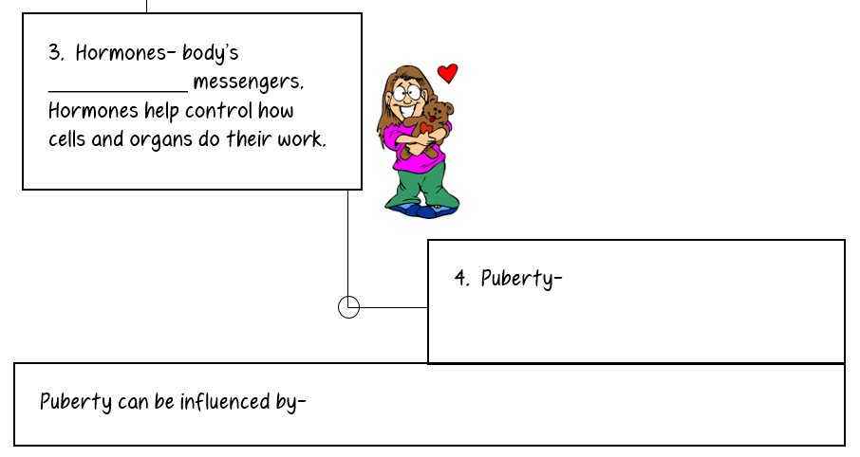
chemical
Time when your body begins to develop and change into an adult.
Your parents?! (Heredity)

Slide 6
So, what’s happening to me?
During adolescence (teen years), your body will go through puberty (physical changes towards adulthood). These changes occur because your endocrine system (body system that causes growth) is releasing hormones (chemical messengers) that are telling your cells how to work.

Slide 7
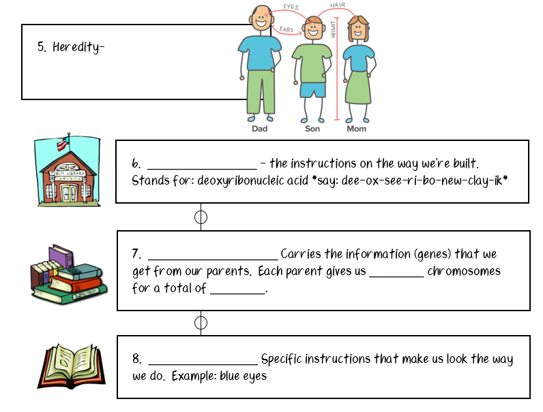
The passing of traits from parents to their offspring.
DNA
Chromosomes
23
46
Genes

Slide 8
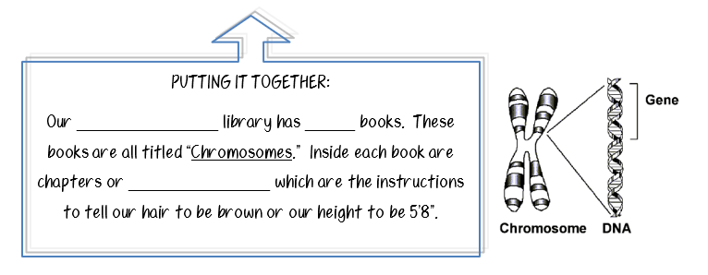
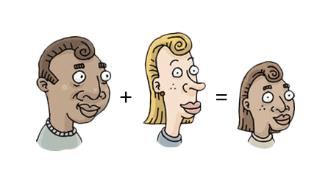
DNA
46
genes

Slide 9
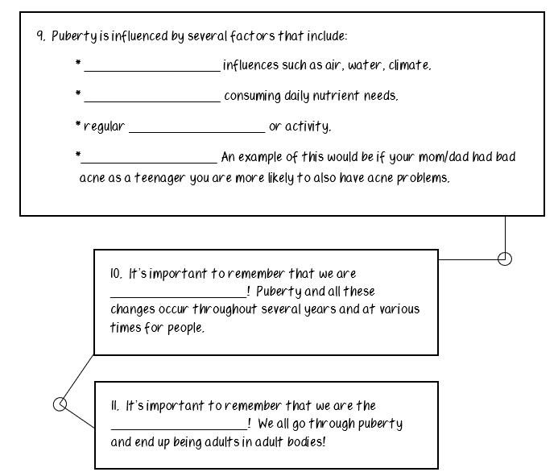
Environmental
Nutrition
exercise
Heredity
different
same

